Slide 1
HW1 for MOLSIM

Slide 2
Instructions
This homework has two parts – due 9 am on Friday
Save this template as “HW1_your name.pptx”
You will turn it in on Github – so this week you should learn how to add this file to Github, must be done by 9 am on Friday (ask questions in Slack channel! #simulationclass)
Part 1, for each of the 4 slides w/the discussion questions I posed at the end of my lecture, add one slide and have 2-4 bullet points for each
Part 2, See slide 11 for info

Slide 3
What is the basis for thinking simulations are accurate?

Slide 4
Response Q1
Simulations are done by performing theory-based calculations
Newton’s Equations of Motion
Statistical averages of ensembles

Slide 5
What are the major limitations of molecular simulations?

Slide 6
Response Q2
Computational Time!!!
Time and size scales of these reactions can be larger than what is computationally feasible
Evaluating force fields is computationally expensive

Slide 7
What are the major benefits of molecular simulation?

Slide 8
Response Q3
Provides molecular insight to many biological and energy reactions
Aid experimentalists in proving their results by what happens on a molecular level
Provide additional details to experiments, that would not be observed on a macroscale
Narrow the discovery pipeline (for experimentalists) by:
Using big data approaches to observe large amounts of data
Performing exploratory research

Slide 9
Why do we sometimes work on new simulation methods?

Slide 10
Response Q4
To combat many of the limitations simulations face (discussed previously)
Lower computational expenses

Slide 11
Part 2
Literature review. Read the paper and make a brief presentation (4 slides, <= 10 minutes) that covers:
Intro to purpose of paper
Major methods used
Major scientific conclusions
Your assessment of the paper

Slide 12
Computational Design of Experiment Unveils the Conformational Reaction Coordinate of GH125 α‐Mannosidases
Santiago Alonso-Gil, Alexandra Males, Pearl Z. Fernandes,§ Spencer J. Williams, Gideon J. Davies, and Carme Rovira*,

Slide 13
Introduction
Sinnott postulated that glycosidases must react through transitions states (TSs) in one of these four conformations: ⁴H₃ and ³H₄ half chairs, or B_{2,5} and ^{2,5}B boats
TS mimicry provides a practical blueprint for the development of tight binding inhibitors
α-mannosidases are interesting for their role in catalyzing sterically challenged reaction of mannose
Important for N-glycan maturation and processing, fungal cell- wall biosynthesis, and catabolism,
Populates a large number of GH enzyme families
Purpose: investigate the conformational itinerary of the GH family reported by Gregg et al.
Notes:
See figure, ³H₄ half chairs, or B_{2,5} are the TS conformations
analysis of these reaction coordinates is invaluable in the design and application of TS mimics as mechanistic probes and therapeutic agents
Glycosidase > CAZy (carbohydrate-active enzymes (CAZy) classification.
) > alpha- and beta- mannosides and mannases (exo and endo acting
- populate a large number of GH families
mechanistic insights of this reaction inform and enlighten key challenges involved in the chemical synthesis of mannosides
And also important for and other cellular reactions of high interest for therapeutic intervention
4. Despite the 1,6-α-thiomannobiose substrate mimic spanning the active site, the mechanistically informative −1 subsite mannose residue was observed in an undistorted, ground-state 4C1 conformation, providing no insight into the conformational itinerary of this family of α-mannosidases.

Slide 14
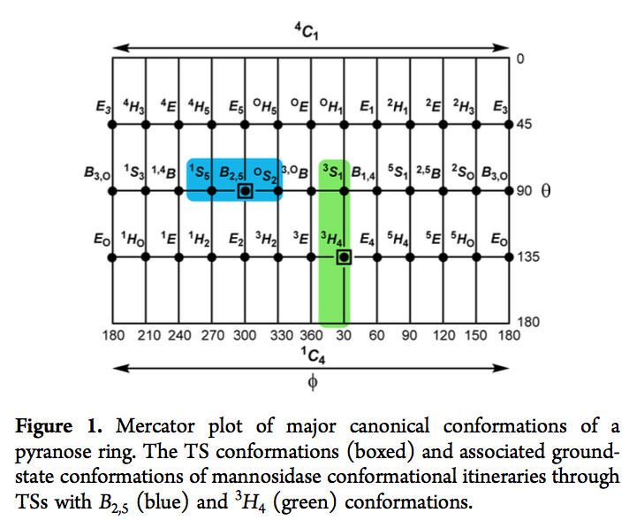
Introduction
Alonso-Gil, Santiago “Computational Design of Experiment Unveils the Conformational Reaction Coordinate of GH125 α‐Mannosidases”. JACS. (2016) . DOI: 10.1021/jacs.6b11247
Notes:
Sinnott postulated that glycosidases must react through TSs in one of 4 major conformations: 4H3 and 3H4 half chairs (or their related envelopes) or B2,5 and 2,5B boats.

Slide 15
Methods
Understand mechanism of 1-thio-α-mannosyl residue at the −1 site
Used an ab initio QM/MM metadynamics approach to map the conformational free energy landscape (FEL)
Used Cremer-Pople Ring coordinates
Substitute the glycosidic sulfur with oxygen in silico in the CpGH125 1,6-α-thiomannobiose complex
MD Equilibration
Perform QM/MM simulations of the reaction mechanism
Compare simulations to experiments done on the same residue, using an inactive variant (D220) of CpGH125
Notes:
Understand mechanism of 1-thio-α-mannosyl residue at the −1 site
Explore power of using soley a computational approach to make testable predictions for the catalytic itinerary

Slide 16
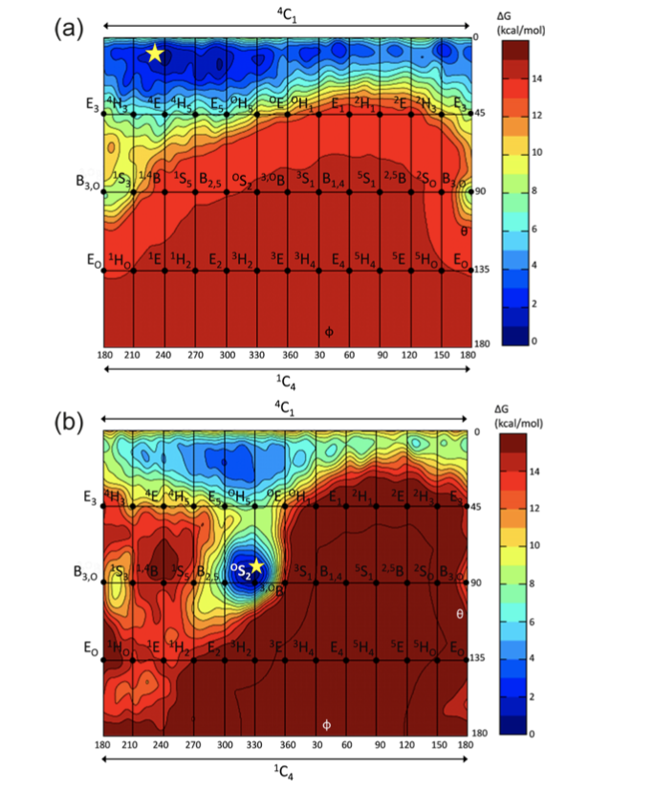
Methods
Confirmational FEL of the 1-thio-α-mannosyl residue at the −1 subsite of CpGH125 in complex
Conformational FEL of the 1-thio-α-mannosyl residue at the −1 subsite of CpGH125 in complex with 1,6-α-mannobiose.
Alonso-Gil, Santiago “Computational Design of Experiment Unveils the Conformational Reaction Coordinate of GH125 α‐Mannosidases”. JACS. (2016) . DOI: 10.1021/jacs.6b11247
Notes:
The star symbol plots the conformation observed experimentally
the star symbol plots the new conformation subsequently observed experimentally (see below). Contour lines are every1 kcal mol−1.

Slide 17
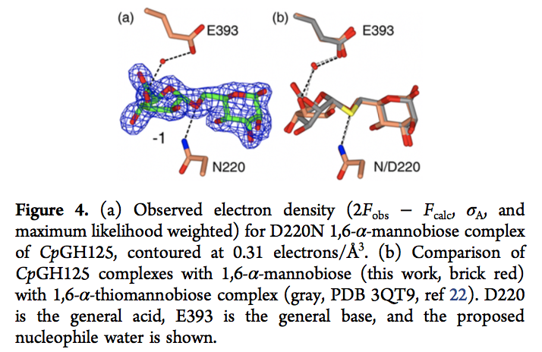
Methods
Alonso-Gil, Santiago “Computational Design of Experiment Unveils the Conformational Reaction Coordinate of GH125 α‐Mannosidases”. JACS. (2016) . DOI: 10.1021/jacs.6b11247
Notes:
The star symbol plots the conformation observed experimentally
the star symbol plots the new conformation subsequently observed experimentally (see below). Contour lines are every1 kcal mol−1.

Slide 18
Conclusions
It was proven that for α- mannopyranose, the sugar has a preference for ⁴C₁ conformation
This supports the ³S₁ → ³H₄ → ¹C₄ pathway for α-mannose
As predicted by experiments the use of an S- linked substrate analogue resulted in a strong bias to a ⁴C₁
Succesfully predicted ES distortion for CpGH125
Assigned a ^{O}S₂ → B_{2,5} → ¹S₅ pathway for that mannoimidazole
GH family 125 joins the growing list of mannose-active enzymes that follows a latitudinal pathway around a B2,5 TS
Notes:
1. This agrees with experimental predicitons and results

Slide 19
Final Thoughts
I enjoyed how they ended the paper with some food for thought:
discussing how their results could provide insight into other thioglycoside complexes
The use of both computational work supporting experimental results, and vise versa was cool
Short ☺

