Slide 1
Ensembles, thermostats, and barostats, oh my!
MOLSIM Win 2017

Slide 2
Program (git with it)
Ensembles
NVE, NVT, NPT
Ergodicity
Thermo/Barostats
Types (Stochastic, strong/weak-coupling, extended dynamics)
Thermostats
Barostats
Practical application
Selecting these in gmx
Homework: fun with ensembles and coupling!

Slide 3
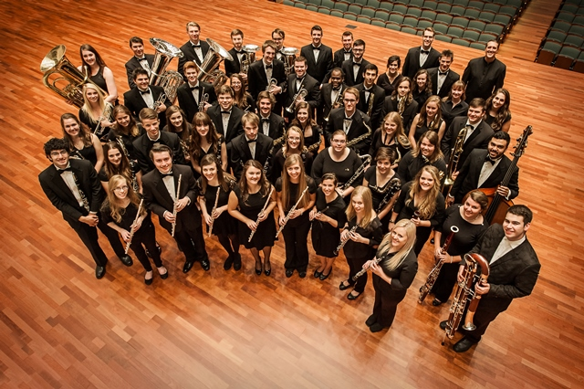
Ensembles
Belmont University Wind Ensemble

Slide 4
Statistical Ensembles
Ensemble: collection of microstates sharing constant macroscopic properties.
Microcanonical: NVE
Characteristic of classical MD
Canonical: NVT
Characteristic of Metropolis Monte Carlo
Add thermostat to MD for experimental relevance
Isobaric-Isothermal: NPT
Add a barostat to control the pressure!
Ensemble of choice for biomolecular simulations

Slide 5
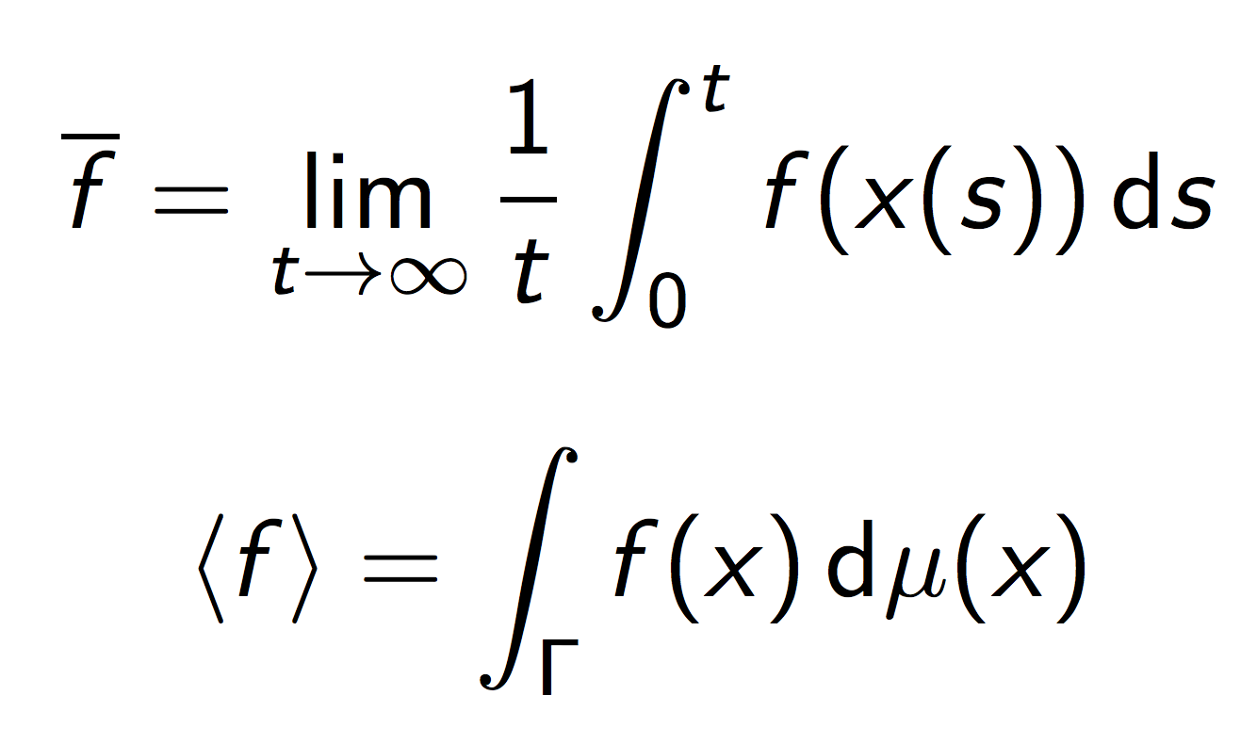
Why are statistical ensembles relevant to MD?
Ergodic Hypothesis: time avg. approximates ensemble avg.
If our property stops changing with time, we’ve approximated the time limit which in turn approximates the ensemble.

Slide 6
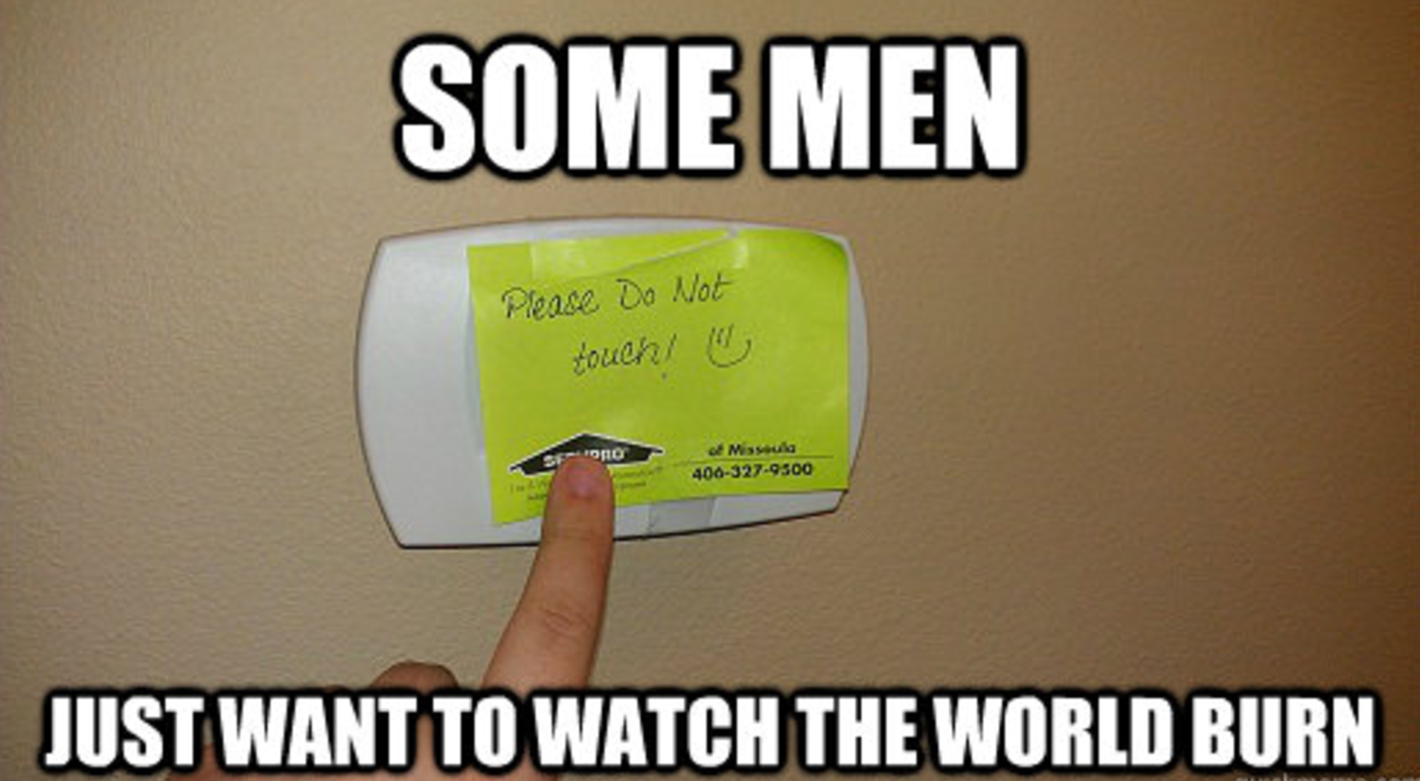
Thermostats and Barostats

Slide 7
What are thermostats and barostats?
For future reference…
Methods of controlling T and P
Why should we care? (because I wouldn’t otherwise be discussing them)
Types
Stochastic (Langevin)
Strong/weak-coupling (Rescale, Berendsen)
Extended dynamics (Nose-Hoover, Parinello-Rahman)
Notes:
We care because performance is different, and they influence the ensemble we’re trying to simulate. Thermostats and barostats prevent may prevent ergodicity if improperly implemented.

Slide 8
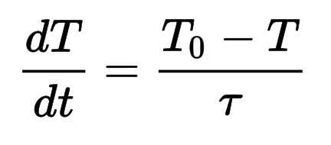
Thermostats
Berendsen
Weak coupling to constant temperature heat bath
Does not correspond directly to canonical ensemble
Nudges system in the right direction
Effective approximation for large systems - O(1000)
Typically used for equilibration

Slide 9
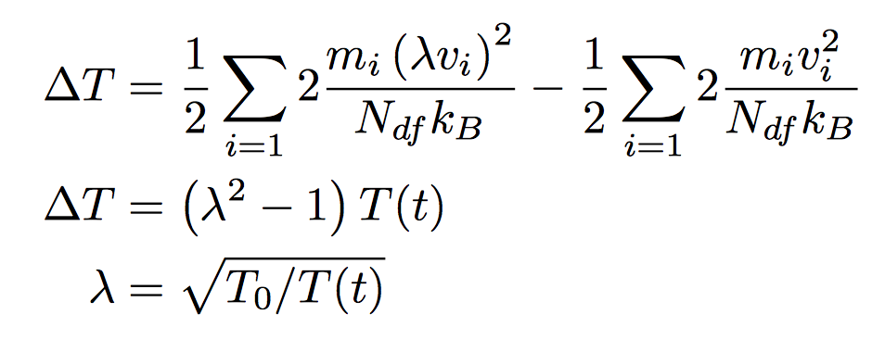
Thermostats
V-rescale
Traditional velocity rescaling doesn’t allow fluctuation
V-rescale as implemented in GROMACS includes an additional stochastic term for random coupling
GROMACS implementation IS canonical or close enough?

Slide 10
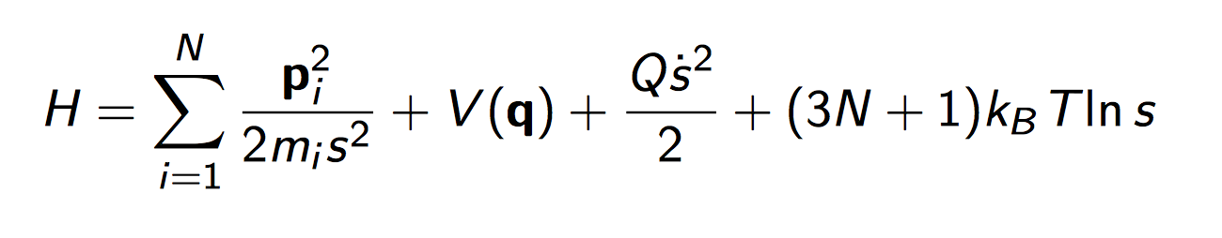
Thermostats
Nose-Hoover
Generates trajectories which recreate canonical ensemble for large systems.
Deterministic ☺ Time reversibility required for detailed balance.
Inefficient temperature control for large systems!

Slide 11
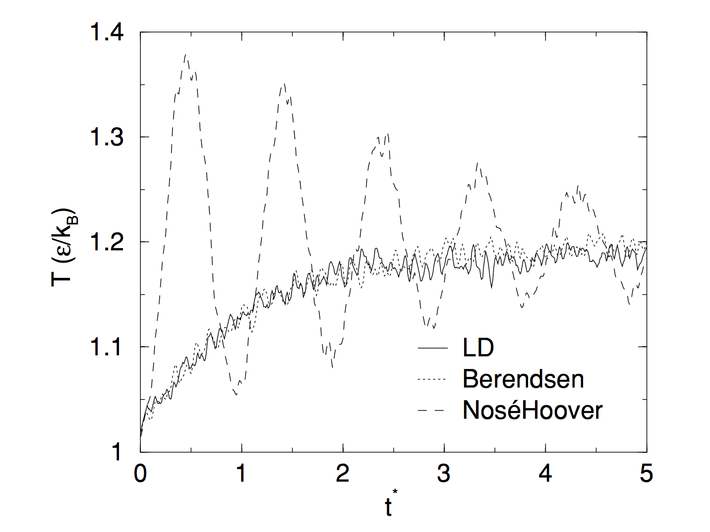
Thermostats
Visualization of temperature control

Slide 12
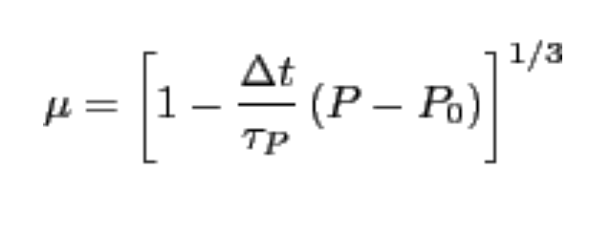
Barostats (equilibration o production)
Berendsen (equil.)
Similar implementation as Berendsen thermostat
Pressure (calculated with T and virial), dP/dt coupled
Volume and coordinates scaled by:
Great for equilibration, not accurate enough for production

Slide 13
Barostats (equilibration o production)
Parrinello-Rahman (prod.)
Similar to the Nose-Hoover thermostat, though additional terms in EOM are more complex
Most reliable for predicting equilibrium thermo properties in the NPT ensemble
We ALWAYS use this for equilibrium production runs! (or at least I do)

Slide 14
Practical Application
How does this translate to what you’ll see in Gromacs?
Typical workflow may include multiple barostats…
Check out the mdp files!
Quickly run the HW problem (with different thermostat and barostat) for crash course on requirements

Slide 15
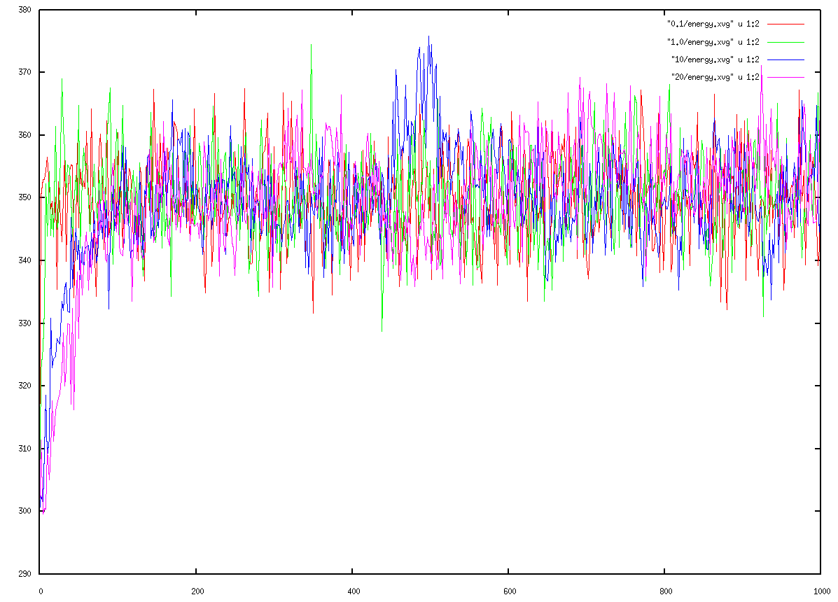
Homework
Coupling time constant effects
Make something pretty……

Slide 16
Selected References
http://www.grs-sim.de/cms/upload/Carloni/Tutorials/FMCP/Thermostats_and_Barostats.pdf
http://people.math.umass.edu/~markos/697SC/ThermostatMD_Final.pdf
http://www.gromacs.org/Documentation/Terminology/Thermostats (gromacs documentation is invaluable)
Frenkel and Smit

