Slide 1
GROMACS
(Still friendlier than Gaussian)
MiwakO Ito

Slide 2
What’s the big idea?
1) Simulate a CHX + water biphasic system.
2) Simulate a CHX + water + KALP-15 system with KALP-15 in the water phase.
3) Simulate a CHX + water + KALP-15 system wit KALP-15 in the CHX phase.
All using GROMACS! :D

Slide 3
Process Overview: Pure Biphasic
1) Create a CHX box → EM → NPT → NVT → check density
- Let the system relax!
2) Expanded CHX box to include some empty space.
3) Solvate water to expanded CHX box of previous step → EM → NPT → NVT
4) Scaling → MD

Slide 4
Process Overview: Alt w/ KALP-15
1) Create a CHX box → EM → NPT → NVT → check density
2) Expanded CHX box to include some empty space.
3) Add KALP-15 to cyclohexane box in either empty OR cyclohexane portion of expanded CHX box.
4) Solvate water to expanded CHX+KALP-15 box → EM → NPT → NVT
5) Scaling → MD

Slide 5
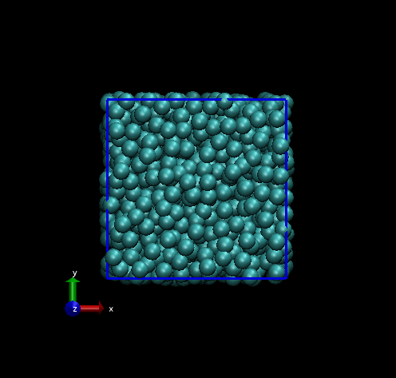
The birth of a new system

Slide 6
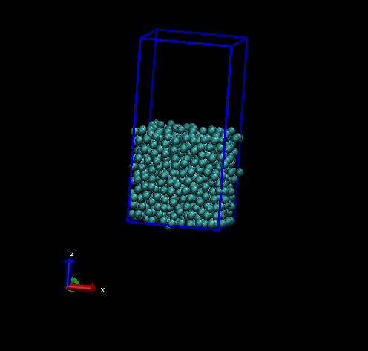
Making some room…

Slide 7
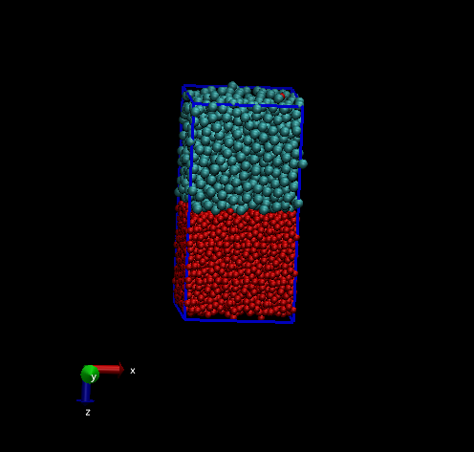
Water

Slide 8
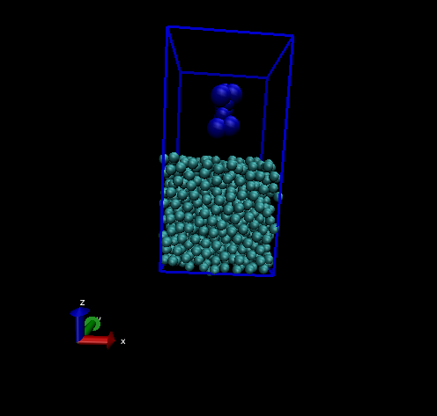
Optional: Add a KALP-15

Slide 9
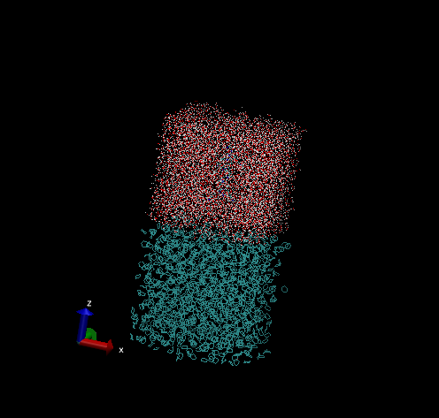
KALP-15 System (Aqueous)

Slide 10
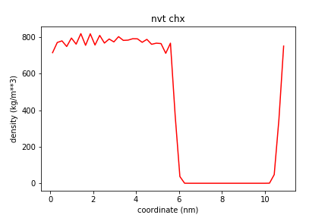
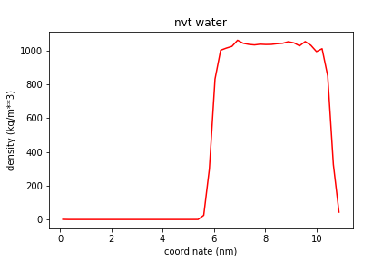
NVT Density Profiles (Biphasic)

Slide 11
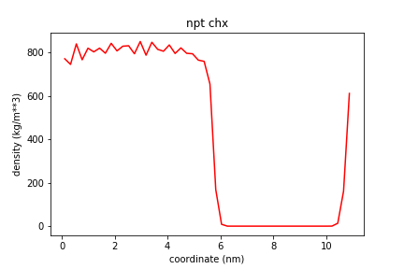
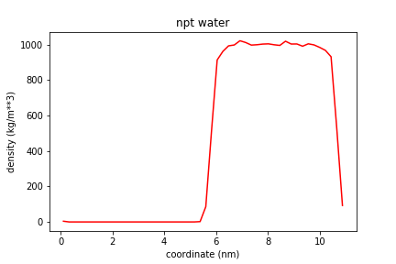
NPT Density Profiles (Biphasic)

Slide 12
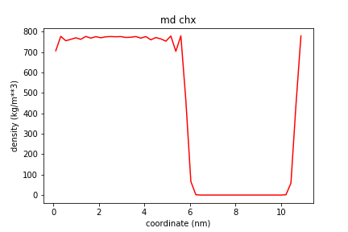
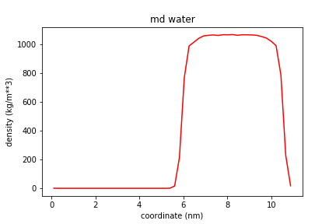
50 ns MD Density Profiles (Biphasic)

Slide 13
EM Problems: Pure Biphasic
Had a huge (3E16 Coulombs) problem with the energy minimization step.
What was the problem?
- Main symptom: biphasic system was inherently unstable.
- Possible cause #1: cyclohexane seeping into water layer.
- Possible cause #2: beheaded cyclohexane molecules.
What fixed it? (Thanks Isaiah!)
- Increasing vdw radius of carbon past what the tutorial suggested.
- GROMACS command make the cyclohexane molecules whole again BEFORE expansion.

Slide 14
KALP-15 never made it to MD ☹
What went wrong?
- Errors with the topology file during energy minimization step.
- Likely due to choosing the wrong forcefield.

Slide 15
What more could be done?
1) Literally run the system for longer. Folding can be on the scale of ms!
2) Add more proteins! Proteins usually aren’t isolated.
3) Try different solvents. KALP-15 could be particularly disinterested or overactive in CHX or water.
4) Try adding the protein to the full biphasic system.
5) Try different arrangements for production steps (don’t steal Janani’s .mdp files :P )

Slide 16
Mistakes
1) Not investing an extended period of time for the initial setup.
2) Error and command documentation.
3) Didn’t use VMD enough.

