Slide 1
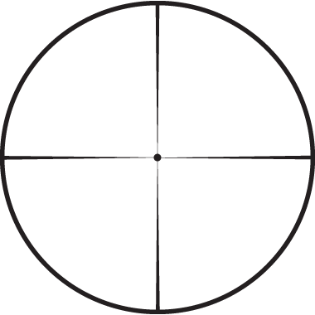

OBJECT D ETECTION
GROUP
1/11

Slide 2

BACKGROUND
2/11
Potential of self-driving car
Need robust perception systems
Deep learning (specifically CNNs) advances
Notes:
Hello everyone, we are team zero. Just six days ago, I heard a news: a self-driving bus start to run on city roads in Shenzhen, China. But soon it turns out this piece of news is just sensational: this self-driving bus is still in test. But now, let’s just imagine, one day you get on a bus, after scan your husky card, you find there is no driver.
You feel a little bit nervous, a little bit exciting. You may start to think, what makes it happen? First thing first, if you want to teach a car to drive, you have to teach it to see! Yes, this is object detection. A robust perception system is the starting point of a self-driving car.
Meanwhile, in the past few years, significant advances have done in the field of computer vision and deep learning (especially CNNs). Actually, our team’s name -- ‘zero’ is named after alphago zero. These contexts motivate us to make a software based on the state of art algorithms to deal with object detection problem.
As I just said, our software is just the beginning of the whole system, so our users could be researchers who are working on the rest part of self driving cars or beginners who are interested in object detection.

Slide 3

DATA
3/11
Dataset | Source | Object | Quantity
Train | UCar Technology Inc. | car, human, cyclist and traffic lights | 10,000
Test | Object Detection Evaluation 2012 | car, human | 7,481
Download data: UCar DATA: training set; test set; KITTI

Slide 4
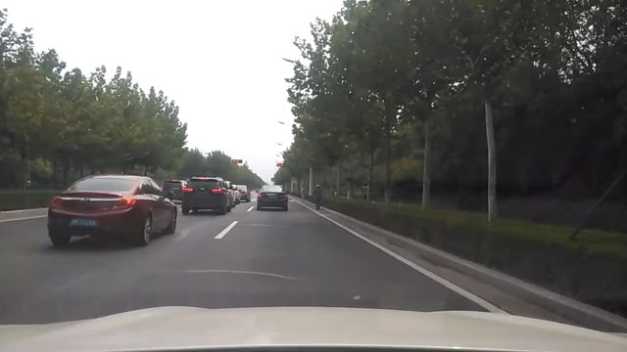
TRAINING DATA-EXAMPLE
(x1, y1)
Image
(x2, y2)
{"61213.jpg": [ [319.00032, 185.50008, 329.83296, 217.33344, 2], [258.99968, 187.99991999999997, 296.49984, 218.00016, 1], [182.83328, 179.49996000000002, 237.16672, 222.50016000000002, 1], [162.0, 181.9998, 199.00032, 209.00016, 1], [46.0, 176.3334, 182.0, 252.8334, 1], [232.83328, 188.1666, 257.00032, 207.8334, 1], [233.49952, 161.25012, 248.75008000000003, 169.0002, 20], [305.49952, 187.25004, 312.49984, 208.75032, 2]]}
Label Map
(bounding box + class name)
4/11
Notes:
To describe an object in an image, we need 5 variables: four fixes a bounding box, and one indicate the class name.

Slide 5
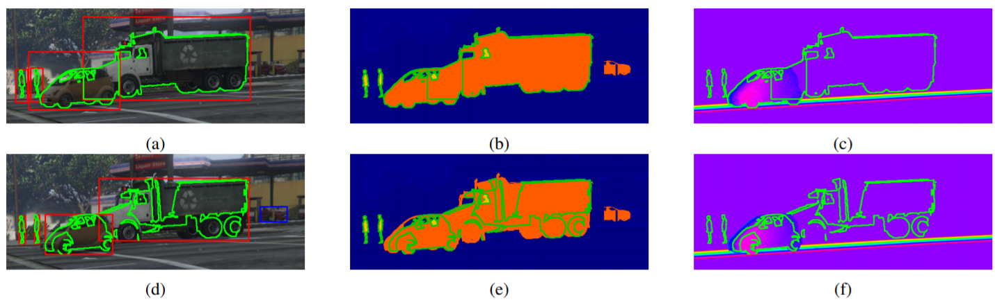
USE CASE1: Self-driving detection
User | Researchers in self-driving
Input | Images/Video/Live Camera to be detected
Output | Labeled Images/Video/Live Camera
Detected object
Box bounding
3D Depth Image
Object localization
Driving in the Matrix: Can Virtual Worlds Replace Human-Generated Annotations for Real World Tasks?
(M. Johnson-Roberson, Charles Barto, Rounak Mehta, Sharath Nittur Sridhar, Karl Rosaen, Ram Vasudevan), In IEEE International Conference on Robotics and Automation, 2017.
5/11

Slide 6
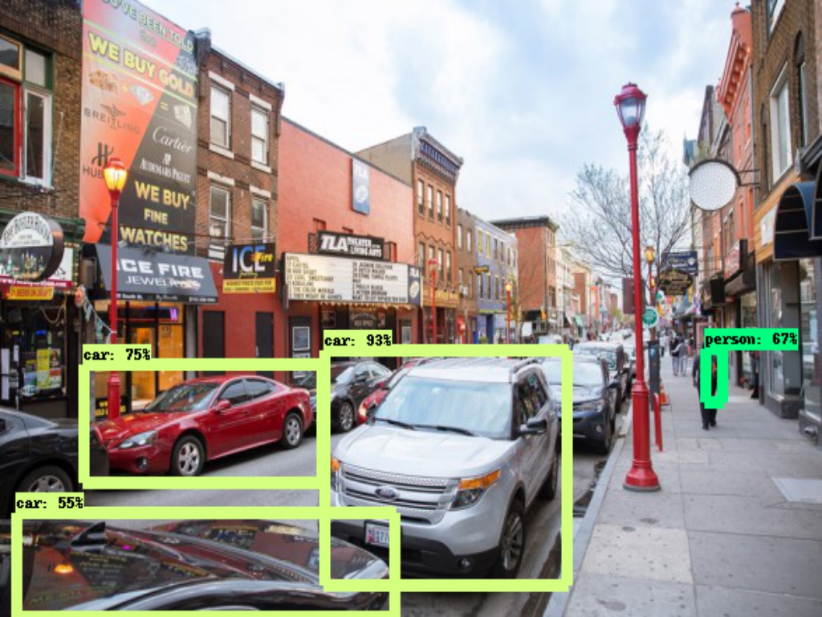
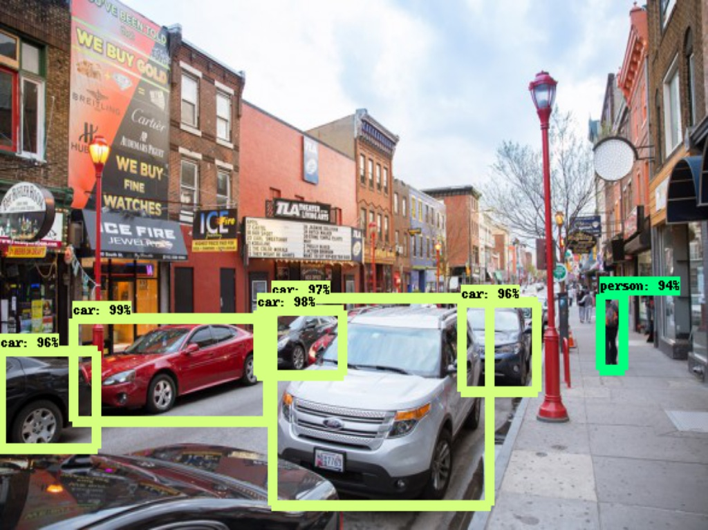
USE CASE2: Compare different algorithm
User | Researchers in self-driving
Input | Different Object Detection Models, Photos to be detected, LabelMaps
Output | Labeled Images
SSD Algorithm
Faster R-CNN Algorithm
Processing Time: 0.22s
Processing Time: 3.55s
6/11

Slide 7
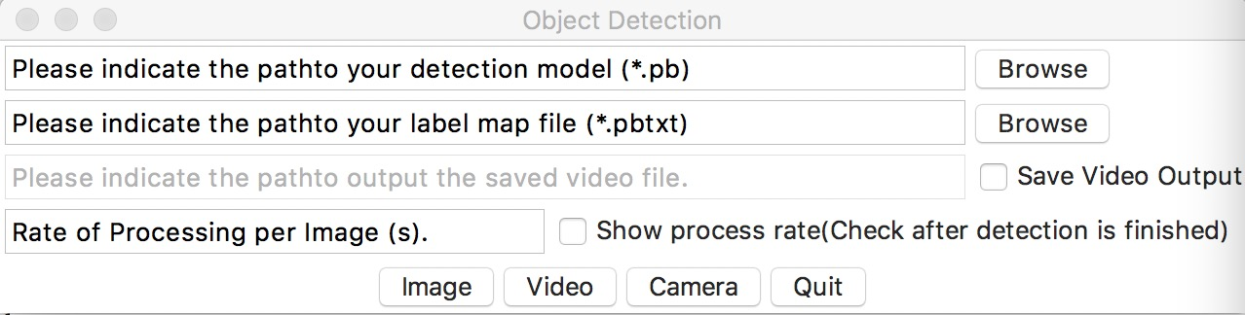
DEMO
Detect Image/Video/Camera
Calculate processing speed for a specific model
7/11
Notes:
researcher has own pre-model of a specific DL algorithm and a label map file relates to it. ---import / use our default ssd
save or not
Static image --- processing ---
want to detect the video recorded yesterday on the University Way
once we succeed in video detection, we can move to live camera to see how it goes.
If install a camera on the bus, then it can see what’s going on on the street. To detect there is a car or a person. But there’s no cars in classroom still, it can see us.

Slide 8
COMPONENT DESIGN
read images
Train a model
Train the model with image data
Interface
Load detect models, label maps select
Read in inputs
Show result
input data
read videos
interface
label map select
read camera
models select
model
model
Training Function
data
8/11
Notes:
there are two main module in our software. The first one is training module, it has one component which is the training function. it take the data and train a model. the second module is the user interface. with model select component we can select the model we trained or the models trained by other people, with the label map select, we can select the corresponding label map for the model, and with different input we has different components for different media data. After we read the input data, select the label maps and models, the interface we show us the detec result as we see in the demo. that’s all for component design.

Slide 9
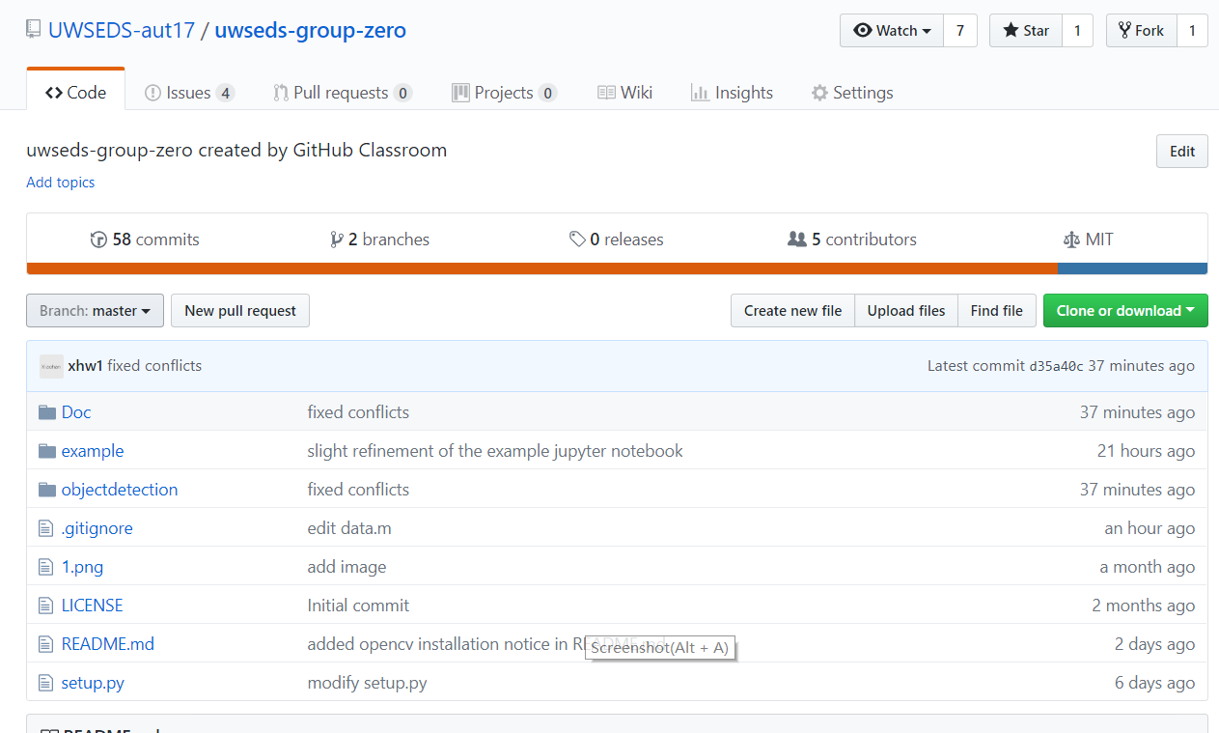
PROJECT STRUCTURE
|--Doc/
|--Examples/
|--objectdetection/
| |--data/
| |--ssd_mobilenet/
| |--submodule/
| |--tests/
| |--__init.py
| |--objdetapp.py
| ㄴ-user_interface.py
|--README.md
|--LICENSE
ㄴ-setup.py
9/11
Notes:
In terms of project structure. In the root we have readme file, license, setup script and two folders. in the doc folder, there are some documentation, such as component design and function specification. in the object detection folder, there are some label maps data, pretrained models, and source code scripts. As you can see, it’s not well organized yet, we will work on that later. that’s all for project structure. our last teammate will talk about lesson learned and future work.

Slide 10




LESSON LEARNED
Design and implemented a complete software (detection algorithm, component, interface, test...)
Git version control
(Tkinter)
Dealing with different data format (images, json, csv, pbtxt , camera input, tensorflow tf record, etc)
10/11
Notes:
We used Github for version control and collaboration, opencv for reading the realtime camera input, tensorflow for model training and object detection. TK interface for building the graphic user interface.
Also we learned how to deal with a lot of different datafile formats for different tools. for example, , we learned how to convert between them, and integrate them into our workflow.

Slide 11
FUTURE WORK
Tune hyperparameters in Faster R-CNN Model
Upgrade user interface
Add input data from other sensors (radar, lidar) to make more robust detection.
11/11

Slide 12

Thank you!
https://github.com/UWSEDS-aut17/uwseds-group-zero

