Slide 1

DATA 515A
Software Engineering for Data Scientists Working in Teams
David Beck^{1,2}, Joseph Hellerstein^{1,3}, Jake VanderPlas^{1,4}
Dimitrios Gklezakos³
¹eScience Institute
²Chemical Engineering
³Computer Science Engineering
⁴Astronomy
The University of Washington
April 10, 2018

Slide 2
Agenda
Software licenses
Team process with in-class exercises:
Code reviews (10 min)
Technology review (30 min)
Status standup

Slide 3
Software Licenses

Slide 4
Overview of Software Licenses*
A software license is a legal instrument (usually by way of contract law, with or without printed material) governing the use or redistribution of software. Under United States copyright law all software is copyright protected, in source code as also object code form. The only exception is software in the public domain. A typical software license grants the licensee, typically an end-user, permission to use one or more copies of software in ways where such a use would otherwise potentially constitute copyright infringement of the software owner's exclusive rights under copyright law.
*Mark Webbink

Slide 5
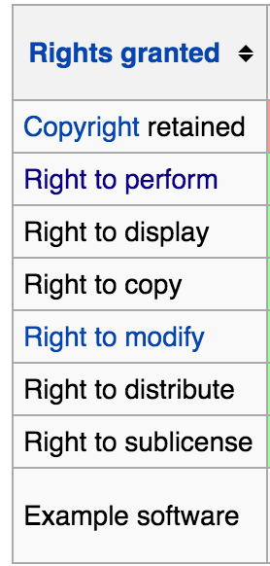
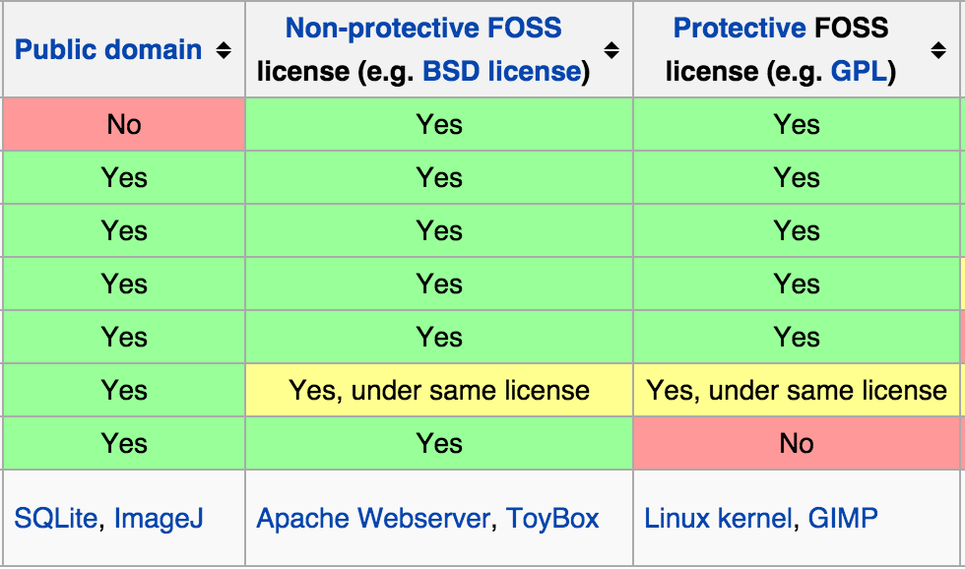
Software Licenses*
FOSS = Free and Open Source Software
*Mark Webbink

Slide 6
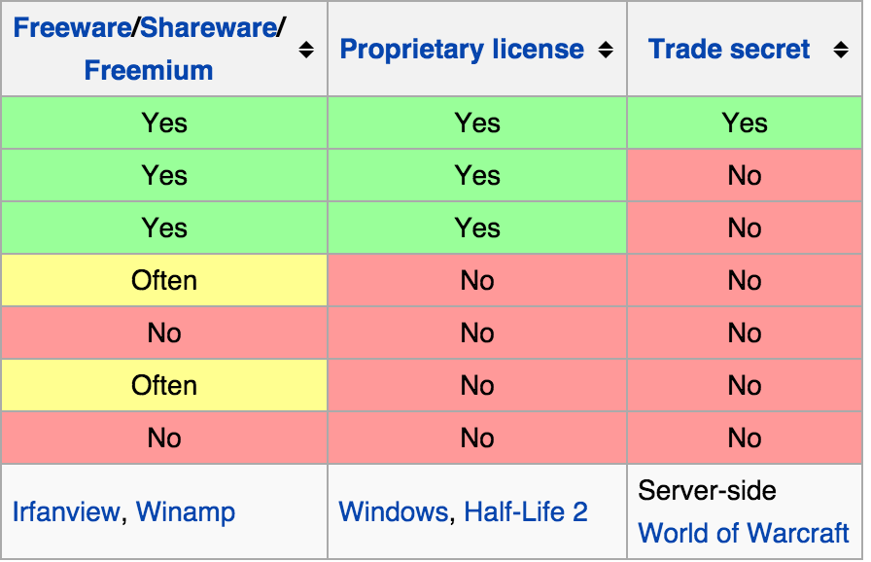
Software Licenses*
The default (no license): No rights are granted.
*Mark Webbink

Slide 7
Team Process

Slide 8
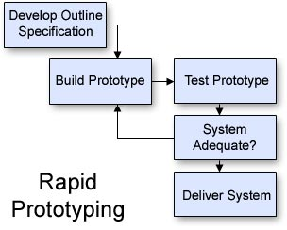
Team Activities
Revise the
specification
Reqs gathering (functional spec.)
Design
Technology assessments
Write specifications
Review specification
Implementation
Code
Code review
Bug prioritization and resolution
Standups (status update)

Slide 9
Projects

Slide 10
Project Updates
What is your data?
You should have 2 datasets in hand!
Who are your users?
General public? Scientists? Analysts?
What questions are users trying to answer?
What are the use cases (user-system interactions) to answer their questions?
What issues are there ("known unknowns") with building your system?

Slide 11
Code Review

Slide 12
Code Review Template
Why code review?
Improve code quality and find bugs
Background
Describe what the application does
Describe the role of the code being reviewed
Comment on
Choice of variable and function names
Readability of the code
How improve reuse and efficiency
How use existing python packages

Slide 13
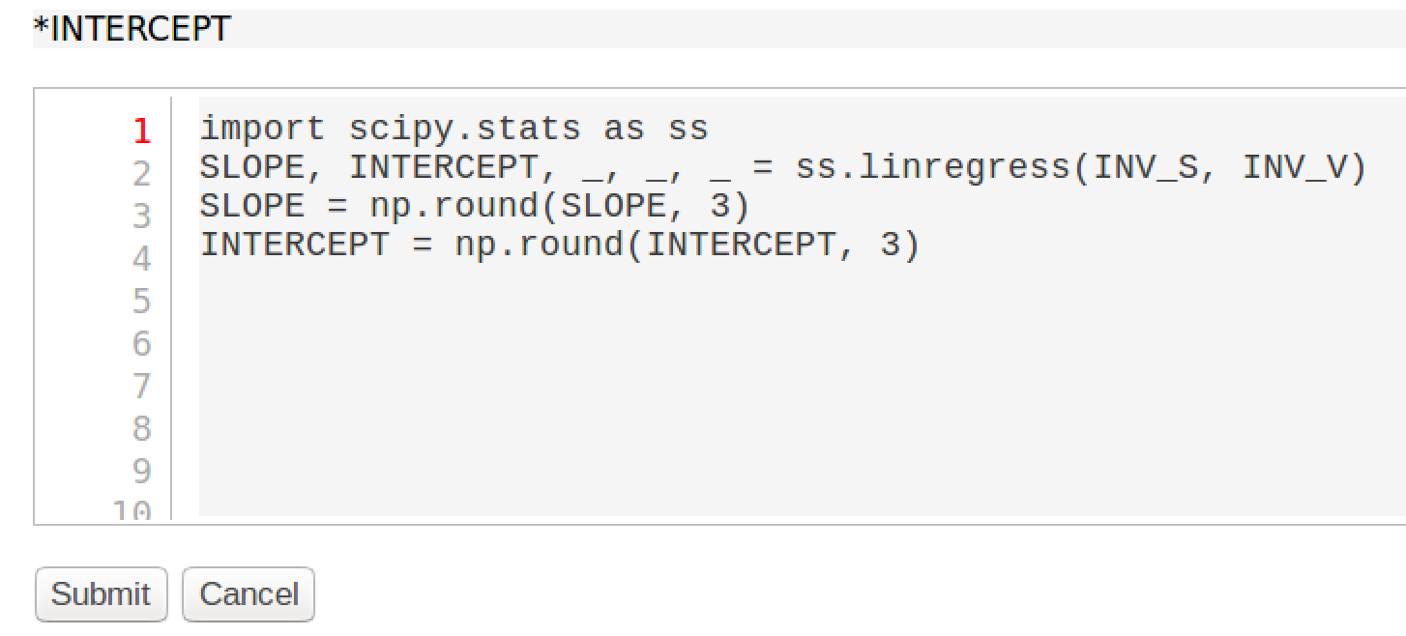
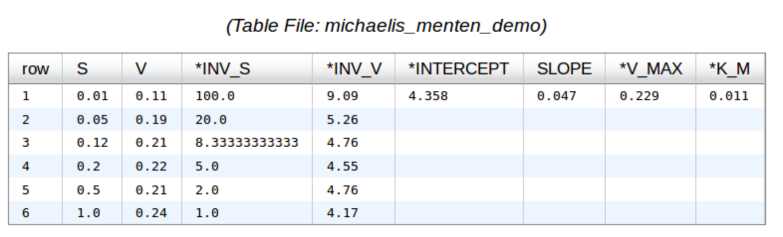
Code Review Example: SciSheets
SciSheets is a spreadsheet system in which formulas are python expressions
Columns are numpy arrays

Slide 14
makeEvaluationScriptProgram()
Generates python code that evaluates the formulas associated with each column in the spreadsheet
No assumption about order of evaluation of the columns

Slide 15
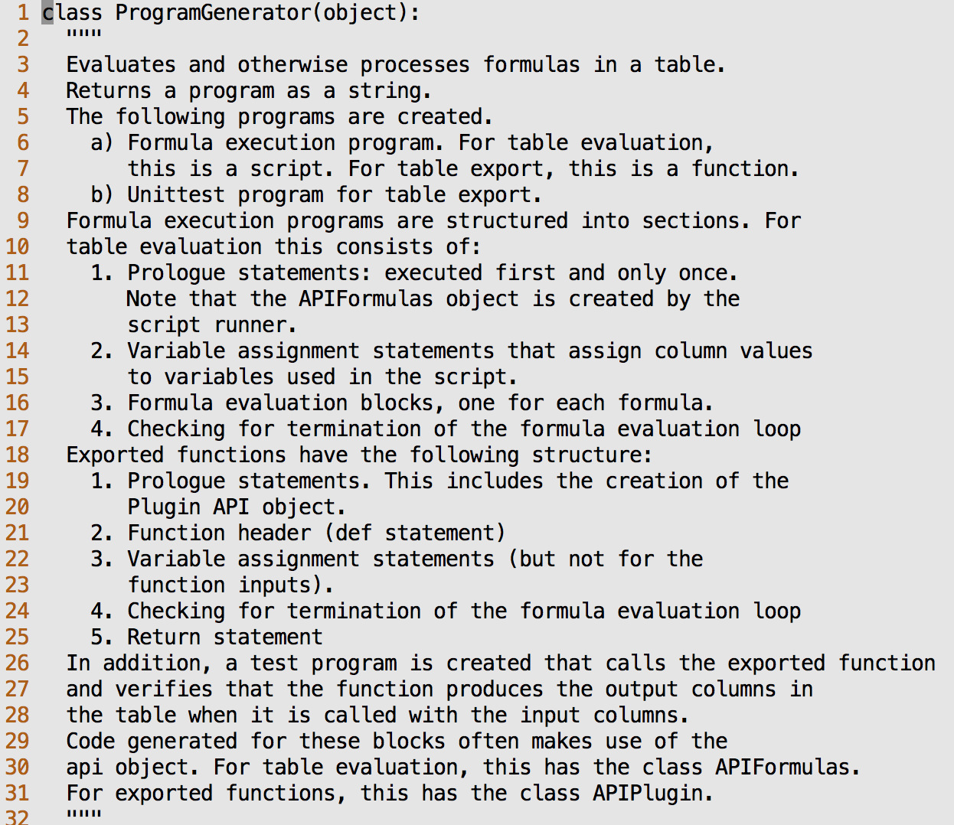
SciSheet Example: Enzyme Kinetics

Slide 16
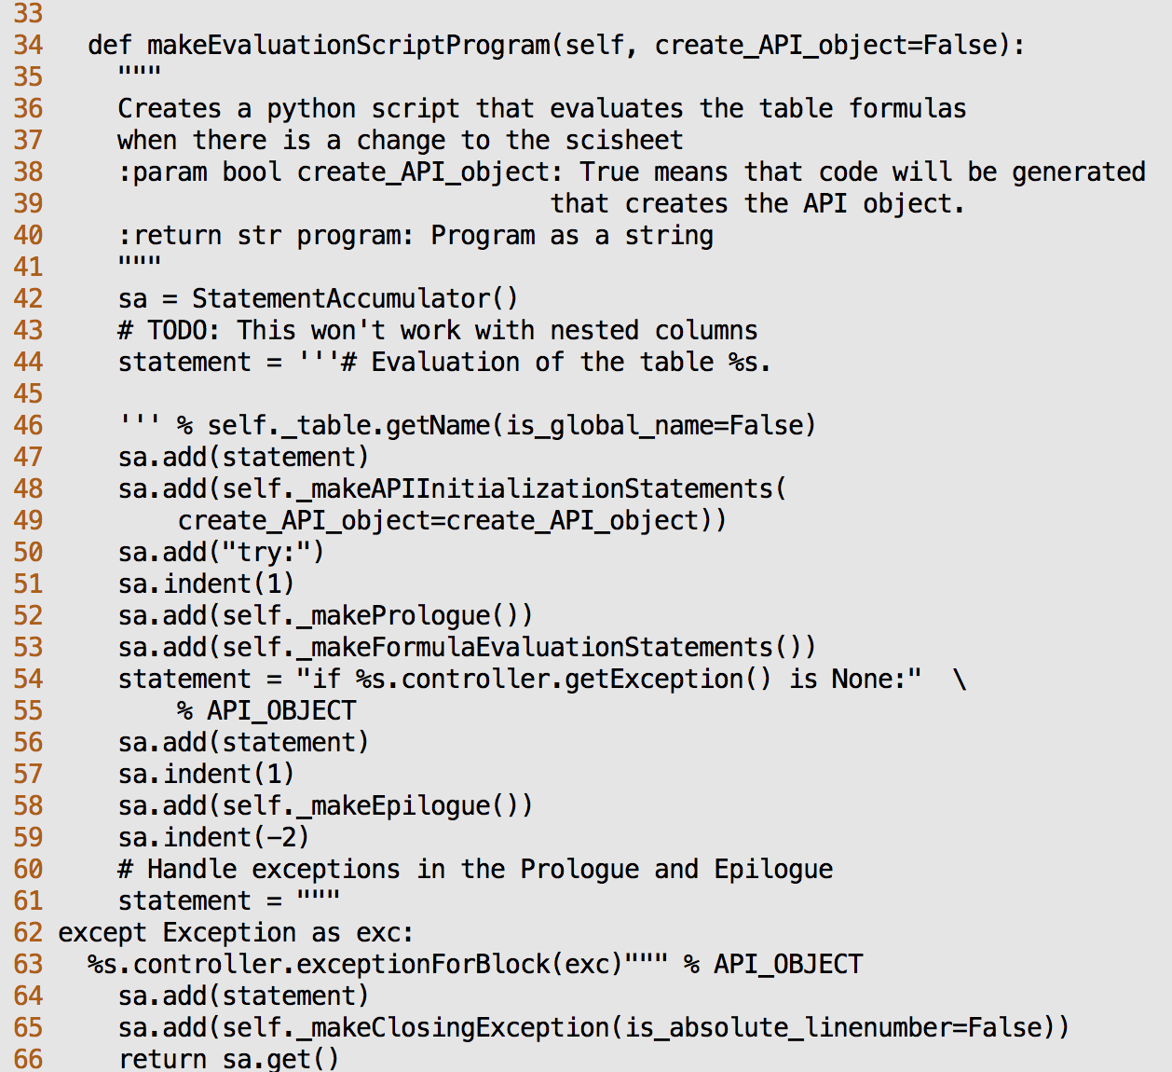

Slide 17
Team Exercise: 15 minutes
Team Breakout (10 min)
Review makeEvaluationScriptProgram() based on code review template
Breakout reports (5 min)

Slide 18
Technology Review

Slide 19
Technology Review Template
Why technology reviews?
Determine if use a package
Background
Requirements that indicate a need for the proposed package
Discuss
How the package works
Appeal of using the package
Drawbacks of using the package

Slide 20
Example of A Technology Review Command line argument parsing
Background
Have a python script that needs to be run from the command line
What python module should we use to handle command line arguments?
Some options include
click
docopt
argparse

Slide 21
Assessment of Antimony
Appeal
Drawbacks

Slide 22
Team breakouts (20 min)
Identify a technology that may use in project
Pick within 5 minutes
Complete the technology review template
Breakout reports (5 min)

Slide 23
Standup Template
Why standups?
Communicate status and actions within and between teams
Should be presented in 1-2 minutes
Progress this period
How it compares with the plan
If behind plan, how compensate to make plan end date
Deliverables for next period
Challenges to making next deliverables such as:
Technology uncertainties and blockers
Team issues

Slide 24
Team Exercise: 10 minutes
Team breakouts (5 min)
Draft a standup report
Breakout reports (5 min)

