Slide 1

DATA 515A
Software Engineering for Data Scientists Working in Teams
David Beck^{1,2}, Joseph Hellerstein^{1,3}, Jake VanderPlas^{1,4}
Dimitrios Gklezakos³
¹eScience Institute
²Chemical Engineering
³Computer Science Engineering
⁴Astronomy
The University of Washington
April 10, 2018

Slide 2
Agenda
Software licenses
Team process with in-class exercises:
Code reviews (10 min)
Technology review (30 min)
Status standup

Slide 3
Software Licenses

Slide 4
Overview of Software Licenses*
A software license is a legal instrument (usually by way of contract law, with or without printed material) governing the use or redistribution of software. Under United States copyright law all software is copyright protected, in source code as also object code form. The only exception is software in the public domain. A typical software license grants the licensee, typically an end-user, permission to use one or more copies of software in ways where such a use would otherwise potentially constitute copyright infringement of the software owner's exclusive rights under copyright law.
*Mark Webbink

Slide 5
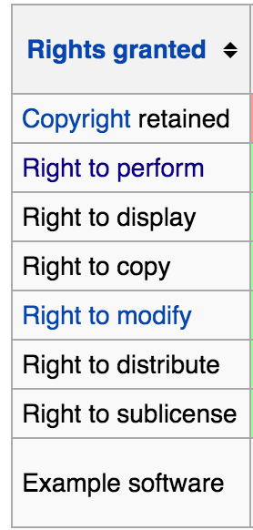
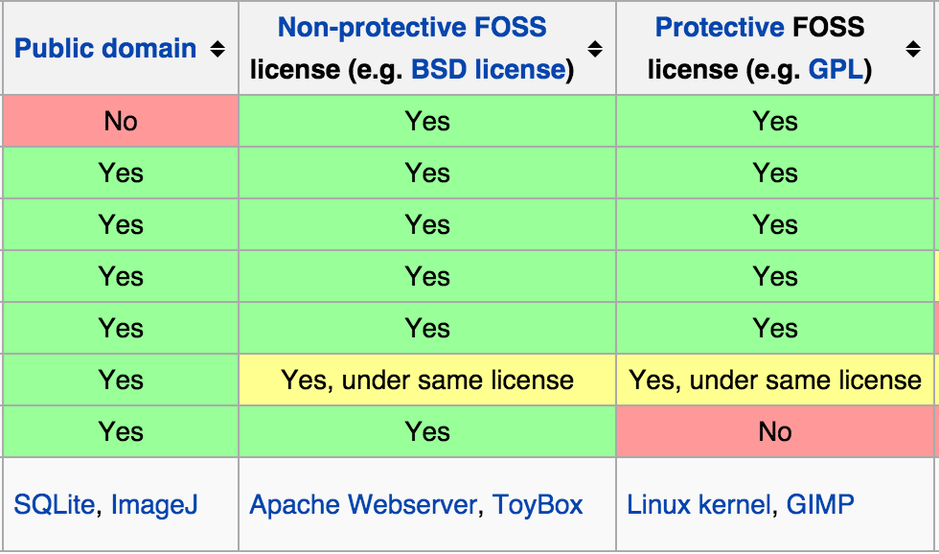
Software Licenses*
FOSS = Free and Open Source Software
*Mark Webbink

Slide 6
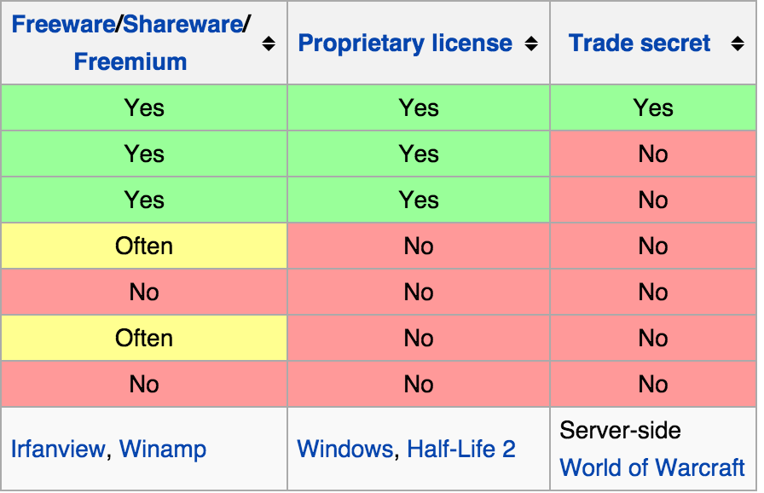
Software Licenses*
The default (no license): No rights are granted.
*Mark Webbink

Slide 7
Team Process

Slide 8
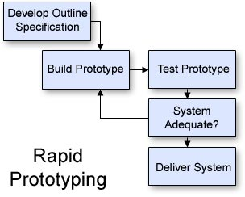
Team Activities
Revise the
specification
Reqs gathering (functional spec.)
Design
Technology assessments
Write specifications
Review specification
Implementation
Code
Code review
Bug prioritization and resolution
Standups (status update)

Slide 9
Code Review

Slide 10
Code Review Template
Why code review?
Improve code quality and find bugs
Background
Describe what the application does
Describe the role of the code being reviewed
Comment on
Choice of variable and function names
Readability of the code
How improve reuse and efficiency
How use existing python packages

Slide 11
Paired Exercise: 10 minutes
Do a code review of the code on the next slide
Make notes of some issues you find and suggestions for improvement
At the end of the time, we’ll share ideas

Slide 12
Background
This is some code that takes a list of numbers and returns a list of values > two std. dev. from mean

Slide 13
Technology Review

Slide 14
Technology Review Template
Why technology reviews?
Determine if use a package
Background
Requirements that indicate a need for the proposed package
Discuss
How the package works
Appeal of using the package
Drawbacks of using the package

Slide 15
Example of A Technology Review Command line argument parsing
Background
Have a python script that needs to be run from the command line
What python module should we use to handle command line arguments?
Some options include
click
docopt
argparse

Slide 16
Example of A Technology Review Command line argument parsing
[dacb@D-108-179-129-50 ~/tmp]$ ./solver.py
usage: solver.py [-h] -C PLIGC -H PLIGH -O PLIGO [-t TEMPERATURE]
[-m MAX_TEMPERATURE] [-r HEATING_RATE] [-s STOP_TIME]
solver.py: error: the following arguments are required: -C/--PLIGC, -H/--PLIGH, -O/--PLIGO

Slide 17
Example of A Technology Review Command line argument parsing
[dacb@D-108-179-129-50 ~/tmp]$ ./solver.py -h
usage: solver.py [-h] -C PLIGC -H PLIGH -O PLIGO [-t TEMPERATURE]
[-m MAX_TEMPERATURE] [-r HEATING_RATE] [-s STOP_TIME]
optional arguments:
-h, --help show this help message and exit
-C PLIGC, --PLIGC PLIGC
mol number of C in input
-H PLIGH, --PLIGH PLIGH
mol number of H in input
-O PLIGO, --PLIGO PLIGO
mol number of O in input
-t TEMPERATURE, --temperature TEMPERATURE
starting temperature
-m MAX_TEMPERATURE, --max_temperature MAX_TEMPERATURE
maximum pyrolysis temperature
-r HEATING_RATE, --heating_rate HEATING_RATE
heating rate in K/s
-s STOP_TIME, --stop_time STOP_TIME
stop time in seconds

Slide 18
Example of A Technology Review Command line argument parsing
[dacb@D-108-179-129-50 ~/tmp]$ ./solver.py --PLIGC 1.444234 --PLIGH 0.442 --PLIGO 0.320500 --temperature 325.0
Solver arguments are:
PLIGC = 1.444234
PLIGH = 0.442000
PLIGO = 0.320500
temperature = 325.000000
max temperature = nan
heating rate = 2.700000
stop time (s) = 175.925926
Runtime exhausted. Output written to `solver.log`.

Slide 19
Assessment of CLI Argument Parsers
Appeal
Drawbacks

Slide 20
Technology Review Example
Small group (3-4 people) breakouts (20 min)
Evaluate the three proposed technologies (or others)
Complete the technology review template
Breakout reports (10 min)
Note the in class reports are 15 minutes / group

Slide 21
Breakout reports
Appeal
Drawbacks

Slide 22
Standup Template
Why standups?
Communicate status and actions within and between teams
Should be presented in 1-2 minutes
Progress this period
How it compares with the plan
If behind plan, how compensate to make plan end date
Deliverables for next period
Challenges to making next deliverables such as:
Technology uncertainties and blockers
Team issues

Slide 23
Note on upcoming project activities
Technology Review: May 8, 2018
Standups: weekly starting May 8 (or before)

