Slide 1

DATA 515A
Software Design for Data Scientists
Course Introduction & Data Essentials
David Beck^{1,2}, Joseph Hellerstein¹, Jake VanderPlas^{1,4}
Dimitrios Gklezakos³
¹eScience Institute
²Chemical Engineering
³Computer Science
⁴Astronomy
University of Washington
March 27, 2018

Slide 2
What's the class about? Who are we?
Objectives
  Teach how to create and collaborate on data- and computation-intensive research projects
  Provide practical software skills for data analysis in research & industry
  Elevate coding in science to the level of technical writing
Instructor introductions
Beck & Hellerstein, 2018

Slide 3
Agenda
Course overview
Using the command line
Basic version control
Table manipulation & testing
Beck & Hellerstein, 2018

Slide 4
Course Overview
Beck & Hellerstein, 2018

Slide 5
Skills Taught
Program in python using the Python scientific stack, including numpy, pandas, and matplotlib.
Search, evaluate, and integrate into a project externally developed Python packages; create your own Python packages.
Develop unit tests that validate important aspects of the project implementation.
Develop software that it can be used by others including: shared code on github, documentation, installing packages, setup, and running computational studies.
Create technical specifications for what a program should do and how this is accomplished.
Beck & Hellerstein, 2018

Slide 6
Course Environment
Active Learning classroom
  Bring your laptop and be ready to use it
This is a safe space
  We follow the UW student code of conduct
We follow the UW guidelines on academic misconduct
  Cheating
  Falsification
  Plagiarism
Beck & Hellerstein, 2018

Slide 7
Survey Results
Question | Response
Years of programming? | Mostly > 1 yr
Years of python? | < 1 yr
Experience with a text editor | Mostly "Yes"
Comfort with if-statements? | Yes
Comfort with for-statements? | Yes
Comfort with functions? | Mostly "Yes"
Python packages (scipy, pandas, ...) | Mostly "No"
Experience with iPython? | Very little
Experience with github? | Very little
Beck & Hellerstein, 2018

Slide 8
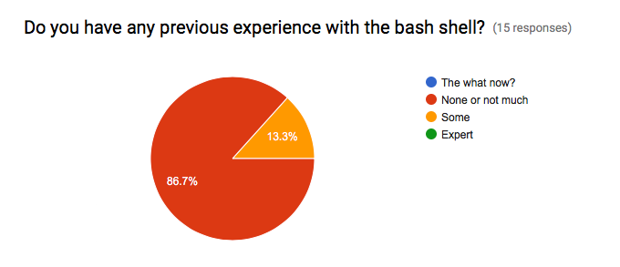
Survey Results
Beck & Hellerstein, 2018

Slide 9
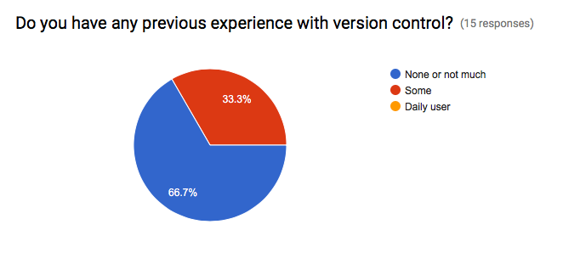
Survey Results
Beck & Hellerstein, 2018

Slide 10
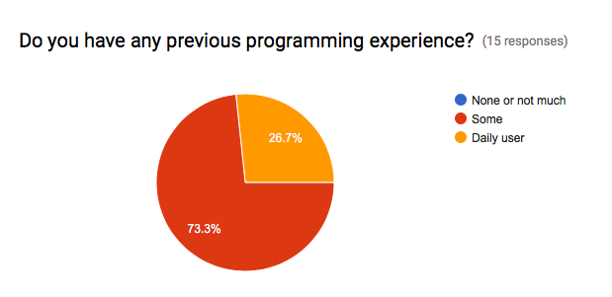
Survey Results
Beck & Hellerstein, 2018

Slide 11
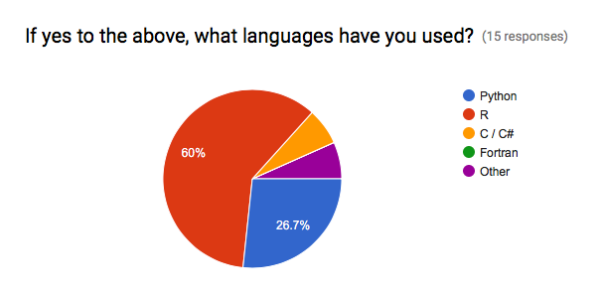
Survey Results
Beck & Hellerstein, 2018

Slide 12
Course Structure
Programming basics (3 weeks)
  Version control, Python, data manipulation
Software development (3 weeks)
  Debugging, documentation, design, collaboration
Data manipulations in detail (2 weeks)
  Visualization, machine learning
Software engineering practicum (2 weeks)
Beck & Hellerstein, 2018

Slide 13
Programming vs. Software Engineering
Analogy: What is the difference between the following kinds of writing:
  Note to yourself
  An article in the NY Times
Beck & Hellerstein, 2018

Slide 14
Relating Writing to Software
How Learn Skills
Reporter
Writing quality
Content
Structure
Review
SW Eng
Code quality
Features
Design
Testing
Freshman English
Programming
class
{
{
Composition & literature classes, professional writer
Computer Science degree, Collaborate on a big project
Beck & Hellerstein, 2018

Slide 15
Grading
Item | %
Homework (~7 homeworks) | 35
Class participation | 15
Class project | 50
Beck & Hellerstein, 2018
Notes:
Describe the importance of the homework and address concerns about rigidity for grad students

Slide 16
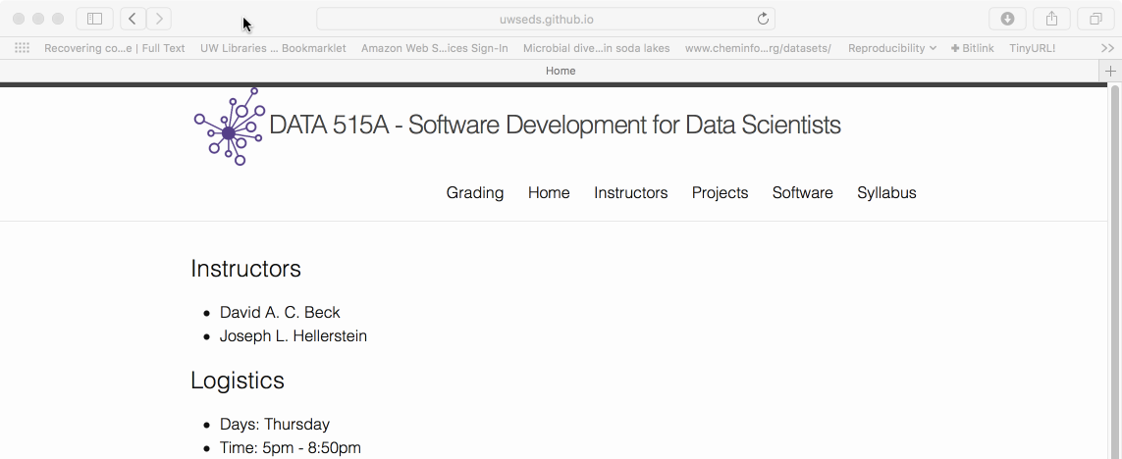
Course Web Page
http://uwseds.github.io
Beck & Hellerstein, 2018

Slide 17
Using the command line
Beck & Hellerstein, 2018

Slide 18


File System Basics
File – container of data
Directory – container of files and directories
Directories are organized into a tree
Current directory
Data
README
File
Directory
Pronto
File
Beck & Hellerstein, 2018

Slide 19
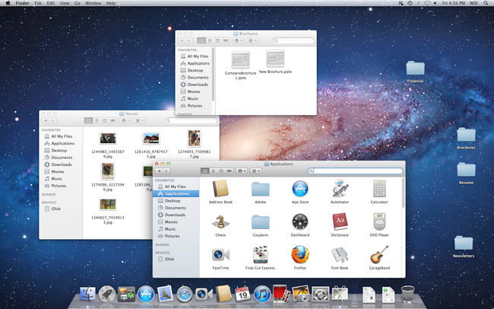
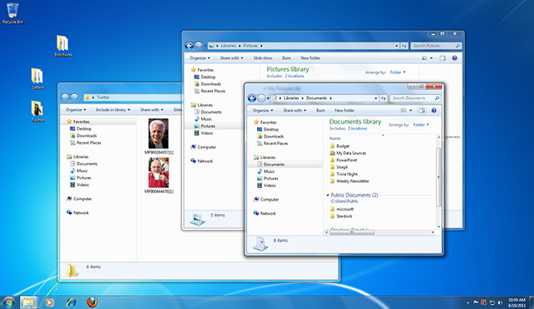
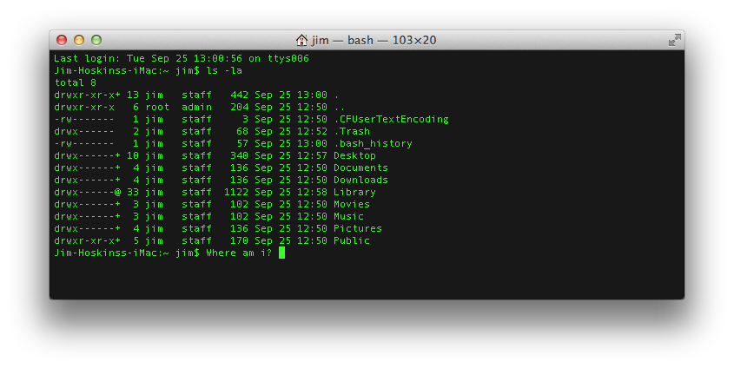
Command Line Tools
Graphical User Interface (GUI)
Command Line Interface (CLI)
Beck & Hellerstein, 2018

Slide 20
Command Line Tools
What is the command line?
  Also known as a ‘shell’
  Most common is bash (what we will use)
    Bourne Again Shell
    Reimplementation of a shell from 1977
    Every OS/X Mac
    Every Linux
    Every supercomputer
  For later…
    Programming language itself!
Beck & Hellerstein, 2018

Slide 21
Command Line Tools
Where is the command line?
  Mac (pre-installed)
    Applications -> Utilities -> Terminal
  Windows (after install Git / Bash)
    Start -> Git -> Git Bash
(See the "software" tab of the course web page to install Gitbash.)
Beck & Hellerstein, 2018

Slide 22
Command Line Tools
Commands take arguments (stuff after cmd.)
  Arguments alter the function of commands, e.g.
    Specify what file to use as input
  Many commands accept the special argument to return help, usually one of
    --help
    -help
    -h
Tab completion is your friend!
  When entering file arguments
  Hitting tab key will autocomplete the filename
Beck & Hellerstein, 2018

Slide 23
Commands for Files & Directories
By category
  Create
    Directory: mkdir
    File: various (e.g., cp)
  View contents
    Directory: ls
    File: cat
  Remove
    Directory: rmdir
    File: rm
Data
README
Pronto
Beck & Hellerstein, 2018

Slide 24
Demo
Create the project directory structure and README
Get the pronto data from the Internet, https://github.com/UWSEDS/uwseds.github.io/blob/master/data/youtube-new.zip?raw=true
Unpack the data
  Comma separated variable (CSV) files
Automate the workflow using a shell script
Beck & Hellerstein, 2018

Slide 25
Useful Shell Commands
Command | Task | Example usage
ls | List files | ls
cp | Copy files | cp original_file new_file
mv | Move / rename files | mv original_file new_file
rm | Remove / delete files | rm original_file
cd | Change directory | cd some_directory
pwd | Print working / current directory | pwd
mkdir | Create directory | mkdir some_directory
rmdir | Remove / delete directory | rmdir some_directory
cat | View files | cat some_file
head | View begining of file | head some_file
tail | View end of file | tail some_file
grep | Search file for matching lines | grep search.text some_file
sort | Sort lines | sort some_file
uniq | Print unique lines | uniq some_file
diff | Compare to files | diff original_file new_file
unzip | Uncompress a file | unzip compressed_file.zip
curl | Download a file using its URL | curl some URL
  Also see http://www.pixelbeat.org/cmdline.html
  Also search shell + <cmd name>
Beck & Hellerstein, 2018

Slide 26
What is version control?
Writing a manuscript…
  Use undo to revert to a previous state
  Use track changes when sharing doc with your advisor
Beck, Hellerstein & VanderPlas, 2017

Slide 27
What is version control?
Version control is like a combination of undo and track changes for your code
  You can revert to previous versions of code
  You can easily identify who contributed what
  Version control is about tracking versions of code and developing software with people
Beck, Hellerstein & VanderPlas, 2017

Slide 28
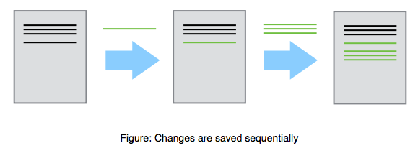
Beck, Hellerstein & VanderPlas, 2017

Slide 29
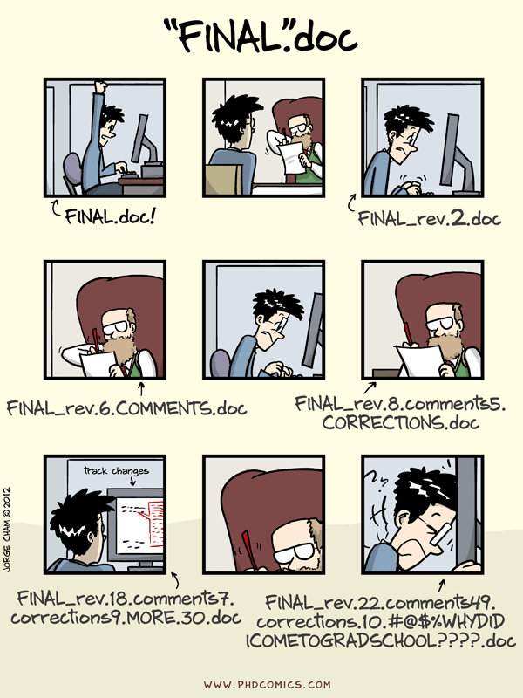
Beck, Hellerstein & VanderPlas, 2017

Slide 30
Why do I need version control?
You have a working piece of software
  You add some new features
  Everything is broken
  You want to revert to the last known working version
Beck, Hellerstein & VanderPlas, 2017

Slide 31
Why do I need version control?
You are developing software with other people
  You want to be able to identify and resolve conflicts during code development
    Two people working on the same function at the same time
  You need to be able to identify who is responsible for what pieces of code
Beck, Hellerstein & VanderPlas, 2017

Slide 32
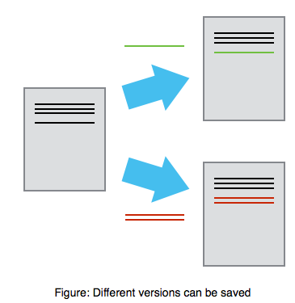
Mary
Alice
Beck, Hellerstein & VanderPlas, 2017

Slide 33
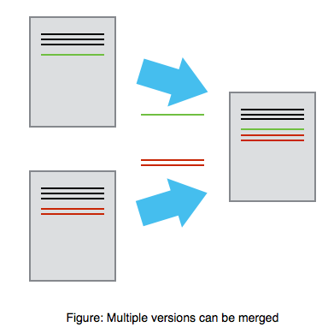
Mary
Alice
Beck, Hellerstein & VanderPlas, 2017

Slide 34
Why do I need version control?
You want a job
  No one will hire a software developer that doesn’t know how to use version control
Beck, Hellerstein & VanderPlas, 2017

Slide 35
What is git?
Git is the most popular version control software
Git is open source
Git runs on every platform
  even Plan 9 From Outer Space
Git is better than all previous version control tools (in my opinion, and I’ve used quite a few)
Beck, Hellerstein & VanderPlas, 2017

Slide 36
What is GitHub?
‘Git in the cloud’
  Your git repository lives on GitHub.com
  Other people can download and use your code
  There is an issue tracker for your code
  You can develop code collaboratively using GitHub
Beck, Hellerstein & VanderPlas, 2017

Slide 37
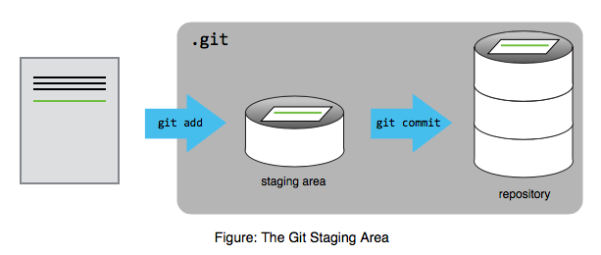
Beck, Hellerstein & VanderPlas, 2017

Slide 38
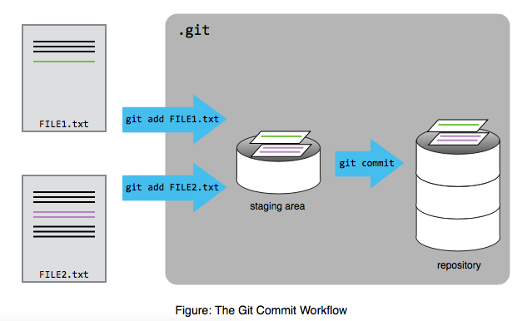
Beck, Hellerstein & VanderPlas, 2017

Slide 39
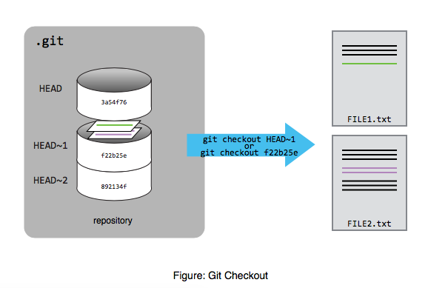
Beck, Hellerstein & VanderPlas, 2017

Slide 40
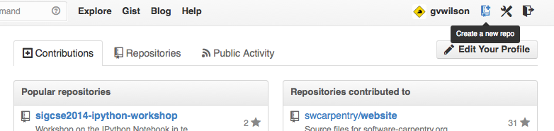
Beck, Hellerstein & VanderPlas, 2017

Slide 41
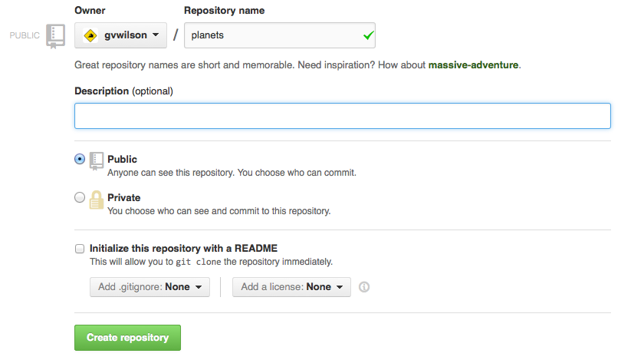
Beck, Hellerstein & VanderPlas, 2017

Slide 42
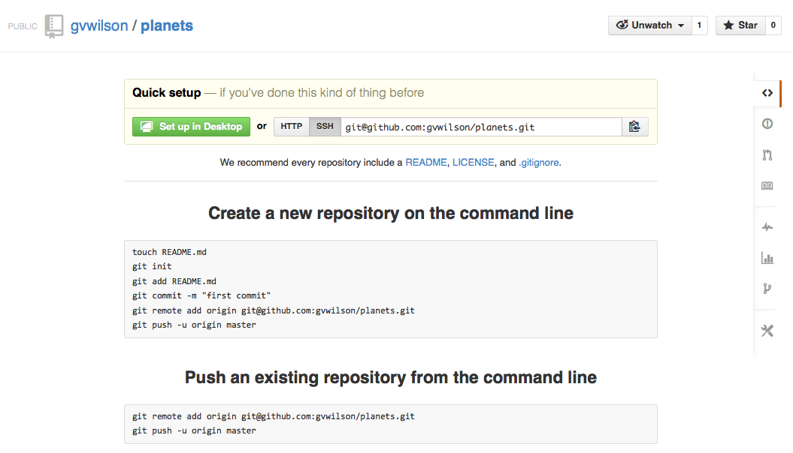
Beck, Hellerstein & VanderPlas, 2017

Slide 43
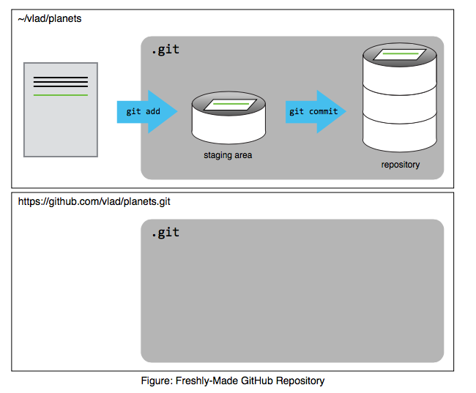
Beck, Hellerstein & VanderPlas, 2017

Slide 44
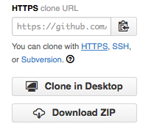
Beck, Hellerstein & VanderPlas, 2017

Slide 45
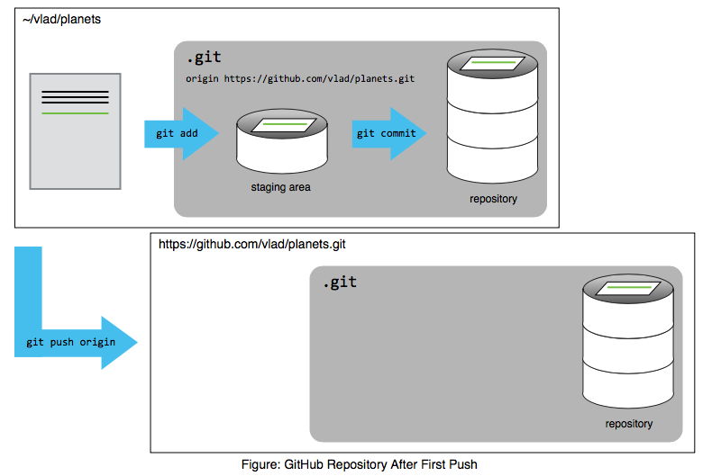
Beck, Hellerstein & VanderPlas, 2017

Slide 46
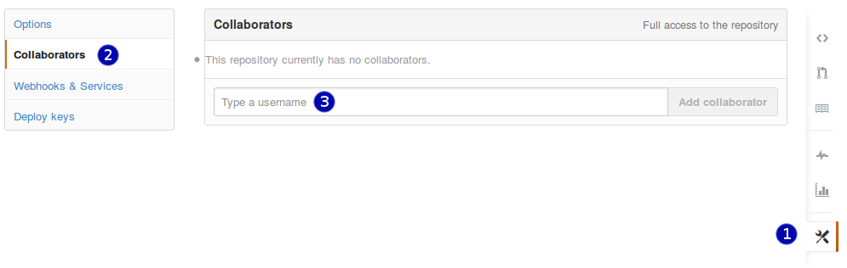
Beck, Hellerstein & VanderPlas, 2017

Slide 47
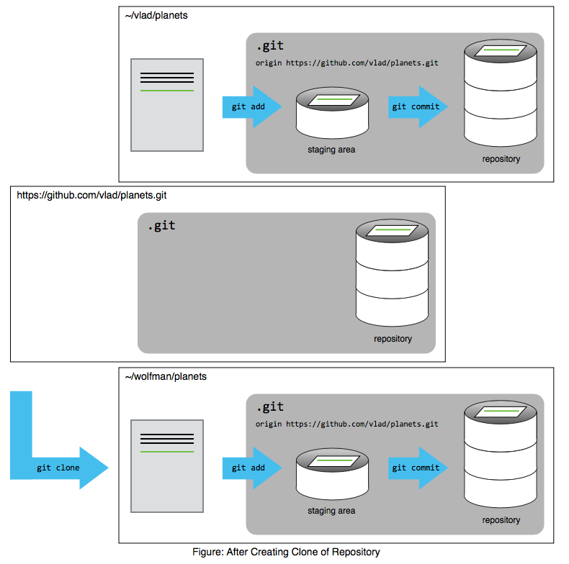
Beck, Hellerstein & VanderPlas, 2017

Slide 48
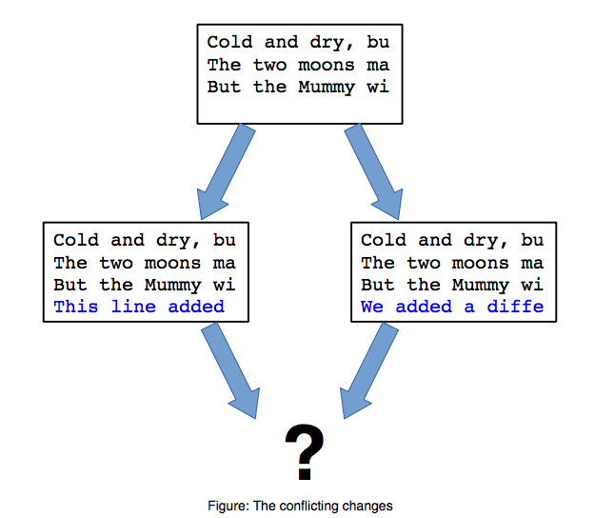
Beck, Hellerstein & VanderPlas, 2017

