Slide 1

CSE 583
Software Design for Data Scientists
Course Introduction & Data Essentials
David Beck^{1,2,3}, Joseph Hellerstein^{1,3}, Bernease Herman¹
Colin Lockard³
¹eScience Institute
²Chemical Engineering
³Computer Science
University of Washington
September 27, 2018

Slide 2
What's the class about? Who are we?
Objectives
  Teach how to create and collaborate on data- and computation-intensive research projects
  Provide practical software skills for data analysis in research & industry.
  Elevate coding in science to the level of technical writing.
Instructor introductions
Beck, Hellerstein & Herman, 2018

Slide 3
Agenda
Why data science?
Course overview
Pronto data
Getting data with shell scripts
Beck, Hellerstein & Herman, 2018

Slide 4
Why
Data Science?
Beck, Hellerstein & Herman, 2018

Slide 5
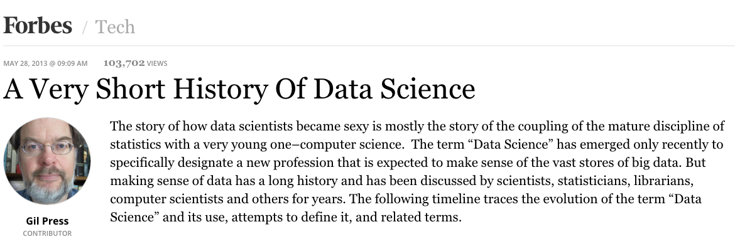
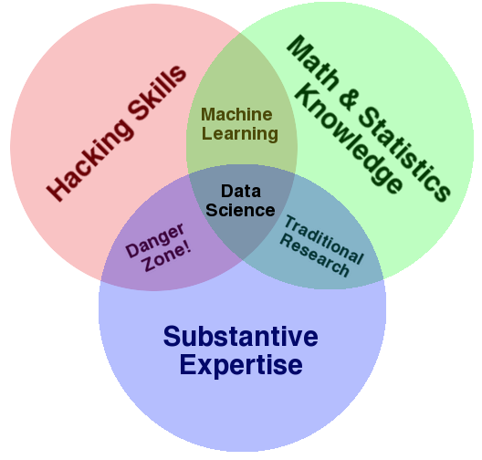
Data Science
Beck, Hellerstein & Herman, 2018

Slide 6
Course Overview
Beck, Hellerstein & Herman, 2018

Slide 7
Skills Taught
Program in python using the Python scientific stack, including numpy, pandas, and matplotlib.
Search, evaluate, and integrate into a project externally developed Python packages; create your own Python packages.
Develop unit tests that validate important aspects of the project implementation.
Develop software that it can be used by others including: shared code on github, documentation, installing packages, setup, and running computational studies.
Create technical specifications for what a program should do and how this is accomplished.
Beck, Hellerstein & Herman, 2018

Slide 8
Survey Results
Question | Response
Years of programming? | Mostly > 1 yr
Years of python? | < 1 yr
Experience with a text editor | Mostly "Yes"
Comfort with if-statements? | Yes
Comfort with for-statements? | Yes
Comfort with functions? | Mostly "Yes"
Python packages (scipy, pandas, ...) | Mostly "No"
Experience with iPython? | Very little
Experience with github? | Very little
Beck, Hellerstein & Herman, 2018

Slide 9
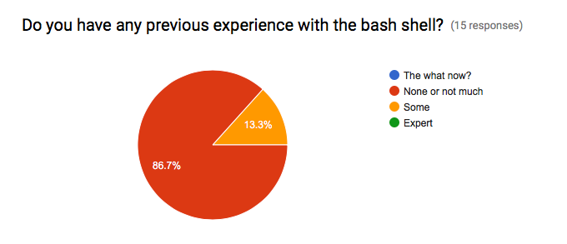
Survey Results
Beck, Hellerstein & Herman, 2018

Slide 10
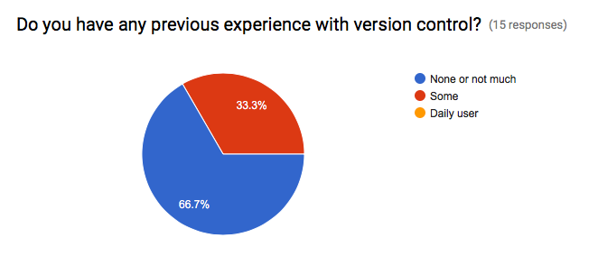
Survey Results
Beck, Hellerstein & Herman, 2018

Slide 11
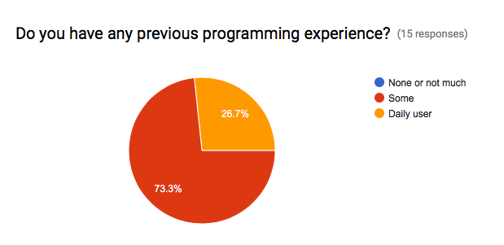
Survey Results
Beck, Hellerstein & Herman, 2018

Slide 12
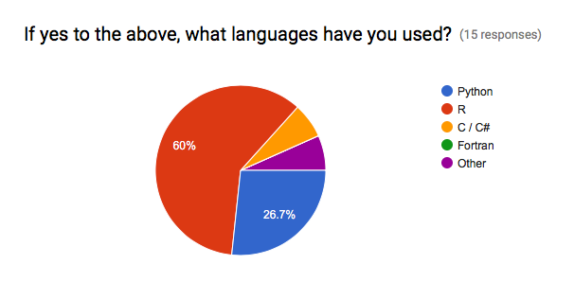
Survey Results
Beck, Hellerstein & Herman, 2018

Slide 13
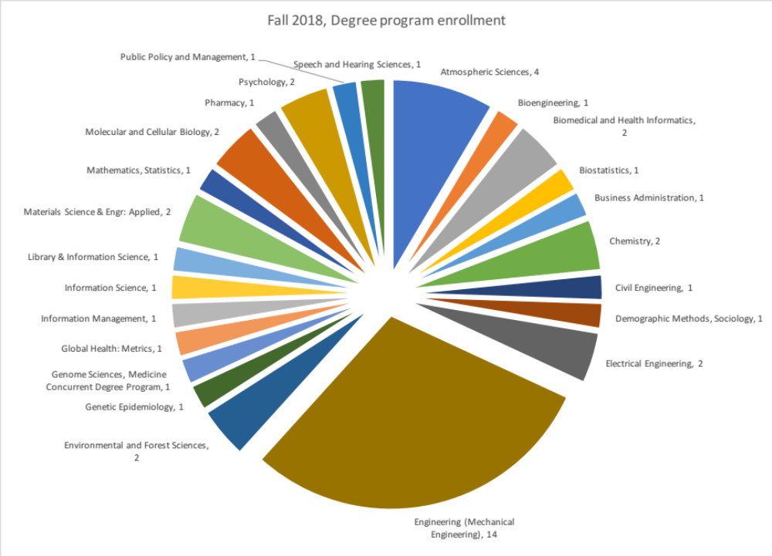
Course Registration by Field of Study
Beck, Hellerstein & Herman, 2018

Slide 14
Course Structure
http://uwseds.github.io/syllabus.html
Programming basics (3 weeks)
  Version control, Python, data manipulation
Software development (3 weeks)
  Debugging, documentation, design, collaboration
Data manipulations in detail (2 weeks)
  Visualization, machine learning
Software engineering practicum (2 weeks)
Beck, Hellerstein & Herman, 2018

Slide 15
Programming vs. Software Engineering
Analogy: What is the difference between the following kinds of writing:
  Note to yourself
  An article in the NY Times
Beck, Hellerstein & Herman, 2018

Slide 16
Relating Writing to Software
How Learn Skills
Reporter
Writing quality
Content
Structure
Review
SW Eng
Code quality
Features
Design
Testing
Freshman English
Programming
class
{
{
Composition & literature classes, professional writer
Computer Science degree, Collaborate on a big project
Beck, Hellerstein & Herman, 2018

Slide 17
CSE 583 Grading
Item | %
Homework (~7 homeworks) | 35
Class participation | 15
Class project | 50
Beck, Hellerstein & Herman, 2018
Notes:
Describe the importance of the homework and address concerns about rigidity for grad students

Slide 18
CSE 583 Grading
How we grade homework…
  You submit homework using GitHub (version control tool) by the due date
  We take up to a week to review the homework and give feedback with a GitHub Issue
  You have an additional week to revise the homework to address any weaknesses
  Your final grade for a homework given
  There is no reason you can’t get 5/5 on all HW
Beck, Hellerstein & Herman, 2018
Notes:
Describe the importance of the homework and address concerns about rigidity for grad students

Slide 19
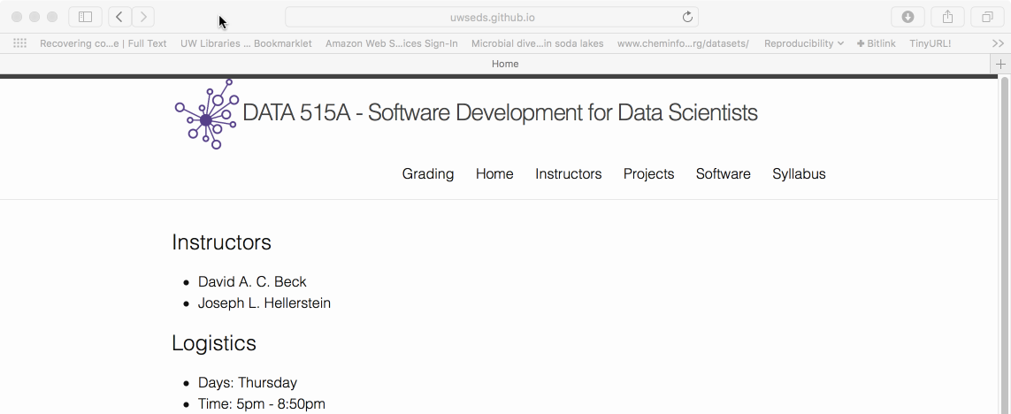
Course Web Page
http://uwseds.github.io
Beck, Hellerstein & Herman, 2018

Slide 20
Pronto Data
Beck, Hellerstein & Herman, 2018

Slide 21
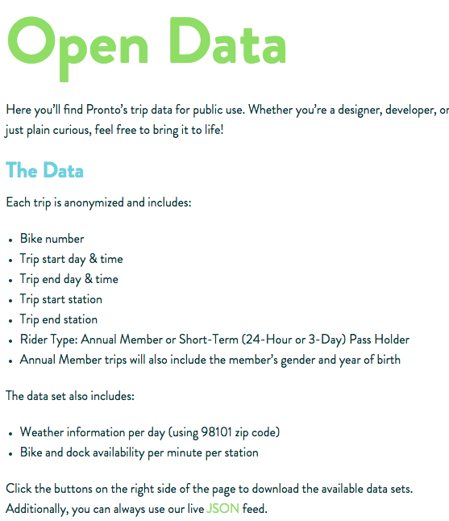

https://www.prontocycleshare.com/datachallenge
Beck, Hellerstein & Herman, 2018

Slide 22
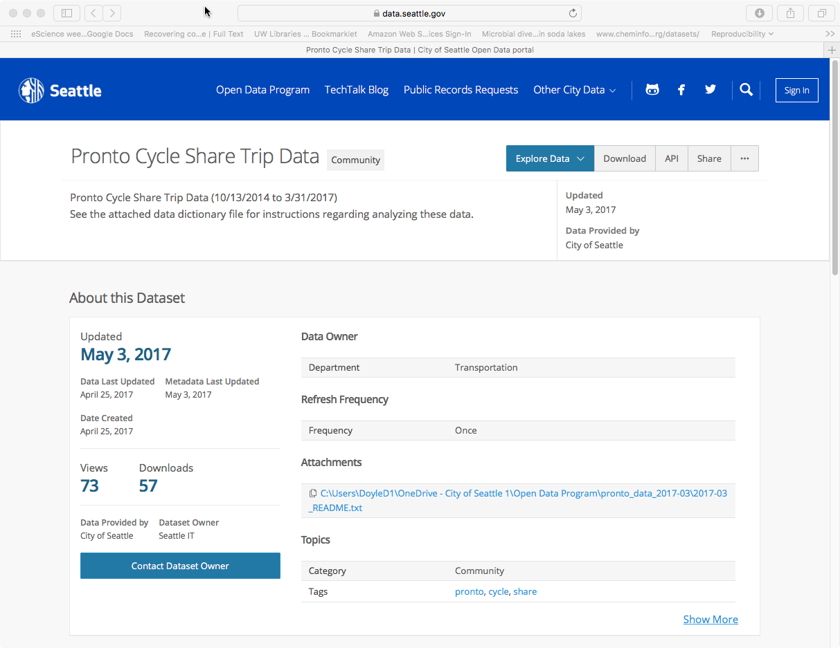
https://data.seattle.gov/Community/Pronto-Cycle-Share-Trip-Data/tw7j-dfaw
Beck, Hellerstein & Herman, 2018

Slide 23
Fields in Pronto Data
Variable | Data Type | Units
trip_id | Int64
starttime | datetime64
stoptime | datetime64
bikeid | string | Coded (e.g., "SEA00298")
tripduration | float | Seconds
from_station_name | string | Address
to_station_name | string | Address
from_station_id | string | Coded (e.g., "PS-04")
to_station_id | string | Coded (e.g., "PS-04")
usertype | string | Coded (e.g., "Annual Member")
gender | string | Coded (e.g., "Male")
Beck, Hellerstein & Herman, 2018

Slide 24
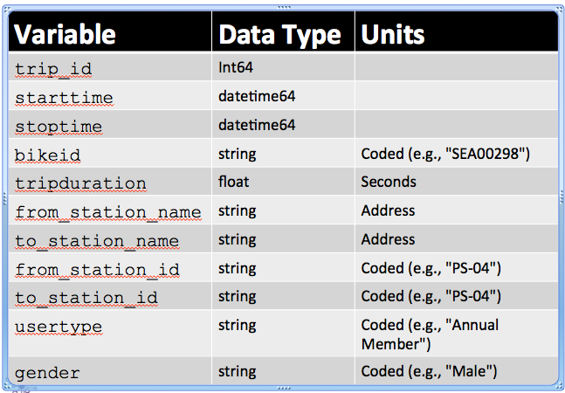
Data Considerations
Do similar fields have the same data type and/or code (e.g., from_station_id, to_station_id)?
Do coded data have useful information hidden in the codes (e.g., "PS-04")?
How merge with other data (e.g., weather)?
Beck, Hellerstein & Herman, 2018

Slide 25
Data Schema
"Meta data" – describes the data
  data types
  units
  "keys" (how relate one data set to another)
Beck, Hellerstein & Herman, 2018

Slide 26
Getting Data With Shell Scripts
Beck, Hellerstein & Herman, 2018

Slide 27


File System Basics
File – container of data
Directory – container of files and directories
Directories are organized into a tree
Current directory
Data
README
File
Directory
Pronto
File
Beck, Hellerstein & Herman, 2018

Slide 28
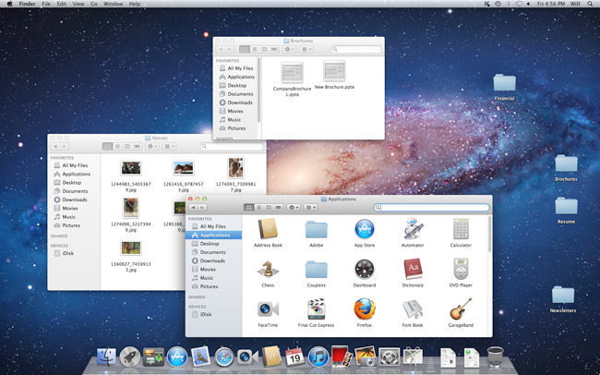
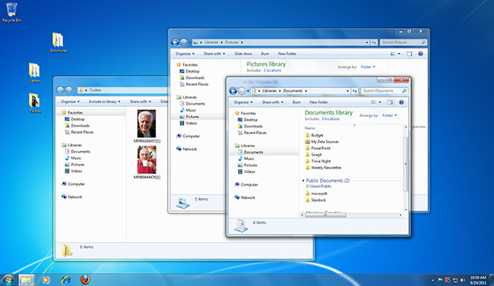
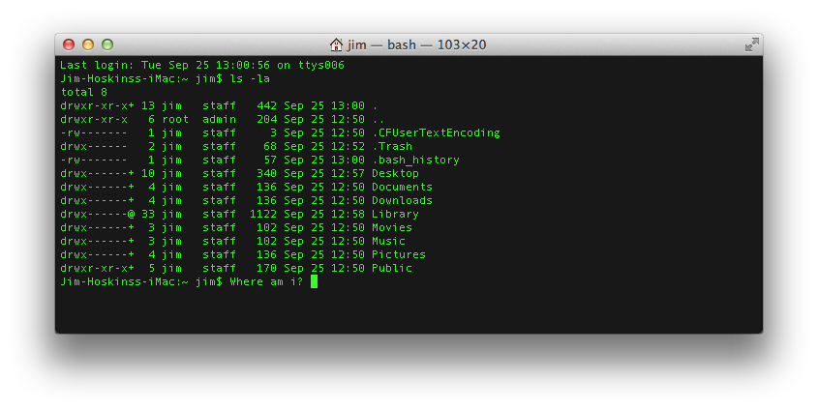
Command Line Tools
Graphical User Interface (GUI)
Command Line Interface (CLI)
Beck, Hellerstein & Herman, 2018

Slide 29
Command Line Tools
What is the command line?
  Also known as a ‘shell’
  Most common is bash (what we will use)
    Bourne Again Shell
    Reimplementation of a shell from 1977
    Every OS/X Mac
    Every Linux
    Every supercomputer
  For later…
    Programming language itself!
Beck, Hellerstein & Herman, 2018

Slide 30
Command Line Tools
Where is the command line?
  Mac (pre-installed)
    Applications -> Utilities -> Terminal
  Windows (after install Git / Bash)
    Start -> Git -> Git Bash
(See the "software" tab of the course web page to install Gitbash.)
Beck, Hellerstein & Herman, 2018

Slide 31
Command Line Tools
Commands take arguments (stuff after cmd.)
  Arguments alter the function of commands, e.g.
    Specify what file to use as input
  Many commands accept the special argument to return help, usually one of
    --help
    -help
    -h
Tab completion is your friend!
  When entering file arguments
  Hitting tab key will autocomplete the filename
Beck, Hellerstein & Herman, 2018

Slide 32
Commands for Files & Directories
By category
  Create
    Directory: mkdir
    File: various (e.g., cp)
  View contents
    Directory: ls
    File: cat
  Remove
    Directory: rmdir
    File: rm
Data
README
Pronto
Beck, Hellerstein & Herman, 2018

Slide 33
Demo
Create the project directory structure and README
Get the pronto data from the Internet, https://data.seattle.gov/api/views/tw7j-dfaw/rows.csv?accessType=DOWNLOAD
Unpack the data
  Comma separated variable (CSV) files
Automate the workflow using a shell script
Beck, Hellerstein & Herman, 2018

Slide 34
Useful Shell Commands
Command | Task | Example usage
ls | List files | ls
cp | Copy files | cp original_file new_file
mv | Move / rename files | mv original_file new_file
rm | Remove / delete files | rm original_file
cd | Change directory | cd some_directory
pwd | Print working / current directory | pwd
mkdir | Create directory | mkdir some_directory
rmdir | Remove / delete directory | rmdir some_directory
cat | View files | cat some_file
head | View begining of file | head some_file
tail | View end of file | tail some_file
grep | Search file for matching lines | grep search.text some_file
sort | Sort lines | sort some_file
uniq | Print unique lines | uniq some_file
diff | Compare to files | diff original_file new_file
unzip | Uncompress a file | unzip compressed_file.zip
curl | Download a file using its URL | curl some URL
  Also see http://www.pixelbeat.org/cmdline.html
  Also search shell + <cmd name>
Beck, Hellerstein & Herman, 2018

Slide 35
Lecture Review: Data Essentials
Structure of data
  Schema
  File format (CSV)
File systems (directories, files)
Terminal sessions
Shell commands
  File system operations (create, view, delete)
  Data access (download URL, decompress)
Beck, Hellerstein & Herman, 2018

