Slide 1

CSE 599 B1
Software Engineering for Data Scientists
Working in Teams
David Beck^{1,2}, Joseph Hellerstein^{1,3}, Jake VanderPlas^{1,4}
De Dennis Meng⁵ (TA)
¹eScience Institute
²Chemical Engineering
³Computer Science Engineering
⁴Astronomy
⁵Electrical Engineering
The University of Washington
February 17, 2016

Slide 2
Agenda
Software licenses
Software development overview
Team process with in-class exercises:
  Code reviews (15 min)
  Technology review (25 min)
  Status standup (10 min)
Beck, Hellerstein & VanderPlas, 2016

Slide 3
Software Licenses
Beck, Hellerstein & VanderPlas, 2016

Slide 4
Overview of Software Licenses*
A software license is a legal instrument (usually by way of contract law, with or without printed material) governing the use or redistribution of software. Under United States copyright law all software is copyright protected, in source code as also object code form. The only exception is software in the public domain. A typical software license grants the licensee, typically an end-user, permission to use one or more copies of software in ways where such a use would otherwise potentially constitute copyright infringement of the software owner's exclusive rights under copyright law.
*Mark Webbink
Beck, Hellerstein & VanderPlas, 2016

Slide 5
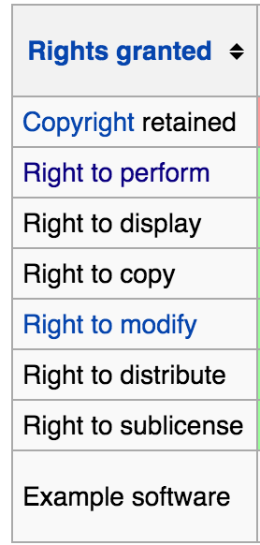
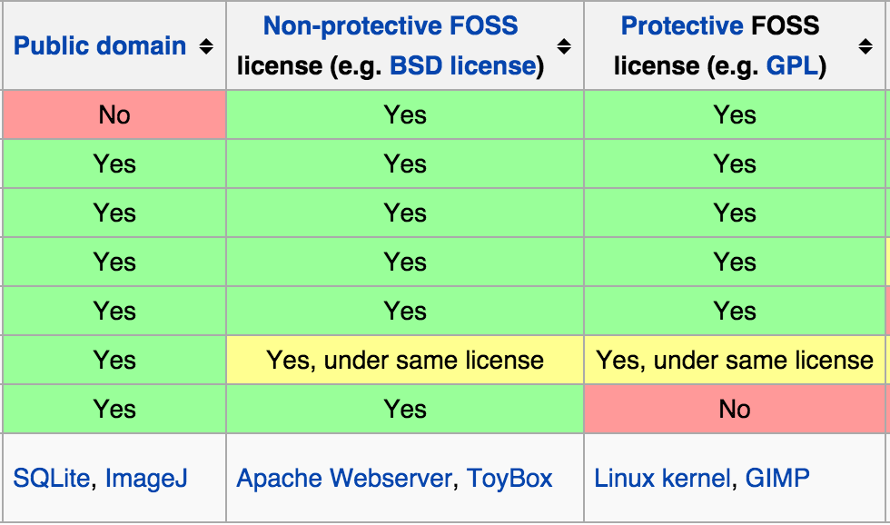
Software Licenses*
FOSS = Free and Open Source Software
*Mark Webbink
Beck, Hellerstein & VanderPlas, 2016

Slide 6
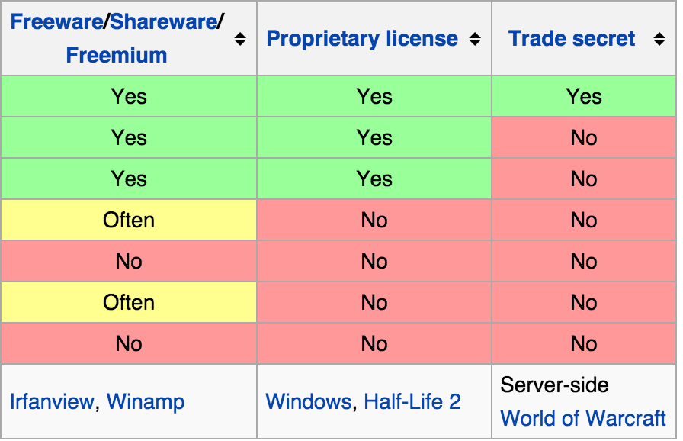
Software Licenses*
The default (no license): No rights are granted.
*Mark Webbink
Beck, Hellerstein & VanderPlas, 2016

Slide 7
Software Development Overview
Beck, Hellerstein & VanderPlas, 2016

Slide 8
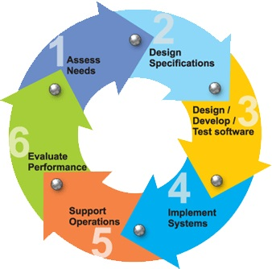
Software Development Phases
Beck, Hellerstein & VanderPlas, 2016

Slide 9
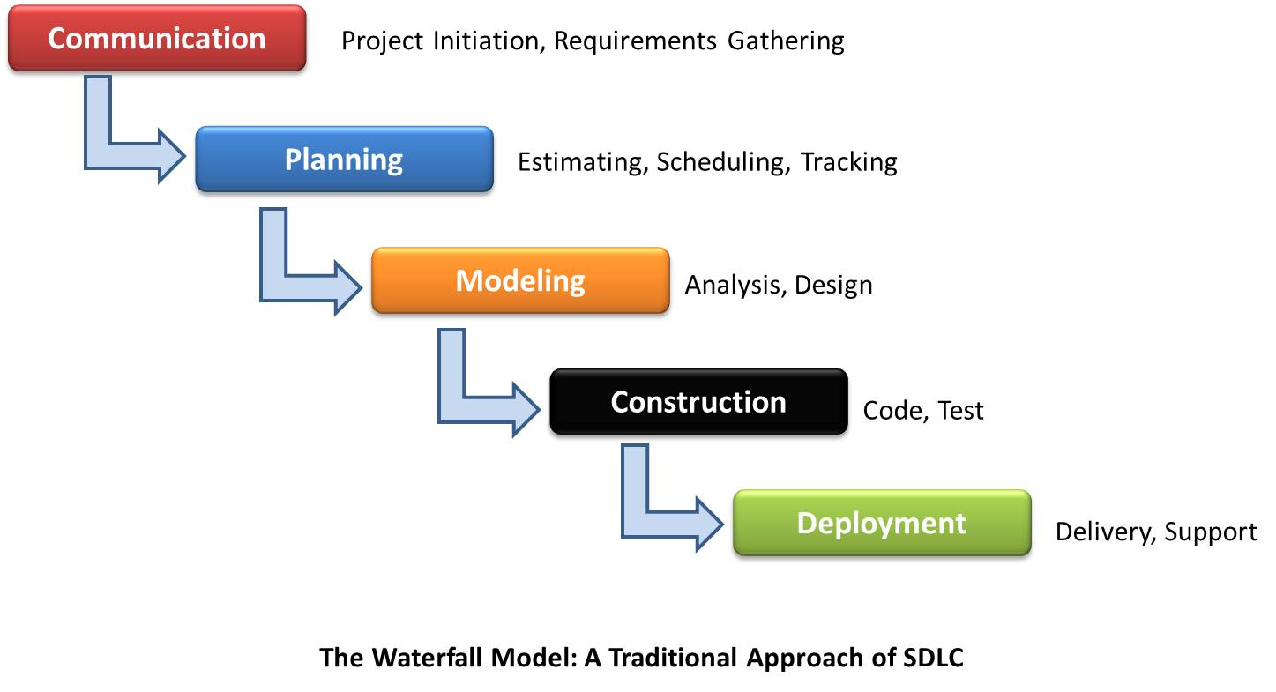
Waterfall Process Model
Software
Development
Why does this work poorly?
Beck, Hellerstein & VanderPlas, 2016

Slide 10
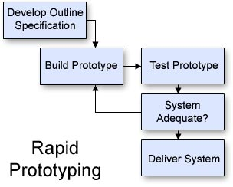
Rapid Prototyping
Why?
  Cannot specify all requirements in advance
Revise the specification
Software
Development
Beck, Hellerstein & VanderPlas, 2016

Slide 11
Team Process
Beck, Hellerstein & VanderPlas, 2016

Slide 12
Team Activities
Revise the
specification
Requirements gathering
Design
  Technology assessments
  Write specifications
  Review specification
Implementation
  Code
  Code review
Bug prioritization and resolution
Standups (status update)
Beck, Hellerstein & VanderPlas, 2016

Slide 13
Code Review Template
Why code review?
  Improve code quality and find bugs
Background
  Describe what the application does
  Describe the role of the code being reviewed
Comment on
  Choice of variable and function names
  Readability of the code
  How improve reuse and efficiency
  How use existing python packages
Beck, Hellerstein & VanderPlas, 2016

Slide 14
Code Review for SciSheets evaluate()
SciSheets is a spreadsheet system in which formulas are python expressions
  Columns are numpy arrays
evaluate() assigns values to all columns in a table
  No apriori knowledge of logical dependencies between columns
  Must return meaningful error to the spreadsheet user
Beck, Hellerstein & VanderPlas, 2016

Slide 15
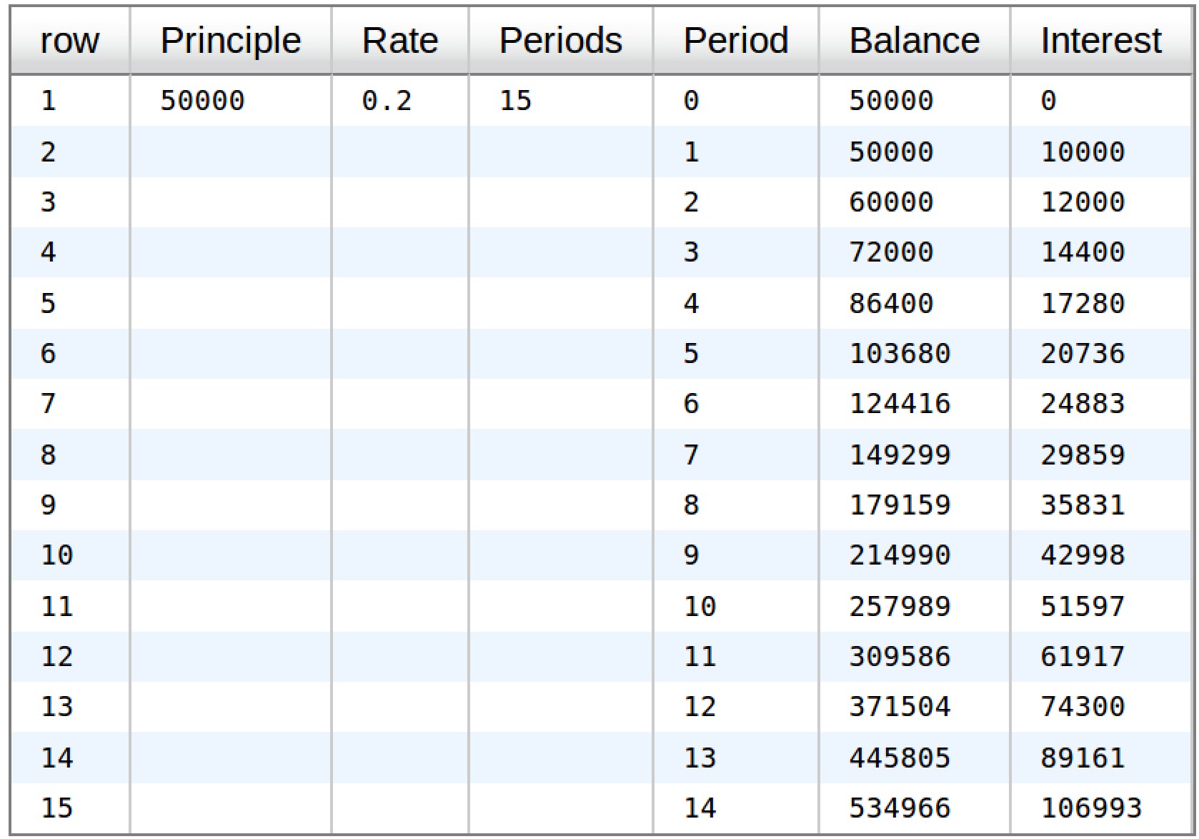
SciSheet Example: Compound Interest
Beck, Hellerstein & VanderPlas, 2016

Slide 16
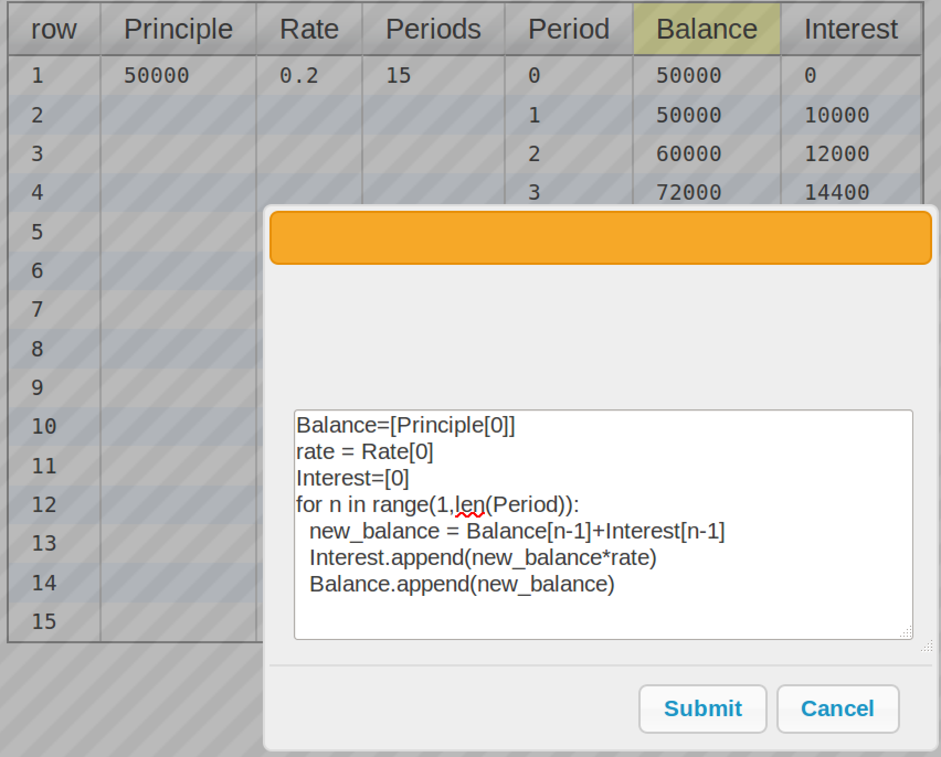
SciSheet Formula for Balance Column
Beck, Hellerstein & VanderPlas, 2016

Slide 17
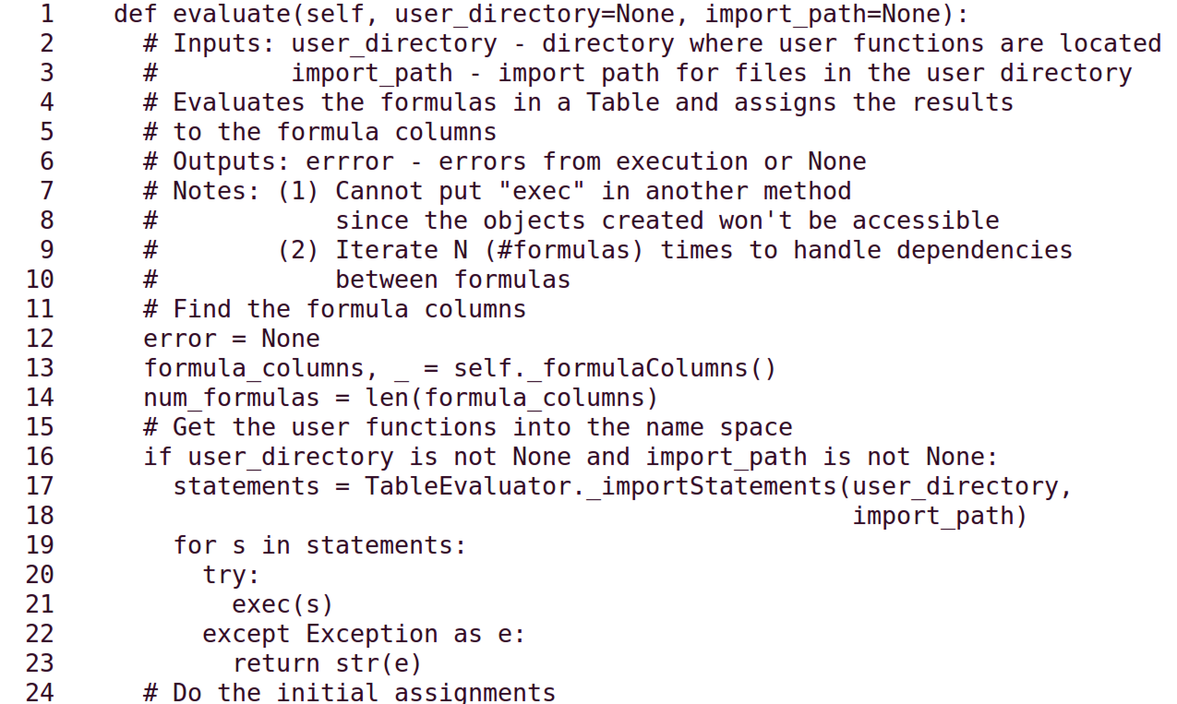
Beck, Hellerstein & VanderPlas, 2016

Slide 18
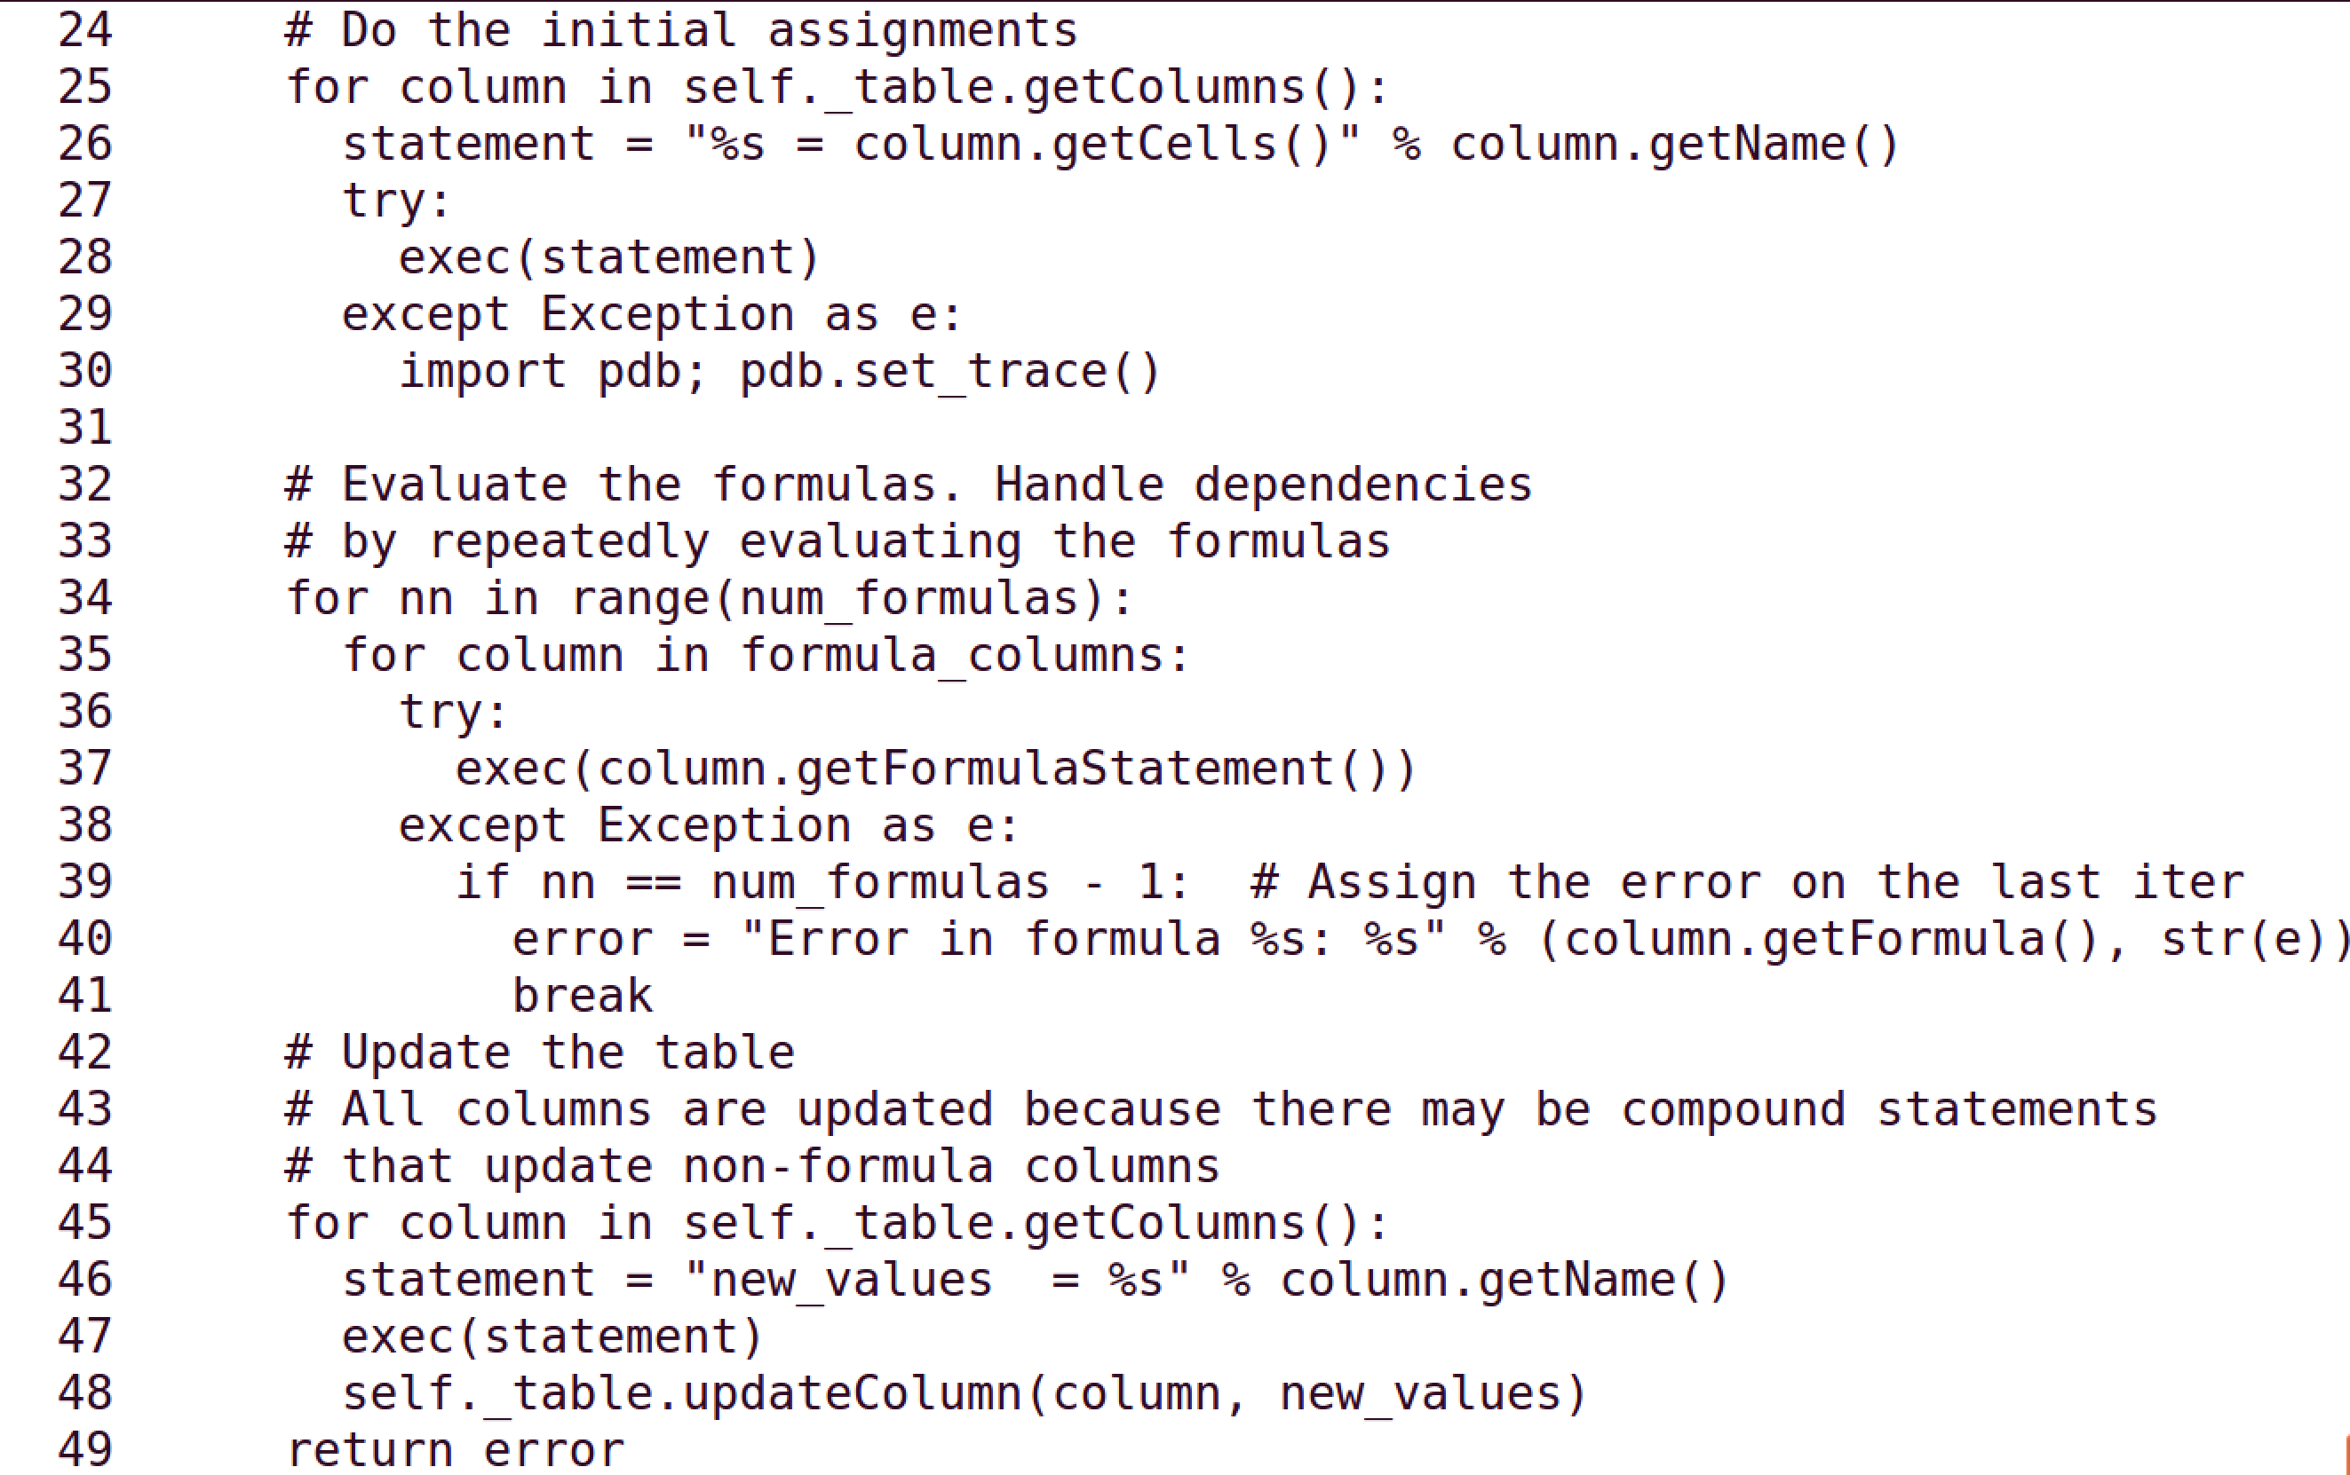
Beck, Hellerstein & VanderPlas, 2016

Slide 19
Team Exercise: 15 minutes
Team Breakout (10 min)
  Review evaluate() based on code review template
Breakout reports (5 min)
Beck, Hellerstein & VanderPlas, 2016

Slide 20
Technology Review Template
Why technology reviews?
  Determine if use a package
Background
  Requirements that indicate a need for the proposed package
Discuss
  How the package works
  Appeal of using the package
  Drawbacks of using the package
Beck, Hellerstein & VanderPlas, 2016

Slide 21
Example of A Technology Review
Antimony Package for Kinetics Modeling
Background
  Need kinetics models to explore certain what-if questions in chemical systems.
Beck, Hellerstein & VanderPlas, 2016

Slide 22
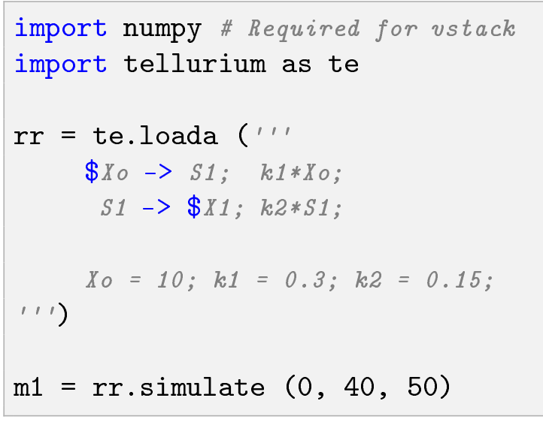
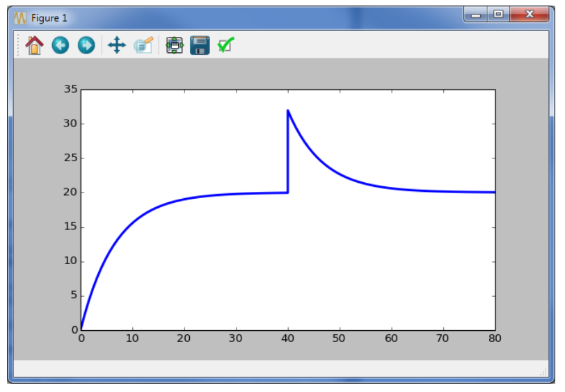
Using Antimony
Kinetics model is a python string
Perturbation of S1
Beck, Hellerstein & VanderPlas, 2016

Slide 23
Assessment of Antimony
Appeal
  Readable kinetics models
  Can use python with Antimony
  Exports to and imports from SBML (systems biology modeling language)
Drawbacks
  Poor support for the package
  Scaling may be a problem
Beck, Hellerstein & VanderPlas, 2016

Slide 24
Team Exercise: 25 minutes
Team breakouts (20 min)
  Identify a technology that may use in project
    Pick within 5 minutes
  Complete the technology review template
Breakout reports (5 min)
Beck, Hellerstein & VanderPlas, 2016

Slide 25
Standup Template
Why standups?
  Communicate status and actions within and between teams
Should be presented in 1-2 minutes
Progress this period
  How it compares with the plan
  If behind plan, how compensate to make plan end date
Deliverables for next period
Challenges to making next deliverables such as:
  Technology uncertainties and blockers
  Team issues
Beck, Hellerstein & VanderPlas, 2016

Slide 26
Team Exercise: 10 minutes
Team breakouts (5 min)
  Draft a standup report
Breakout reports (5 min)
Beck, Hellerstein & VanderPlas, 2016

