Slide 1

Lessons learned from teaching
Software Design for Data Scientists
David Beck^{1,2,3}, Joseph Hellerstein^{1,3}, Bernease Herman¹ , Jake vanderPlas^{1,3}
¹eScience Institute
²Chemical Engineering
³Computer Science
University of Washington
October 11, 2018

Slide 2
Overview
Motivation & course objectives
How we got to this point (hint: teaching a lot)
Student backgrounds
Challenges & advantages in our setting
Overall course structure
Closing thoughts
Questions / suggestions

Slide 3
Motivation
Academia is littered with lots of poorly written, abandoned, unsustainable software
Industry demands repeatable computationally verifiable software tools written by engineers to advance business goals

Slide 4
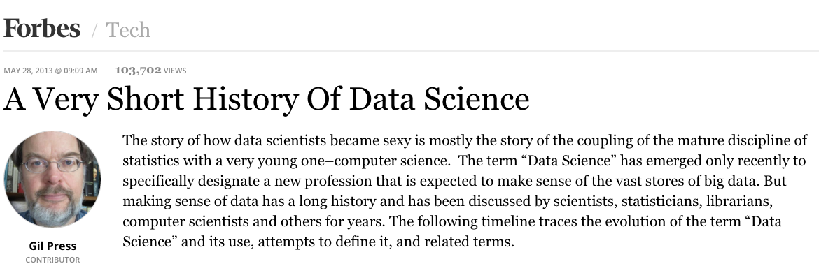
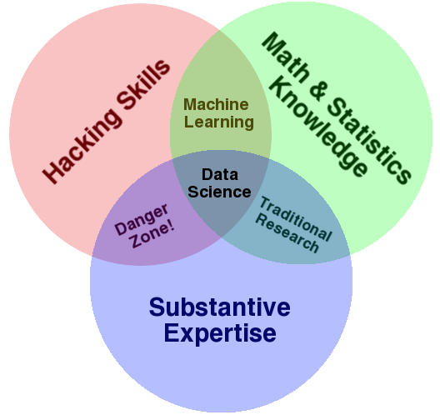
Data Science: The Danger Zone!
https://escience.washington.edu/data-science-courses-at-the-university-of-washington/

Slide 5
Course objectives
Teach how to create and collaborate on data- and computation-intensive research projects
Provide practical software skills for data analysis in research & industry
Elevate coding in science to the level of technical writing

Slide 6
Lessons from experience
Joe & Dave taught CSE 491 – Quantitative Software Skills for Biologists (‘14)
Joe, Jake & Dave taught CSE 583 in the Fall (’15, ‘16, ‘17, ‘18)
Joe & Dave taught DATA 515 in the Spring (‘17, ‘18)
Dave taugh CHEME 546 in Winter (‘17, ‘18)

Slide 7
Typical student background
Several years ago we did a pre-course survey

Slide 8
Survey Results
Question | Response
Years of programming? | Mostly > 1 yr
Years of python? | < 1 yr
Experience with a text editor | Mostly "Yes"
Comfort with if-statements? | Yes
Comfort with for-statements? | Yes
Comfort with functions? | Mostly "Yes"
Python packages (scipy, pandas, ...) | Mostly "No"
Experience with iPython? | Very little
Experience with github? | Very little

Slide 9
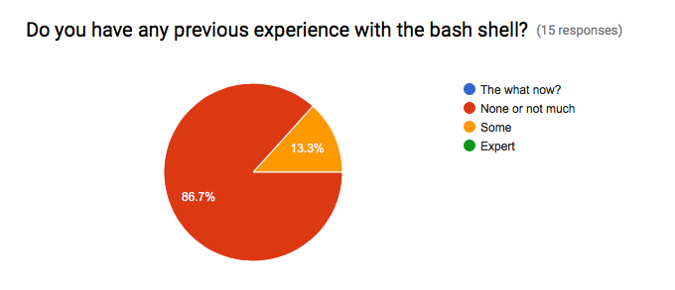
Survey Results

Slide 10
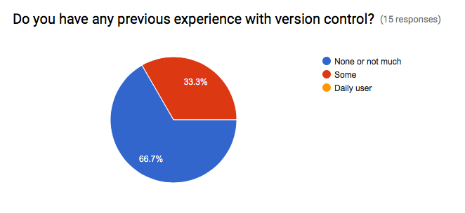
Survey Results

Slide 11
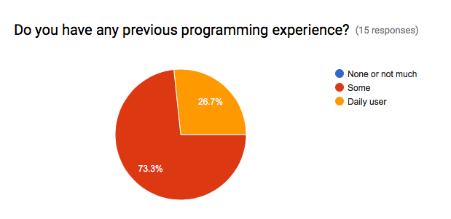
Survey Results

Slide 12
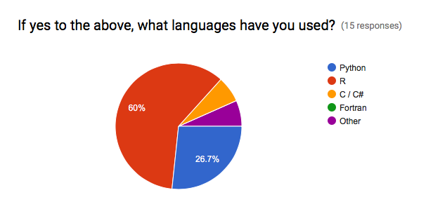
Survey Results

Slide 13
Discipline areas of students
Fall of 2018 is representative
50 students / quarter
Most students come from across disciplines
Occasionally, one department has significant enrollment, e.g. ChemE, Civil E, Oceanography

Slide 14
Course Registration by Field of Study

Slide 15
Challenges
Aim for baseline of 0
Teach to students with:
None or minimal programming
No command line experience
No version control knowledge
Lots of good ideas and a desire to learn
Need to integrate concepts into all course activities, e.g. version control for homework, peer communication during in class exercises

Slide 16
Advantages
Active learning classrooms = engaged students

Slide 17
Advantages
TA support + three instructors = lots of per student contact time
50 students with a range of backgrounds can be demanding
TAs help spread the support load
TAs bring their own experience and often author and deliver content

Slide 18
Overall course structure
Discuss current sequence by reviewing syllabus
Mention sequencing issues, e.g. when to do version control & documentation / style
How to rectify bad habbits

Slide 19
Example projects

Slide 20
Closing thoughts
Don’t teach on Monday in Winter quarter (holidays reduce contact time by up to 20%)

Slide 21
Why we didn’t MOOCify
Coursera does not have the ability to handle group projects in the way we wanted
$$$

Slide 22
Questions / suggestions?

Slide 23
Remaining slides are left from lecture 01

Slide 24
Course Overview
24

Slide 25
Skills Taught
Program in python using the Python scientific stack, including numpy, pandas, and matplotlib.
Search, evaluate, and integrate into a project externally developed Python packages; create your own Python packages.
Develop unit tests that validate important aspects of the project implementation.
Develop software that it can be used by others including: shared code on github, documentation, installing packages, setup, and running computational studies.
Create technical specifications for what a program should do and how this is accomplished.

Slide 26
Course Structure
http://uwseds.github.io/syllabus.html
Programming basics (3 weeks)
Version control, Python, data manipulation
Software development (3 weeks)
Debugging, documentation, design, collaboration
Data manipulations in detail (2 weeks)
Visualization, machine learning
Software engineering practicum (2 weeks)

Slide 27
Programming vs. Software Engineering
Analogy: What is the difference between the following kinds of writing:
Note to yourself
An article in the NY Times
27

Slide 28
Relating Writing to Software
How Learn Skills
Reporter
Writing quality
Content
Structure
Review
SW Eng
Code quality
Features
Design
Testing
Freshman English
Programming
class
{
{
Composition & literature classes, professional writer
Computer Science degree, Collaborate on a big project
28

Slide 29
CSE 583 Grading
Item | %
Homework (~7 homeworks) | 35
Class participation | 15
Class project | 50
29
Notes:
Describe the importance of the homework and address concerns about rigidity for grad students

Slide 30
CSE 583 Grading
How we grade homework…
You submit homework using GitHub (version control tool) by the due date
We take up to a week to review the homework and give feedback with a GitHub Issue
You have an additional week to revise the homework to address any weaknesses
Your final grade for a homework given
There is no reason you can’t get 5/5 on all HW
30
Notes:
Describe the importance of the homework and address concerns about rigidity for grad students

Slide 31
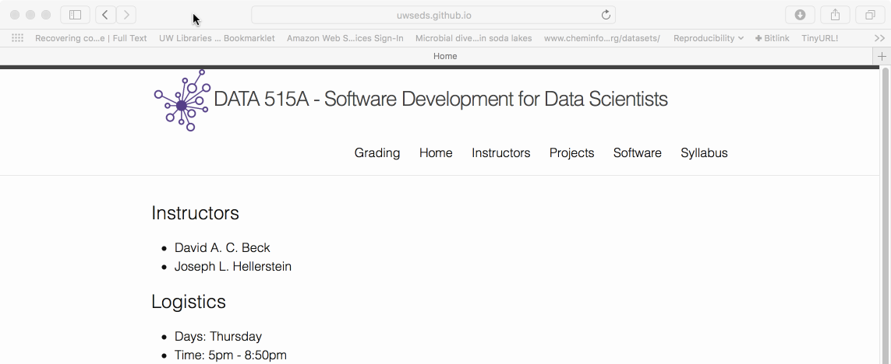
Course Web Page
http://uwseds.github.io
31

Slide 32
Pronto Data
32

Slide 33
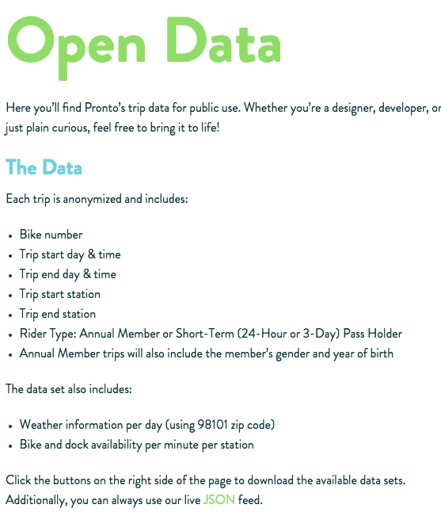

https://www.prontocycleshare.com/datachallenge

Slide 34
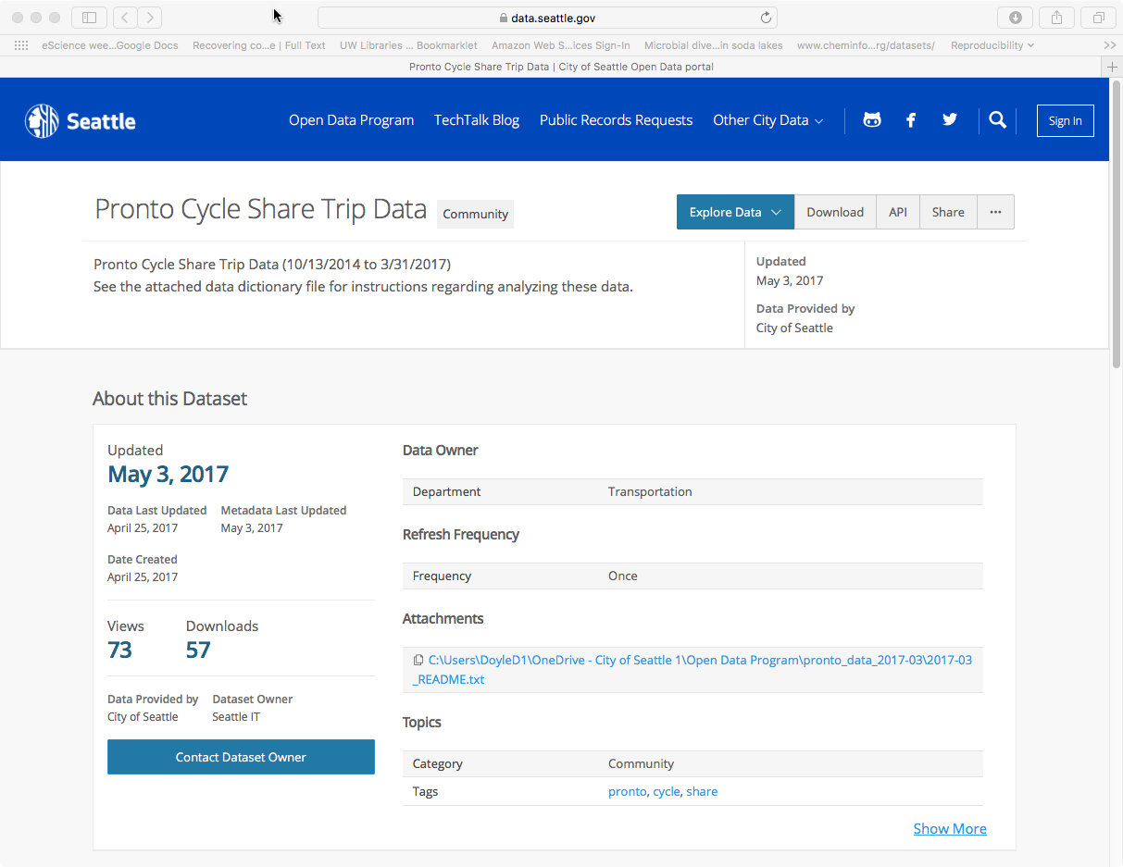
https://data.seattle.gov/Community/Pronto-Cycle-Share-Trip-Data/tw7j-dfaw

Slide 35
Fields in Pronto Data
Variable | Data Type | Units
trip_id | Int64
starttime | datetime64
stoptime | datetime64
bikeid | string | Coded (e.g., "SEA00298")
tripduration | float | Seconds
from_station_name | string | Address
to_station_name | string | Address
from_station_id | string | Coded (e.g., "PS-04")
to_station_id | string | Coded (e.g., "PS-04")
usertype | string | Coded (e.g., "Annual Member")
gender | string | Coded (e.g., "Male")

Slide 36
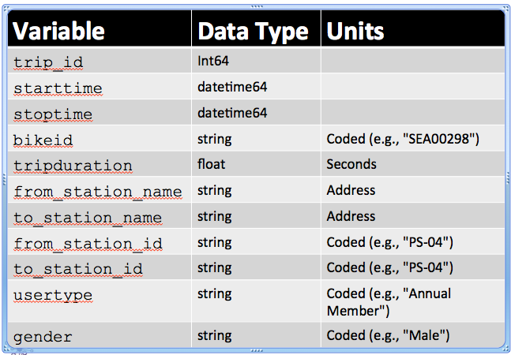
Data Considerations
Do similar fields have the same data type and/or code (e.g., from_station_id, to_station_id)?
Do coded data have useful information hidden in the codes (e.g., "PS-04")?
How merge with other data (e.g., weather)?

Slide 37
Data Schema
"Meta data" – describes the data
data types
units
"keys" (how relate one data set to another)

Slide 38
Getting Data With Shell Scripts
38

Slide 39


File System Basics
File – container of data
Directory – container of files and directories
Directories are organized into a tree
Current directory
Data
README
File
Directory
Pronto
File

Slide 40
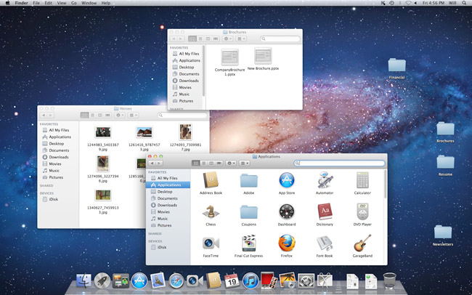
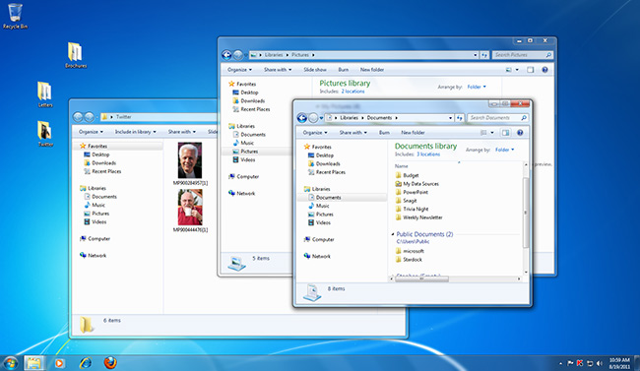
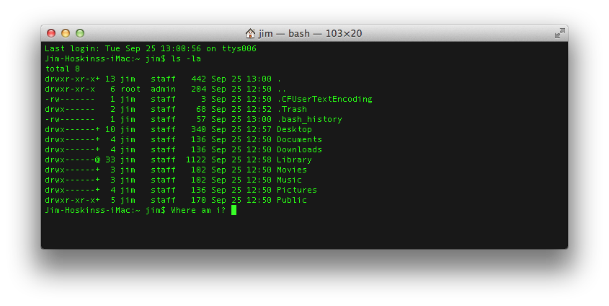
Command Line Tools
Graphical User Interface (GUI)
Command Line Interface (CLI)

Slide 41
Command Line Tools
What is the command line?
Also known as a ‘shell’
Most common is bash (what we will use)
Bourne Again Shell
Reimplementation of a shell from 1977
Every OS/X Mac
Every Linux
Every supercomputer
For later…
Programming language itself!

Slide 42
Command Line Tools
Where is the command line?
Mac (pre-installed)
Applications -> Utilities -> Terminal
Windows (after install Git / Bash)
Start -> Git -> Git Bash
(See the "software" tab of the course web page to install Gitbash.)

Slide 43
Command Line Tools
Commands take arguments (stuff after cmd.)
Arguments alter the function of commands, e.g.
Specify what file to use as input
Many commands accept the special argument to return help, usually one of
--help
-help
-h
Tab completion is your friend!
When entering file arguments
Hitting tab key will autocomplete the filename

Slide 44
Commands for Files & Directories
By category
Create
Directory: mkdir
File: various (e.g., cp)
View contents
Directory: ls
File: cat
Remove
Directory: rmdir
File: rm
Data
README
Pronto

Slide 45
Demo
Create the project directory structure and README
Get the pronto data from the Internet, https://data.seattle.gov/api/views/tw7j-dfaw/rows.csv?accessType=DOWNLOAD
Unpack the data
Comma separated variable (CSV) files
Automate the workflow using a shell script

Slide 46
Useful Shell Commands
Command | Task | Example usage
ls | List files | ls
cp | Copy files | cp original_file new_file
mv | Move / rename files | mv original_file new_file
rm | Remove / delete files | rm original_file
cd | Change directory | cd some_directory
pwd | Print working / current directory | pwd
mkdir | Create directory | mkdir some_directory
rmdir | Remove / delete directory | rmdir some_directory
cat | View files | cat some_file
head | View begining of file | head some_file
tail | View end of file | tail some_file
grep | Search file for matching lines | grep search.text some_file
sort | Sort lines | sort some_file
uniq | Print unique lines | uniq some_file
diff | Compare to files | diff original_file new_file
unzip | Uncompress a file | unzip compressed_file.zip
curl | Download a file using its URL | curl some URL
Also see http://www.pixelbeat.org/cmdline.html
Also search shell + <cmd name>

Slide 47
Lecture Review: Data Essentials
Structure of data
Schema
File format (CSV)
File systems (directories, files)
Terminal sessions
Shell commands
File system operations (create, view, delete)
Data access (download URL, decompress)

