Slide 1

DATA 515 A
Software Design for Data Scientists Introduction to Version Control part 1
David Beck^{1,2}, Joseph Hellerstein^{1,3}, Jake VanderPlas^{1,4}
Jay Garlapati³
¹eScience Institute
²Chemical Engineering
³Computer Science Engineering
⁴Astronomy
University of Washington
April 6, 2017

Slide 2
Review
In the shell, how do I
List the contents of a directory
Change the current directory
Find out the current directory
What is .?
What is ..?
What is …?
2

Slide 3
Review
In the shell, how do I
Display the contents of a file?
Display the first few lines of a file?
Start Jupyter notebooks?
Rename a file?
Copy a file?
Delete a file?
3

Slide 4
Review
In Python,
What kind of data structure is (42, ”hi”, 32)?
What kind of DS is [ “foo”, “bar”, 42 ]?
What kind of DS is { “Dave” : ”instructor, “Joe” : “instructor”, “Anqi” : student }
4

Slide 5
Agenda
What is version control?
Why do I need version control?
What are git and GitHub?
Hands-on guided tour
5

Slide 6
What is version control?
Writing a manuscript…
Use undo to revert to a previous state
Use track changes when sharing doc with your advisor
6

Slide 7
What is version control?
Version control is like a combination of undo and track changes for your code
You can revert to previous versions of code
You can easily identify who contributed what
Version control is about tracking versions of code and developing software with people
7

Slide 8
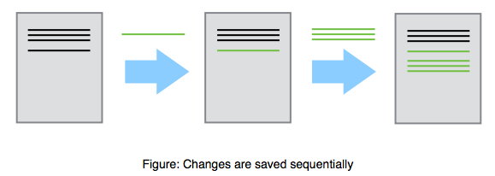
8

Slide 9
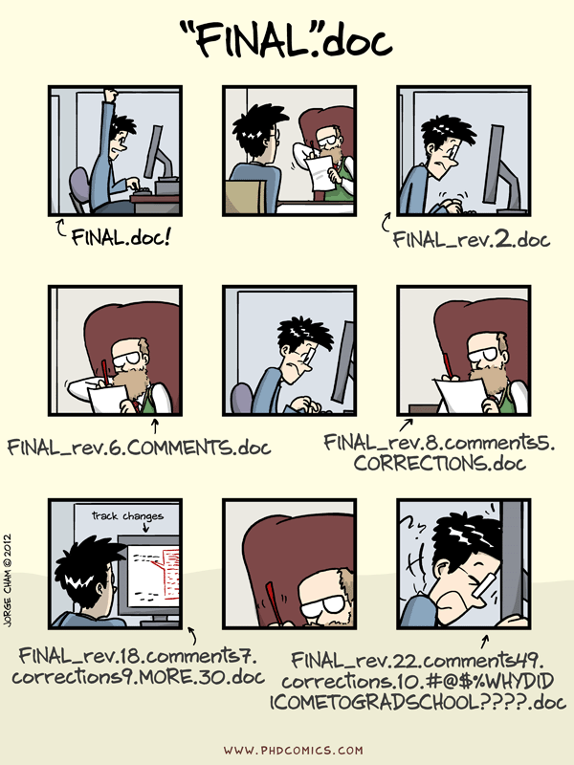
9

Slide 10
Why do I need version control?
You have a working piece of software
You add some new features
Everything is broken
You want to revert to the last known working version
10

Slide 11
Why do I need version control?
You are developing software with other people
You want to be able to identify and resolve conflicts during code development
Two people working on the same function at the same time
You need to be able to identify who is responsible for what pieces of code
11

Slide 12
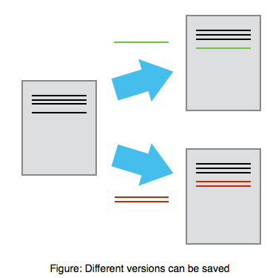
Mary
Alice
12

Slide 13
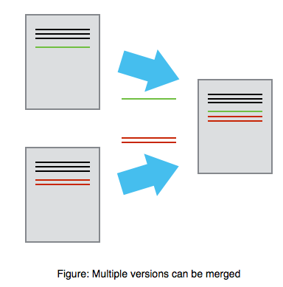
Mary
Alice
13

Slide 14
Why do I need version control?
You want a job
No one will hire a software developer that doesn’t know how to use version control
14

Slide 15
What is git?
Git is the most popular version control software
Git is open source
Git runs on every platform
even Plan 9 From Outer Space
Git is better than all previous version control tools (in my opinion, and I’ve used quite a few)
15

Slide 16
What is GitHub?
‘Git in the cloud’
Your git repository lives on GitHub.com
Other people can download and use your code
There is an issue tracker for your code
You can develop code collaboratively using GitHub
16

Slide 17
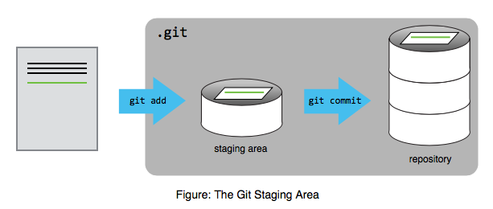
17

Slide 18
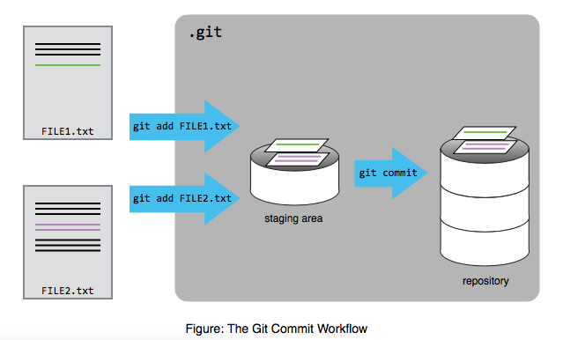
18

Slide 19
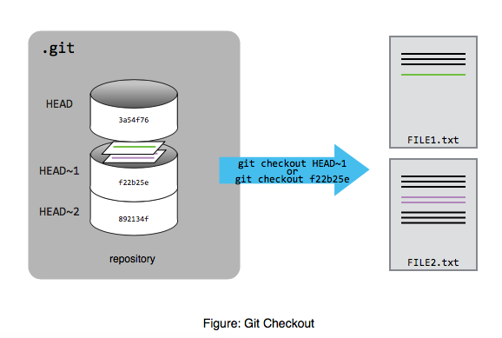
19

Slide 20
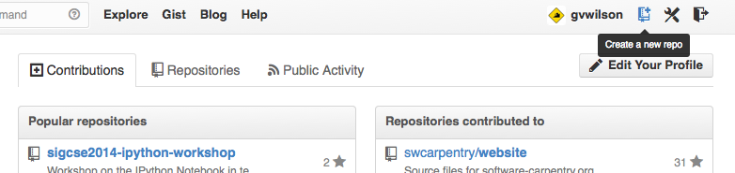
20

Slide 21
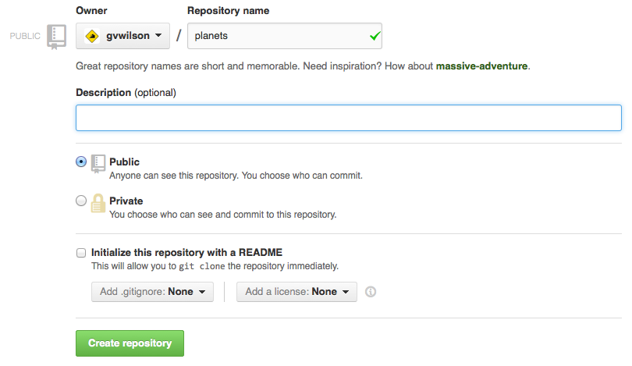
21

Slide 22
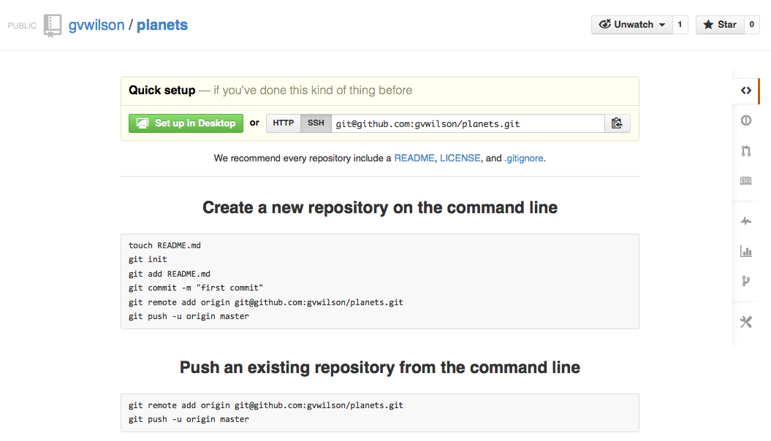
22

Slide 23
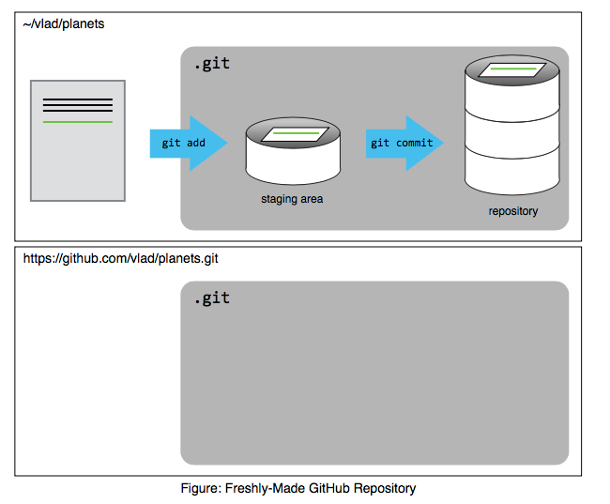
23

Slide 24
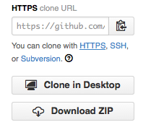
24

Slide 25
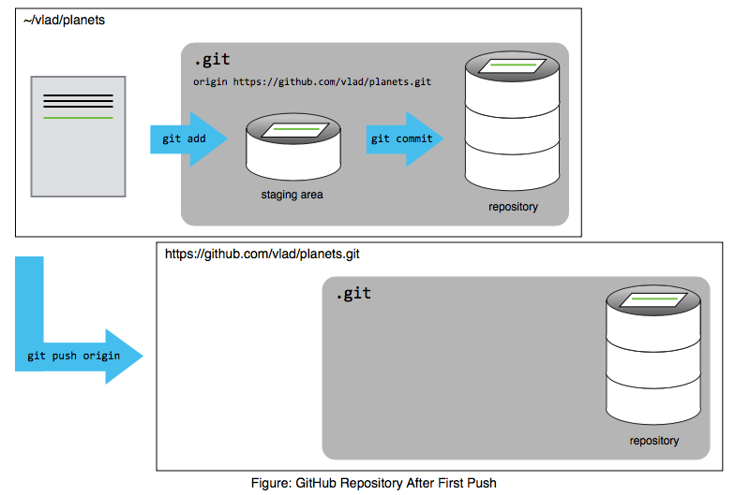
25

Slide 26
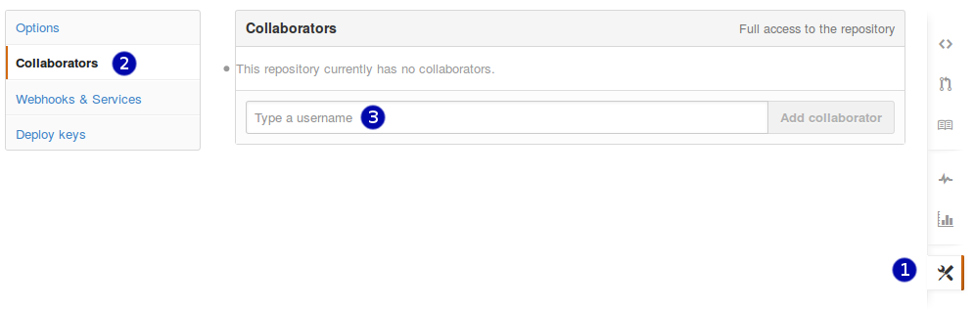
26

Slide 27
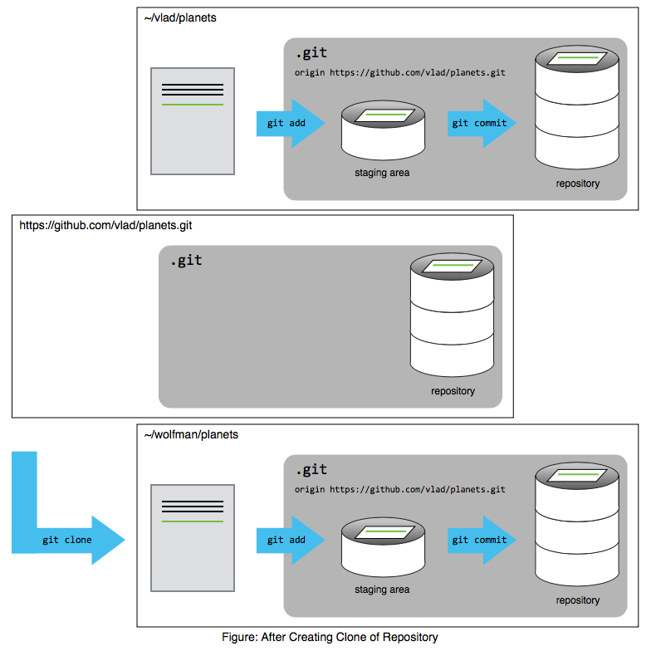
27

Slide 28
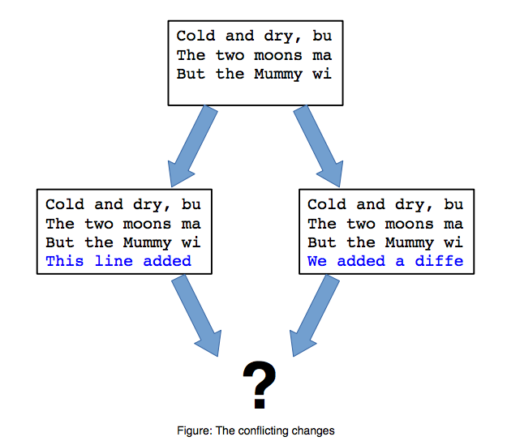
28

