Slide 1

CSE 583
Software Engineering for Data Scientists
Working in Teams – Technology Reviews
David Beck, Joseph Hellerstein, Bernease Herman
University of Washington
Oct 25, 2018

Slide 2
Technology Review Template
Why technology reviews?
  Determine if use a package
Background
  Requirements that indicate a need for the proposed package
Discuss
  How the package works
  Appeal of using the package
  Drawbacks of using the package
Beck, Hellerstein & VanderPlas, Fall, 2017

Slide 3
Example of A Technology Review
Antimony Package for Kinetics Modeling
Background
  Need kinetics models to explore certain what-if questions in chemical systems.
Beck, Hellerstein & VanderPlas, Fall, 2017

Slide 4
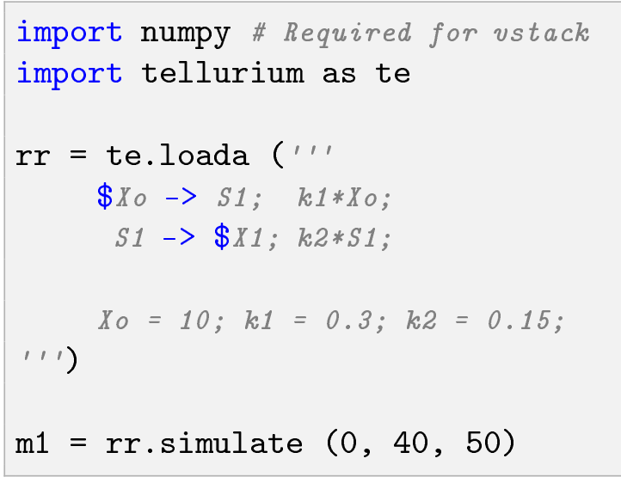
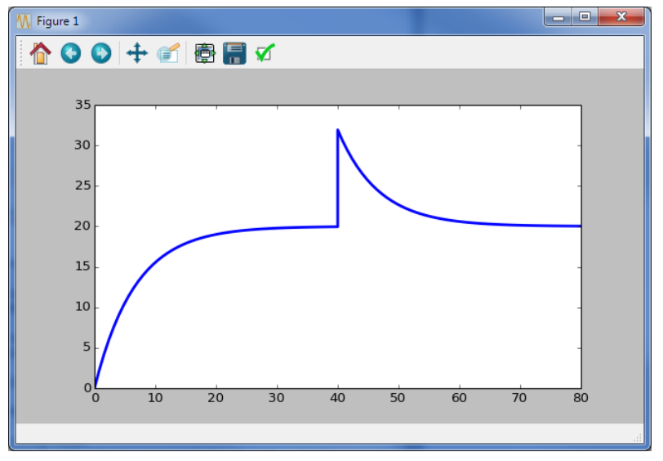
Using Antimony
Kinetics model is a python string
Perturbation of S1
Beck, Hellerstein & VanderPlas, Fall, 2017

Slide 5
Assessment of Antimony
Appeal
  Readable kinetics models
  Can use python with Antimony
  Exports to and imports from SBML (systems biology modeling language)
Drawbacks
  Poor support for the package
  Scaling may be a problem
Beck, Hellerstein & VanderPlas, Fall, 2017

