Slide 1

CSE 599 B1
Software Engineering for Data Scientists
Software Design
David Beck^{1,2}, Joseph Hellerstein^{1,3}, Jake VanderPlas^{1,4}
De Dennis Meng⁵ (TA)
¹eScience Institute
²Chemical Engineering
³Computer Science Engineering
⁴Astronomy
⁵Electrical Engineering
The University of Washington
February 1, 2016

Slide 2
For Teams of 2-3
Choose one member who has a word processor running on their computer
  MS Word, Libre Office, Google Docs
Beck, Hellerstein & VanderPlas, 2016

Slide 3

Beck, Hellerstein & VanderPlas, 2016

Slide 4
Software Design
"...specification of a software artifact, intended to accomplish goals, using a set of primitive components ..." [wikipedia]
Beck, Hellerstein & VanderPlas, 2016
Notes:
Question: From the perspective of evolutionary biology, are organisms designed? Why or why not?

Slide 5
Class Timeline
45 min: Lecture
  Design: why & how
  Use cases
  Component specification
30 min: Team component specification (4 members)
25 min: Team reports
Beck, Hellerstein & VanderPlas, 2016

Slide 6
Design: Why & How
Beck, Hellerstein & VanderPlas, 2016

Slide 7
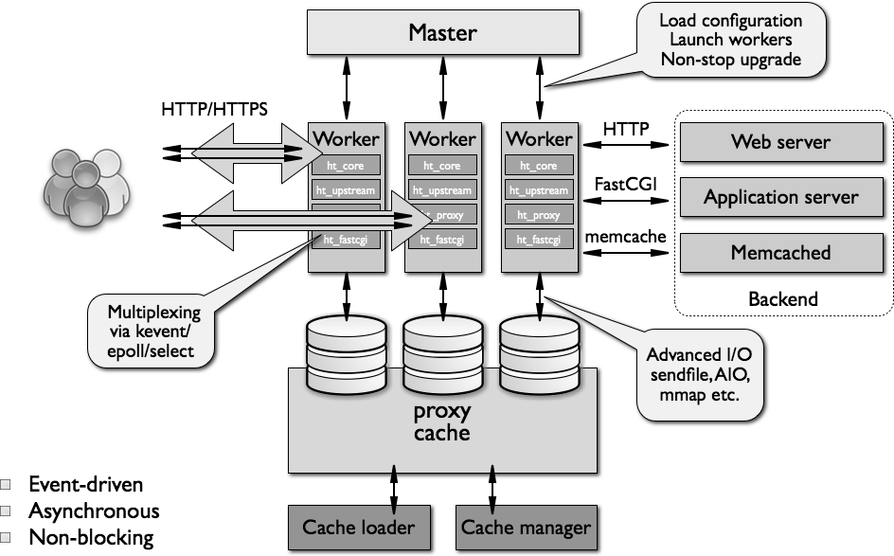
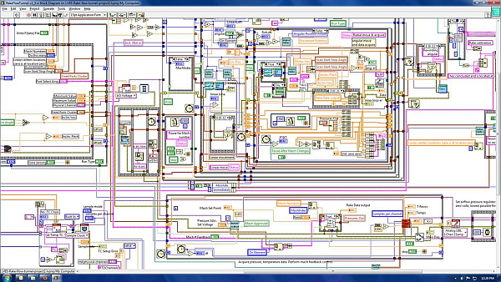
What Makes A Design Understandable?
Few components with clear roles
  Use abstraction hierarchies
Few interactions between components
  Carefully choose the features and interfaces
Similarity with other designs
  Use design patterns
Beck, Hellerstein & VanderPlas, 2016

Slide 8
Benefits of a Software Design
Provides a systematic approach to a complex problem
Finds bugs before you code
Enables many people to work in parallel
Promotes testability
Beck, Hellerstein & VanderPlas, 2016

Slide 9
Steps in Design
Describe what the system does (use cases)
Specify the components
  Each use case has a "Top level" component.
  Sub-components implements portions of the use case
    Ideally want many components that are common across use cases
Iterate. Iterate. Iterate.
Beck, Hellerstein & VanderPlas, 2016

Slide 10
Use Cases
Beck, Hellerstein & VanderPlas, 2016

Slide 11
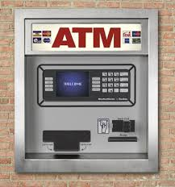
Running Example: Design of ATM
Beck, Hellerstein & VanderPlas, 2016

Slide 12
What Do We Do With ATMs?
Get cash
Deposit checks
Check balances
These are examples of Use Cases.
Implied use case – User authentication.
Beck, Hellerstein & VanderPlas, 2016

Slide 13
Describing a Use Case
What information the user provides
  E.g., command entered with its options
What responses the system provides
  E.g., prompts, plots, error messages
Authenticate User Use Case
User: Put ATM card in reader
ATM: Display 'Enter PIN'
User: Enters PIN on keyboard
ATM: [if correct] Show main menu
[if incorrect] Display 'Enter PIN'
Beck, Hellerstein & VanderPlas, 2016

Slide 14
Component Specification
Beck, Hellerstein & VanderPlas, 2016

Slide 15
"Functional" Specification of Components
Describe components with sufficient detail so that someone with modest knowledge of the project can implement the code for the component.
  Name
  What it does
  Inputs (with type information)
  Outputs (with type information)
  How use other components
Beck, Hellerstein & VanderPlas, 2016

Slide 16
Developing Component Specifications
What are the components in the use cases?
What components are already available?
What are the sub-components needed to implement those components that aren't already available?
  Do 1-2 for each such component
Beck, Hellerstein & VanderPlas, 2016

Slide 17
Example Component Specification
Find Primes < N
Name
  FindPrimes
What it does:
  Finds the primes that are less than N
Inputs (with type information)
  N, an integer
Outputs (with type information)
  List of integers
Beck, Hellerstein & VanderPlas, 2016

Slide 18
Pseudo Code: "How Use Other Components"
Pseudo code for finding the primes < N if the one component is divides
  For n < N
    is_prime = True
    For d < n
      If divides(n, d)
      Then is_prime = False
    If is_prime, add n to list_of_primes
"Rules" for pseudo code
  Consistent use of flow control & variable names
  Readable English where details are sparse
Beck, Hellerstein & VanderPlas, 2016
Notes:
Not executeable statements
Some logic is implied (e.g., initializing list_of_primes)

Slide 19
ATM Components by Use Case
Authenticate user
  Database with user PIN
  User interface that reads ATM card
  User interface that reads user PIN
  Control logic
Get cash
  Database with users cash balance
  User interface that reads user cash requested
  Cash drawer interface that dispenses cash
  Control logic
Beck, Hellerstein & VanderPlas, 2016

Slide 20
The Next 30 Minutes
Your charter: Design for Authenticate User
  List of components of their interactions
    Who calls whom for each step in the use case
  Component(s) design using the design template
What you'll report: Very brief
  Summary of design
  Issues, open questions
Beck, Hellerstein & VanderPlas, 2016

Slide 21
Team Component Specifications
30 min
Beck, Hellerstein & VanderPlas, 2016

Slide 22
Report: What we designed, Issues we encountered.
Authenticate User Use Case
User: Put ATM card in reader
ATM: Display 'Enter PIN'
User: Enters PIN on keyboard
ATM: [if correct] Show main menu
[if incorrect] Display 'Enter PIN'
Components
  Database with user PIN
  User interface that reads ATM card
  User interface that reads user PIN
  Control logic
Beck, Hellerstein & VanderPlas, 2016

Slide 23
Team Results
20 min
Beck, Hellerstein & VanderPlas, 2016

