Slide 1

DATA 515 A
Software Engineering for Data Scientists
Software Design
Bernease Herman¹, Joseph Hellerstein^{1,2},
Sam Gao²
¹eScience Institute
²Computer Science Engineering
University of Washington
April 30, 2019
Hellerstein & Herman, 2019

Slide 2
Please Sit With Your Team Members
Choose one member who has a word processor running on their computer
  MS Word, Libre Office, Google Docs
Hellerstein & Herman, 2019

Slide 3

Hellerstein & Herman, 2019

Slide 4
Software Design
"...specification of a software artifact, intended to accomplish goals, using a set of primitive components ..." [wikipedia]
Hellerstein & Herman, 2019
Notes:
Question: From the perspective of evolutionary biology, are organisms designed? Why or why not?

Slide 5
Class Timeline
40 min: Lecture
  Design: why & how
  Use cases
  Component specification
10 min: Breakout - Team component specification
5 min: Team reports
Hellerstein & Herman, 2019

Slide 6
Design: Why & How
Hellerstein & Herman, 2019

Slide 7
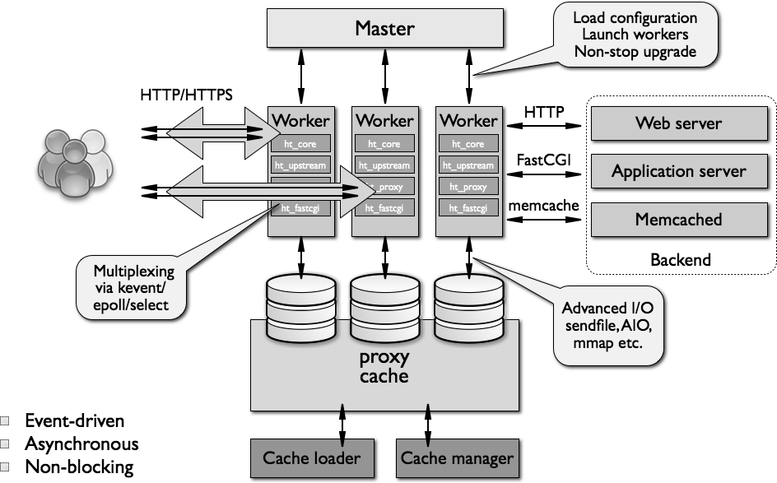
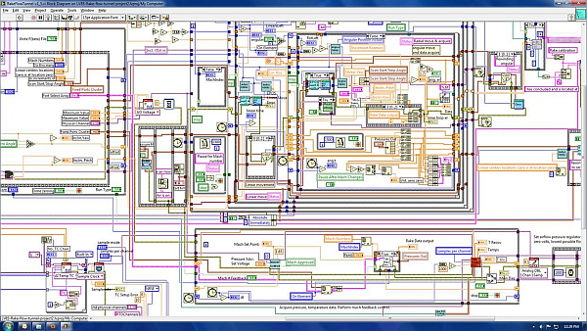
What Makes A Design Understandable?
Few components with clear roles
  Use abstraction hierarchies
Few interactions between components
  Carefully choose the features and interfaces
Similarity with other designs
  Use design patterns
Hellerstein & Herman, 2019

Slide 8
Benefits of a Software Design
Provides a systematic approach to a complex problem
Finds bugs before you code
Enables many people to work in parallel
Promotes testability
Hellerstein & Herman, 2019

Slide 9
Steps in Design
Functional design:
  Describe what the system does (use cases)
Component design: Specify the components
  Each use case has a "Top level" component.
  Sub-components implements portions of the use case
    Ideally want many components that are common across use cases
Iterate. Iterate. Iterate.
Hellerstein & Herman, 2019

Slide 10
Functional Design
Hellerstein & Herman, 2019

Slide 11
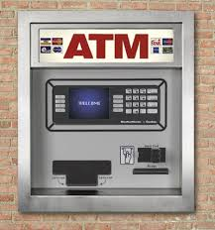
Running Example: Design of ATM
Hellerstein & Herman, 2019

Slide 12
What Do We Do With ATMs?
Get cash
Deposit checks
Check balances
These are examples of Use Cases.
Implied use case – User authentication.
Hellerstein & Herman, 2019

Slide 13
Describing a Use Case
What information the user provides
  E.g., command entered with its options
What responses the system provides
  E.g., prompts, plots, error messages
Authenticate User Use Case
User: Put ATM card in reader
ATM: Display 'Enter PIN'
User: Enters PIN on keyboard
ATM: [if correct] Show main menu
[if incorrect] Display 'Enter PIN'
Hellerstein & Herman, 2019

Slide 14
Component Design
Hellerstein & Herman, 2019

Slide 15
Specification of Components
Describe components with sufficient detail so that someone with modest knowledge of the project can implement the code for the component.
  Name
  What it does
  Inputs (with type information)
  Outputs (with type information)
  Interactions - how use other components
Hellerstein & Herman, 2019

Slide 16
Developing Component Specifications
What are the components in the use cases?
What components are already available?
What are the sub-components needed to implement those components that aren't already available?
  Do 1-2 for each such component
Hellerstein & Herman, 2019

Slide 17
Example Component Specification
Find Primes < N
Name
  FindPrimes
What it does:
  Finds the primes that are less than N
Inputs (with type information)
  N, an integer
Outputs (with type information)
  List of integers
Hellerstein & Herman, 2019

Slide 18
Describing Interactions With Pseudo Code
Pseudo code for finding the primes < N if the one component is divides
  For n < N
    is_prime = True
    For d < n
      If divides(n, d)
      Then is_prime = False
    If is_prime, add n to list_of_primes
"Rules" for pseudo code
  Consistent use of flow control & variable names
  Readable English where details are sparse
Hellerstein & Herman, 2019
Notes:
Not executeable statements
Some logic is implied (e.g., initializing list_of_primes)

Slide 19
ATM Components by Use Case
Authenticate user
  Database with user PIN
  User interface that reads ATM card
  User interface that reads user PIN
  Control logic
Get cash
  Database with users cash balance
  User interface that reads user cash requested
  Cash drawer interface that dispenses cash
  Control logic
Hellerstein & Herman, 2019

Slide 20
Breakout
Your charter: Design for Authenticate User
  List of components of their interactions
    Who calls whom for each step in the use case
  Component(s) design using the design template
What you'll report: Very brief
  Summary of design
  Issues, open questions
Hellerstein & Herman, 2019

Slide 21
Breakout: Component Specification
Hellerstein & Herman, 2019

Slide 22
Team Reports
What we designed
Issues encountered
How operate differently
Hellerstein & Herman, 2019

