Slide 1

CSE 583
Software Design for Data Scientists Course Introduction & validating software
David Beck^{1,2,3,4}, Bryna Hazelton^{1,5},
Natalie Robbins⁶, Nels Schimek²
¹eScience Institute
²Chemical Engineering
³Computer Science
⁴Environmental & Occupational Health Sciences
⁵Physics
⁶Linguistics
University of Washington
October 3, 2024

Slide 2
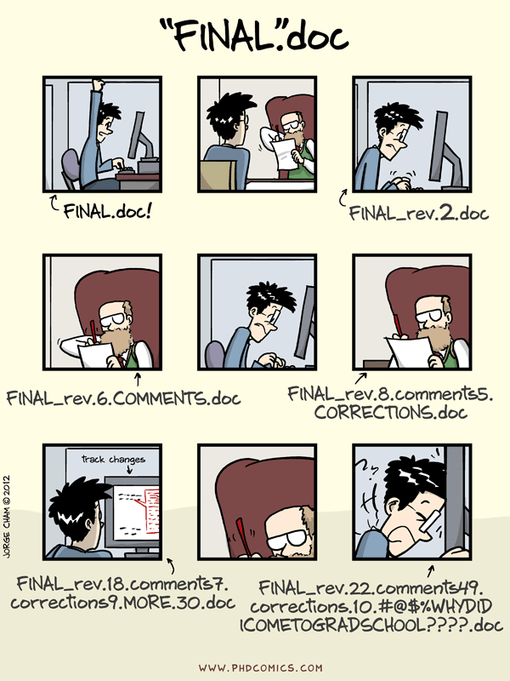

Slide 3
Quick Survey: Raise your hand if...
You’ve never used source / version control
You’ve used source control, but not git
Beginner in git as an individual (git add, git commit)
Moderate/Advanced in git as an individual (git rebase)
Beginner in git as collaborative team (git push, git pull)
Moderate/Advanced in Git/GitHub as collaborative team (pull requests, hooks)

Slide 4
git and GitHub
git
version control
local + remote
GitHub
Tools for collaboration
Issue tracking, pull requests with code review, forking
hosting & public access
Notes:
Delineate git vs GitHub: version control vs collaborative tools

Slide 5
Why version control (and git)
simplicity
only need one copy
always clear what the current version is
git just tracks changes
backup!
freedom to delete code
git keeps the full history, you can always resurrect old code
don’t need to keep commented code around ‘just in case’
provenance and reproducibility
makes it possible to track exactly what code was run for any analysis
fine-grained history
good support for branching and merging
supports development separate from a stable ‘main’ branch
aids parallel development
Notes:
git repos save the full history, but only the “deltas” — lightweight compared to multiple full copies
preserves full, fine-grained history (depending on user behavior) — not just copies of major revisions
with a little work (to capture the git information when code is run) you can always know exactly what code was run for any analysis
branching & merging: makes it easy to develop new features off the main stable branch and merge them in when ready, supports parallel development

Slide 6
GitHub collaboration tools
Issue tracking
with labelling, assignments and links between issues and PRs
Pull Requests (PRs)
build code reviews into the process of merging in new functionality
integrations with other services
Continuous integration: tests and other checks run every time the repo is updated
Documentation hosting: rebuild the documentation every time the repo is updated
user interface for exploring code changes
graphical diffs between any commits or branches
Notes:
Issue tracking: including labels, assignments, links between issues & PRs
Pull Request: process for merging changes into the main branch of repository, builds in code review

Slide 7
Reproducibility & Open Scholarship Hierarchy
public code
complementary (some times required) to publishing
documentation and readability are key
the analysis is the code — allows others to see what you did
open source code
requires an open source license
API documentation
unit testing and continuous integration
building a user community
reproducibility
capture of versions & settings
open data
full stack capture, containers (docker)
Notes:
public vs open source
No license means no one can use your code (or even write new code based on your code)
spectrum of reproducibility

Slide 8
git basics
local repository
a complete copy (with the full history) on your local machine
self-contained and self-sufficient
remote repository
a complete copy hosted remotely (e.g. on GitHub) — the repository all collaborators have access to
snapshots (commits)
the unit of tracking within git — can be multiple changes to multiple files
should be used to identify ‘atomic’ changes — things that go together
commit early & often — fine-grained commits make the history more useful

Slide 9
Working directory
staging area (index)
local repository:
snapshots
remote repository:
snapshots
Notes:
talk through the working directory and staging (briefly)

Slide 10
git add
git commit
Working directory
staging area (index)
local repository:
snapshots
remote repository:
snapshots
git status: use frequently to understand where files & code changes are in this process
Notes:
talk through the way git fundamentally thinks
purpose of the staging area is to make it possible to only commit some of the local changes

Slide 11
git add
git commit
git push
Working directory
staging area (index)
local repository:
snapshots
remote repository:
snapshots
git merge
git fetch
git pull
git status: use frequently to understand where files & code changes are in this process

Slide 12
git user interfaces
command line
available everywhere including remote servers
can be hard to visualize the process
gui (GitKraken, SourceTree, Lazygit — terminal gui, GitLens in VSCode)
good for visualizing the process
great interface for viewing history and diffs
encourages some good practices (viewing changes before adding)
easy to do powerful things (add parts of files, deal with merge conflicts, undo)
GitHub
great interface for viewing history and diffs, but restricted to what’s on the remote
required for issue tracking and pull request management

Slide 13
Resources
git parable (conceptually building up why git is the way it is): https://tom.preston-werner.com/2009/05/19/the-git-parable.html
Software Carpentry hands-on tutorial: http://swcarpentry.github.io/git-novice/
Lab-style git intro: https://github.com/HERA-Team/CHAMP_Bootcamp/blob/master/Lesson2_IntroToComputing/git-lab-handout.pdf
eScience office hours (https://escience.washington.edu/office-hours/#eScienceDataScientists)

Slide 14
Hands on practice

Slide 15
git config
Global settings for git
name and email address (to identify who made changes) — should match email associated with your GitHub account
preferred text editor (for commit messages)
To see current settings:
git config —list
To change these settings:
git config --global user.name "Vlad Dracula"
git config --global user.email "vlad@tran.sylvan.ia"
git config --global core.editor "nano -w”

Slide 16
Making a new repository
On GitHub
choose public or private
initialize with a readme
choose a .gitignore (also see https://github.com/github/gitignore for more language options, including matlab)
choose a license
Clone the repository locally
ssh vs https
git clone <repo-address>
git remote -v to see the address of the remote
Notes:
show the process

Slide 17
making changes
Check the status
use git status to see what things have changed
use this command liberally — it’s always safe and helps you know what’s going on
Identify all the changes you want to snapshot together
use git diff to see what the changes are
use git add <file> to move changes to the staging area
only include changes that go together
make the snapshot
use git commit to make the snapshot: brings up a browser to add a commit message
or git commit -m ‘your message here’
commit messages should be descriptive
view the history
git log, git show
Notes:
talk through the way git fundamentally thinks
purpose of the staging area is to make it possible to only commit some of the local changes

Slide 18
syncing with the remote
get snapshots from the remote
use git fetch to get the snapshots but not apply them to the local repo
use git status to see differences between the local and remote
use git merge to apply the snapshots to the local repo
git pull is git fetch immediately followed by git merge but doesn’t let you examine the snapshots before applying them
send your snapshots to the remote
use git push to send your local snapshots to the remote
git will not let you push if there are snapshots on the remote that you have not yet merged into your local repository
view the history
git log, git show
Notes:
in order to push, you have to have all the remote changes

Slide 19
branching
create a new branch and switch to it
use git checkout -b <branch_name> to create the branch and switch to it
for existing branches, use git checkout <branch_name> to switch to that branch
make changes and snapshots on that branch
push the branch up to the remote
use git push --set-upstream origin <branch_name> to make a branch on the remote that tracks your new local branch
make more changes and snapshots and push/pull
to merge the branch into the main, make a pull request
leads to a code review

Slide 20
merging vs rebasing branches
merging in branches is straightforward, but can result in a somewhat complicated graph
rebasing is an alternative approach that results in a neat, linear graph at the expense of rewriting history
rebasing effectively moves the location that a branch leaves the tree
can be used to place branches at the tip of the master branch to avoid having to merge
effectively replays the changes in the branch after the end of the master branch

Slide 21
Collaborating with GitHub

Slide 22
Collaborative coding and data analysis
Issues and discussions
Keep track of TODOs and worries
Use labels!
Communicating with collaborators, including non-coding ones (advisors)
Threaded logbook linked to code (e.g. https://github.com/EoRImaging/FHD/issues/39)
Can embed plots, images as appropriate
Notes:
show FHD discussion

Slide 23
Collaborating on code
Branching workflow
make a branch for a specific topic
you can have multiple branches!
Pull Requests for code reviews (e.g. https://github.com/RadioAstronomySoftwareGroup/pyuvdata/pull/1292)
linking to issues
GitHub Milestones/Projects
track sets of issues towards a larger goal
Notes:
continuous integration
templating
changelog

