Slide 1
Software (design) for Data Scientists CSE 583 David Beck University of Washington, SSEC, eScience 10.31.2024

Slide 2
Overview of today
Motivate the role of intentional software design
Overview of a software design approach
Users and their stories inform design
Use cases describe the function of software
Components implement the use cases
Testing and testing strategies
Notes:
Question: From the perspective of evolutionary biology, are organisms designed? Why or why not?

Slide 3
Software Design
"...specification of a software artifact, intended to accomplish goals, using a set of primitive components ..." [wikipedia]
Notes:
Question: From the perspective of evolutionary biology, are organisms designed? Why or why not?

Slide 4
Why design? “I have an idea and I’m ready to code now!”

Slide 5
Benefits of a Software Design
Provides a systematic approach to a complex problem
Find bugs before you code
Enables many people to work in parallel
Promotes testability
Promotes usability
Demonstrably “true” software with features users want is going to be used.

Slide 6
Drawbacks of a Software Design
Heavy lift for small tasks
It can be impossible to know when a design is complete
Others?

Slide 7
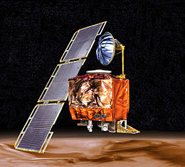
Design fails
Mars Climate Orbiter (1998-1999)
$551 million in 2022 USD
NASA and Lockheed Martin did not specify units in design
Two separate systems interacted during injection burn
Foot/pounds = 1.356 Newton-meters
Bounced of Martian atmosphere circling the sun today

Slide 8

Design fails
caBIG 2004-2012
$350 million in 2022 in 2010 USD
CAncer Biomedical Informatics Grid
Unified software infrastructure for cancer data collection, analysis, management, including
Clinical trials from enrollment to adverse event reporting
Sample collection, annotation, storage and sharing of medical imaging data
Biospecimen management and control

Slide 9
Design fails
caBIG 2004-2012
$350 million in 2022 in 2010 USD
CAncer Biomedical Informatics Grid
Unified software infrastructure for cancer data collection, analysis, management
Who were the users? Pharma? Academic research?
Did people want the software proposed?
Competition with existing software

Slide 10
Design fails
caBIG 2004-2012
$350 million in 2022 in 2010 USD
Renamed and replaced by a successor (National Cancer Informatics Program) in 2012.

Slide 11
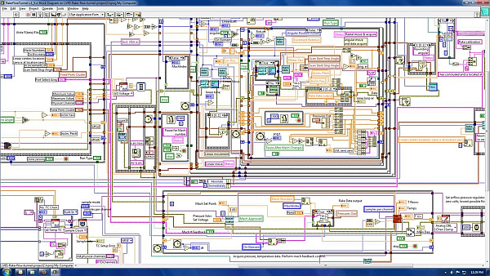
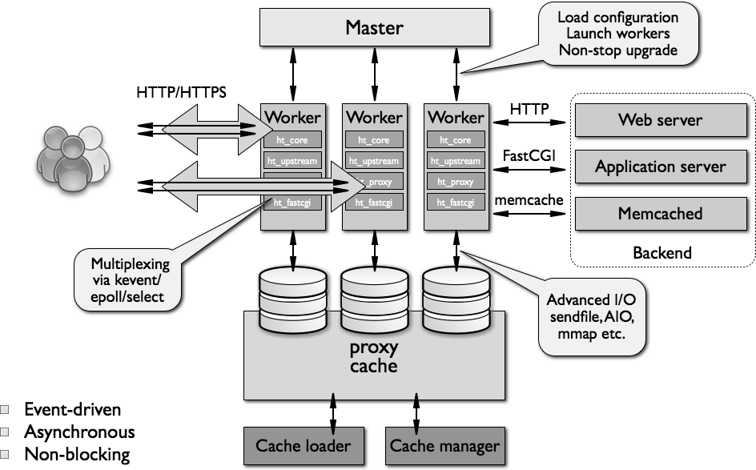
What makes a design understandable?
Few components with clear roles
Few interactions between components
Carefully choose the features and interfaces
Similarity with other designs
Uses design patterns (user interfaces, parallel computing, message observers, …)
Simple where possible is better

Slide 12
Steps in Design¹
Iterate. Iterate. Iterate.
Identify the users and their needs
Functional design
Describe what the system does (use cases)
Component design
Components are the “software artifacts” that implement the specific features of the use cases
Components are often hierarchical and reused
1. There are many paradigms of software design. This is one. It is focused on humans.

Slide 13
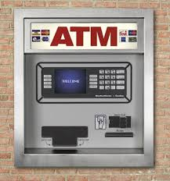
Running Example: Design of ATM

Slide 14
User stories

Slide 15
Design begins with your users
Who are your users?
E.g. Researchers, policy makers, educators, learners, …
What do they want to do with your software?
How are they going to be interacting with it?
What skill level(s) do they have and how will that impact the design?
Information from interviews, observations, direct knowledge, best guesses

Slide 16
Start by writing a user story
Who is the user. What do they want to do with the tool. What needs and desires do they want for the tool. What is their skill level.

Slide 17
Start by writing a user story
Who is the user. What do they want to do with the tool. What needs and desires do they want for the tool. What is their skill level.

Slide 18
Start by writing a user story
Ram is a bank customer.

Slide 19
Start by writing a user story
Ram is a bank customer. Ram wants to check his balance, deposit money.

Slide 20
Start by writing a user story
Ram is a bank customer. Ram wants to check his balance, deposit money. He rarely uses cash.

Slide 21
Start by writing a user story
Ram is a bank customer. Ram wants to check his balance, deposit money. He rarely uses cash. Ram wants a safe and secure interface for interacting with the ATM.

Slide 22
Start by writing a user story
Ram is a bank customer. Ram wants to check his balance, deposit money. He rarely uses cash. Ram wants a safe and secure interface for interacting with the ATM. Ram’s job does not involve technical skills and he values a simple user interface.

Slide 23
Start by writing a user story
Ram is a bank customer. Ram wants to check his balance, deposit money. He rarely uses cash. Ram wants a safe and secure interface for interacting with the ATM. Ram’s job does not involve technical skills and he values a simple user interface.

Slide 24
Start by writing a user story
We may write multiple stories around similar users
These can reveal “importance” of certain features
Take 2-3 minutes to sketch a user story for another “bank customer.”
(You can’t interview anyone… Use direct knowledge: you are the user, feel free to express your frustrations with your bank!)
Who is the user. What do they want to do with the tool. What needs and desires do they want for the tool. What is their skill level.

Slide 25
Start by writing a user story
Asma is a bank customer. Asma wants to check her balance and take out cash. She uses auto-deposit for her paychecks. She wants a safe and secure interface for interacting with the ATM. Asma is quite technical, but she wants to minimize her time interacting with the ATM and values a simple interface.

Slide 26
Start by writing a user story
Asma is a bank customer. Asma wants to check her balance and take out cash. She uses auto-deposit for her paychecks. She wants a safe and secure interface for interacting with the ATM. Asma is quite technical, but she wants to minimize her time interacting with the ATM and values a simple interface.

Slide 27
Start by writing a user story
Ram is a bank customer. Ram wants to check his balance, deposit money. He rarely uses cash. Ram wants a safe and secure interface for interacting with the ATM. Ram’s job does not involve technical skills and he values a simple user interface.
How are Ram and Asma the same?
How are Ram and Asma different?
What are the key takeaways from their user stories?
Asma is a bank customer. Asma wants to check her balance and take out cash. She uses auto-deposit for her paychecks. She wants a safe and secure interface for interacting with the ATM. Asma is quite technical, but she wants to minimize her time interacting with the ATM and values a simple interface

Slide 28
Start by writing a user story
How are Ram and Asma the same?
Bank customers, check balance, want safe and secure, simple user interface
How are Ram and Asma different?
Use of cash, technical skill level
What are the key takeaways from their user stories?
Safety, security and simplicity of the UI

Slide 29
Start by writing a user story
Other user stories?
You may have several different kinds of “users”
There may be a “technician”
There may be a “systems administrator”

Slide 30
Start by writing a user story
Valentina is an ATM technician. She services ATMs as part of preventative maintenance, applies hardware and software updates and for performs emergency repairs. For maintenance and updates she will follow a standard protocol. For repairs, she needs access to a diagnostic interface. Valentina is highly technical and knows how to replace standardized parts.

Slide 31
Start by writing a user story
Valentina is an ATM technician. She services ATMs as part of preventative maintenance, applies hardware and software updates and for performs emergency repairs. For maintenance and updates she will follow a standard protocol. For repairs, she needs access to a diagnostic interface. Valentina is highly technical and knows how to replace standardized parts.

Slide 32
Start by writing a user story
Other user stories?
You may have several different kinds of “users”
There may be a “technician”
Train a machine learning model to be used by the system, manage external data sources
There may be a “systems administrator”
Creates user accounts, sends maintenance announcements

Slide 33
Start by writing a user story
Other user stories?
Thieves, scammers, safe crackers, ne'er-do-wells
How do you design “against” these types of “users?”

Slide 34
Use Cases
Functional Design

Slide 35
Running Example: Design of ATM

Slide 36
How to find use cases? In the user stories!
Ram is a bank customer. Ram wants to check his balance, deposit money. He rarely uses cash. Ram wants a safe and secure interface for interacting with the ATM. Ram’s job does not involve technical skills and he values a simple user interface.

Slide 37
How to find use cases? In the user stories!
Ram is a bank customer. Ram wants to check his balance, deposit money. He rarely uses cash. Ram wants a safe and secure interface for interacting with the ATM. Ram’s job does not involve technical skills and he values a simple user interface.

Slide 38
How to find use cases? In the user stories!
Ram is a bank customer. Ram wants to check his balance, deposit money. He rarely uses cash. Ram wants a safe and secure interface for interacting with the ATM. Ram’s job does not involve technical skills and he values a simple user interface.
Check balances
Deposit checks

Slide 39
How to find use cases? In the user stories!
Ram is a bank customer. Ram wants to check his balance, deposit money. He rarely uses cash. Ram wants a safe and secure interface for interacting with the ATM. Ram’s job does not involve technical skills and he values a simple user interface.
Check balances
Deposit checks

Slide 40
What do we do with ATMs?
Check balances
Deposit checks
Get cash
These are examples of Use Cases.
They describe the functional potential of software.
Ram and Asma
Asma

Slide 41
Describing a Use Case (one way)
What are the inputs and what are the outputs?
Adding two numbers
Take a minute to think about this use case
What are the input(s)?
What are the output(s)?
How does the use case transform input to output?

Slide 42
Describing a Use Case (one way)
What are the inputs and what are the outputs?
Adding two numbers
Inputs: two numbers
Outputs: one number, the sum of the two inputs
Can we add more detail? What kind of numbers? Positive and negative?

Slide 43
Describing a Use Case (Check Balance)
What are the inputs and what are the outputs?
Check balance
Take a minute to think about this use case
What are the input(s)?
What are the output(s)?
How does the use case transform input to output?

Slide 44
Describing a Use Case (Check Balance)
What are the inputs and what are the outputs?
Check balance
Input: User selects an account
Output: ATM displays the current account balance
The account information is looked up in the account database and the current balance is retrieved.

Slide 45
Implied use cases are important!
Some uses cases are implied
Involved without being a primary use case
“Easily overlooked”
What might be an implied use case of an ATM?

Slide 46
Implied use cases are important!
Authentication is an implied use case.
Do we need this use case?
What users is authentication for?
Take 2-3 minutes to describe the authentication use case.

Slide 47
Describing a Use Case (Authentication)
What information the user provides (inputs)
What responses the system provides (outputs)
Authenticate User Use Case
User: Put ATM card in reader
ATM: Display 'Enter PIN'
User: Enters PIN on keyboard
ATM: [if correct] Show main menu
[if incorrect] Display 'Enter PIN'

Slide 48
Component Design

Slide 49
What is a component?
Software (or other kinds) components “do the work”
Components store data
Components calculate values
Components “interact” with each other
Components “interact” with the user
Components can be functions, databases, interfaces, external web sites, ..

Slide 50
Component design or component spec
Breaks down use cases into the required components.
Describe components in sufficient detail for someone else (or ChatGPT*) to write the code.
* ChatGPT writes much of the first pass code in my research team based on our text descriptions of the components.‡
https://github.com/EvanKomp/aide/blob/main/docs/component_specification.md

Slide 51
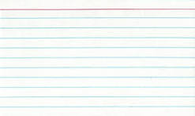
Specification of a component
Describe components with sufficient detail so that someone with modest knowledge of the project can implement the code for the component.
Name
What it does
Inputs (with type information)
Outputs (with type information)
How it uses other components
Side effects

Slide 52
Developing component specifications
Use case by use case: what are the components required for this use case?
A component is a distinct entity that “does the work”
What are some components on an ATM?
Display, keypad, card reader, camera
Cash dispenser, envelope reader

Slide 53
Developing component specifications
Use case by use case: what are the components required for this use case?
Are those components used for another use case?
Good, we can reuse them!
Can the component be further divided in complexity for sub-components?
Good, we can simplify them!

Slide 54
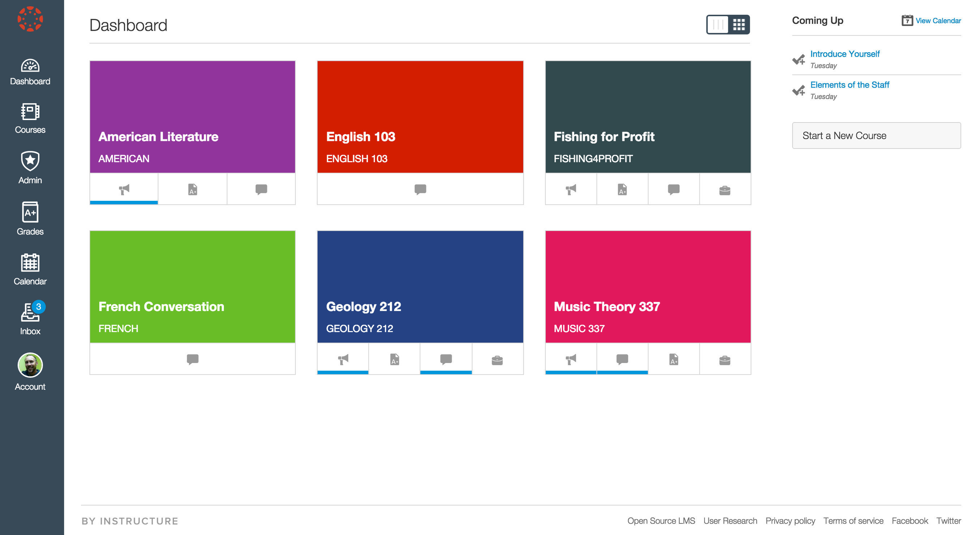
Subcomponents can be confusing
I really don’t like all your fancy vocabulary.
What kinds of components have subcomponents?
User interfaces
Subcomponents are
buttons, sidebars
Databases
Student table
Teacher table
Grades table

Slide 55
Subcomponents can be confusing
What kinds of components have subcomponents?
User interfaces, databases, application programming interfaces
When do I need to define a subcomponent?
Top down or bottom up
Goal: simple is better
Does subdividing the component simplify building or testing the component?

Slide 56
ATM components by Use Case
Authenticate user
Take 1 minute to think about the components in the authenticate user use case. What components can you identify?
User: Put ATM card in reader
ATM: Display 'Enter PIN'
User: Enters PIN on keyboard
ATM: [if correct] Show main menu
[if incorrect] Display 'Enter PIN'
Authenticate User Use Case

Slide 57
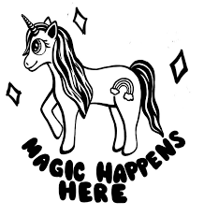
ATM components by Use Case
Authenticate user
Database with user info including ATM card # and PIN
Card reader that reads ATM card
User interface that shows information (80x24)
User interface that reads user PIN
Authenticate control logic
What is this?
1
1. https://www.deviantart.com/love-rainbowflower/art/Magic-Happens-Here-lineart-292524154

Slide 58
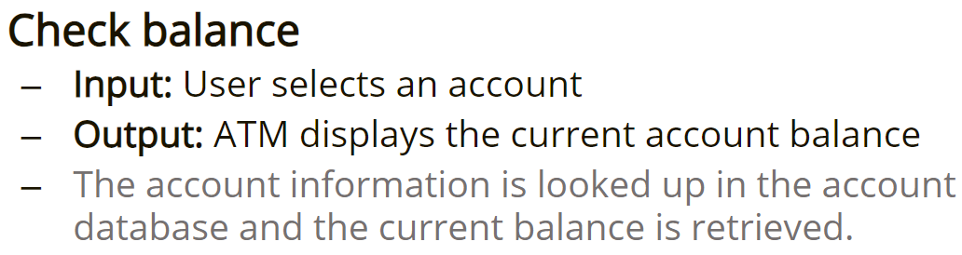
ATM components by Use Case
Check balance
Take 1 minute to think about the components in the check balance use case. What components can you identify?

Slide 59
ATM components by Use Case
Check balance
Database with user info including account balances
User interface that reads account selection
User interface that shows information (80x24)
Check balance control logic

Slide 60
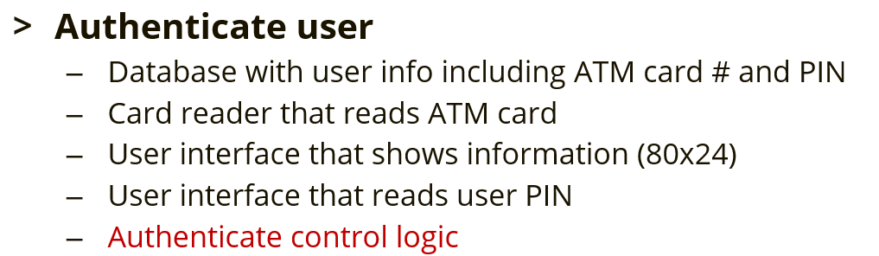
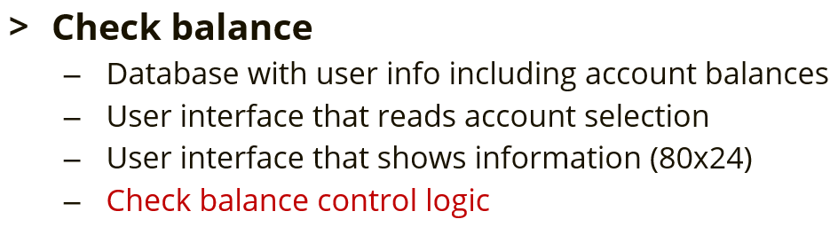
Identify shared components
User interface (output)?
User interface (input)?
Database?
Control logic?

Slide 61
Identify shared components
User interface (output)? Yes!
User interface (input)? Yes!
Database? After subcomponents.
Control logic? No!

Slide 62
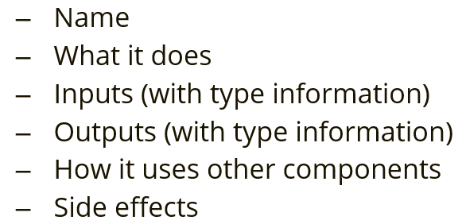
Specify components
Authenticate user control logic
Take 2-3 minutes to sketch out a specification for the authenticate user control logic component.

Slide 63
Specify components
Name: Authenticate user control logic
What it does:
Verifies a user is in the database and that the PIN supplied by the user matches the PIN in the database
Inputs (with type information)
Card number, a string that is the user’s card number
PIN, an integer
Outputs (with type information)
Boolean: True if success, False if failure
Components used: ATM card reader supplies Card number input, user inputs PIN via keypad, verification is performed by database
Side effects: If successful, all other bank customer use cases are enabled for the User matching the Card number.

Slide 64
Specify components
Check balance control logic
Take 2-3 minutes to sketch out a specification for the check balance control logic component.

Slide 65
Specify components
Name: Check balance control logic
What it does:
Looks up a user's account that they provided in the account database and returns the current balance associated with that account in the database.
Inputs (with type information)
Account number, a string that is the user’s account number
Outputs (with type information)
False if account does not exist or a floating-point number equal to the account balance
Components used: User selects an Account Number shown on the display with keypad input and the verification and balance lookup is provided by the database
Side effects: None.

Slide 66
Overview of today
Motivate the role of intentional software design
Overview of a software design approach
Users and their stories inform design
Use cases describe the function of software
Components implement the use cases
Testing and testing strategies
Notes:
Question: From the perspective of evolutionary biology, are organisms designed? Why or why not?

Slide 67
Component specifications get you to code
Code needs review, testing continuously
Has this happened to you:
You wrote some code. It works! You are happy.
You add a neat little feature. You think it works. You are happy.
It doesn’t work, but you don’t know. You will be sad.
You found out before anything bad happened.
Notes:
Question: From the perspective of evolutionary biology, are organisms designed? Why or why not?

Slide 68
What is software testing?
Code that checks if other code (code under test) is working properly
If the “code under test”
Runs successfully
Fails gracefully (as expected, when expected)
The tests pass and the code is “accepted” as working

Slide 69
What is software testing?
def code_under_test(a, b):
return a + b
What is the code under test?
What is the code under test doing?
Could we name the code under test function better?

Slide 70
What is software testing?
if add(0, 0) == 0:
return True
else:
return False
def add(a, b):
return a + b
What is a test we can do for add?
Is this sufficient?

Slide 71
What is software testing?
if add(0, 1) == 1:
return True
else:
return False
def add(a, b):
return a + b
Can we test a different a, b pair?
Is this sufficient?
if add(0, 2) == 2:
return True
else:
return False

Slide 72
What is software testing?
for i in range(10):
if add(0, i) != i:
return False
def add(a, b):
return a + b
Can we test many a, b pairs?
Is this sufficient?
Testing is hard! Testing is fun! Testing can drive development!

Slide 73
What is continuous software testing?
add(a, b)
multiply(a, b)
In version 2, we want to support complex numbers. How can we be sure that our changes don’t break things?
“Continuous integration” or continuously integrating new code into your software after testing.
The tests pass and the code is “accepted” as working
Version 1 of our simple math library

Slide 74
Homework for next week
Can you imagine a piece of software that is missing from your Ed-Tech workflow, LMS, or some other software that you need? If not, please use your favorite cell phone application as an example
What are the top three user stories that would be necessary to begin to lay out a software design?
Can you create a set of use cases for each user story?
How do those use cases derived from different user stories overlap?
Which use cases will create the biggest design and testing challenges downstream because of their complexity? Can you identify a complex component that should be subdivided?

Slide 75
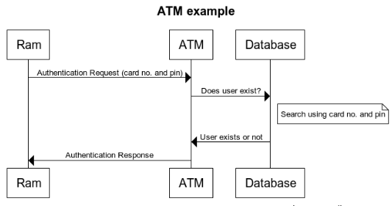
Interaction diagrams

