Slide 1

CSE 583
Software Design for Data Scientists
Course Introduction & validating software
Bryna Hazelton^{1,5}, David Beck^{1,2,3,4},
Elli Beres^{3,6}, Ian Quah⁷
¹eScience Institute
²Chemical Engineering
³Computer Science
⁴Environmental & Occupational Health Sciences
⁵Physics
⁶Seattle Hub for Synthetic Biology,
⁷Psychology
University of Washington
October 13, 2026

Slide 2
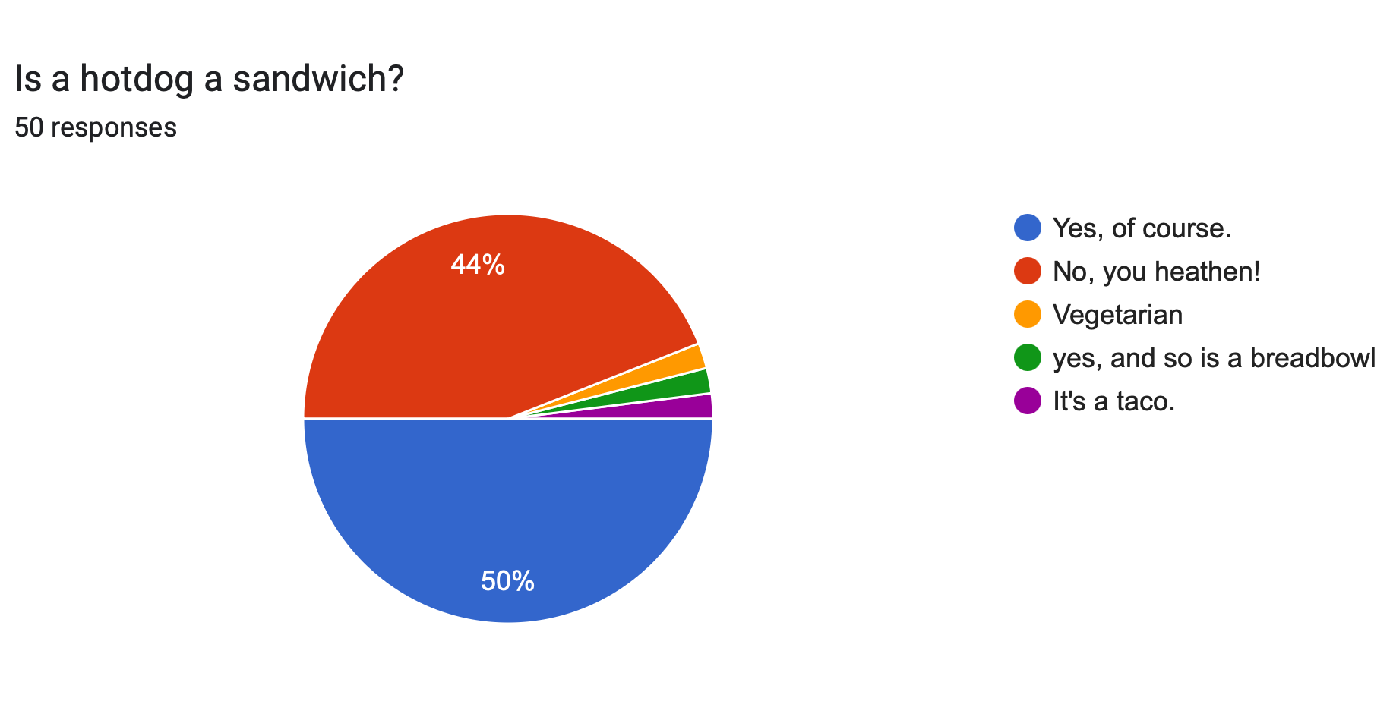
Make sure you have a GitHub account and fill out the survey to link it to you netid

Slide 3
Review from Tuesday
What do the following commands do?
  ls
  mkdir
  cp
  rm
  touch
  cat
  rmdir
  cat
  more / less
  curl

Slide 4
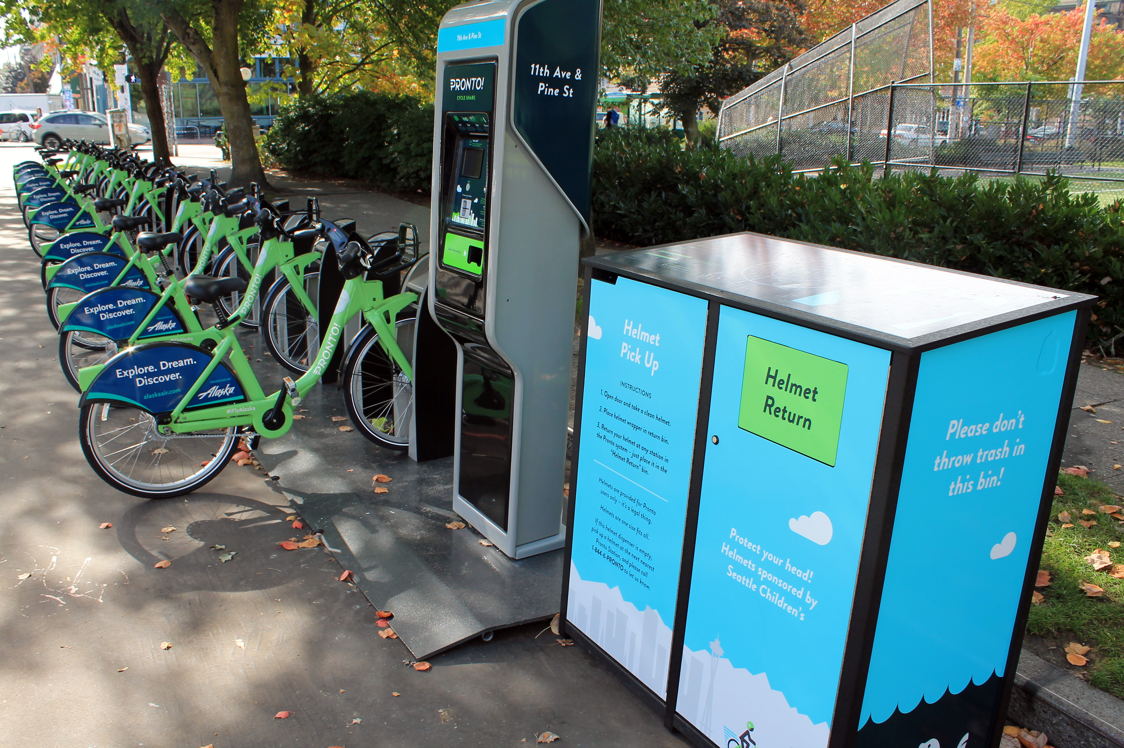
Pronto Data

Slide 5
Pronto Data
Used to be available from Seattle’s open data portal, but it was finally taken down.
So we will access it from an AWS bucket where it’s been conveniently stored for us:
https://s3.amazonaws.com/pronto-data/open_data_year_one.zip

Slide 6
Getting Data With Shell Scripts

Slide 7
Demo
Create the project directory structure and README
Get the pronto data from the Internet, https://s3.amazonaws.com/pronto-data/open_data_year_one.zip
Unpack the data
  Comma separated variable (CSV) files
Automate the workflow using a shell script

Slide 8
Useful Shell Commands
Command | Task | Example usage
ls | List files | ls
cp | Copy files | cp original_file new_file
mv | Move / rename files | mv original_file new_file
rm | Remove / delete files | rm original_file
cd | Change directory | cd some_directory
pwd | Print working / current directory | pwd
mkdir | Create directory | mkdir some_directory
rmdir | Remove / delete directory | rmdir some_directory
cat | View files | cat some_file
head | View begining of file | head some_file
tail | View end of file | tail some_file
grep | Search file for matching lines | grep search.text some_file
sort | Sort lines | sort some_file
uniq | Print unique lines | uniq some_file
diff | Compare to files | diff original_file new_file
unzip | Uncompress a file | unzip compressed_file.zip
curl | Download a file using its URL | curl some URL
  Also see http://www.pixelbeat.org/cmdline.html
  Also search shell + <cmd name>

Slide 9
Version Control

Slide 10
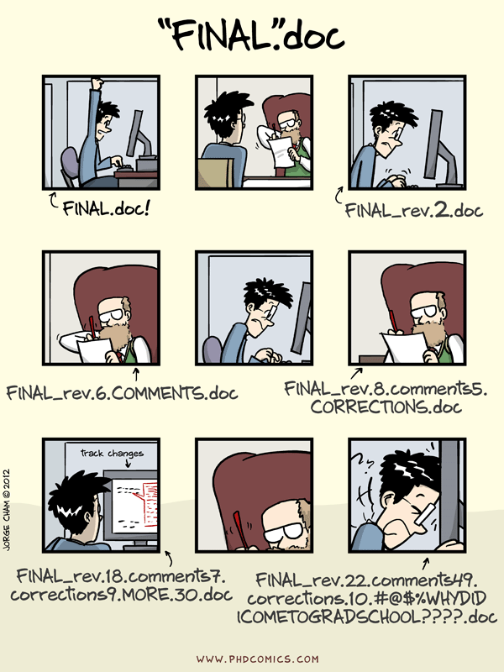

Slide 11
Quick Survey: Raise your hand if...
You’ve never used source / version control
You’ve used source control, but not git
Beginner in git as an individual (git add, git commit)
Moderate/Advanced in git as an individual (git rebase)
Beginner in git as collaborative team (git push, git pull)
Moderate/Advanced in Git/GitHub as collaborative team (pull requests, hooks)

Slide 12
git and GitHub
git
  version control
  local + remote
GitHub
  Tools for collaboration
    Issue tracking, pull requests with code review, forking
  hosting & public access
Notes:
Delineate git vs GitHub: version control vs collaborative tools

Slide 13
Why version control (and git)
simplicity
  only need one copy
  always clear what the current version is
  git just tracks changes
  backup!
freedom to delete code
  git keeps the full history, you can always resurrect old code
  don’t need to keep commented code around ‘just in case’
provenance and reproducibility
  makes it possible to track exactly what code was run for any analysis
  fine-grained history
good support for branching and merging
  supports development separate from a stable ‘main’ branch
  aids parallel development
Notes:
git repos save the full history, but only the “deltas” — lightweight compared to multiple full copies
preserves full, fine-grained history (depending on user behavior) — not just copies of major revisions
with a little work (to capture the git information when code is run) you can always know exactly what code was run for any analysis
branching & merging: makes it easy to develop new features off the main stable branch and merge them in when ready, supports parallel development

Slide 14
GitHub collaboration tools
Issue tracking
  with labelling, assignments and links between issues and PRs
Pull Requests (PRs)
  build code reviews into the process of merging in new functionality
integrations with other services
  Continuous integration: tests and other checks run every time the repo is updated
  Documentation hosting: rebuild the documentation every time the repo is updated
user interface for exploring code changes
  graphical diffs between any commits or branches
Notes:
Issue tracking: including labels, assignments, links between issues & PRs
Pull Request: process for merging changes into the main branch of repository, builds in code review

Slide 15
Reproducibility & Open Scholarship Hierarchy
public code
  complementary (some times required) to publishing
  documentation and readability are key
  the analysis is the code — allows others to see what you did
open source code
  requires an open source license
  API documentation
  unit testing and continuous integration
  building a user community
reproducibility
  capture of versions & settings
  open data
  full stack capture, containers (docker)
Notes:
public vs open source
No license means no one can use your code (or even write new code based on your code)
spectrum of reproducibility

Slide 16
git basics
local repository
  a complete copy (with the full history) on your local machine
  self-contained and self-sufficient
remote repository
  a complete copy hosted remotely (e.g. on GitHub) — the repository all collaborators have access to
snapshots (commits)
  the unit of tracking within git — can be multiple changes to multiple files
  should be used to identify ‘atomic’ changes — things that go together
  commit early & often — fine-grained commits make the history more useful

Slide 17
Working directory
staging area (index)
local repository:
snapshots
remote repository:
snapshots
Notes:
talk through the working directory and staging (briefly)

Slide 18
git add
git commit
Working directory
staging area (index)
local repository:
snapshots
remote repository:
snapshots
git status: use frequently to understand where files & code changes are in this process
Notes:
talk through the way git fundamentally thinks
purpose of the staging area is to make it possible to only commit some of the local changes

Slide 19
git add
git commit
git push
Working directory
staging area (index)
local repository:
snapshots
remote repository:
snapshots
git merge
git fetch
git pull
git status: use frequently to understand where files & code changes are in this process

Slide 20
git user interfaces
command line
  available everywhere including remote servers
  can be hard to visualize the process
gui (GitKraken, SourceTree, Lazygit — terminal gui, GitLens in VSCode)
  good for visualizing the process
  great interface for viewing history and diffs
  encourages some good practices (viewing changes before adding)
  easy to do powerful things (add parts of files, deal with merge conflicts, undo)
GitHub
  great interface for viewing history and diffs, but restricted to what’s on the remote
  required for issue tracking and pull request management

Slide 21
Resources
git parable (conceptually building up why git is the way it is): https://tom.preston-werner.com/2009/05/19/the-git-parable.html
Software Carpentry hands-on tutorial: http://swcarpentry.github.io/git-novice/
Lab-style git intro: https://github.com/HERA-Team/CHAMP_Bootcamp/blob/master/Lesson2_IntroToComputing/git-lab-handout.pdf
eScience office hours (https://escience.washington.edu/office-hours/#eScienceDataScientists)

Slide 22
Hands on practice

Slide 23
git config
Global settings for git
  name and email address (to identify who made changes) — should match email associated with your GitHub account
  preferred text editor (for commit messages)
To see current settings:
  git config —list
To change these settings:
  git config --global user.name "Vlad Dracula"
  git config --global user.email "vlad@tran.sylvan.ia"
  git config --global core.editor "nano -w”

Slide 24
Making a new repository
On GitHub
  choose public or private
  initialize with a readme
  choose a .gitignore (also see https://github.com/github/gitignore for more language options, including matlab)
  choose a license
Clone the repository locally
  ssh vs https
  git clone <repo-address>
  git remote -v to see the address of the remote
Notes:
show the process

Slide 25
making changes
Check the status
  use git status to see what things have changed
  use this command liberally — it’s always safe and helps you know what’s going on
Identify all the changes you want to snapshot together
  use git diff to see what the changes are
  use git add <file> to move changes to the staging area
  only include changes that go together
make the snapshot
  use git commit to make the snapshot: brings up a browser to add a commit message
  or git commit -m ‘your message here’
  commit messages should be descriptive
view the history
  git log, git show
Notes:
talk through the way git fundamentally thinks
purpose of the staging area is to make it possible to only commit some of the local changes

Slide 26
syncing with the remote
get snapshots from the remote
  use git fetch to get the snapshots but not apply them to the local repo
  use git status to see differences between the local and remote
  use git merge to apply the snapshots to the local repo
  git pull is git fetch immediately followed by git merge but doesn’t let you examine the snapshots before applying them
send your snapshots to the remote
  use git push to send your local snapshots to the remote
  git will not let you push if there are snapshots on the remote that you have not yet merged into your local repository
view the history
  git log, git show
Notes:
in order to push, you have to have all the remote changes

Slide 27
branching
create a new branch and switch to it
  use git checkout -b <branch_name> to create the branch and switch to it
  for existing branches, use git checkout <branch_name> to switch to that branch
make changes and snapshots on that branch
push the branch up to the remote
  use git push --set-upstream origin <branch_name> to make a branch on the remote that tracks your new local branch
  make more changes and snapshots and push/pull
to merge the branch into the main, make a pull request
  leads to a code review

Slide 28
merging vs rebasing branches
merging in branches is straightforward, but can result in a somewhat complicated graph
rebasing is an alternative approach that results in a neat, linear graph at the expense of rewriting history
rebasing effectively moves the location that a branch leaves the tree
  can be used to place branches at the tip of the master branch to avoid having to merge
  effectively replays the changes in the branch after the end of the master branch

Slide 29
Collaborating with GitHub

Slide 30
Collaborative coding and data analysis
Issues and discussions
  Keep track of TODOs and worries
    Use labels!
  Communicating with collaborators, including non-coding ones (advisors)
    Threaded logbook linked to code (e.g. https://github.com/EoRImaging/FHD/issues/39)
    Can embed plots, images as appropriate
Notes:
show FHD discussion

Slide 31
Collaborating on code
Branching workflow
  make a branch for a specific topic
  you can have multiple branches!
Pull Requests for code reviews (e.g. https://github.com/RadioAstronomySoftwareGroup/pyuvdata/pull/1292)
  linking to issues
GitHub Milestones/Projects
  track sets of issues towards a larger goal
Notes:
continuous integration
templating
changelog

