Slide 1
Prepare for today’s activities
Create a GitHub repo for your project
Will you create an organization?
Add the link to the project tracking Google sheet
Add all the users as collaborators
Clone the repo and create a doc directory
Use Markdown files in the doc directory to complete the in-class exercises
Add, commit, push at the end of class
Continue the design exercise for review next Tue
Notes:
Question: From the perspective of evolutionary biology, are organisms designed? Why or why not?

Slide 2
Software Design
"...specification of a software artifact, intended to accomplish goals, using a set of primitive components ..." [wikipedia]
Notes:
Question: From the perspective of evolutionary biology, are organisms designed? Why or why not?

Slide 3
Why design?

Slide 4
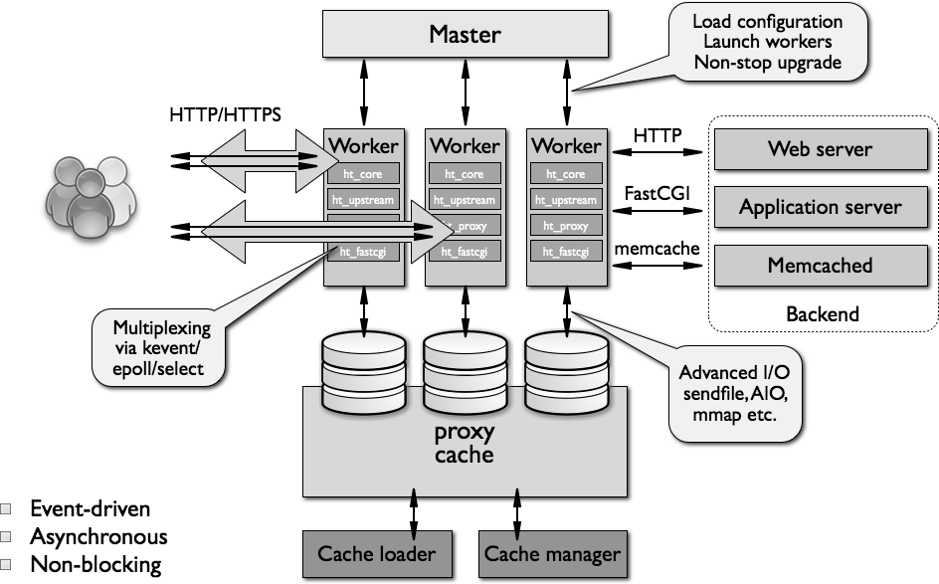
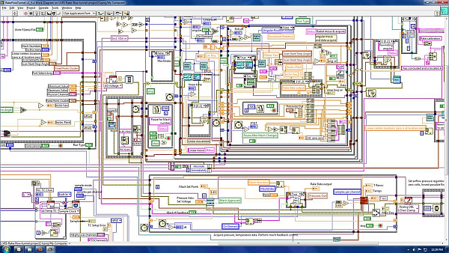
What Makes A Design Understandable?
Few components with clear roles
Few interactions between components
Carefully choose the features and interfaces
Similarity with other designs
Use design patterns

Slide 5
Benefits of a Software Design
Provides a systematic approach to a complex problem
Finds bugs before you code
Enables many people to work in parallel
Promotes testability

Slide 6
Steps in Design
Iterate. Iterate. Iterate.
Identify the users
Describe who your users are and what they want from the tool at a high level
Functional design:
Describe what the system does (use cases)
Component design: Specify the components
Each use case has a "Top level" component.
Sub-components implements portions of the use case
Ideally want many components that are common across use cases

Slide 7
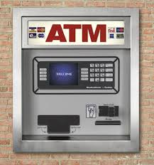
Running Example: Design of ATM

Slide 8
User stories

Slide 9
Planning begins with your users
Who are your users?
E.g. researchers, policy makers, developers, children, trained monkeys
What do they want to do with your software?
How are they interacting with it?
What skill level will they have and how will that impact the design?

Slide 10
Running Example: Design of ATM

Slide 11
Start by writing a user story
Who is the user. What do they want to do with the tool. What needs and desires do they want for the tool. What is their skill level.

Slide 12
Start by writing a user story
Ram is a bank customer. Ram wants to check his balance, deposit money, take out money. Ram wants a safe and secure interface for interacting with the ATM. Ram’s job does not involve technical skills and he values a simple user interface.

Slide 13
Start by writing a user story
Other user stories?

Slide 14
Start by writing a user story
Valentina is an ATM technician. She services ATMs as part of preventative maintenance, applies hardware and software updates and for performs emergency repairs. For maintenance and updates she will follow a standard protocol. For repairs, she needs access to a diagnostic interface. Valentina is highly technical and knows how to replace standardized parts.

Slide 15
Start by writing a user story
You will probably have several different kinds of “users” and a “technician” or two.
If you have a machine learning model backing your tool, don’t forget the “technician” who will train the machine learning model or update it.
Take a few minutes to write 2-3 user stories with your team.

Slide 16
Functional Design (Use Cases)

Slide 17
Running Example: Design of ATM

Slide 18
Your user stories should reveal these
Ram is a bank customer. Ram wants to check his balance, deposit money, take out money. Ram wants a safe and secure interface for interacting with the ATM. Ram’s job does not involve technical skills and he values a simple user interface.
Get cash
Deposit checks
Check balances

Slide 19
What Do We Do With ATMs?
Get cash
Deposit checks
Check balances
These are examples of Use Cases.
Implied use case – User authentication.

Slide 20
Describing a Use Case
What information the user provides
E.g., command entered with its options
What responses the system provides
E.g., prompts, plots, error messages
Authenticate User Use Case
User: Put ATM card in reader
ATM: Display 'Enter PIN'
User: Enters PIN on keyboard
ATM: [if correct] Show main menu
[if incorrect] Display 'Enter PIN'

Slide 21
Functional design
Take some time with your team to translate 2-3 user stories into a use cases (functional designs)
Use a Markdown file in the doc directory!
Don’t forget the implied use cases!

Slide 22
Component Design

Slide 23
Specification of Components
Describe components with sufficient detail so that someone with modest knowledge of the project can implement the code for the component.
Name
What it does
Inputs (with type information)
Outputs (with type information)
How use other components

Slide 24
Developing Component Specifications
What are the components in the use cases?
What components are already available?
What are the sub-components needed to implement those components that aren't already available?
Do 1-2 for each such component

Slide 25
Example Component Specification Find Primes < N
Name
FindPrimes
What it does:
Finds the primes that are less than N
Inputs (with type information)
N, an integer
Outputs (with type information)
List of integers

Slide 26
Use case: Find Primes < N
Name
FindPrimes
What it does:
Finds the primes that are less than N
Inputs (with type information)
N, an integer
Outputs (with type information)
List of integers

Slide 27
Pseudo Code: "How Use Other Components"
Pseudo code for finding the primes < N if the one component is divides
For n < N
is_prime = True
For d < n
If divides(n, d)
Then is_prime = False
If is_prime, add n to list_of_primes
"Rules" for pseudo code
Consistent use of flow control & variable names
Readable English where details are sparse
Notes:
Not executeable statements
Some logic is implied (e.g., initializing list_of_primes)

Slide 28
ATM Components by Use Case
Authenticate user
Database with user PIN
User interface that reads ATM card
User interface that reads user PIN
Control logic
Get cash
Database with users cash balance
User interface that reads user cash requested
Cash drawer interface that dispenses cash
Control logic

Slide 29
Use case: Authenticate user
Name
AuthenticateUser
What it does:
Verifies a user is in the database and that the pin supplied by the user is correct
Inputs (with type information)
Card number, a string that is the user’s card no.
Pin, an integer
Outputs (with type information)
Boolean: True if success, False if failure

Slide 30
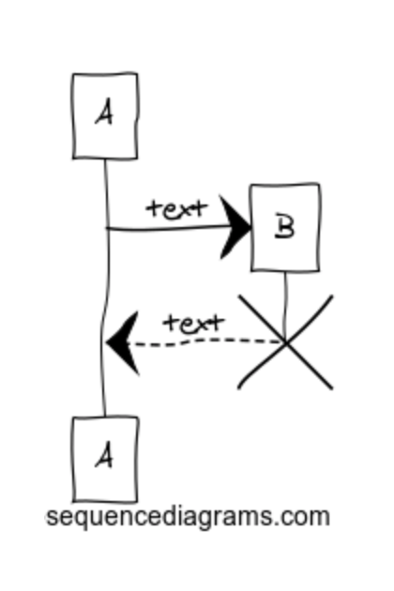
Interaction diagrams
These describe interactions between your components, users, filesystems, etc.
Very useful for describing how things relate without words
Web tools for making these
E.g. https://www.websequencediagrams.com

Slide 31
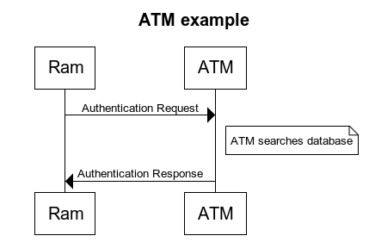
Interaction diagrams
title ATM example
Ram->ATM: Authentication Request
note right of ATM: ATM searches database
ATM->Ram : Authentication Response

Slide 32
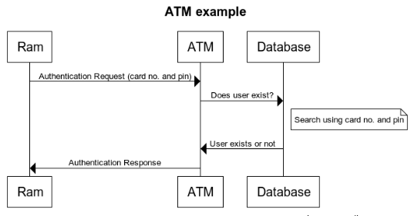
Interaction diagrams

Slide 33
After today…
Use Markdown files in the doc directory to complete the design
Add, commit, push at the end of class
We will review these next Tuesday out of class.
Notes:
Question: From the perspective of evolutionary biology, are organisms designed? Why or why not?

