Slide 1



Software Engineering for Data Scientists
Knowledge and solutions for a changing world
Advancing data-intensive discovery in all fields
Be boundless
Version Control, part 1
David A. C. Beck (dacb)
Chemical Engineering & eScience Institute

Slide 2
A note…
Ecosystem integration
  What is the relationship between
    The command line
    Python
    Jupyter notebooks
    Version control
  Why aren’t we using an Integrated Development Environment (IDE) for our Python work?

Slide 3
Overview
What is version control?
Why do I need version control?
What are git and GitHub?
Hands-on guided tour

Slide 4
What is version control?
Writing a white paper or document with colleagues…
  Use undo to revert to a previous state
  Use track changes when sharing doc with your advisor

Slide 5
What is version control
Version control is like a combination of undo and track changes for your code
  You can revert to previous versions of code
  You can easily identify who contributed what
  Version control is about tracking versions of code and developing software with people

Slide 6
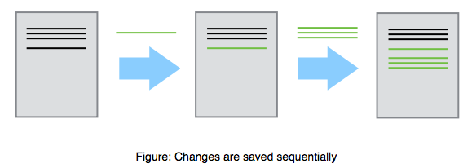
What is version control?

Slide 7
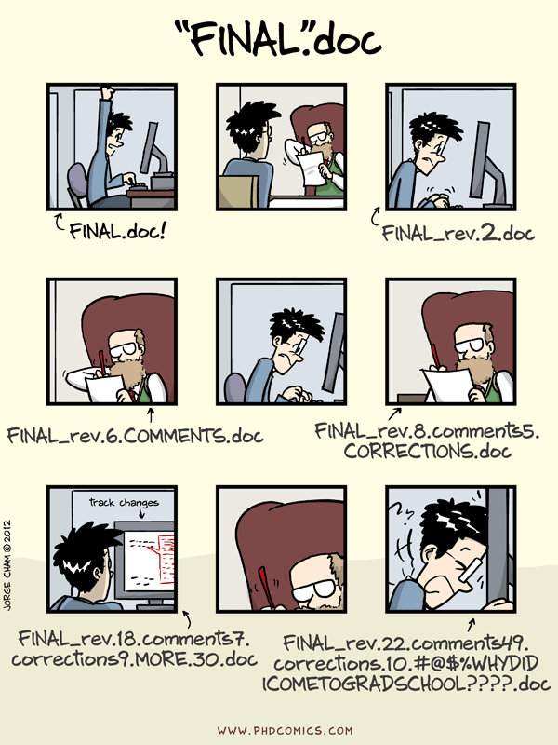

Slide 8
Why do I need version control?
You have a working piece of software
  You add some new features
  Everything is broken
  You want to revert to the last known working version

Slide 9
Why do I need version control?
You are developing software with other people
  You want to be able to identify and resolve conflicts during code development
    Two people working on the same function at the same time
  You need to be able to identify who is responsible for what pieces of code

Slide 10
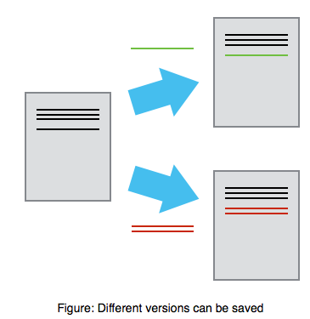
Why do I need version control?

Slide 11
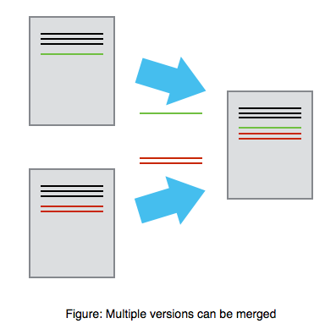
Why do I need version control?
Mary
Alice

Slide 12
Why else?
You want a job
  No one will hire a software developer that doesn’t know how to use version control

Slide 13
What is git?
Git is the most popular version control software
Git is open source
Git runs on every platform
  even Plan 9 From Outer Space
Git is better than all previous version control tools (in my opinion, and I’ve used quite a few)

Slide 14
What is GitHub?
‘Git in the cloud’
  Your git repository lives on GitHub.com
  Other people can download and use your code
  There is an issue tracker for your code
  You can develop code collaboratively using GitHub

Slide 15
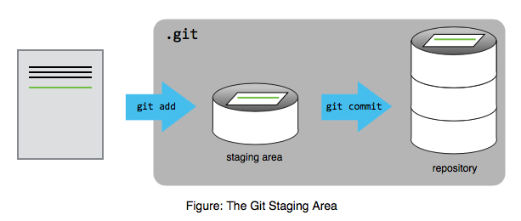

Slide 16
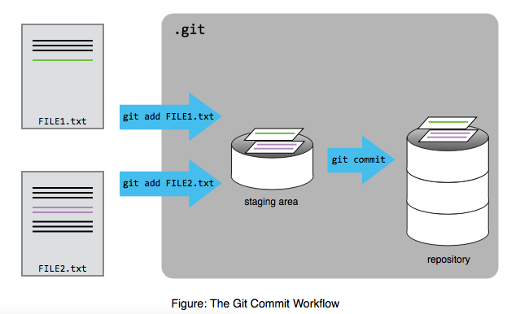

Slide 17
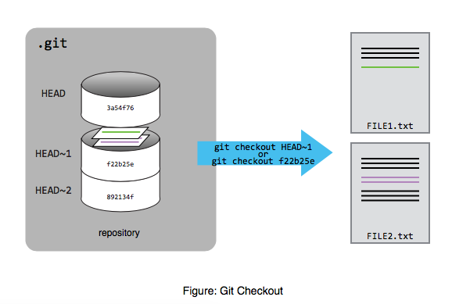

Slide 18
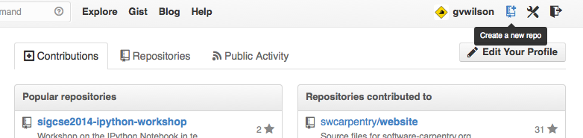

Slide 19
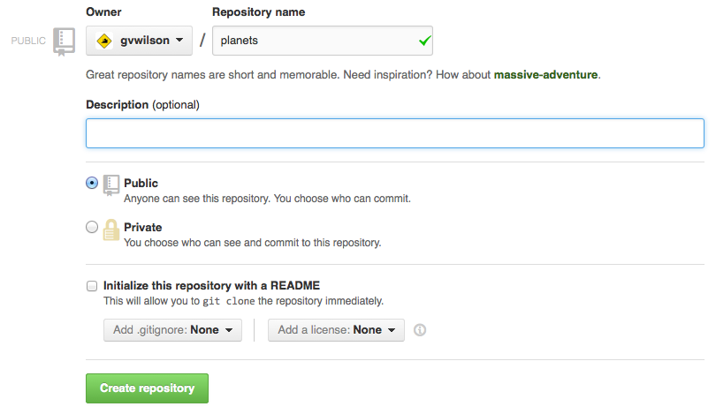

Slide 20
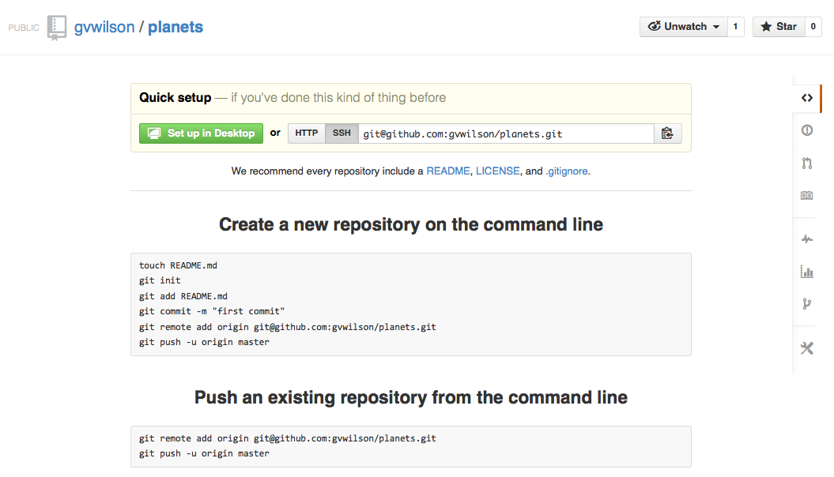

Slide 21
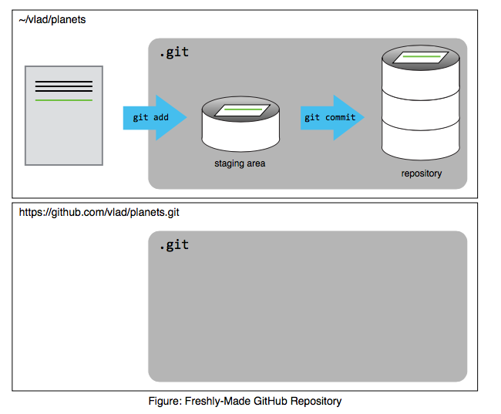

Slide 22
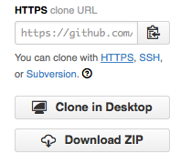

Slide 23
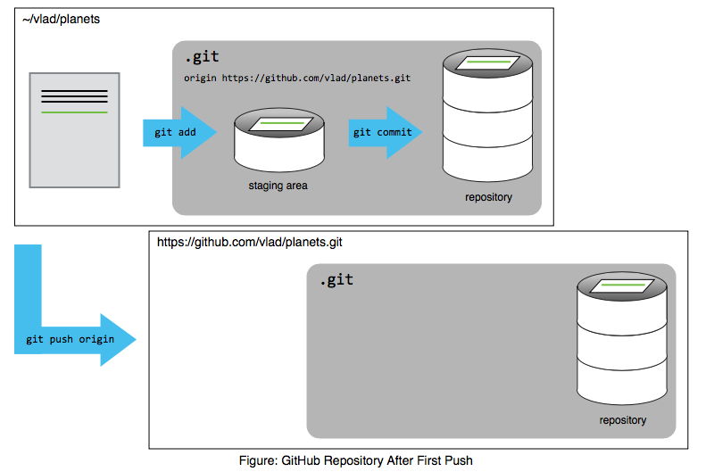

Slide 24
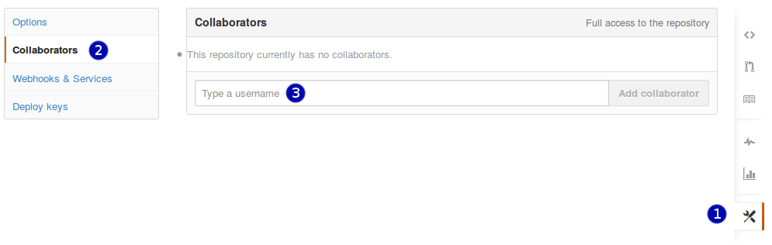

Slide 25
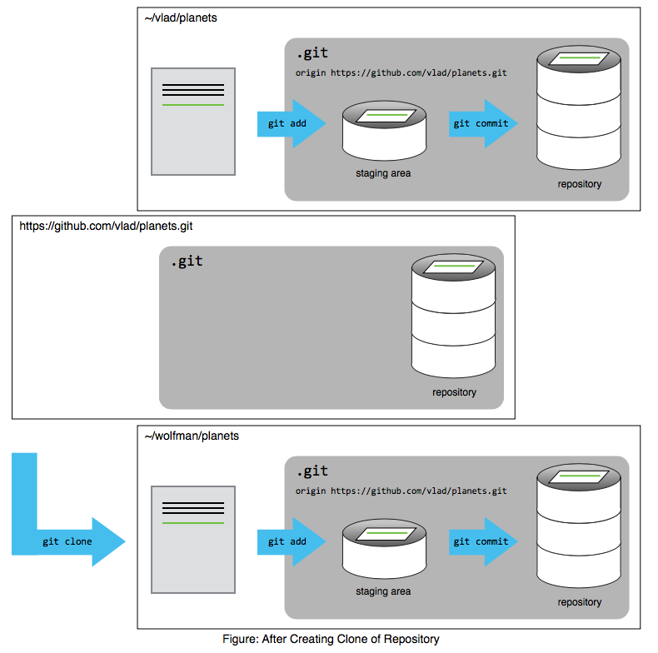

Slide 26
