Slide 1

Software Engineering for Data Scientists
Software Design
David Beck^{1,2}, Joseph Hellerstein^{1,3}, Jake VanderPlas^{1,4}
¹eScience Institute
²Chemical Engineering
³Computer Science Engineering
⁴Astronomy
University of Washington
March 13, 2016

Slide 2

Beck, Hellerstein & VanderPlas, 2017

Slide 3
Software Design
"...specification of a software artifact, intended to accomplish goals, using a set of primitive components ..." [wikipedia]
Beck, Hellerstein & VanderPlas, 2017
Notes:
Question: From the perspective of evolutionary biology, are organisms designed? Why or why not?

Slide 4
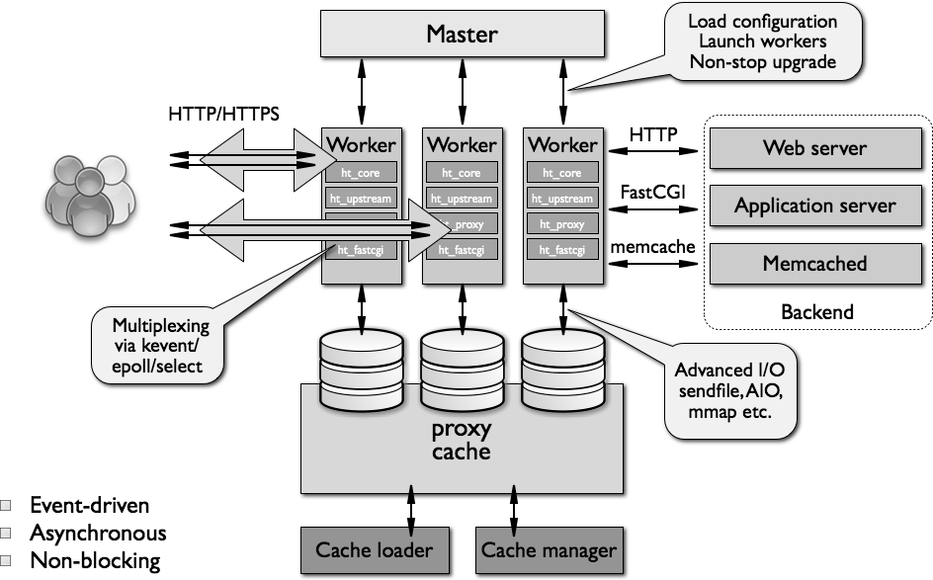
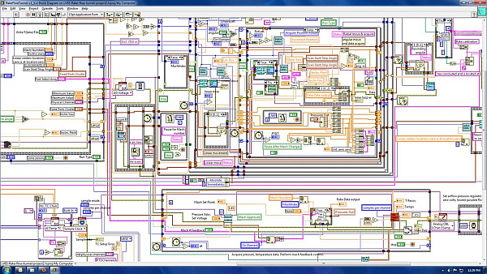
What Makes A Design Understandable?
Few components with clear roles
  Use abstraction hierarchies
Few interactions between components
  Carefully choose the features and interfaces
Similarity with other designs
  Use design patterns
Beck, Hellerstein & VanderPlas, 2017

Slide 5
Benefits of a Software Design
Provides a systematic approach to a complex problem
Finds bugs before you code
Enables many people to work in parallel
Promotes testability
Beck, Hellerstein & VanderPlas, 2017

Slide 6
Steps in Building Software
Describe what the system does (use cases)
Specify the components
  Each use case has a "Top level" component.
  Sub-components implements portions of the use case
    Ideally want many components that are common across use cases
Iterate. Iterate. Iterate.
Beck, Hellerstein & VanderPlas, 2017

Slide 7
Use Cases
Beck, Hellerstein & VanderPlas, 2017

Slide 8
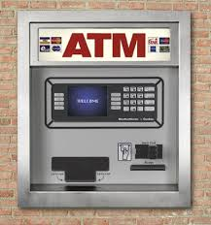
Running Example: Design of ATM
Beck, Hellerstein & VanderPlas, 2017

Slide 9
What Do We Do With ATMs?
Get cash
Deposit checks
Check balances
These are examples of Use Cases.
Implied use case – User authentication.
Beck, Hellerstein & VanderPlas, 2017

Slide 10
Describing a Use Case
What information the user provides
  E.g., command entered with its options
What responses the system provides
  E.g., prompts, plots, error messages
Authenticate User Use Case
User: Put ATM card in reader
ATM: Display 'Enter PIN'
User: Enters PIN on keyboard
ATM: [if correct] Show main menu
[if incorrect] Display 'Enter PIN'
Beck, Hellerstein & VanderPlas, 2017

Slide 11
Component Specifications
Beck, Hellerstein & VanderPlas, 2017

Slide 12
"Functional" Specification of Components
Describe components with sufficient detail so that someone with modest knowledge of the project can implement the code for the component.
  Name
  What it does
  Inputs (with type information)
  Outputs (with type information)
  How use other components
Beck, Hellerstein & VanderPlas, 2017

Slide 13
Developing Component Specifications
What are the components in the use cases?
What components are already available?
What are the sub-components needed to implement those components that aren't already available?
  Do 1-2 for each such component
Beck, Hellerstein & VanderPlas, 2017

Slide 14
Example Component Specification
Find Primes < N
Name
  FindPrimes
What it does:
  Finds the primes that are less than N
Inputs (with type information)
  N, an integer
Outputs (with type information)
  List of integers
Beck, Hellerstein & VanderPlas, 2017

Slide 15
Pseudo Code: "How Use Other Components"
Pseudo code for finding the primes < N if the one component is divides
  For n < N
    is_prime = True
    For d < n
      If divides(n, d)
      Then is_prime = False
    If is_prime, add n to list_of_primes
"Rules" for pseudo code
  Consistent use of flow control & variable names
  Readable English where details are sparse
Beck, Hellerstein & VanderPlas, 2017
Notes:
Not executeable statements
Some logic is implied (e.g., initializing list_of_primes)

Slide 16
ATM Components by Use Case
Authenticate user
  Database with user PIN
  User interface that reads ATM card
  User interface that reads user PIN
  Control logic
Get cash
  Database with users cash balance
  User interface that reads user cash requested
  Cash drawer interface that dispenses cash
  Control logic
Beck, Hellerstein & VanderPlas, 2017

Slide 17
Summary
Use cases
  Details of the user interactions with the system
Design
  Component specifications
    Name
    What it does
    Inputs
    Outputs
    How it uses other components
Beck, Hellerstein & VanderPlas, 2017

