Slide 1


A crash course in ideation

Slide 2
If I only had time for 3 things…
big fish
convergent/divergent
priming, pros & cons
intrinsic/extrinsic
skill & process > talent

Slide 3
“How to catch a big fish:
1. Catch a lot of fish.
2. Throw back all the little ones.”
Linda Carson
@lccarson
lccarson@gmail.com
Please jot down a noun & answers (for later). Thanks.
Notes:
Crash course
Ditch the stereotypes; leverage the differences
Tell you some key findings about creativity, from psychology & practitioners
Show you how to practice
Jot down:
A noun you might have to say out loud later
Something you know an unusual amount about, perhaps more than anyone here
In the workplace
Outside the workplace

Slide 4
“There are fewer rules than you think”
Linda, don’t go to the next slide until after the divergent and convergent noun exercises.
What happens in Vegas, stays in Vegas.
Say yes.
Be kind.
Edit later.
Laughter is praise.
Notes:
Random nouns to practice divergent and convergent thinking:
Free association
Forced association
Remote associates

Slide 5

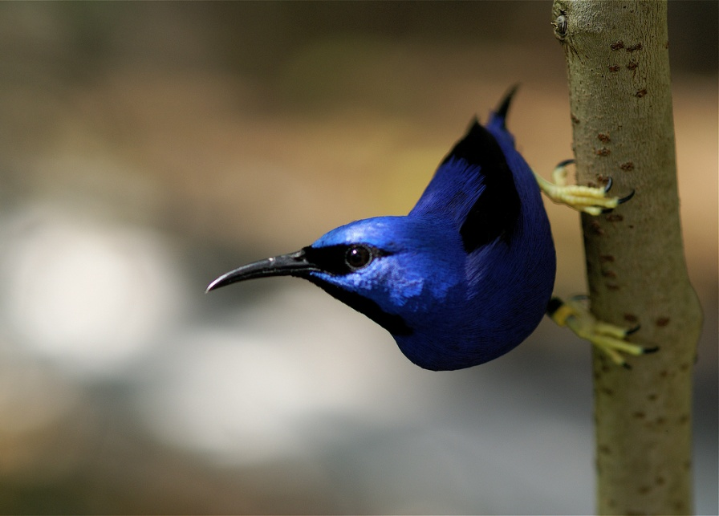
Notes:
MrClean1982, creative commons, http://www.flickr.com/photos/mrclean/507500551/
voyageAnatolia.blogspot.com, creative commons, http://www.flickr.com/photos/fotogezi/2904707915/

Slide 6
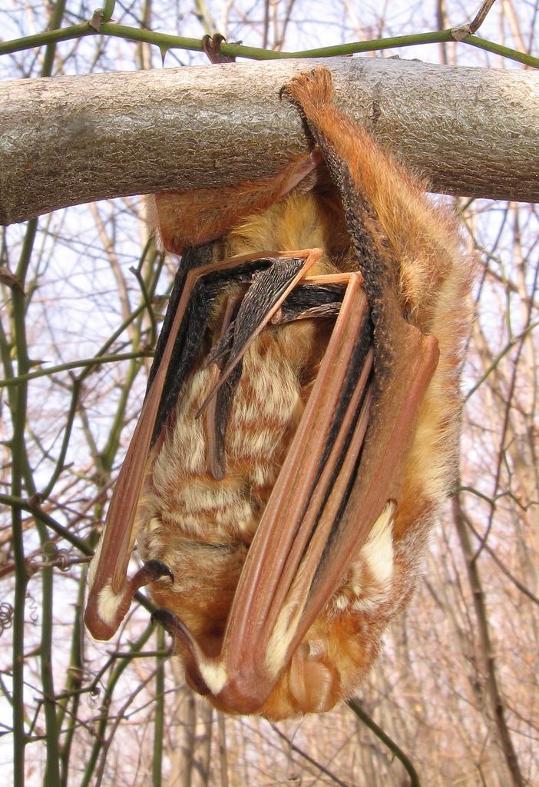

Notes:
tonx, creative commons, http://www.flickr.com/photos/tonx/45026294/
Anita363, creative commons, http://www.flickr.com/photos/anitagould/123840700/

Slide 7



Notes:
Bob Jagendorf, creative commons, http://www.flickr.com/photos/bobjagendorf/137869644/
Lord Dane, creative commons, http://www.flickr.com/photos/lord_dane/5058487375/
Alessandro Pinna, creative commons, http://www.flickr.com/photos/alessandropinna/3600909115/

Slide 8
Briefly: How to be creative
Preparation
Incubation
Inspiration
Verification
Divergent/convergent
Priming, pros & cons
Intrinsic/extrinsic
Start solo!
Defer judgment
Seek quantity, not quality
Question assumptions
Go over the top
Stir
Take notes and follow through
Iteration
Notes:
Skills and fluent process trump talent. Here’s what skills and process look like.
The normal tempo and patterns of our workplaces are seldom ideal for creative thinking. What can you tweak to improve that?
Not instantly.
Not forever.
Just sometimes, either when things are unusually mellow or when the need for creativity is unusually urgent.
Key concepts from creative thinking that you need to consciously incorporate at work because the normal workplace, the normal tempo of work, don't naturally put these into place. You can get away without any of these, but you can usually do a more reliable and productive job if you can put more of them in place. "All other things being equal"

Slide 9
Linda’s seven-point plan for making the most of many minds
How innovators can turn idea generation into a team sport

Slide 10
1. Defer judgment.
“The core skill of innovators is error recovery not failure avoidance.”
Randy Nelson
“Scientists have another name for failure: data.”
Tina Seelig
Notes:
Guildford observes that the earliest ideas are the least creative.
Separate the writing from the editing. Separate the writer from the editor.
Freedom to fail.
Randy Nelson, former Dean of Pixar University
Tina Seelig, Executive Director, Stanford Technology Ventures Program, inGenious

Slide 11
2. Seek quantity, not quality.
“Ideas have to be like ninjas, plentiful and ready to die.”
Suzanne Pope
Notes:
Divergent thinking
“What’s the next right answer?”
Linda Carson
Suzanne Pope, Senior VP and Creative Director, Sudler & Hennessey ad agency in Toronto

Slide 12
3. Question assumptions.
“I have a friend I go to whenever I have a really tough problem to solve. After I explain it to him, invariably his first question is, ‘What rules can we break?’ He knows that I have assimilated so many rules into my thinking that after a while they become blind assumptions. It’s difficult to be innovative if you’re following blind assumptions.”
Roger von Eoch
Notes:
This is the “outside the box” part.
Open vs closed problems, how to open an apparently closed problem;
“There are fewer rules than you think.”
Linda Carson
Roger von Eoch, writer/speaker on creativity, toy-maker

Slide 13
4. Go over the top.
“It is easier to tone down a wild idea than to think up a new one.”
Alex F. Osborne
Notes:
Divergent thinking
Alex Osborne, ad exec, “brainstorming”

Slide 14
5. Stir: Debate; Combine & extend ideas; Use ideas as stepping stones.
“Creativity occurs at the intersection of previously unconnected planes of thought.”
Dorothy Leonard
Notes:
Convergent thinking
Analogical thinking
Dorothy Leonard, the William J. Abernathy Professor of Business Administration Emerita, Harvard

Slide 15
6. Take notes and follow through.
“Never go anywhere without pen and paper. Not even to bed. Especially not to bed.”
Linda Carson

Slide 16
Step 7 is really the 0th step
The most important rule for making idea generation a team sport…

Slide 17

Start solo.
“There are no good collaborations … Once the miracle of creation has taken place, the group can build and extend it, but the group never invents anything.”
John Steinbeck
Notes:
Talk about priming.
“A meeting where no one took notes is a meeting that never happened.”
Linda Carson
John Steinbeck, novelist, Grapes of Wrath, East of Eden, Of Mice and Men

Slide 18
Practicing what I preach
Small groups test-drive different methods:
What’s the technique?
What was your problem?
How many ideas?
Most promising idea?
Wildest idea?
What would this technique be good for? Not so good for?

Slide 19
It’s about improving the odds
“Findings from psychological studies are a bit like batting averages. Except—and this is critical—you’re not the batter. You’re the at bat.”
Jamil Zaki
Notes:
http://blogs.scientificamerican.com/moral-universe/2013/09/05/psychological-studies-are-not-about-you/

Slide 20
Incremental, timely change
Translating the principles into everyday actions
Do you have time and interest and need, today, on this project, to unpack the way you’re tackling it for a bit and see if you can improve it?
Notes:
Incremental change > sweeping change
Use these skills when you need them most and with every success you’ll improve and you’ll build a case for doing it more

Slide 21
Thank you.
Any questions?

Slide 22
Bonus slides for future reference

Slide 23



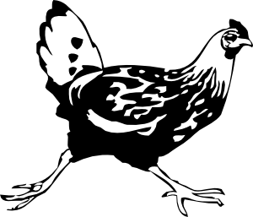

A man with a fox, a chicken, a bag of grain & a small boat
Notes:
Open and closed problems

Slide 24
Red herrings like fox/chicken/grain
Closed problems
A solution exists
There’s just one solution
We’ll recognize it when we see it
Yes, this demands some creative insight, but mostly this calls for convergent production
Open problems
There may not be a solution
There may be many solutions
We may not know what a solution would look like
This calls for more fluent divergent production and questioning the rules
Notes:
Some approaches to solving closed problems may not generalize or scale up. Sometimes the more critical solution may depend on recognizing that the problem is closed and that solving it in that form isn’t as good a solution as breaking it open and solving that version.

Slide 25
This bit is sort of brainstorming.
How to be creative
Preparation
Incubation
Inspiration
Verification
Divergent/convergent
Priming, Pros & Cons
Intrinsic/extrinsic
Start solo
Defer judgment
Seek quantity, not quality
Question assumptions
Go over the top
Stir
Take notes and follow through
Iteration
This bit is classic brainstorming...
…but this bit is bigger than brainstorming.
Notes:
You may have read that brainstorming “doesn’t work.” That’s why I’m not teaching you classic brainstorming.
“Defer judgment” is brainstorming in the sense that it says “don’t judge ideas during brainstorming”.
It’s not brainstorming in that most classical brainstorming is just about producing the ideas, and there’s nothing built in for judging them. That’s a later, necessary part of dealing with the output of brainstorming, but it’s not part of brainstorming. Make sense?
Let me generalize from the advice of many different creative practitioners.
Out of everything I’ve said today, what’s surprising? What resonates with your own experience? How could you change something about your day to do more of just one of these things?

Slide 26
Priming
What do you know an unusual amount about?
Stereotype threat
Heterogeneity
“The adjacent possible”
Linda says, “Big problems are seldom solved by naïve outsiders. What an outsider can contribute is an unexpected dimension to the solution space.”
Notes:
Priming is a normal psychological phenomenon. Our responses to stimuli are biased by prior experience.
Stereotype threat is another psychological phenomenon. People’s performance on many cognitive tests can be diminished by reminding them of their membership in some social group about which there is a stereotypical performance expectation.
Steven Johnson, in Where Ideas Come From: “The scientist Stuart Kauffman has a suggestive name for the set of all those first-order combinations: "the adjacent possible." The phrase captures both the limits and the creative potential of change and innovation..” I suspect Kauffman was being pretty literal about the origins of life. Johnson is being metaphorical about innovation.

Slide 27
I just checked Amazon and there were six hundred books on Creativity & Genius. I haven’t read them all. Here are some books I found valuable. They’re not all trying to do the same things, but I got good stuff from all of them.
Austin Kleon’s Steal Like an Artist: 10 Things Nobody Told You About Being Creative
Chip and Dan Heath’s Made to Stick: Why Some Ideas Survive and Others Die
Daniel Goleman’s The Creative Spirit (companion to a PBS television special)
James C. Kaufman and Robert J. Sternberg’s The Cambridge Handbook of Creativity
Julia Cameron’s The Artist’s Way
Keith Sawyer’s Zig Zag: The Surprising Path to Greater Creativity
Michael Michalko’s Thinkertoys: A Handbook of Creative Thinking Techniques
Mihaly Csikszentmihalyi’s Creativity: Flow and the Psychology of Discovery and Invention
Roger von Oech’s A Whack on the Side of the Head: How You Can Be More Creative
Shelley Carson’s Your Creative Brain: Seven Steps to Maximize Imagination, Productivity, and Innovation in Your Life (no relation)
Steven Johnson’s Where Good Ideas Come From: The Natural History of Innovation
Tina Seelig’s inGenius: Unleash Your Creativity to Transform Obstacles into Opportunities
Twyla Tharp’s The Creative Habit: Learn It and Use It for Life (see also, The Collaborative Habit)

