Slide 1
Docker Containerization
docker run hello-world
Rob Fatland, Kristen Finch
UW IT Research Computing
2-DEC-2025
Hypothesis refinement: AWS Q Developer coding assistant

Slide 2
The Lab Sequence: Optional “code along”
docker run hello-world
Run a hello-world Docker Image (this page)
Access workshop content (copy with git clone or read along)
  git clone https://github.com/robfatland/docker-workshop
Simplest possible Container–from–Dockerfile
Bind mount
Summary + Context
Build a Prime Checker web application on Localhost: C–C
Run ResNet-50 as a web app: From HuggingFace to Localhost
Summary + Conclusion

Slide 3
Part 2. Clone the repo for this Docker Container workshop
git clone https://github.com/robfatland/docker-workshop
Clone this repository for localhost material; or you can simply visit the above website
The repo includes documents that go further into what why and how.
Workshop instructions: Follows this procedural
Docker Q&A: Learning by asking questions
Docker Reference: Learning by reading themes (includes a K-means walkthrough)
This Google Slides deck as a pdf
The repo includes three project folders used later in the workshop

Slide 4
Part 3. Dockerfile (No actions for this slide)
FROM python:3.11-slim
This single line of text is the simplest possible Dockerfile
python:3.11-slim is an existing image
  Implicitly Debian Linux comes along for the ride
    Ubuntu is based on Debian
-slim is a smaller/faster-to-load version of Python (with no C compiler)
Version number of Python (3.11): Compatibility, stability
  For example: Run python --version
Put this Dockerfile in project folder /fu to work:
  Use docker build to build a corresponding Image
  Use docker run to create the corresponding Container and run it
  After we verify it is ok: Delete everything except the Dockerfile

Slide 5
Part 3. Dockerfile: Run these!
cd ~
mkdir fu
echo FROM python:3.11-slim > ~/fu/Dockerfile
cd ~/fu && ls
docker build -t fu-image .
docker images
docker ps -a
docker run -it fu-image bash
<In the Container terminal: Try some Linux, run Python… then quit() and exit
docker ps -a
docker container prune
docker ps -a
docker images
docker rmi fu-image
docker images
notice period at the end

Slide 6
Part 3. Dockerfile sequence 2: Run these!
Repeat with a difference: Create an artifact during the visit to the Container; then leave; then go back: Still there?
cd ~/fu
docker build -t fu-image .
docker images
docker run -it fu-image bash
(From within the Container, on the command line)
  pwd
  ls
  echo curious > thiswasnotherebefore
  exit
docker ps -a
docker start -ai crazy_bullwinkle
(From within the Container, on the command line)
  pwd
  ls
  cat thiswasnotherebefore
  exit
docker rmi fu-image
docker container prune
confirm the image is present
take note of the Container name…
…use it to start the Container again
is the artifact still there?

Slide 7
Part 4: Bind Mount
This section continues to use “fu” from Part 3.
ls ~/fu
cat ~/fu/Dockerfile
echo WORKDIR app >> ~/fu/Dockerfile
cd fu
docker build -t fu-image .
mkdir ~/dwdata
echo This is the host machine > ~/dwdata/host.txt
cat ~/dwdata/host.txt
docker run -it -v ~/dwdata:/data fu-image bash

Slide 8
Part 4: Bind Mount 2
We are in the Container: A pseudo-terminal bash shell
Notice where we are: pwd
We can navigate to /data and confirm there is a text file here from the host
We can add a new text file from the Container
Then we leave to go see if this appears in ~/dwdata

Slide 9
Part 4: Bind Mount 2
pwd
ls
cd /data
ls
cat host.txt
echo This is from the Container > container.txt
exit
cd ~/dwdata
ls
cat container.txt

Slide 10
Part 5. Summary so far and Context
Part 1 (hello-world) invisibly retrieved an Image from Docker Hub
  Docker Hub is a big feature of the Docker ecosystem. It is Home Depot.
Part 2 just git clone
Part 3 fu and the Docker workflow D > I > C
Part 4 Bind Mount gets at Container Duality
  A running Container is an isolated execution space…
  …but it needs to extend into the real world to be relevant
Now we’ll step through some context to try and expand / solidify our picture of how Containers might be useful.

Slide 11
Read Later: Communication C ⇐⇒ C and U ⇐⇒C
Flask is a lightweight web framework that translates between Python functions and network API calls.
C–C uses a user-defined bridge virtual network that Containers use to pass information. The virtual network exists in the Linux kernel’s network namespace managed by the Docker daemon. We can say this network exists inside the kernel of Docker Desktop’s hidden VM.
We can inspect this network using docker network inspect prime-net.
This produces a JSON rundown of the network. Note that bridge networks like this support C–C for many Containers all on the same host. A different type of network called an Overlay Network spans multiple Docker hosts.

Slide 12

Miscellaneous Tactics
Compute anywhere: Supported by the Docker ecosystem / framework
Kristen Finch presented containerization using AppTainer on Tillicum
  Including automatic translation from Docker Containers
Naomi Alterman teaches Docker in MSE544
The Carpentries features a Docker tutorial
Why two (or more) flavors of Container?
Why ‘Docker Desktop’ + the docker command?

Slide 13
Read Later: Docker Containers in a nutshell
There are three central nouns in the Docker ecosystem: Dockerfile, Image, and Container.
Dockerfile is a text file we edit and read. Our aim is to create a Container that executes some code-based task; either continuously as with a web app; or episodically as in analysis of a dataset. Web apps are punchier for demos; analysis is more what a STEM person would use in practice.
Repeating: Dockerfile, Image, Container. Dockerfile is the starting point of a recipe for the Container. We create it within a dedicated project folder along with other components. We want to run say k-Means on a dataset. We write some Python code for this; and we also need SciKit-Learn Library with its k-Means method. So we have three files in our project folder: Dockerfile, Python code in app.py, and a requirements.txt file that lists scikit-learn, a necessary Library.
Data access we saw in the Bind Mount, part 4: Containers need to connect to the wide world.
So the Dockerfile behaves as an organizing set of instructions; and the Container executes a task when it runs. The Image is an intermediate template. It does not execute. It is a snapshot that includes everything needed to create and run the Container inside the Docker VM.
We built an Image using the command docker build. The subsequent command docker run creates a Container from the Image and then runs it. The image remains unchanged so the process can be repeated.
Crossing the fine line into too much detail: An Image is actually a layered filesystem. If we change only the Python code and do a new build: Docker will rebuild just that layer, not the entire Image: Faster development.

Slide 14
Docker Vocabulary
Docker Desktop
Docker CLI docker <task name> <qualifiers>
Dockerfile
Image
Container
Docker workflow pull → create → run → exit
Docker hub
Docker Engine
Docker client
Docker daemon
Docker root
Docker Compose

Slide 15
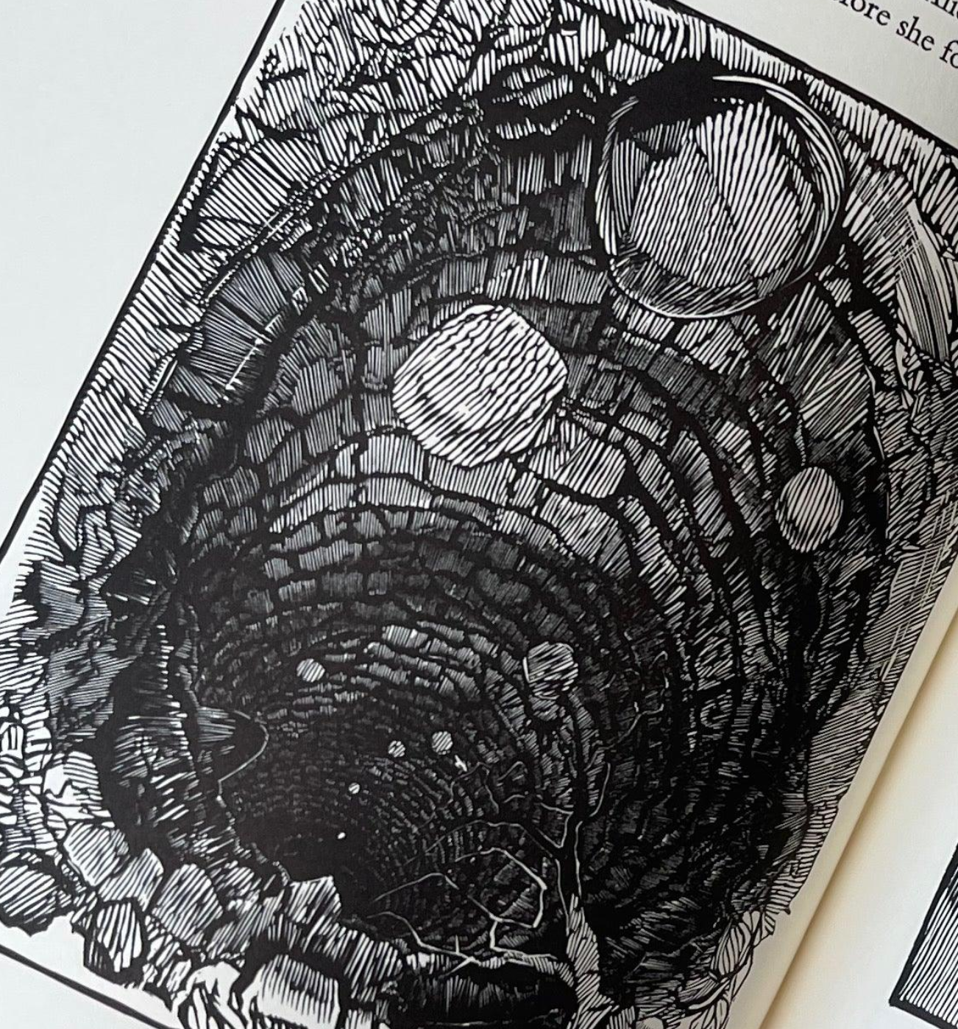
Container Duality
On one hand: Containers function like hermetic automaton VMs (that borrow the OS)...
  “I’m not a VM!!! …but I am isolated” -the Container
On the other hand: Containers need connectivity to the outside world
  Container to terminal or browser (port-wise)
  Container to disk (volume-wise)
  Container to Container (network-wise)
Today’s plan / Container-learner’s plan
  Get into the Container headspace
  Maximize awareness, skills
  Minimize the rabbit hole
Docker Containers need connectivity to the outside world in three ways (setting aside terminal access): ports, volumes and networks. Port connectivity is for Container to Host port of course. Volume connectivity is for filesystem overlap, i.e. data / results from the Container are visible in the Host. Networks exist within the Docker VM and facilitate communication between Containers.

Slide 16
Philosophical Concerns
Containerization – we will find – follows from some design principles
isolation no collisions / overlap with host
abstraction Images, Containers are “somewhere”
multiplication From one Image: Many Containers
derision resilience Container modified → auto-saves
(and more resilience to follow)
Separation of Concerns: Map pieces of a complex workflow to Containers

Slide 17
The Diagram
Docker Engine API
Docker daemon
Image
Image
User
Image
Image
Container
Container
bash shell (Linux)
Container
Container
Container
Container
docker CLI
Network
Forwarding
Port
Port
Volume
Volume
Same/Shared
Docker Desktop VM

Slide 18
Docker Images and Containers
‘Don’t Worry About It: Abstraction’
In the bash shell: We run the command docker with arguments
docker run hello-world checks locally, then scoots to docker hub
There it gets an image and converts that into a container
The container runs, does what it does, halts
We never worry about where the containers and images are on localhost because we are managing them via the docker command. This is a key design feature called abstraction.

Slide 19
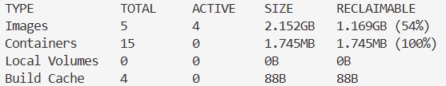
No worrying: Linux ‘disk free’ (df) command
…so now we turn to the file/image/container ecosystem…
this df command is running inside the Docker VM

Slide 20
Ports, Volumes, Networks
Reminder: Containers must connect to the outside world
  Port mapping: localhost to Container ‘View a web app’
    Resolve: Does this include the -ai attach?
  Volumes: Preserve stable information
    Named volumes (inside the Docker VM)
    Bind mounts (alias for a host folder)
  Networks: Container ←→ Container

Slide 21
docker run versus docker start
We run the docker CLI from a terminal: docker <action> <etc>
docker run: Create a container from an image and run the container
  default behavior: Attach the terminal to the container’s standard output
…contrast with…
docker start: Container already exists; so start it up
  default behavior: This container is old news so terminal is not connected to standard output
We can override the start default behavior using -a for “attach”
This wires up the Container output to the terminal display

Slide 22
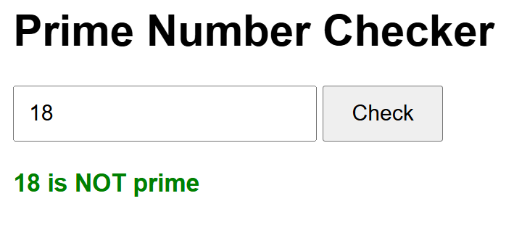
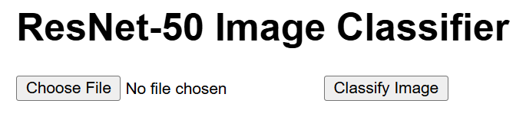
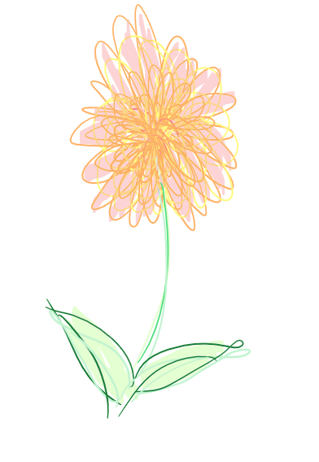
End of Part 5 Summary + Context
Remaining:
Two Container build, test
ResNet build, test
Summary & Conclusion

Slide 23
Part 6: Two Containers Working Together
Container Duality (isolation ~ connection) provides for creating networks defined within the Docker VM. Result: Multiple Containers on a single host can intercommunicate.
This example: One Container acts as a frontend (User-oriented) piece of a web application. Second Container is the backend: Evaluates a positive integer as prime or composite.
Both Containers use the Flask web framework (from Python)
We run both Containers on our host. Test by copying this URL into the browser: http://localhost:8080. Prep commands:
Create the network
Build the front-end Image
Build the back-end Image
Run the front-end Image → front-end Container
Run the back-end Image → back-end Container
docker ps (to verify the Containers are running)

Slide 24
Part 6: Two Containers Working Together
docker network create prime-net
docker build -t prime-checker .
docker build -t prime-frontend .
docker images
docker run -d --name prime-api --network prime-net prime-checker
docker run -d --name prime-web --network prime-net -p 8080:8080 prime-frontend
docker ps
Test: Browser tab address bar: http://localhost:8080

Slide 25
Read Later: Prime Check localhost web app narrative
We have two directories: prime-frontend and prime-checker. These include respective Dockerfiles used to build two Images called prime-frontend and prime-checker.
These Images were used to create and run two Containers called prime-web and prime-api.
We created a Docker network called prime-net.
We associate http://localhost:8080 with the proxy server: The Container called prime-web. This association was established between the host machine port 8080 and the Container port 8080 (where Flask is listening for traffic) using
docker run -d --name prime-web --network prime-net -p 8080:8080 prime-frontend
This docker command uses run: Converts the named Image to a Container and runs that Container.
Uses the -d flag to run in detached mode, as a background task. (We get the cursor back right away.)
The -p flag indicates a port mapping: host port:Container port.
We use docker run to start prime-api as well, also with --network prime-net
Localhost browser tab: Enter port 8080: Translates to port 8080 inside the Container (> Flask). Sends back the HTML for the web app.
The User enters a number, say 17, and clicks Check: A different message (a prime query for 17) goes to prime-web.
prime-web in turn connects to prime-api using the network prime-net. The evaluation comes back (17 is prime) and this result is passed back to the browser.
The browser never interacts with the backend prime-api Container.

Slide 26
Part 7: Running ResNet in a Container
ResNet is a Residual Neural Network invented circa 2015.
We will use an instance that fits in a modest Container.
It has already been trained to recognize 1000 categories of objects (ImageNet dataset)
It has 50 neuronal layers; and 26 million parameters.
The image classifier is not so much the point here…
…rather: a concluding look at docker build + run
…particularly relating to huggingface
cd ~/docker-workshop/resnet-classifier
docker build -t resnet-classifier .
docker run -d --name resnet -p 8081:8080 resnet-classifier
browser tab address bar: http://localhost:8081

Slide 27
WORKDIR /app
COPY requirements.txt .
RUN pip install --no-cache-dir -r requirements.txt
RUN python -c "from transformers import AutoModelForImageClassification; AutoModelForImageClassification.from_pretrained('microsoft/resnet-50')"
COPY app.py .
EXPOSE 8080
CMD ["python", "app.py"]
docker run → from Image to (running) Container
RUN → What happens to create the Image
CMD → Dockerfile: What runs in the Container
WORKDIR “where home is in the Container” /app
COPY → from project folder to home

Slide 28
Part 8. Summary and Conclusions
Once these atomic Containers become second nature: A next topic is getting multiple Containers working in concert on a collective task. This is known as Container orchestration.
On a smaller scale you can use docker compose.
On a larger scale (across many host machines) you have Kubernetes and so on.

Slide 29
Part 8. Summary and Conclusions
docker build Dockerfile (.) to Image
docker create Image to Container (no run, rare)
docker run Image to running Container
docker start Stopped Container to running Container
The UW IT RC workshop: November, KF: AppTainer + Tillicum
  Bridge to Docker via subtle auto-convert: Docker Hub > Tillicum HPC
Docker (et al) key design principles
  Rapid development, minimal support infrastructure
  Isolation from host
  Portability
  Persistence (Containers remember changes)
  From SPF/Research paradigm → Research Software Engineering paradigm
There may (will) be bumps along the way
  Localhost ARM may not translate to HPC AMD processor architecture
  One approach is Multi-Platform Building
  Another approach: Build where you will run

Slide 30
Conclusion
Docker is a Container ecosystem → learning curves
This workshop attempted ‘from the ground up’
Note existence: Tillicum / AppTainer workshop
Docker Hub: Free, public Container space
GitHub: Free, public Project space
HuggingFace: Free, public Data + Models space
Coding Assistants (Copilot, Q etc)
Orchestration
Duality
UW IT Research Computing + eScience Institute

