Slide 2
My Journey with AI Chatbots
Common-Floor Real Estate Portal: 2014
Revolutionized property searches with AI-driven chat assistance, simplifying decision-making for buyers and sellers.
DIY Loan Journey: 2019
Designed an intelligent assistant for a seamless loan process, empowering users with real-time information and support.
Health Care App: 2024
Developed an intelligent assistant to streamline operations for doctors, administrators, and patients, improving care delivery and patient experience.

Slide 3
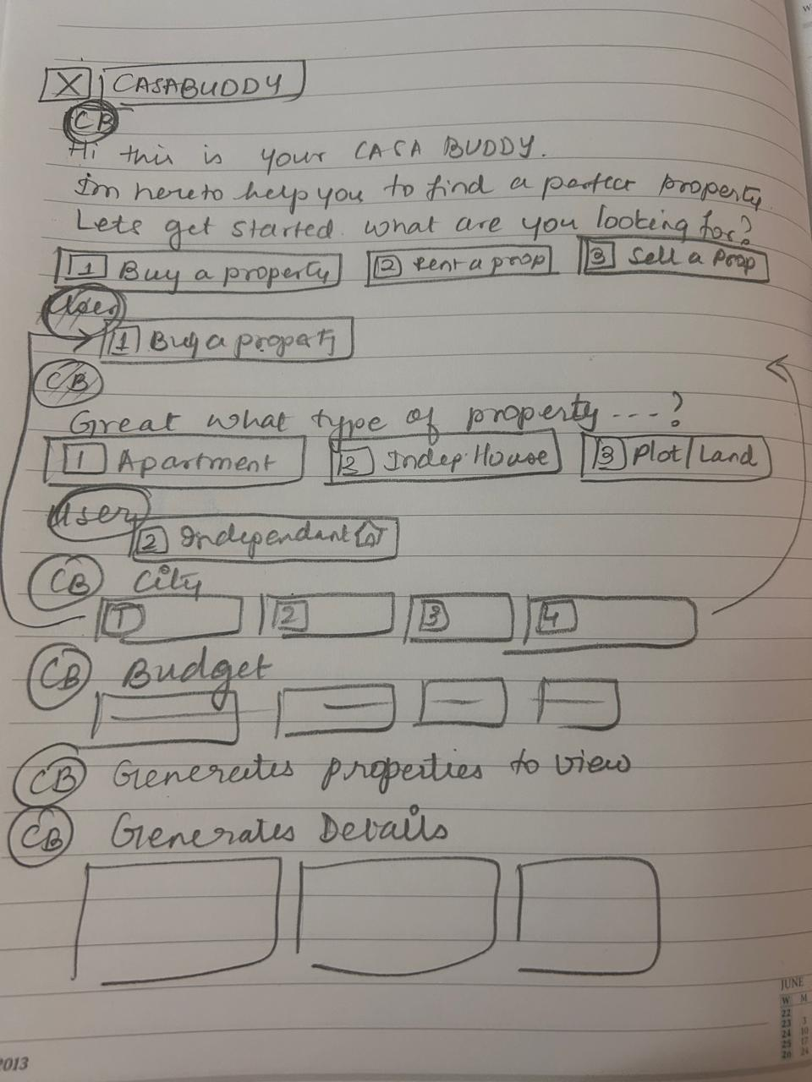
Immediate thought process

