Slide 1

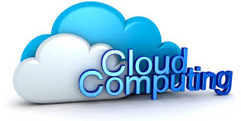
by:
RUFUS NGANGA

Slide 2
MY PRESENTATION GUIDE
What is cloud computing?
Types of cloud of Computing Services.
Advantages of cloud Computing Services.
Small Demo on Cloud Computing.

Slide 3
What is Cloud Computing
Cloud computing, often referred to as simply “the cloud,” is the delivery of on-demand computing resources—everything from applications to data centers—over the Internet on a pay-for-use basis.
(e.g., computer networks, servers, storage, applications and services)

Slide 4
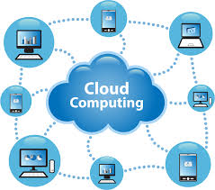
Graphical Presentation of Cloud Computing

Slide 5
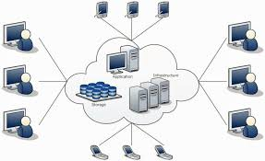
Graphical Structure of the cloud

Slide 6
TYPES OF CLOUD COMPUTING SERVICES
Software as a service (SaaS)
Cloud-based applications—or software as a service—run on distant computers “in the cloud” that are owned and operated by others and that connect to users’ computers via the Internet and, usually, a web browser. For example an email account, google, yahoo being the owners.

Slide 7
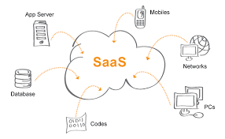
Software as a service (SaaS)

Slide 8
The benefits of SaaS
You can sign up and rapidly start using innovative business apps
Apps and data are accessible from any connected computer
No data is lost if your computer breaks, as data is in the cloud
The service is able to dynamically scale to usage needs

Slide 9
Platform as a service (PaaS)
Platform as a service provides a cloud-based environment with everything required to support the complete lifecycle of building and delivering web-based (cloud) applications—without the cost and complexity of buying and managing the underlying hardware, software, provisioning, and hosting.
Example
Google drive, Apple store, Ipage.

Slide 10
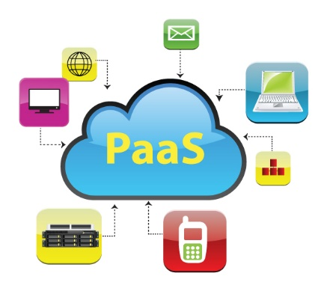
Platform as a service (PaaS)

Slide 11
The benefits of PaaS
Develop applications and get to market faster
Deploy new web applications to the cloud in minutes
Reduce complexity with middleware as a service

Slide 12
Infrastructure as a service (IaaS)
Infrastructure as a service provides companies with computing resources including servers, networking, storage, and data centre space on a pay-per-use basis.
The benefits of IaaS
No need to invest in your own hardware
Infrastructure scales on demand to support dynamic workloads
Flexible, innovative services available on demand.
Example:
Our Procurement project is on cloud.

Slide 13
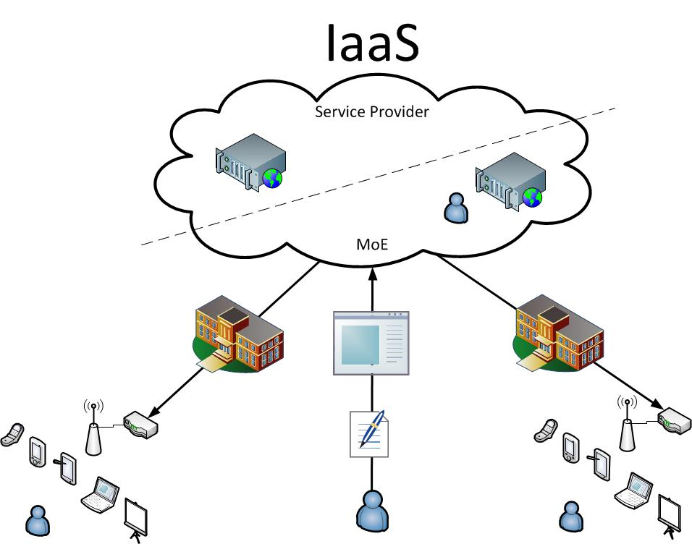
Infrastructure as a service (IaaS)

Slide 14
Infrastructure as a service (IaaS)
Infrastructure as a service provides companies with computing resources including servers, networking, storage, and data centre space on a pay-per-use basis.
demand

Slide 15
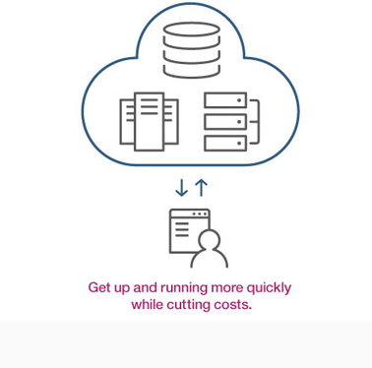
The benefits of IaaS
No need to invest in your own hardware
Infrastructure scales on demand to support dynamic workloads
Flexible, innovative services available on

Slide 16
Public cloud
Public clouds are owned and operated by companies that offer rapid access over a public network to affordable computing resources. With public cloud services, users don’t need to purchase hardware, software, or supporting infrastructure, which is owned and managed by providers.

Slide 17
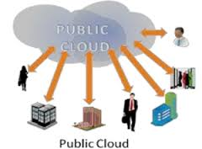
Public cloud

Slide 18
Key aspects of public cloud
Innovative SaaS business apps for applications ranging from customer resource management (CRM) to transaction management and data analytics
Flexible, scalable IaaS for storage and compute services on a moment’s notice
Powerful PaaS for cloud-based application development and deployment environment.
Example:
Git.

Slide 19
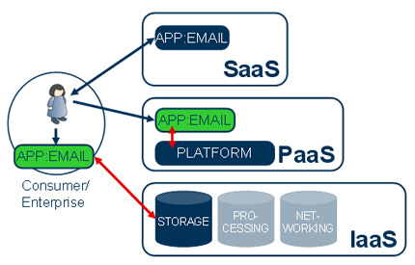
SUMMARY

