Slide 1
Segmentation of Vascular Trees using Convolutional Neural Networks
Batch No : 50
Sai Krishna R: 212714104129 IV- “C”
Siva Subramanian P.A: 212714104146 IV- “C”
Sudharshan Krishnamurthy: 212714104155 IV- “C”
Domain : Machine Learning
Guided by: Ms. D. Sasikala, Assistant Professor

Slide 2
Problem Statement
Retinal Fundus images have been widely used by ophthalmologists to diagnose and treat various diseases like Glaucoma, diabetic retinopathy and other cardiovascular diseases.
With rapid advancements in Machine Learning, especially in the medical field, an important computing system, the Neural Network is chosen to solve the problem.
A computer aided diagnostics and machine learning techniques such as Convolutional Neural Networks is used to segment the blood vessels or the vascular tree from the retinal fundus images to show a clear cut picture of the segmented vascular tree.

Slide 3
Literature Survey
Year of Work | Researchers | Work Done | Strength | Weakness
2003 | B. S. Y. Lam and H. Yan | Segmentation using Differential Vector Fields | Accurate segmentation in bright abnormalities | No prediction in dark abnormalities
2013 | Matthew D. Zeiler and Rob Fergus | Visualizing and Understanding Convolutional Networks | Accurate predictions with the CIFAR-100 dataset | Lack of a loss function that would have multiple objects per image

Slide 4
Literature Survey
Year of Work | Researchers | Work Done | Strength | Weakness
2014 | Qing Li, Weidong Cai , Xiaogang Wang, Yun Zhou, David Dagan Feng and Mei Chen | Medical Image Classification using CNN | Simple and an efficient algorithm with a single CNN layer | Limited Datasets.
2016 | Qiaoliang Li, Bowei Feng, LinPei Xie, Ping Liang*, Huisheng Zhang and Tianfu Wang | Segmented the Vascular tree from the retinal images | A near accurate prediction of the tree with respect to the ground truth | Difficulty in setting the hyperparameters

Slide 5
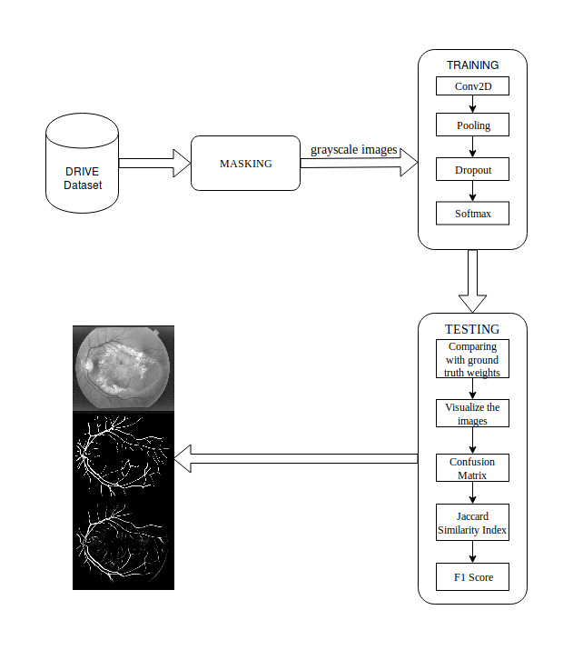
Proposed Architecture

Slide 6
The DRIVE Dataset is loaded into the memory as input and is masked using the mask image present in the dataset.
The training phase is where the masked image is given as input to the Convolutional Neural Network where activation functions and dropouts are applied to create a model for the given training dataset which is used in the testing stage.
The testing program takes the model as input and segments the vascular tree from the retinal fundus images of the test dataset. The segmented image is compared with the ground truth images and scores are evaluated accordingly.

Slide 7
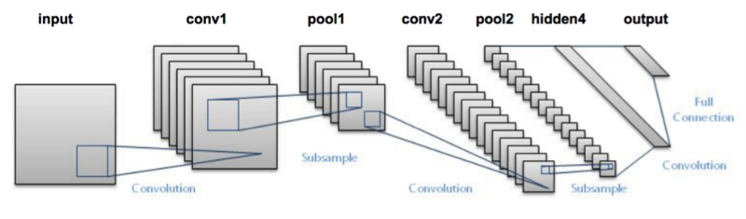
CNN Architecture

Slide 8
Modules
Masking
Training
Testing

Slide 9
Module 1: Masking
Masking is a process of combining the retinal fundus images with the masks so that it forms an image which resembles the tracing activity where a tracing paper is placed on top of a desired image.
The retinal fundus images are compared with the mask images for their dimensions and cropping factor. If they are found to be different, proper resizing and adjustments are made without losing the crucial part of the retinal fundus image.

Slide 10
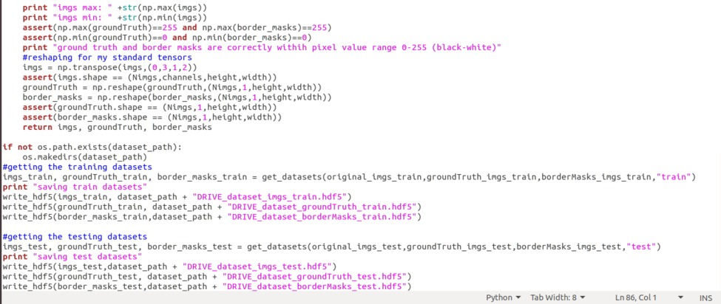
Module 1: Masking

Slide 11
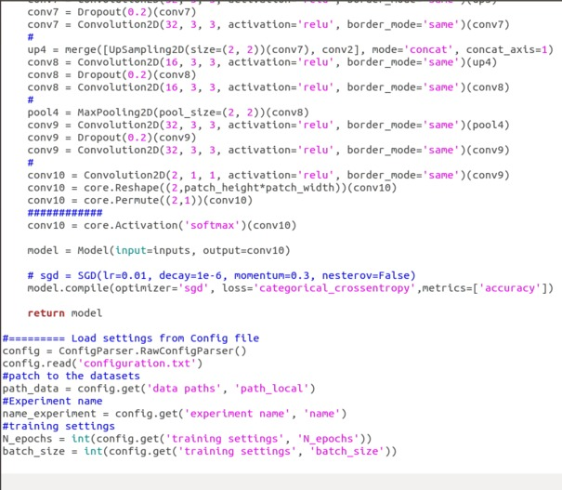
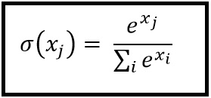
Module 2: Training the neural network
The preprocessed or the cropped green chanel image is given as input to the neural network and the training starts.
Various Convolutional layers are added to increase the efficiency.
Finally the Softmax function is used to restrict the predicted outputs in the range of [0,1].

Slide 12
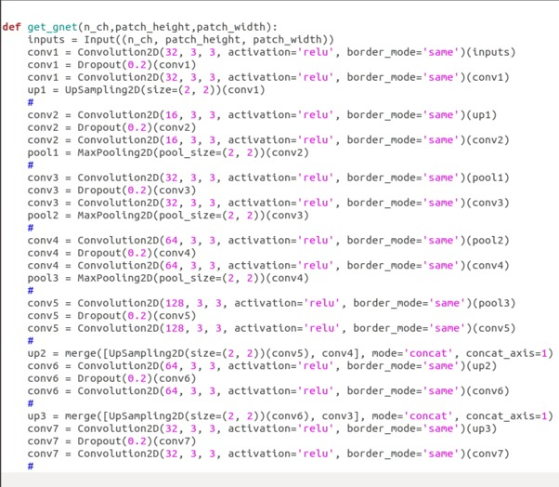
Module 2: Training the neural network

Slide 13
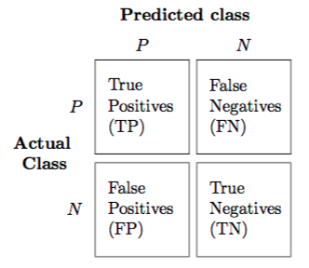
Module 3: Testing
The images that are to be tested is loaded by the testing program and are divided into patches to decrease the load of the system and to produce better results.
The masked retinal fundus images are tested with the trained model by applying hyperparameters like stride height, stride width, number of epochs and number of patches.
Confusion Matrix

Slide 14

Module 3: Testing
F1 Score:
It is a measure of a test's accuracy. It considers both the precision p and the recall r of the test to compute the score: p is the number of correct positive results divided by the number of all positive results returned by the classifier, and r is the number of correct positive results divided by the number of all relevant samples.

Slide 15
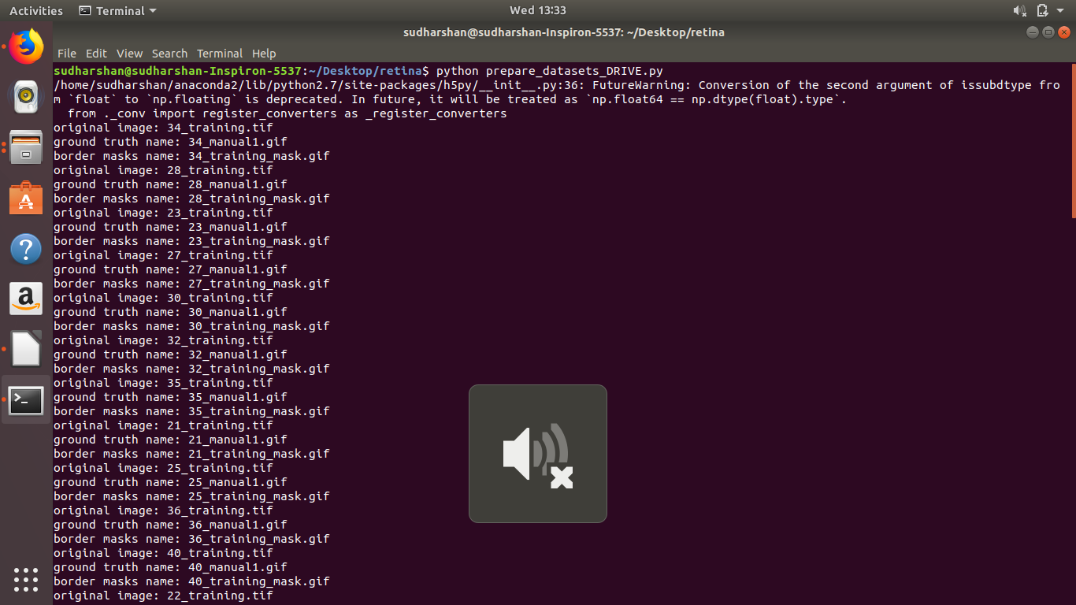
Screenshot of the masked images

Slide 16
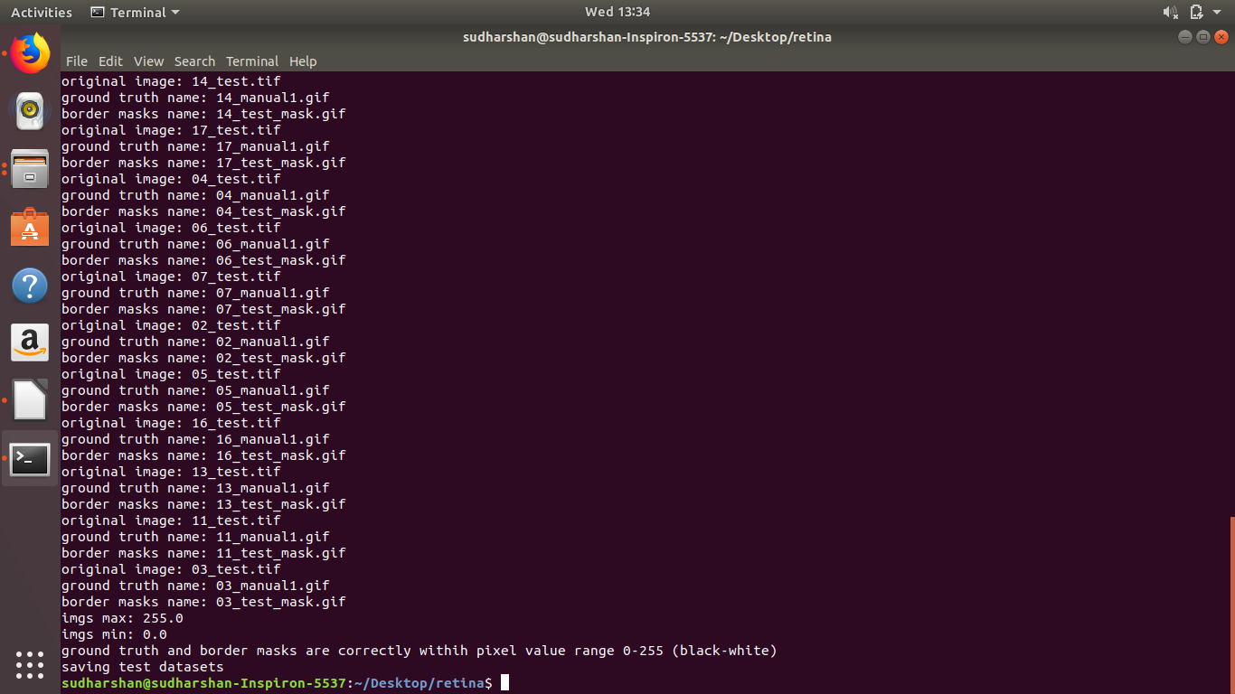
Screenshot of the masked images

Slide 17
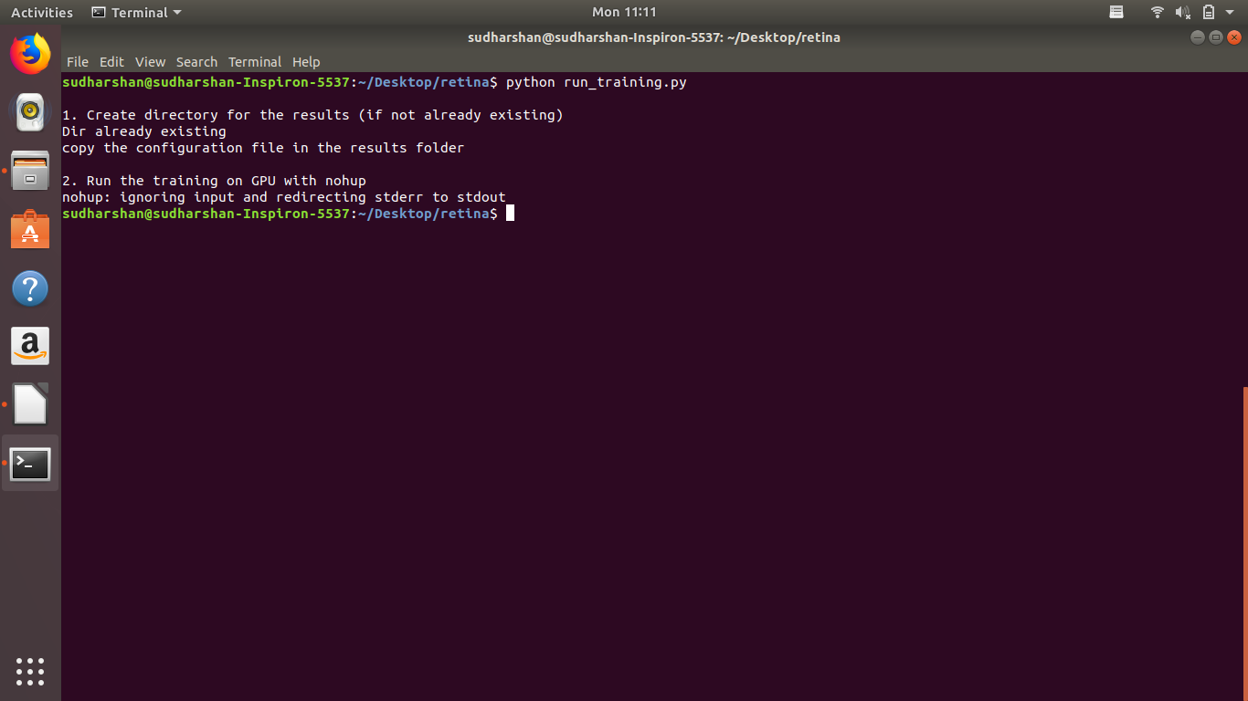
Screenshot of the training phase

Slide 18
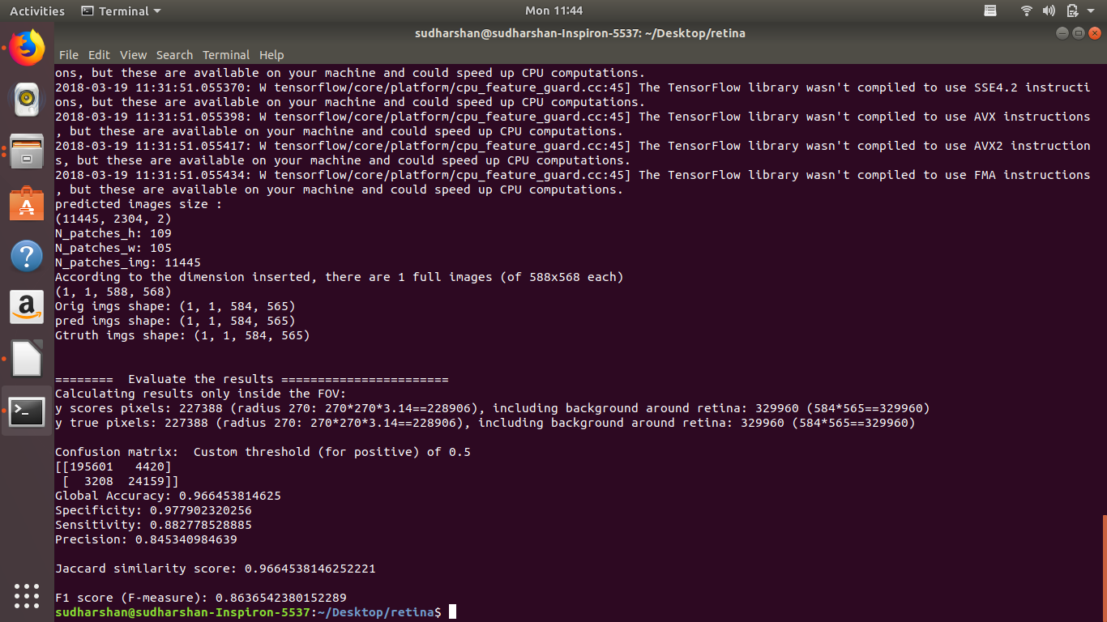
Screenshot of the testing phase

Slide 19
Working Environment
Hardware: Intel Core i7 4th gen processor with 8GB DDR2 RAM
Software:
Python 2.7
Tensorflow 1.2.0
Keras 2.1.3

Slide 20
WorkPlan (Specify the % completion of your work in the table given below)
Modules | Period | Status
Masking | Review 2 (Feb 7,2018) | Completed
Training | Review 3 – Last week of Feb 2018 | 60%
Testing and results | Mid of March 2018 | 100%

Slide 21
References
1. Abramoff M.D. (2013), ‘Automated analysis of retinal images for detection of referable diabetic retinopathy’, JAMA Ophthalmology., Vol. 131, No.3,
pp. 351-357.
2. Bowei Feng, Huisheng Zang, LienPei Xei, Ping Liang, Qioliang Li, Tianfu Wang(2016), ‘A Cross-modality Learning Approach for Vessel Segmentation in Retinal Images’, IEEE Transactions on Medical Imaging, Vol.35, No.1,pp. 109-118.
3. Carreira M.J, Espona .L, Ortega .M,Penedo M.G. (2008)‘Retinal vessel tree segmentation using a deformable contour model’, 19th International Conference on Pattern Recognition, pp. 2128-2131.

Slide 22
References
4. Fraz M.M. (2012) ‘Blood vessel segmentation methodologies in retinal images—A survey’, Computer Methods and Programs in Biomedicine, Vol. 108, No.1, pp. 407-433.
5. Fraz M.M. (2012), ‘An approach to localize the retinal blood vessels using bit planes and centerline detection’, Computer Methods and Programs in Biomedicine, Vol. 108, No:2,pp. 600-616.
6. Kirbas C and Quek F. (2004), ‘A review of vessel extraction techniques and algorithms’, ACM Computing Surveys, Vol. 36, No.2, pp. 81-121.
7. Klein J.C. and Zana F. (1999), ‘A multimodal registration algorithm of eye fundus images using vessels detection and Hough transform’, IEEE Transactions on Medical Imaging, Vol. 18, No. 5, pp. 419-428.

Slide 23
References
8. Lam B.S.Y and Yan H. (2008), ‘A novel vessel segmentation algorithm for pathological retina images based on the divergence of vector fields’, IEEE Transactions on Medical Imaging, Vol. 27, No. 2, pp. 237-246.

