Slide 1
Segmentation of Vascular Trees using Convolutional Neural Networks
Batch No : 50
Sai Krishna R : 212714104129 IV- “C”
Siva Subramanian P A : 212714104146 IV- “C”
Sudharshan K : 212714104155 IV- “C”
Domain : Machine Learning
Guided by: Ms. D. Sasikala, Assistant Professor

Slide 2
Problem Statement
Retinal Fundus images have been widely used by ophthalmologists to diagnose and treat various diseases like Glaucoma, diabetic retinopathy and other cardiovascular diseases.
With rapid advancements in Machine Learning, especially in the medical field, an important computing system, the Neural Network is chosen to solve the problem.
A computer aided diagnostics and machine learning techniques such as Convolutional Neural Networks is used to segment the blood vessels or the vascular tree from the retinal fundus images to show a clear cut picture of the segmented vascular tree.

Slide 3
Abstract
Retinal Fundus images have been widely used by ophthalmologists to diagnose and treat various diseases like Glaucoma, diabetic retinopathy, hypertension, arteriosclerosis and other cardiovascular diseases.
To find the exact cause of the disease with the retinal fundus image for the ophthalmologists is difficult at times as the root cause of the disease can be found at the very end of the blood vessel which tends to be minute and slender.

Slide 4
Abstract
Moreover, due to the presence of liquids and gels like Aqueous Humor and Vitreous Humor, the visibility of the vascular tree gets reduced and the chances of error by humans while detecting the cause of the disease gets increased.
To achieve a level of accuracy that aims at a patient’s faster diagnosis and treatment, a computer aided diagnostics and machine learning techniques such as Convolutional Neural Networks is used to segment the blood vessels or the vascular tree from the retinal fundus images to show a clear cut picture of the segmented vascular tree thereby increasing the chances of the ophthalmologists to detect the disease and provide the necessary treatment.

Slide 5
Introduction
Medical Imaging is a process of creating visual representations of the interior of a body for clinical analysis and medical intervention, as well as visual representation of the function of some organs or tissues. Medical Imaging reveals the organs, tissues etc that are hidden beneath the skin to diagnose and treat the disease. Medical imaging also establishes a database of normal anatomy and physiology to make it possible to identify abnormalities.
Segmentation is the process of partitioning an image into different meaningful segments. In medical imaging, these segments often correspond to different tissue classes, organs, pathologies, or other biologically relevant structures. Medical image segmentation is made difficult by low contrast, noise, and other imaging ambiguities. Although there are many computer vision techniques for image segmentation, some have been adapted specifically for medical image computing.

Slide 6
Introduction
Machine learning is a field of computer science that gives computer systems the ability to "learn" with data, without being explicitly programmed. Machine learning explores the study and construction of algorithms that can learn from and make predictions on data. Such algorithms overcome following strictly static program instructions by making data-driven predictions or decisions, through building a model from sample inputs.
Convolutional Neural Network (CNN) is a class of deep, feed-forward artificial neural networks that has been used to analyze visual imagery. Convolutional networks were inspired by biological processes in that the connectivity pattern between neurons resembles the organization of the animal visual cortex

Slide 7
Literature Survey
Year of Work | Researchers | Work Done | Strength | Weakness
2003 | B. S. Y. Lam and H. Yan | Segmentation using Differential Vector Fields | Accurate segmentation in bright abnormalities | No prediction in dark abnormalities
2013 | Matthew D. Zeiler and Rob Fergus | Visualizing and Understanding Convolutional Networks | Accurate predictions with the CIFAR-100 dataset | Lack of a loss function that would have multiple objects per image

Slide 8
Literature Survey
Year of Work | Researchers | Work Done | Strength | Weakness
2014 | Qing Li, Weidong Cai , Xiaogang Wang, Yun Zhou, David Dagan Feng and Mei Chen | Medical Image Classification using CNN | Simple and an efficient algorithm with a single CNN layer | Limited Datasets.
2016 | Qiaoliang Li, Bowei Feng, LinPei Xie, Ping Liang*, Huisheng Zhang and Tianfu Wang | Segmented the Vascular tree from the retinal images | A near accurate prediction of the tree with respect to the ground truth | Difficulty in setting the hyperparameters

Slide 9
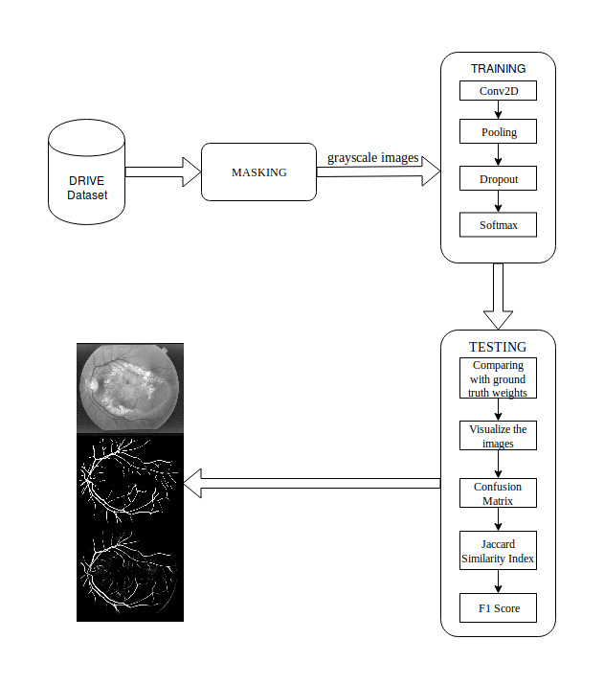
Proposed Architecture

Slide 10
Proposed Architecture
Masking
Masking is a process of combining the retinal fundus images with the masks so that it forms an image which resembles the tracing activity where a tracing paper is placed on top of a desired image or whatsoever.
Once the images are masked, they are converted from Red Green Blue (RGB) colour format to Grayscale colour format to reduce the number of dimensions and store only the required pixel value without its RGB value as it tends to take up memory while storing which decreases the performance of the program that is using the image data .

Slide 11
Proposed Architecture
The DRIVE Dataset is loaded into the memory as input and is masked using the mask image present in the dataset.
The training phase is where the masked image is given as input to the Convolutional Neural Network where activation functions and dropouts are applied to create a model for the given training dataset which is used in the testing stage.
The testing program takes the model as input and segments the vascular tree from the retinal fundus images of the test dataset. The segmented image is compared with the ground truth images and scores are evaluated accordingly.

Slide 12
Proposed Architecture
Convolution Layer
This layer is responsible for passing the output of the convolution operation to the next layer. This is done by processing the data which is available in its receptive field or the sliding window.
During the forward pass, each filter is convolved across the width and height of the input volume, computing the dot product between the entries of the filter and the input and producing a 2-dimensional activation map of that filter.
As a result, the network learns filters that activate when it detects some specific type of feature at some spatial position in the input.

Slide 13
Proposed Architecture
Max Pooling Layer
This layer is responsible for combining the outputs of the neuron clusters at one layer into a single neuron in the next layer.
When the outputs are combined, the maximum value is taken and that becomes a neuron in the next layer.
It partitions the input image into a set of non-overlapping rectangles and, for each such sub-region, outputs the maximum.
The intuition is that the exact location of a feature is less important than its rough location relative to other features.

Slide 14
Proposed Architecture
ReLU Layer
Rectified Linear Unit layer is used to apply the activation function
f(x) = max (0,x) …… (3.1)
which increases the nonlinear properties of the decision function without affecting the receptive fields of the convolution layer. Other functions are also used to increase nonlinearity.
For example,
saturating hyperbolic tangentfx=tan⁡(x) ……. (3.2)
f(x) =| tan(x) | ……. (3.3)
And the sigmoid function f(x) = (1+e^{-x})⁻¹ …… (3.4)
ReLU is often preferred to other functions, because it trains the neural network several times faster without a significant penalty to generalization accuracy.

Slide 15
Proposed Architecture
Fully Connected layer
This layer is used during the last stage of the CNN. This is done for high level reasoning. Neurons in a fully connected layer have connections to all activations in the previous layer and their activations can then be computed with a matrix multiplication. Finally, after several convolutional and max pooling layers, the high-level reasoning in the neural network is done via fully connected layers. Neurons in a fully connected layer have connections to all activations in the previous layer, as seen in regular neural networks. Their activations can hence be computed with a matrix multiplication followed by a bias offset.

Slide 16
Proposed Architecture
Jaccard Similarity Index
This is a statistic used for comparing the similarity and diversity of sample sets. The Jaccard coefficient measures similarity between finite sample sets and is defined as the size of the intersection divided by the size of the union of the sample sets. Equation 3.7 shows the calculation of the scores.
JA,B=|A∩B||A∪B|=|A∩B|A+B-|A∩B| ….. (3.7)

Slide 17
Proposed Architecture
F1 Score
It is a measure of a test's accuracy. It considers both the precision p and the recall r of the test to compute the score: p is the number of correct positive results divided by the number of all positive results returned by the classifier, and r is the number of correct positive results divided by the number of all relevant samples. The F₁ score is the harmonic average of the precision and recall, where an F₁ score reaches its best value at 1 and worst at 0. Equation 3.10 shows the formula to calculate the F1 score.
F1= 2F1=2 / (1/recall)+(1/precision)=2 precision/ (precision+recall) ….. (3.10)

Slide 18
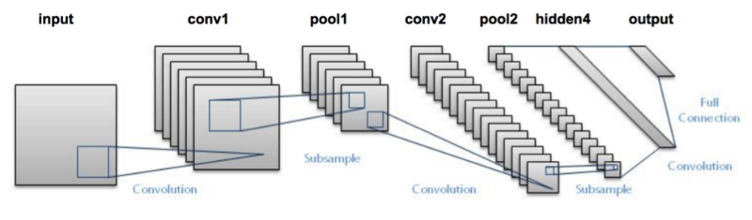
CNN Architecture

Slide 19
System Requirements
HARDWARE REQUIREMENTS
1. CPU - Intel Core i7 4th gen @1.8GHz
2. RAM - 8GB
3. Storage - 10GB or higher
SOFTWARE REQUIREMENTS
1. Operating System - Ubuntu 17.10
2. Programming Language - Python 2.7

Slide 20
System Requirements
TensorFlow is an open source software library for machine learning across a range of tasks and developed by Google to meet their needs for systems capable of building and training neural networks to detect and decipher patterns and correlations, analogous to the learning and reasoning which humans use.
Python is developed under an OSI-approved open source license, making it freely usable and distributable, even for commercial use.
Python's license is administered by the Python Software Foundation. Python is used in many application domains. Python is a widely used high-level programming language for general-purpose programming, created by Guido van Rossum and first released in 1991.

Slide 21
System Requirements
TensorFlow is an open source software library for machine learning across a range of tasks and developed by Google to meet their needs for systems capable of building and training neural networks to detect and decipher patterns and correlations, analogous to the learning and reasoning which humans use.
Keras is an open source neural network library written in Python. It is capable of running on top of TensorFlow, Microsoft Cognitive Toolkit, Theano, or MXNet. Designed to enable fast experimentation with deep neural networks, it focuses on being user-friendly, modular, and extensible. It was developed as part of the research effort of project ONEIROS (Open-ended Neuro-Electronic Intelligent Robot Operating System).

Slide 22
System Requirements
Numpy
NumPy is a library for the Python programming language, adding support for large, multi-dimensional arrays and matrices, along with a large collection of high-level mathematical functions to operate on these arrays.
Using NumPy in Python gives functionality comparable to MATLAB since they are both interpreted, and they both allow the user to write fast programs as long as most operations work on arrays or matrices instead of scalars.
In comparison, MATLAB boasts a large number of additional toolboxes, notably Simulink, whereas NumPy is intrinsically integrated with Python, a more modern and complete programming language.

Slide 23
Modules
Masking
Training
Testing

Slide 24
Module 1: Masking
Masking is a process of combining the retinal fundus images with the masks so that it forms an image which resembles the tracing activity where a tracing paper is placed on top of a desired image.
The retinal fundus images are compared with the mask images for their dimensions and cropping factor. If they are found to be different, proper resizing and adjustments are made without losing the crucial part of the retinal fundus image.

Slide 25
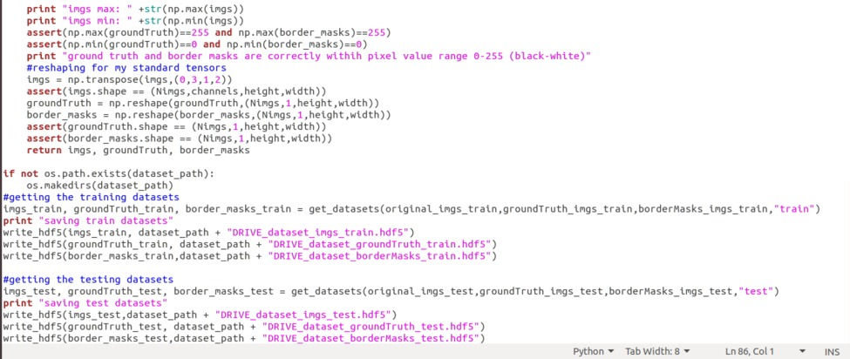
Module 1: Masking

Slide 26
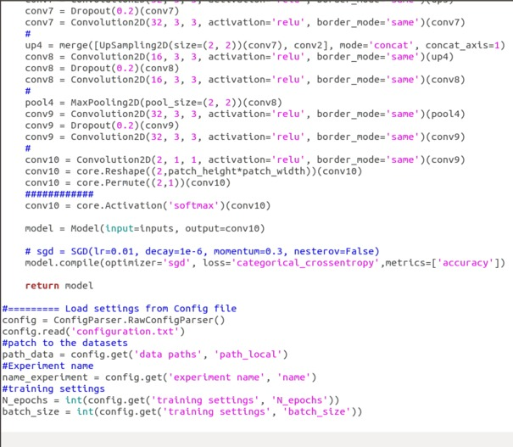
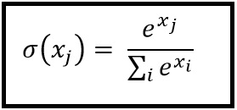
Module 2: Training the neural network
The preprocessed or the cropped green chanel image is given as input to the neural network and the training starts.
Various Convolutional layers are added to increase the efficiency.
Finally the Softmax function is used to restrict the predicted outputs in the range of [0,1].

Slide 27
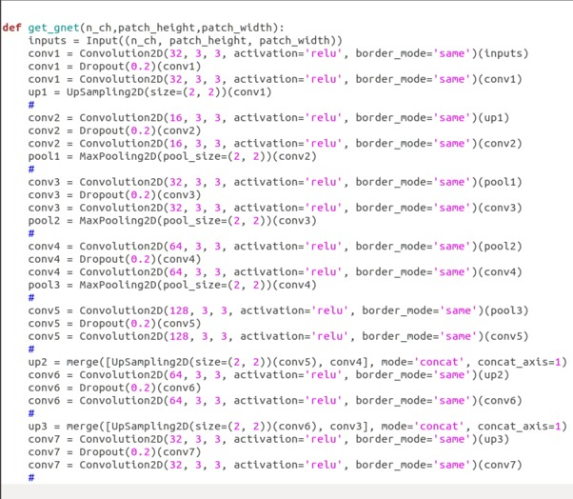
Module 2: Training the neural network

Slide 28
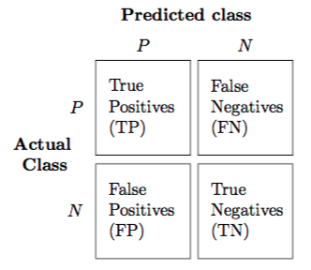
Module 3: Testing
The images that are to be tested is loaded by the testing program and are divided into patches to decrease the load of the system and to produce better results.
The masked retinal fundus images are tested with the trained model by applying hyperparameters like stride height, stride width, number of epochs and number of patches.
Confusion Matrix

Slide 29

Module 3: Testing
F1 Score:
It is a measure of a test's accuracy. It considers both the precision p and the recall r of the test to compute the score: p is the number of correct positive results divided by the number of all positive results returned by the classifier, and r is the number of correct positive results divided by the number of all relevant samples.

Slide 30
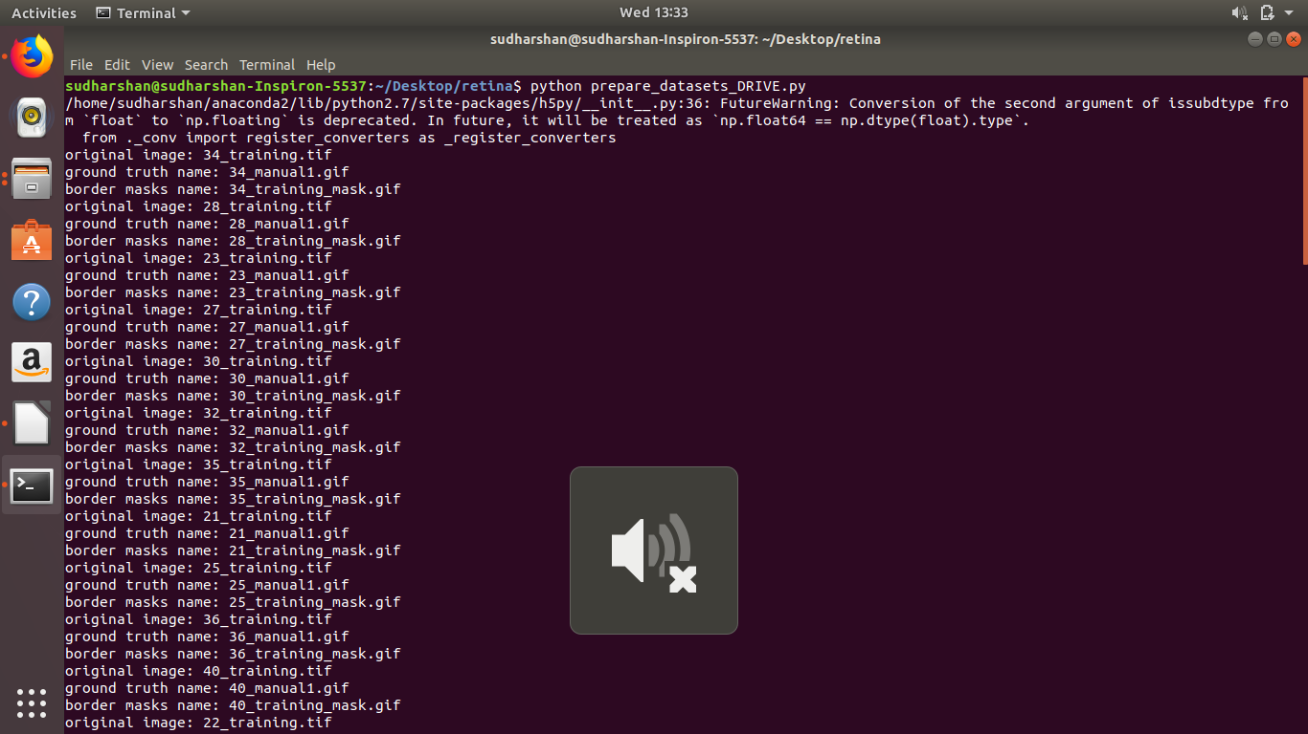
Screenshot of the masked images

Slide 31
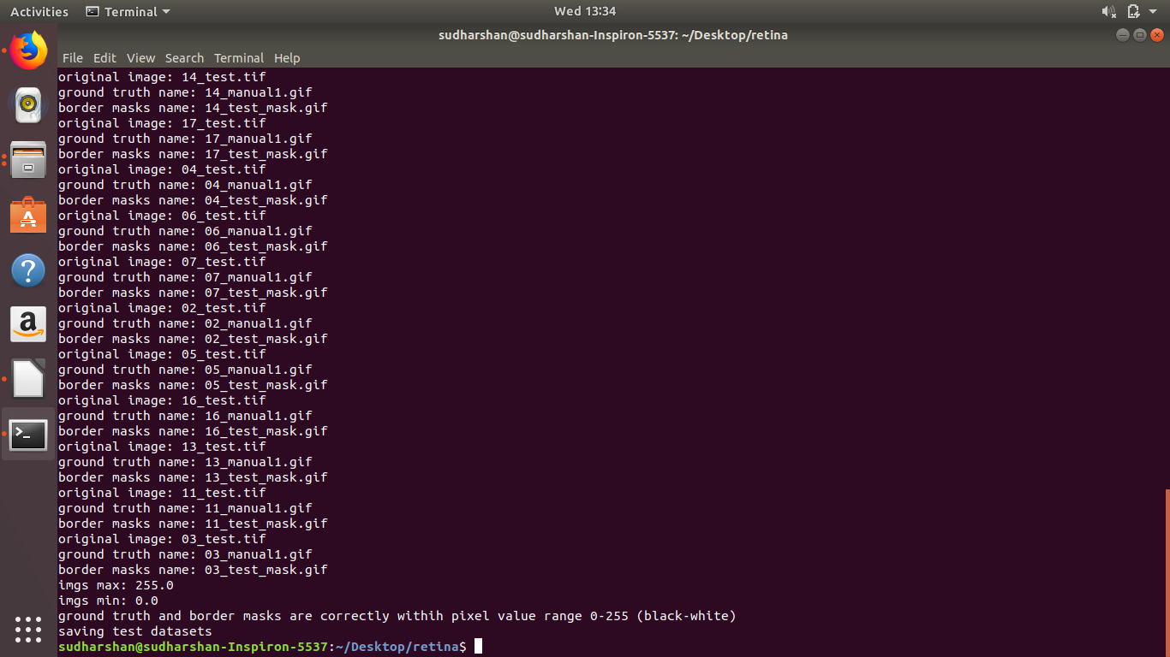
Screenshot of the masked images

Slide 32
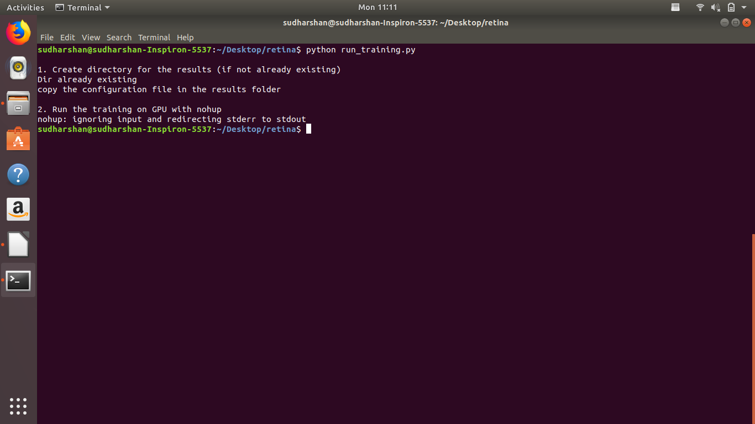
Screenshot of the training phase

Slide 33
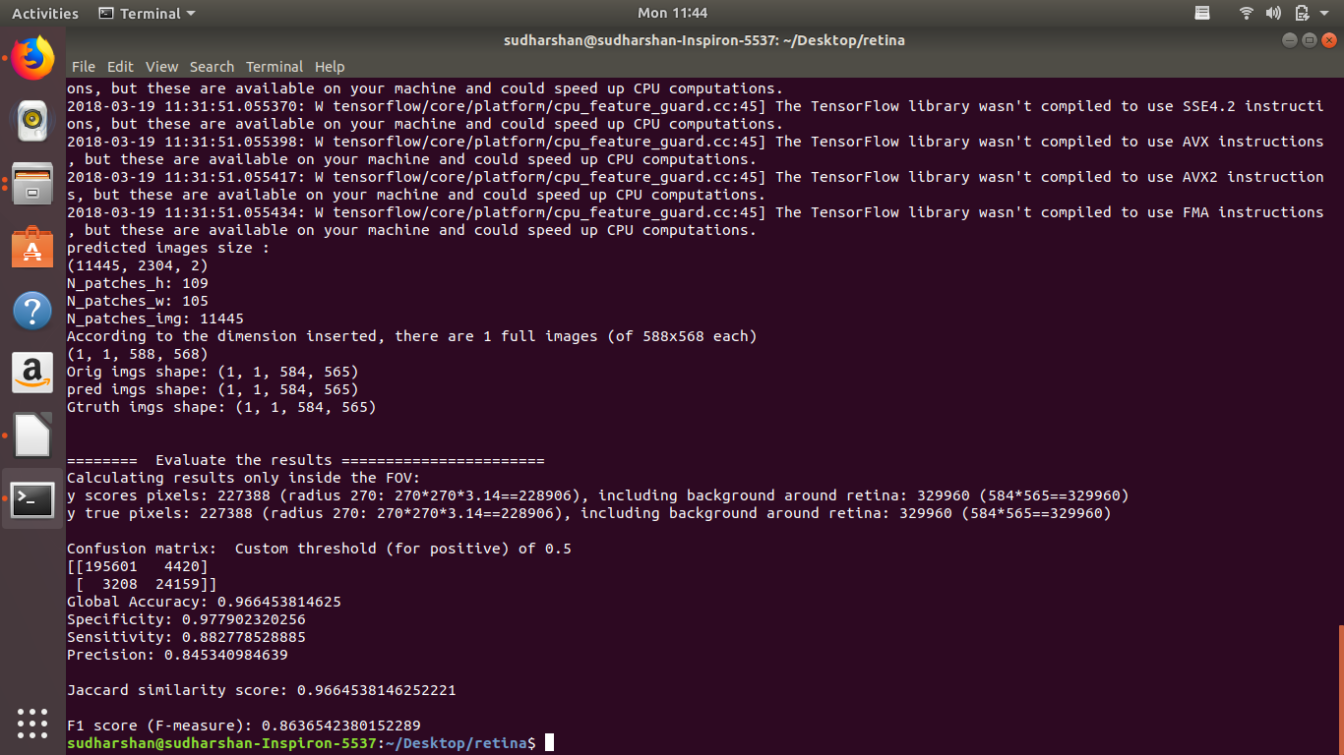
Screenshot of the testing phase

Slide 34
WorkPlan (Specify the % completion of your work in the table given below)
Modules | Period | Status
Masking | Review 2 (Feb 7,2018) | Completed
Training | Review 3 – Last week of Feb 2018 | 60%
Testing and results | Mid of March 2018 | 100%

Slide 35
References
1. Abramoff M.D. (2013), ‘Automated analysis of retinal images for detection of referable diabetic retinopathy’, JAMA Ophthalmology., Vol. 131, No.3,
pp. 351-357.
2. Bowei Feng, Huisheng Zang, LienPei Xei, Ping Liang, Qioliang Li, Tianfu Wang(2016), ‘A Cross-modality Learning Approach for Vessel Segmentation in Retinal Images’, IEEE Transactions on Medical Imaging, Vol.35, No.1,pp. 109-118.

Slide 36
References
4. Fraz M.M. (2012) ‘Blood vessel segmentation methodologies in retinal images—A survey’, Computer Methods and Programs in Biomedicine, Vol.108,
No.1, pp. 407-433.
5. Fraz M.M. (2012), ‘An approach to localize the retinal blood vessels using bit planes and centerline detection’, Computer Methods and Programs in Biomedicine, Vol. 108, No:2,pp. 600-616.

Slide 37
References
6. Kirbas C and Quek F. (2004), ‘A review of vessel extraction techniques and algorithms’, ACM Computing Surveys, Vol. 36, No.2, pp. 81-121.
7. Klein J.C. and Zana F. (1999), ‘A multimodal registration algorithm of eye fundus images using vessels detection and Hough transform’, IEEE Transactions on Medical Imaging, Vol. 18, No. 5, pp. 419-428.

Slide 38
References
8. Lam B.S.Y and Yan H. (2008), ‘A novel vessel segmentation algorithm for pathological retina images based on the divergence of vector fields’, IEEE Transactions on Medical Imaging, Vol. 27, No. 2, pp. 237-246.
9. DRIVE Dataset. https://www.isi.uu.nl/Research/Databases/DRIVE/
10. Tensorflow. https://www.tensorflow.org/
11. Keras. https://keras.io/

Slide 39
References
15. CNN Basics https://pythonprogramming.net/convolutional-neural- network-cnn-machine-learning-tutorial/
16. Machine Learning Basics https://machinelearningmastery.com/about/
17. Feature Learning http://ufldl.stanford.edu/tutorial/supervised/ ConvolutionalNeuralNetwork/

Slide 40
References
12. NumPy. https://docs.scipy.org/doc/numpy-dev/user/quickstart.html
13. Python 2.7. https://docs.python.org/2/
14. ConvolutionalNeuralNetwork https://en.wikipedia.org/wiki/ Convolutional_neural_network

Slide 41
THANK YOU

