Slide 1
Vinyl
Issa
Ugur
Brandon

Slide 2
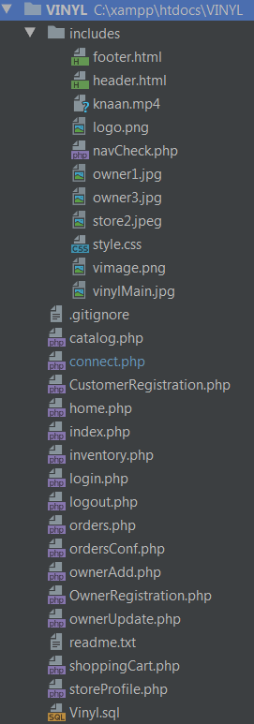
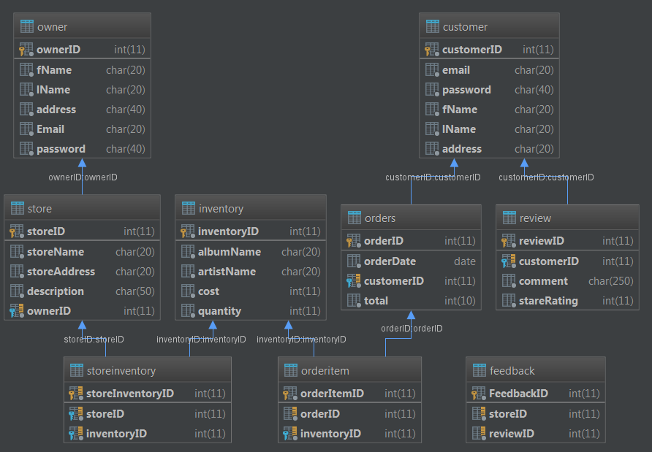
Diagrams

Slide 3

Struggles
No time to implement Spotify API
Merging git conflicts
Conflicting styles of coding
Working with bootstrap
Conflicting schedules

Slide 4
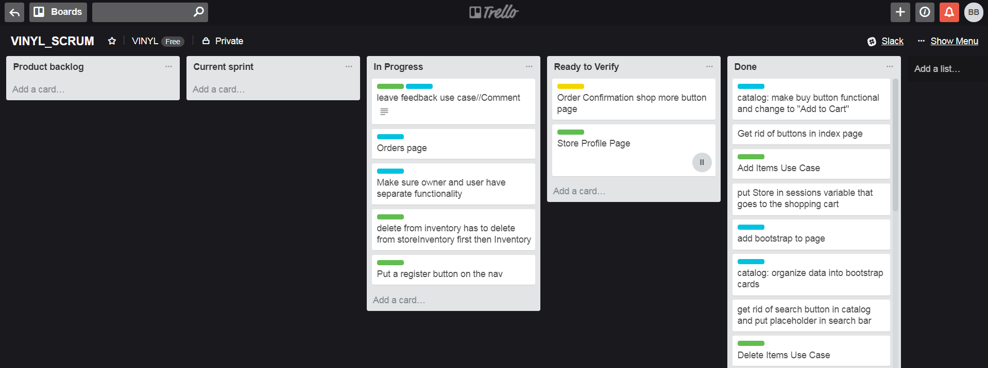
Tasks That Went Well
Writing HTML, CSS, PHP and Javascript
Modeling and building the database
Communicating and Delegating
We used Slack to communicate and Trello to assign and complete tasks

Slide 5
What We Would Do Differently
Make more reasonable and attainable goals
We probably could’ve implemented the Spotify API if we had fewer features
Meet more frequently
More thorough documentation

