Slide 1
Variational Quantum Eigensolver and Near Quantum Advantage
Presented by: Joshua M Maldonado
jm998521@ohio.edu

Slide 2
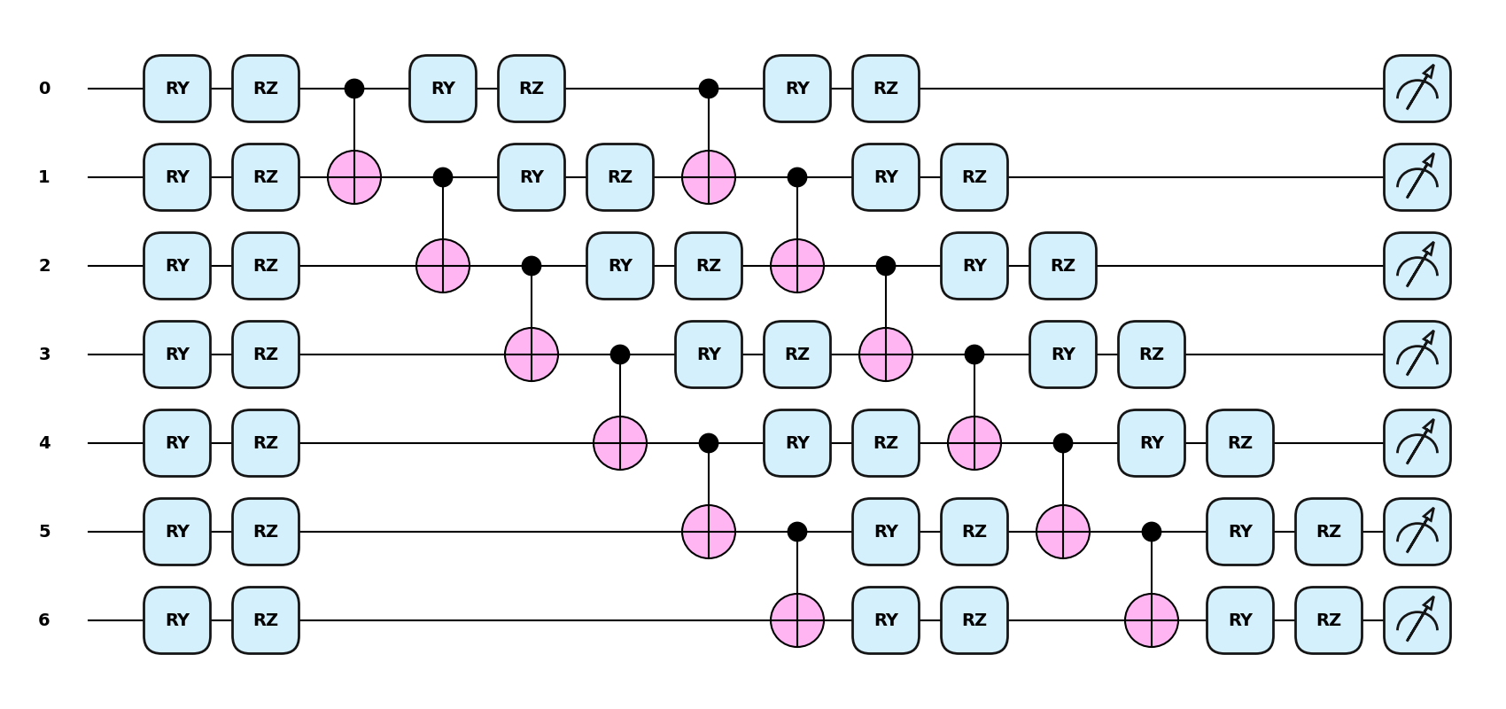
Outline
1
How do Eigensolvers work?
Example with Toy Problem
What is a Variational Quantum Eigensolver (VQE)?
Example with Toy Problem
Advantages and Disadvantages
How close are we to ”Quantum Advantage”

Slide 3
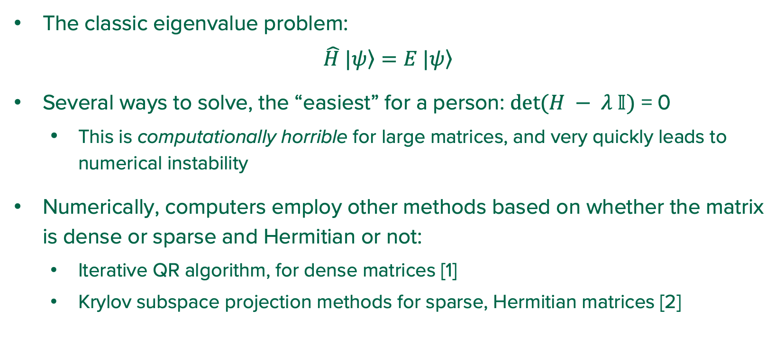
How do Eigensolvers Work?
2
The classic eigenvalue problem:
$$\hat{H} |\left.ψ\right\rangle =E |\left.ψ\right\rangle$$
Several ways to solve, the “easiest” for a person: $det⁡(H − λ 𝕀)$ = 0
This is computationally horrible for large matrices, and very quickly leads to numerical instability
Numerically, computers employ other methods based on whether the matrix is dense or sparse and Hermitian or not:
Iterative QR algorithm, for dense matrices [1]
Krylov subspace projection methods for sparse, Hermitian matrices [2]
Notes:
Main matrix decompositions:
1. Eigenvalue
2. SVD
3. QR (“orthogonal, rectangular”)
example: least squares computation
4. LU (lower-triangular, upper-triangular)
example: gaussian elimination
5. Cholesky
example: LU for Hermitian matrices, basically

Slide 4
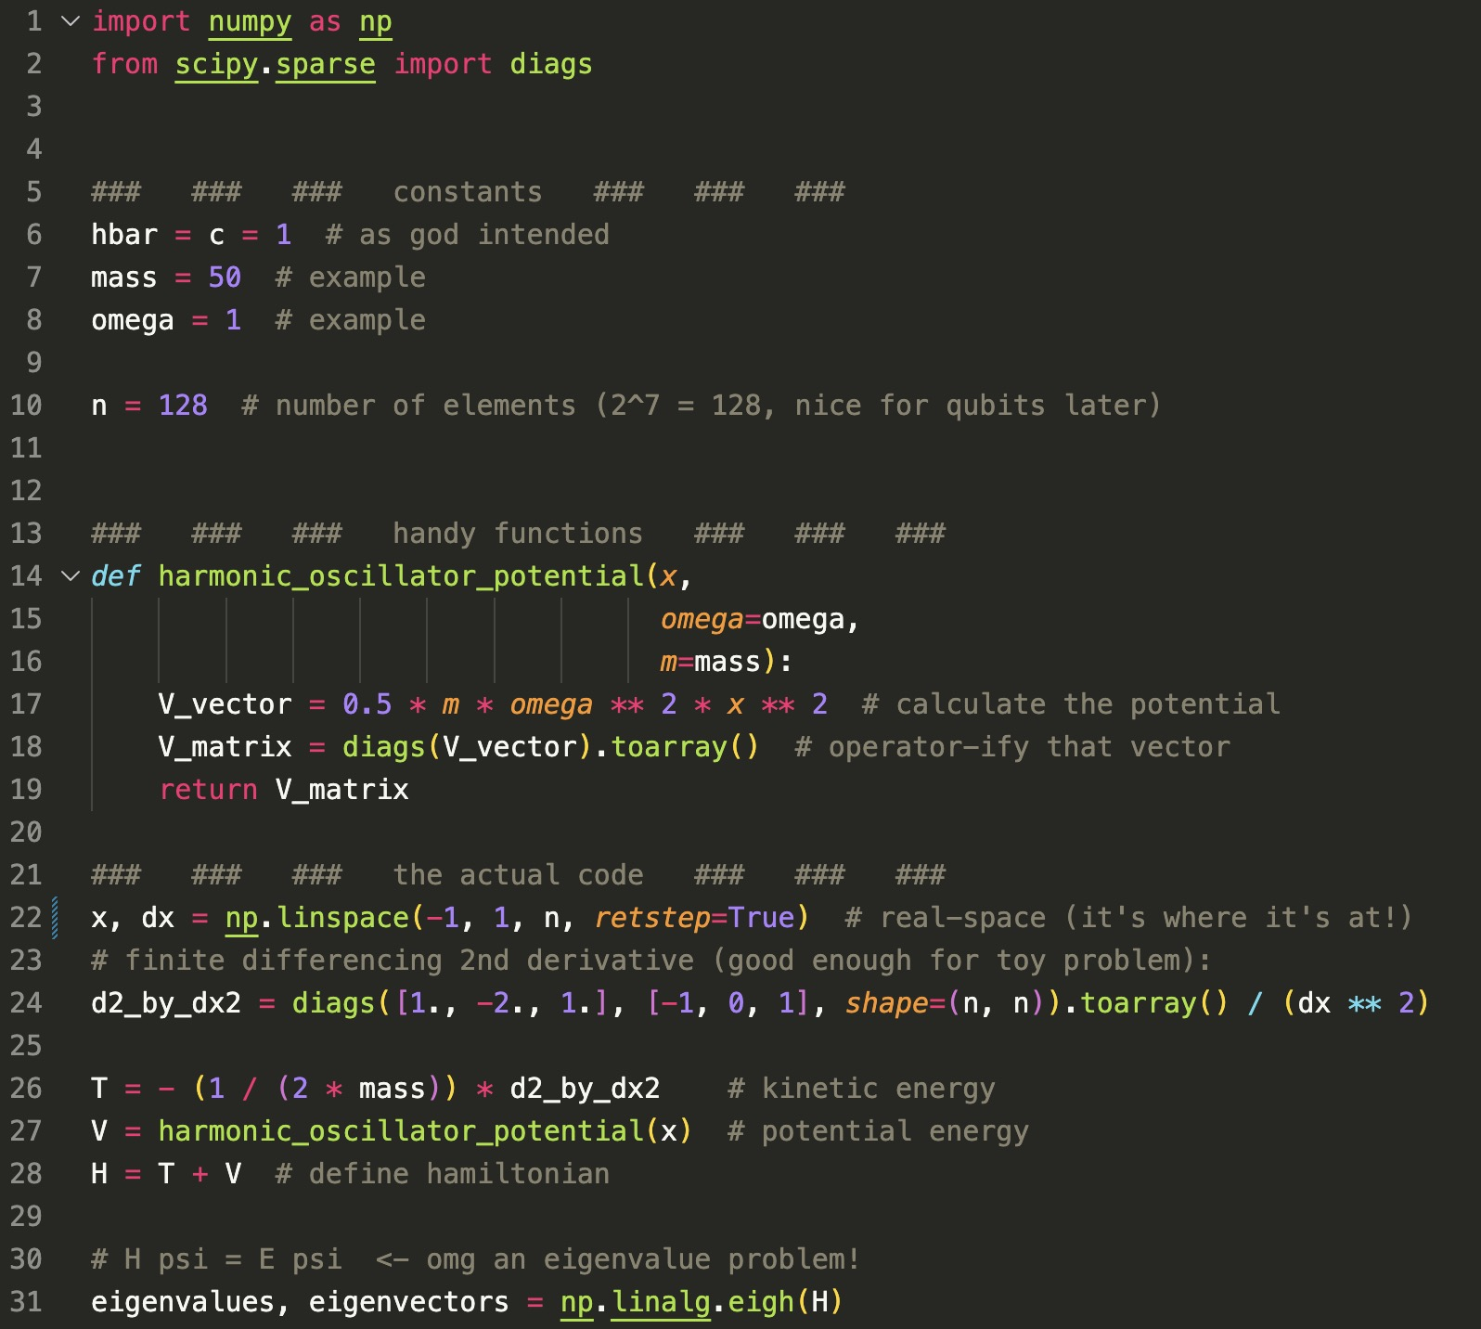
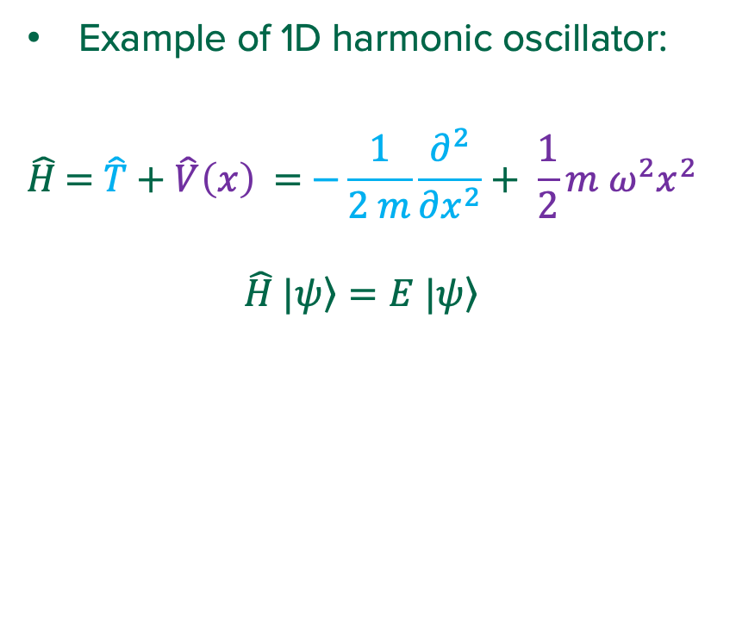
Eigensolver Example
3
Example of 1D harmonic oscillator:
$$\hat{H}\text{ =} \hat{T} \text{+ }\hat{V}\left(x\right) \text{=} \text{−}\frac{1}{2 m}\frac{∂^{2}}{{∂x}^{2}}+ \frac{1}{2}m ω^{2}x^{2}$$
$$\hat{H} |\left.ψ\right\rangle =E |\left.ψ\right\rangle$$
Notes:
Here to setup a toy problem to compare with VQE.
Not here to show the gory details of eigenvalue code.

Slide 5
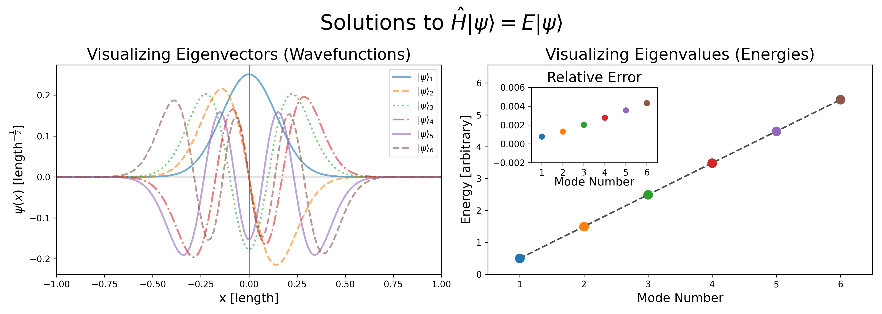
Eigensolver Code Output (first 6 modes)
4
Notes:
Sanity checks:
wavefunctions look believable (come out of `eigh()` already normalized)
Energies are linearly “distributed”
Colors between wavefunctions and energy dots correlate.

Slide 6
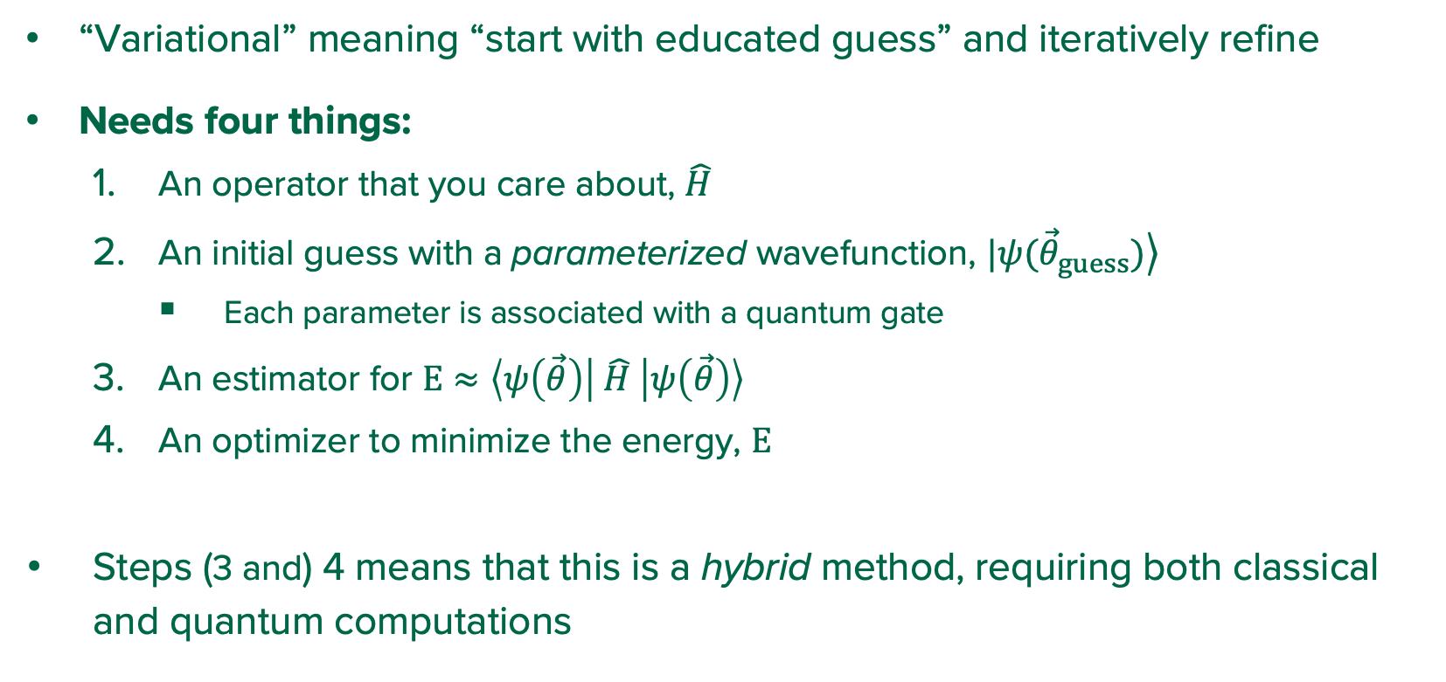
What is a Variational Quantum Eigensolver (VQE)?
5
“Variational” meaning “start with educated guess” and iteratively refine
Needs four things:
An operator that you care about, $\hat{H}$
An initial guess with a parameterized wavefunction, $|\left.ψ({\vec{θ}}_{guess})\right\rangle$
Each parameter is associated with a quantum gate
An estimator for $E≈\left\langle ψ\left(\vec{θ}\right) | \hat{H} | ψ\left(\vec{θ}\right)\right\rangle$
An optimizer to minimize the energy, $E$
Steps (3 and) 4 means that this is a hybrid method, requiring both classical and quantum computations
Notes:
What space are we optimizing?

Slide 7
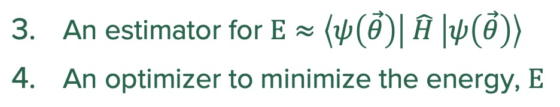
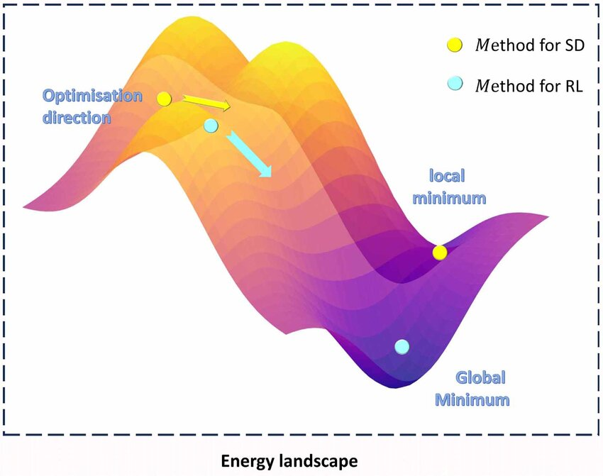

What is a Variational Quantum Eigensolver?
6
Energy
$n_{parameter}$ dimensions
Figure adapted from [3]
Notes:
*Picture yanked from AI/ML paper.
Same principle, though
Note:
- Energy landscapes can have “barren plateaus” where they are relatively flat in regions. This gives optimizers a hard time.

Slide 8
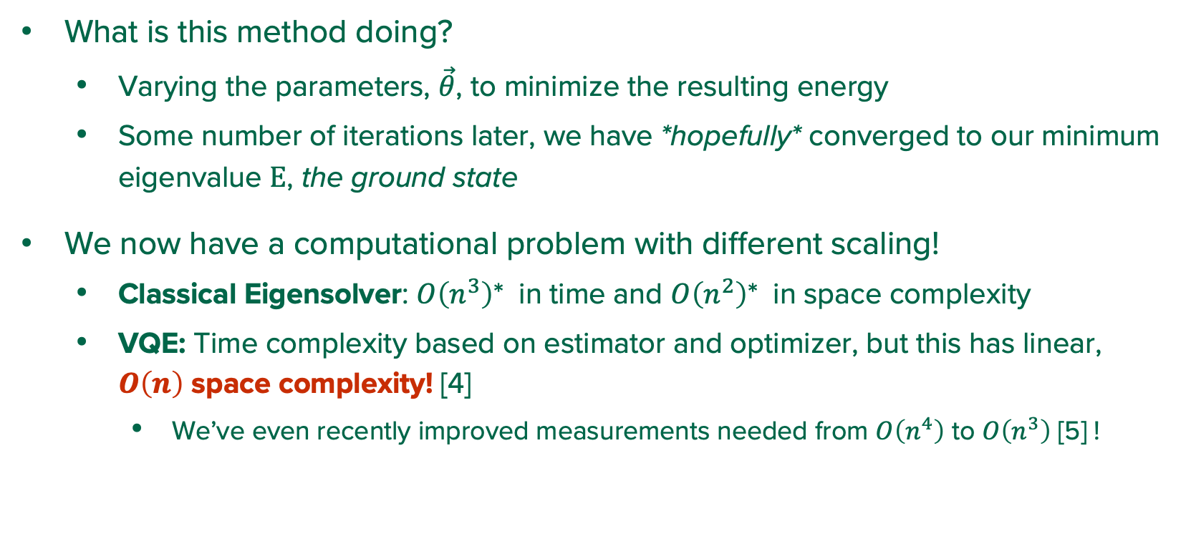
What is a Variational Quantum Eigensolver?
7
What is this method doing?
Varying the parameters, $\vec{θ}$, to minimize the resulting energy
Some number of iterations later, we have *hopefully* converged to our minimum eigenvalue $E$, the ground state
We now have a computational problem with different scaling!
Classical Eigensolver: $O\left(n^{3}\right)$* in time and $O\left(n^{2}\right)$* in space complexity
VQE: Time complexity based on estimator and optimizer, but this has linear, $O\left(n\right)$ space complexity! [4]
We’ve even recently improved measurements needed from $O\left(n^{4}\right)$ to $O\left(n^{3}\right)$ [5] !
*can be improved a bit for sparse matrices
Notes:
The O(n) qubits are because the Hilbert space goes as O(log n)

Slide 9
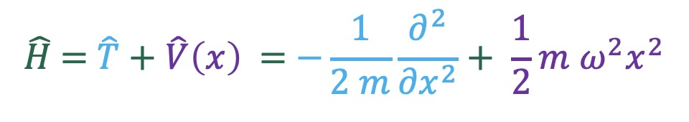
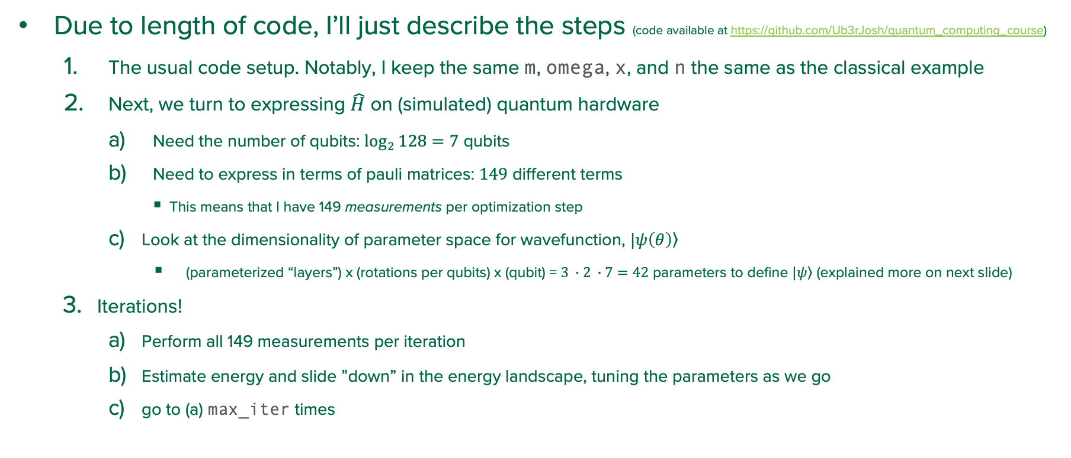
VQE Example (kind of)
8
Due to length of code, I’ll just describe the steps (code available at https://github.com/Ub3rJosh/quantum_computing_course)
The usual code setup. Notably, I keep the same m, omega, x, and n the same as the classical example
Next, we turn to expressing $\hat{H}$ on (simulated) quantum hardware
Need the number of qubits: $\log_{2}{128}=7$ qubits
Need to express in terms of pauli matrices: $149$ different terms
This means that I have 149 measurements per optimization step
Look at the dimensionality of parameter space for wavefunction, $|\left.ψ\left(θ\right)\right\rangle$
(parameterized “layers”) x (rotations per qubits) x (qubit) = $3 ∙2 ∙7=42$ parameters to define $|\left.ψ\right\rangle$ (explained more on next slide)
Iterations!
Perform all 149 measurements per iteration
Estimate energy and slide ”down” in the energy landscape, tuning the parameters as we go
go to (a) max_iter times
Notes:
Here to setup a toy problem to compare with VQE.
Not here to show the gory details of eigenvalue code.

Slide 10
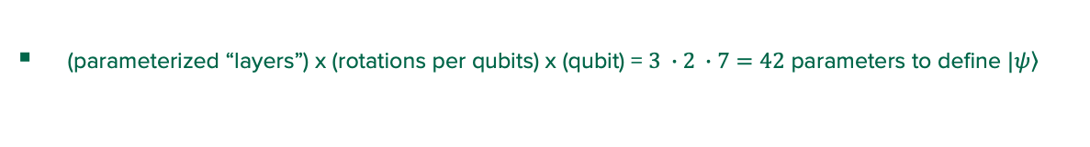
VQE Example Circuit (thanks pennylane)
9
(parameterized “layers”) x (rotations per qubits) x (qubit) = $3 ∙2 ∙7=42$ parameters to define $|\left.ψ\right\rangle$
Notes:
*This example’s* circuit. Thanks to the power of someone else’s work and importing their library
** How did this program do ??

Slide 11
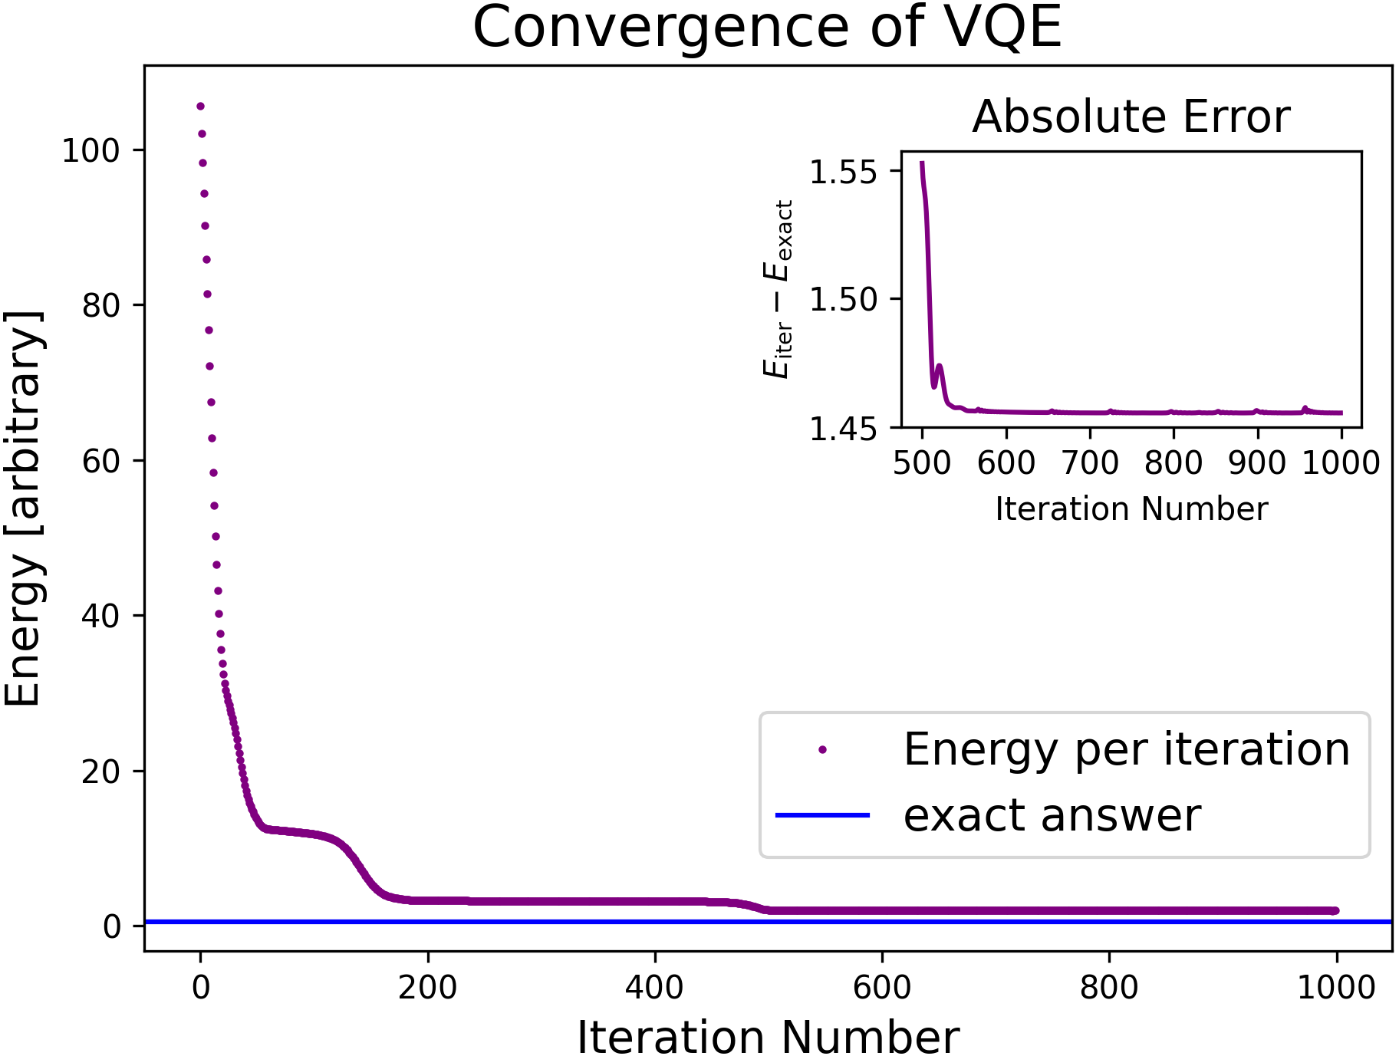
VQE Example Result
10
Notes:
Did it work? -> Not really
Was this user error? -> probably

Slide 12
VQE Example … What Happened?
11
Did my example work? No, not really. Was this user error? Probably.
Challenges with VQE:
Initial guess in parameters
Choice in optimizer, number of iterations, and step size in energy landscape
”Barren plateaus” in the energy landscape
Noise from quantum tomfoolery! (None in this example.)
In the real world:
There are many ”different” VQEs:
VQE for not just the ground state
Adaptive VQE
And many more…
Notes:
Here to setup a toy problem to compare with VQE.
Not here to show the gory details of eigenvalue code.

Slide 13
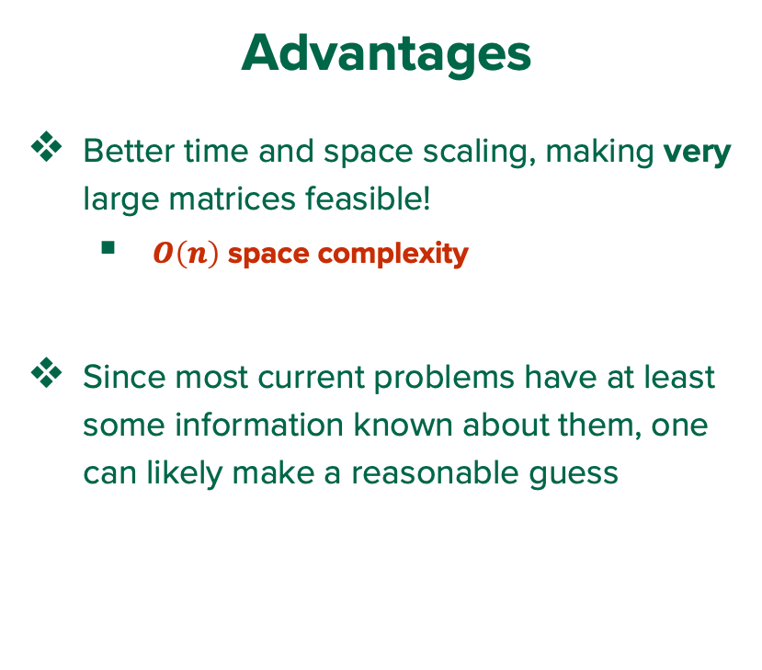
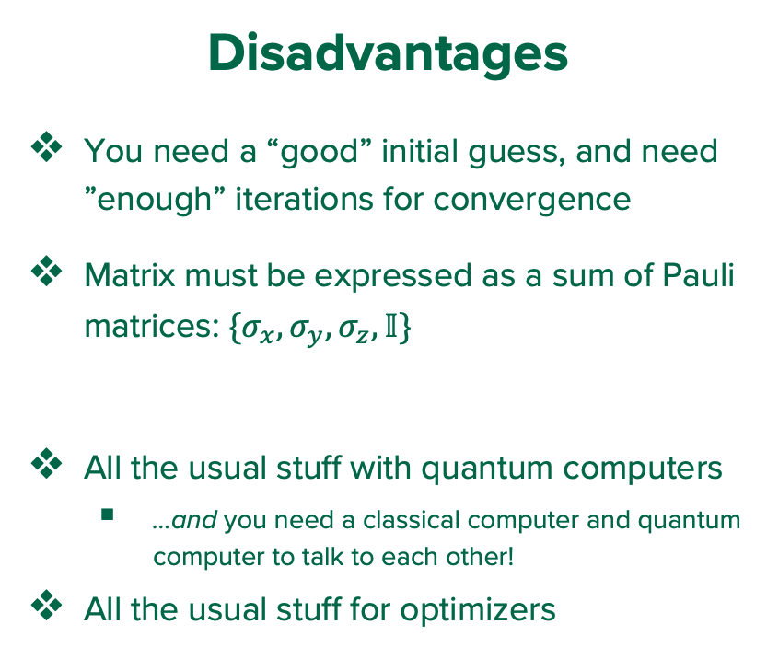
What is a Quantum Variational Eigensolver?
12
Advantages
Better time and space scaling, making very large matrices feasible!
$O\left(n\right)$ space complexity
Since most current problems have at least some information known about them, one can likely make a reasonable guess
Disadvantages
You need a “good” initial guess, and need ”enough” iterations for convergence
Matrix must be expressed as a sum of Pauli matrices: $\{σ_{x},σ_{y},σ_{z},𝕀\}$
All the usual stuff with quantum computers
…and you need a classical computer and quantum computer to talk to each other!
All the usual stuff for optimizers

Slide 14
How close are we to “Quantum Advantage”?
13
Short answer: not very
Longer answer:
VQE allows for very large Hamiltonians to be considered, where classical Eigensolvers would no longer be feasible
Need the quantum hardware for this to be done:
In principle, this can be done classically, but won’t benefit from space complexity scaling. So, very large matrices cannot be considered
Issues with noise in quantum systems:
Requires fault tolerant qubits and, in particular, fault tolerant gates
Since VQE has particular applications with very large matrices, its ”quantum advantage” requires considerable scaling in quantum hardware (on top of its previously mentioned disadvantages).
Notes:
Example classical computing variational method: MCMC

Slide 15
References
?
[1] https://blogs.mathworks.com/cleve/2019/08/05/the-qr-algorithm-computes-eigenvalues-and-singular-values/
[2] https://phys.au.dk/~fedorov/Numeric/13/krylov.pdf
[3] Zhao, Runsheng & Cheng, Tao & Wang, Rui & Fan, Xingkui & Ma, Hongyang. (2024). Artificial intelligence warm-start approach: optimizing the generalization capability of QAOA in complex energy landscapes. New Journal of Physics. 26. 10.1088/1367-2630/ad4629.
[4] Shkolnikov, Vlad O., et al. "Avoiding symmetry roadblocks and minimizing the measurement overhead of adaptive variational quantum eigensolvers." Quantum 7 (2023): 1040.
[5] Jules Tilly, Hongxiang Chen, Shuxiang Cao, Dario Picozzi, Kanav Setia, Ying Li, Edward Grant, Leonard Wossnig, Ivan Rungger, George H. Booth, Jonathan Tennyson,The Variational Quantum Eigensolver: A review of methods and best practices,Physics Reports,Volume 986, 2022

Slide 17

Fun fact
-1
For a given square matrix $H$, $H= ψ∙E∙ψ^{†}$

Slide 18
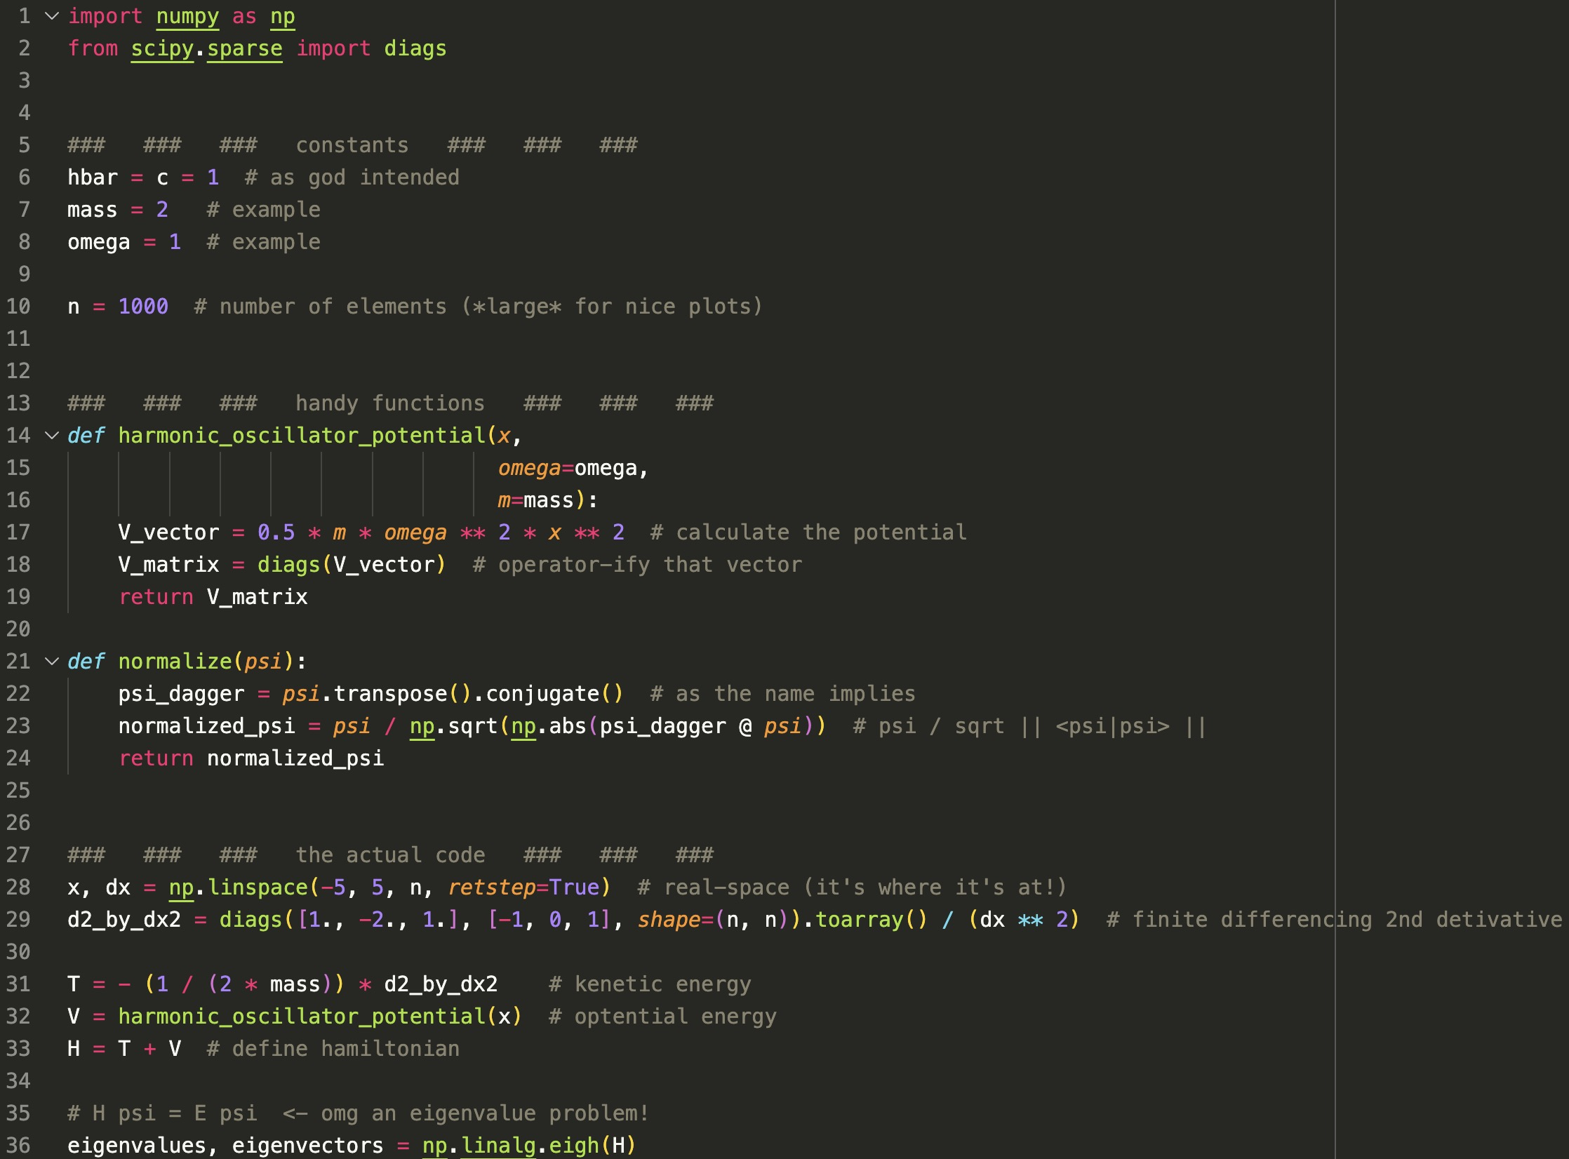
-1

Slide 19
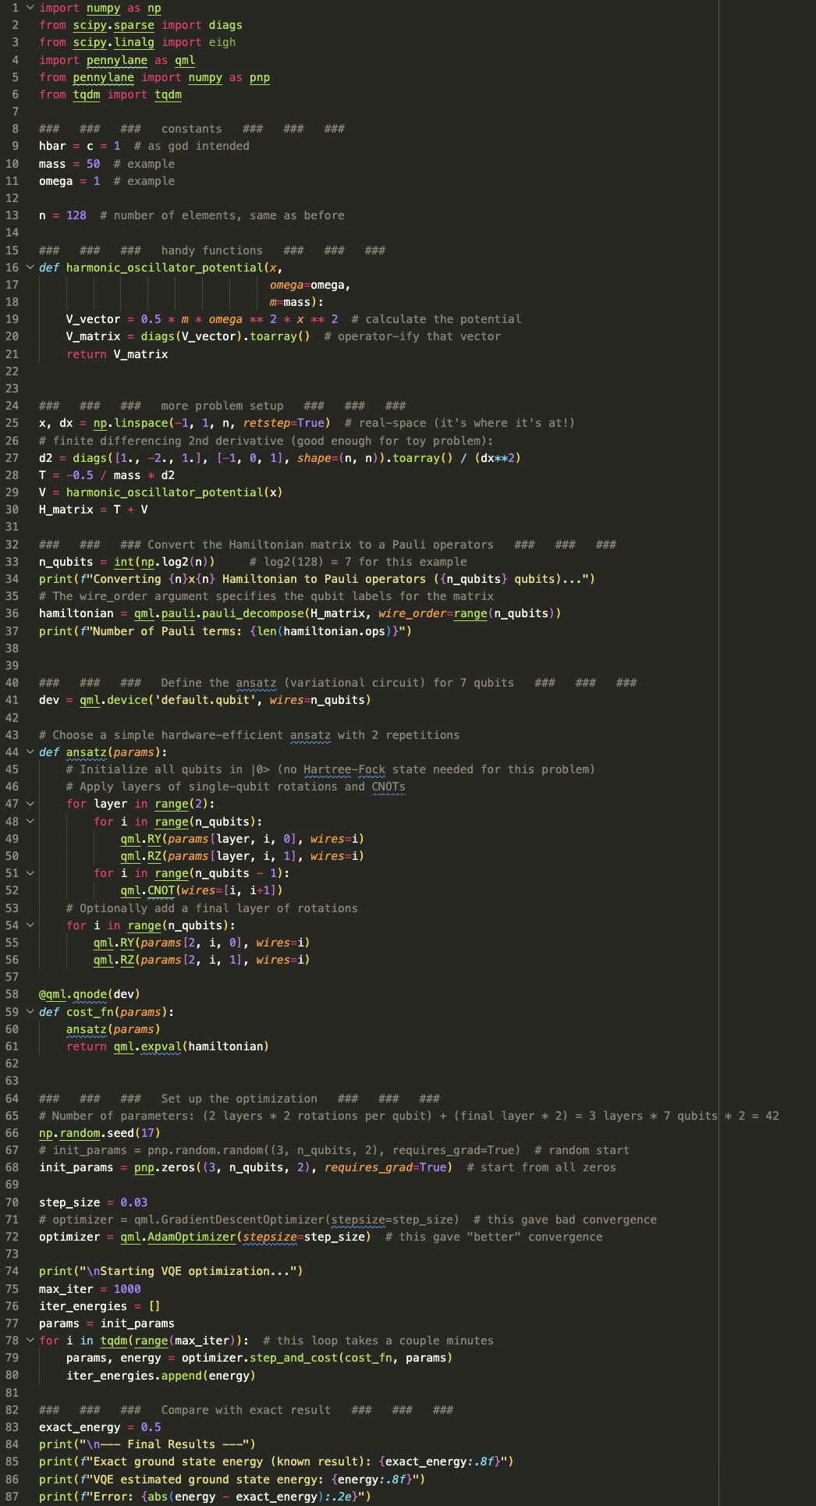
-1

