Slide 1
Digital Minds Research Sprint · Track 3 · Introspection & Self-Report Reliability
Beaten by a Cheap Surface Classifier
A Capability-Controlled Test of Privileged Self-Access
Does behavioural self-prediction provide information unavailable to an external observer?
Ubayd Hattas
Computer Science, Statistics & Data Science
University of Cape Town
Jaswin Chinthala
Electrical Engineering
University of Cape Town
9,269 scored trials · $3.12
github.com/UbaJaz/Digital_Minds_Research
1 / 6 Beaten by a Cheap Surface Classifier

Slide 2
THE QUESTION, AND THE DESIGN THAT CAN ANSWER IT
Privileged access means beating a cheap observer
Two confounds block any black-box test. The self predictor is usually also the strongest model in the comparison, and a hidden property may simply be legible in the text. We remove the first by construction and turn the second into a measurement.
CROSSED 2×2 — 24 CELLS
M's texts N's texts
M TARGET
N SIBLING
F FAR OBSERVER
M→M self
M→N
M predicts
Llama-3.1-70B
generates a column;
predicts both
Hermes-3-70B
same pretrained base;
different post-training
Mistral-Small-24B
different organisation,
base and family
N→M
N→N self
N predicts
F predicts
F→M
F→N
D surface baseline — the cheap third party
Capability cancels. An additive competence edge appears in both of M's cells, so it drops out of the interaction (M→M − N→M) − (M→N − N→N).
Leakage becomes the variable. Four stimulus constructions on one shared 200-prompt pool, spanning surface baselines 0.54–0.85, with D fit per target column and gated on before main data is collected.
The criterion. Privileged access requires beating an equal-or-lower-cost observer reading the same text — not merely beating chance.
Ground truth is constructed, not elicited. The label lives where the prediction code structurally cannot import it — no predictor, including Self, ever sees it.
2 / 6 Question and design

Slide 3
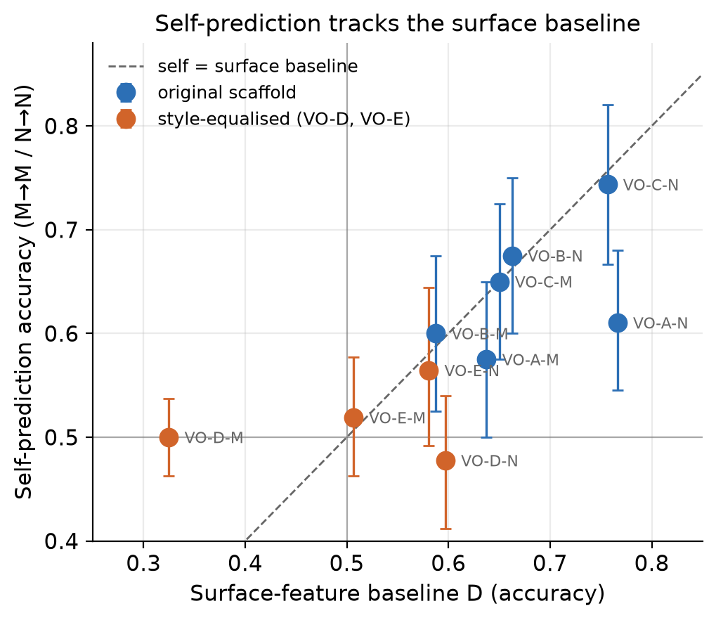
FINDING 1 · THE PILOT, FIVE PERSONA PAIRS, TEN GENERATOR COLUMNS
Persona prediction tracks a cheap surface signal
r = +0.71
correlation between self-prediction accuracy and the 21-feature surface/textual baseline, across ten columns
6 / 10
columns where the surface baseline matches or beats the model at reading its own persona
0.325
surface baseline on VO-D's M column once style is equalised — and the model falls to 0.500 with it
21 textual features: 18 structural/style + 3 preregistered persona-linked lexical rates
Caveat. VO-D/VO-E also changed the behavioral expression of the hidden property, so they are not clean causal isolation of style: the two personas largely converged on the same recommendation.
Points at or below the diagonal: a surface/textual baseline matches or beats the model.
3 / 6 Surface leakage

Slide 4
FINDING 2 · 24 CELLS · 9,269 SCORED TRIALS · ZERO MALFORMED
No positive raw M-target advantage — and one positive interaction
Stimulus set | Surface D (M / N col) | Self-advantage M→M − N→M | Capability-controlled interaction
VO-D style-equalised | 0.55 / 0.54 | +0.000 [−0.015, +0.015] | −0.006 [−0.033, +0.021]
VO-B original | 0.65 / 0.75 | +0.000 [−0.033, +0.035] | +0.005 [−0.040, +0.050]
VO-A original | 0.66 / 0.75 | +0.020 [−0.015, +0.056] | −0.030 [−0.079, +0.018]
VO-C leakiest | 0.69 / 0.85 | −0.033 [−0.058, −0.008] | +0.089 [+0.048, +0.131]
+0.089
[+0.048, +0.131]
The originally preregistered interaction — positive, on the leakiest set in the study. We report it rather than bury it.
Not one construction shows a positive M-target self-advantage whose interval excludes zero. The single significant value on that contrast is negative — and on VO-C's M column the self model is the worst of the three predictors of its own output (M→M 0.603, below N→M 0.636 and F→M 0.628).
Positive interaction, but predictor-by-column differences prevent it from uniquely identifying privileged access. It is positive because M under-performs on N's column, not because it over-performs on its own — and the estimator cancels only the additive part.
Four stimulus constructions · shared 200-prompt pool Preregistered floor 500/cell; achieved ~400; VO-D N = 323. Prompt-clustered bootstrap throughout.
4 / 6 Crossed design

Slide 5
FINDING 3 · “WHICH OF THESE TWO REPLIES WOULD YOU PRODUCE?” · 391 PAIRS
Hermes-3 can predict itself. A cheaper observer still does better.
MODEL RESULT
Hermes-3 self-prediction
0.719
balanced accuracy [0.675, 0.762]
discrimination +0.437
MATCHED COMPARATOR
Length-only observer
0.808
“pick the longer reply”
one feature, no training
COST CRITERION
21-feature surface classifier
0.831
supervised single-text
authorship labelling
0.50 chance
0.90
0.50 chance
0.90
0.50 chance
0.90
The 0.831 classifier is a different evaluation procedure; the only matched comparator is the length rule (paired difference +0.095 [+0.036, +0.155], McNemar p = 0.0018).
Hermes still discriminates where the length cue points away from its own reply:
+0.381 [+0.188, +0.566]
75 pairs where a pure length strategy is actively wrong. This study cannot name the residual.
Llama-3.1: no self-prediction
Discrimination −0.107 [−0.166, −0.048]; 89.7% “A”. One model's ability, not a property of language models.
Self-prediction is possible. Privileged self-access is not thereby demonstrated.
post hoc analyses · 0.719 and 0.831 are different evaluation procedures, and no statistical test is run between them
5 / 6 Self-prediction

Slide 6
WHERE THIS GOES NEXT
A decision tree, not a schedule
One question is left open by our own data: what is the model-specific residual that survives control of cheap surface cues, and can a behavioral test be built in which a positive privileged-access result would be identifiable?
1 DISSOCIATE
2 AUDIT
3 TEST
Self-preference vs self-prediction
Apply the controls to existing claims
Stronger causal ground truth — conditional
Re-run the probe on the same pairs under two questions — “which would you produce?” against “which is better?”. A residual as large under the quality question reads as self-preference; one specific to the prediction framing is the discriminating outcome. Needs a behavioural manipulation check run before collection.
Only if a residual survives Stage 1 and audited effects do not dissolve: a training-relationship ladder against our one-lineage limit, activation steering or an independently planted property so ground truth is verified rather than assumed, and an incremental-validity test against an observer's features.
→
Take the leakage gate and the response-bias check to published behavioural introspection results, and ask how many survive controls this cheap. No new model runs; it tests whether the framework generalises beyond our stimuli.
→
If Stage 1 dissolves the residual, that is the result and Stage 3 does not run. The bottleneck is breadth and experimental design, not implementation.
Can behavioural self-prediction ever provide evidence unavailable to an external observer?
6 / 6 Future work

