Slide 1

PAN Card Validation Using MySQL
SQL Data Cleaning & Validation Project
Ubaid Shaikh

Slide 2
Project Overview
• Created MySQL Database (pancard)
• Loaded PAN Dataset using LOAD DATA INFILE
• Performed Data Cleaning
• Applied REGEXP for PAN Validation
• Implemented CTE for Normalization

Slide 3

Database & Table Creation
CREATE DATABASE pancard;
CREATE TABLE ind_pan_number_dataset (
pan_numbers TEXT
);

Slide 4
Data Cleaning Techniques
• Removed NULL and Blank Values
• Trimmed Extra Spaces
• Converted PAN to Uppercase
• Removed Duplicates using DISTINCT
• Used CTE for Clean Dataset Creation

Slide 5

PAN Validation Using REGEXP
Pattern Used:
^[A-Z]{5}[0-9]{4}[A-Z]$
• 5 Capital Letters
• 4 Digits
• 1 Capital Letter

Slide 6
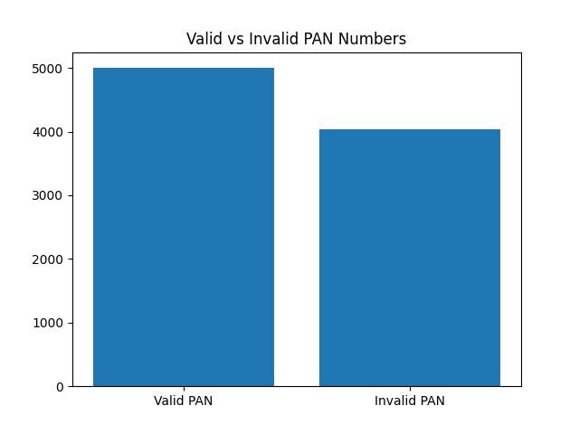
Valid vs Invalid PAN Analysis

Slide 7
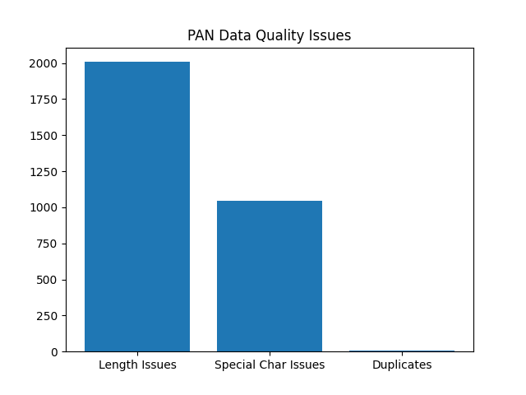
Data Quality Issues Analysis

Slide 8
Conclusion
Total Records: 9033
Valid PAN: 4999
Invalid PAN: 4034
Successfully implemented MySQL-based
Data Cleaning & PAN Validation Project.

