Slide 1
3. Phylogenetic Analysis

Slide 2
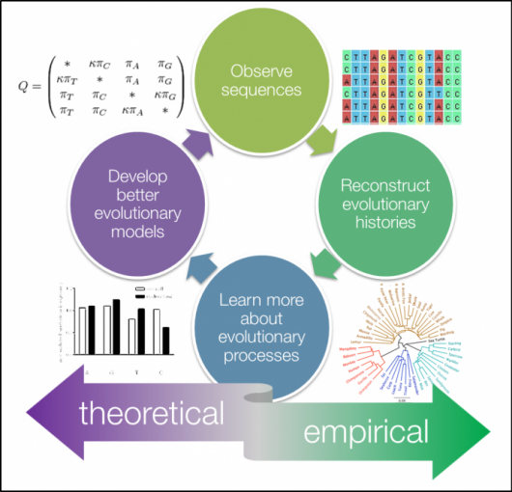
Introduction
Phylogenetic analysis is the study of the evolutionary development of a species or a group of organisms or a particular characteristic of an organism.

Slide 3
Continue..
Typically, phylogeneticists study one of the following types of question:
What are the evolutionary relationships or histories among many species/individuals/genes of interest?
How do sequences evolve?
Can I better describe processes of sequence evolution with a mathematical model?
In phylogenetic analysis, branching diagrams are made to represent the evolutionary history or relationship between different species, organisms, or characteristics of an organism (genes, proteins, organs, etc.) that are developed from a common ancestor.
The diagram is known as a phylogenetic tree.
Phylogenetic analysis is important for gathering information on biological diversity, genetic classifications, as well as learning developmental events that occur during evolution.

Slide 4
Continue…
With advancements in genetic sequencing techniques, phylogenetic analysis now involves the sequence of a gene to understand the evolutionary relationships among species.
DNA being the hereditary material can now be sequenced easily, rapidly, and cost-effectively, and the data obtained from genetic sequencing is very informative and specific.

Slide 5
Fundamental Elements of Phylogenetic Model
Phylogenetic Tree:
A tree is a 2-deimentional graph showing evolutionary relationships among organisms, or in our case, in certain gene from separate organisms.
The Tree is composed of nodes(a point where branches bifurcate) representing the TAXA(Separate source of sequences i.e. singular taxon) and branches representing the relationship among the TAXA.

Slide 6
Basic Properties of Tree
Root: the root is the common ancestor of all taxa. It is defined by including a taxon that we are reasonably sure branched off earlier than the other taxa under study but should be related to the remaining taxa a unique path leads from the root node to any other node and the direction indicates evolutionary time

Slide 7
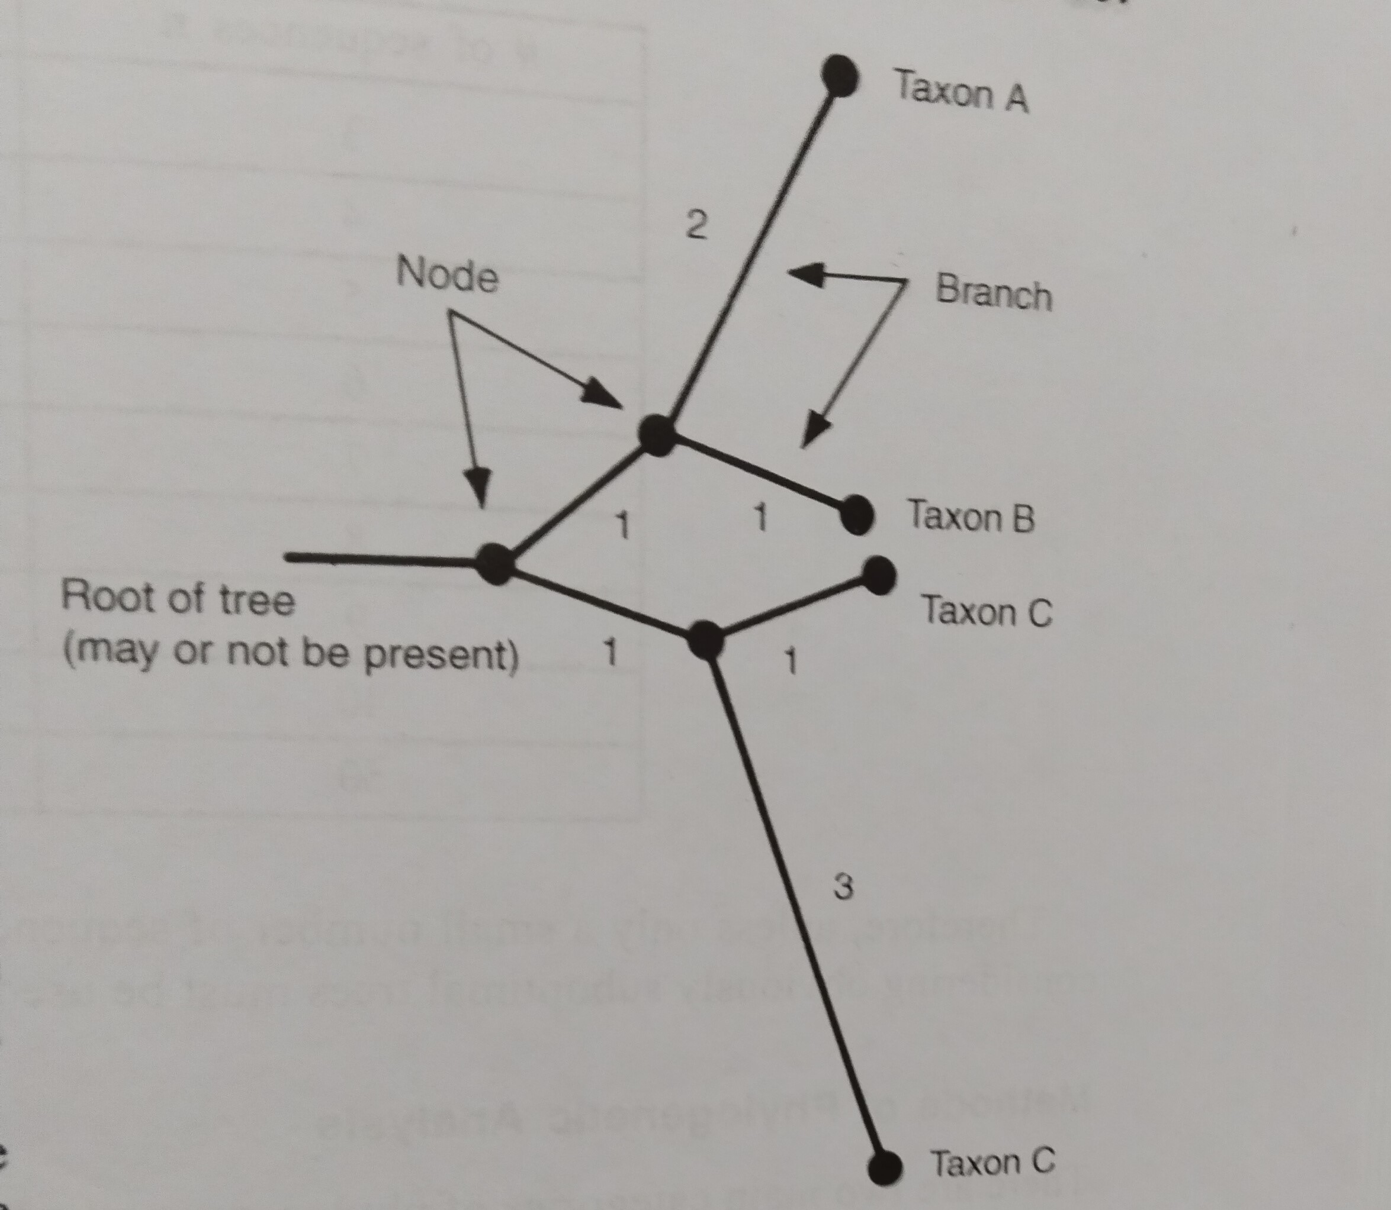

Slide 8
Continue…
If we do not have taxa to define the root we can predict relationships by an uprooted tree.

Slide 9
Continue…
Leaves : represents things being compared(i.e. Genes, speies).
Internal Nodes : These are hypothetical ancestral units.
Evolutionary Path :In a rooted tree, path from root to a node represents evolutionary path.
An uprooted tree : specifies relationships among things but not evolutionary path.
Paralogs: are genes that diverged within the same species. They are multiole genes per species.
Orthologues : are genes that diverged with species.

Slide 10
