Slide 1
Microarray

Slide 2
Introduction To Microarray
A microarray is a technology that can sequence thousands of genes at a time in order to quantify the expression of said genes.
Microarray technology uses a microarray chip which contains probes at different locations on its surface that can bond to target DNA.
The bonding of probes and targets is referred to as hybridization.

Slide 3
Continue..
Microarrays can be used to study gene expression in different conditions or in different cells.
The DNA of a sample of interest is called the target DNA and it is compared to a reference DNA or "control."
The differential binding and expression of fluorescent probes on the chip allow the user to determine the relative expression of target genes.

Slide 4
Types of Microarrays
There are three main types of DNA microarrays that are defined by their preparation:
Spotted arrays
in-situ arrays
self-assembled arrays.

Slide 5
Spotted | These arrays use a poly-lysine coated microscope slide. A robotic arm dips a small tip into DNA and then onto the glass surface to fluorescently label the sample. The probes need to be synthesized prior to chip preparation.
in-situ | These arrays use light or photolithography to create probes on the chip. These probes are oligonucleotides that match known sequences of target DNA.
Self-Assembled | These arrays use fiber optics. DNA is assembled on small polystyrene beads. These beads are then attached to a fiber optic which creates wells slightly larger than the beads. Some versions contain wells already premade in a glass to hold the beads. The beads are encoded with different combinations of fluorophore, so the randomly assembled oligos are identified by their specific combinations, as opposed to the other arrays in which the positions are known.

Slide 6
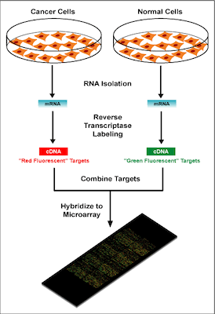

Slide 7
Continue…
There are four main steps to a DNA microarray analysis:
Sample isolation/preparation,
hybridization,
washing, and
analysis.

Slide 8
Sample isolation & preparation
This step requires the control and target mRNA to be extracted - i.e., a non-cancerous cell line versus a cancerous cell line, respectively. The RNA is then converted into cDNA and labeled with a fluorescent dye. Typically, Cy3 (a red fluorescent dye) and Cy5 (a green fluorescent dye) are used to label the target and control cDNA.

Slide 9
Hybridization
In this step the sample DNA is hybridized with complementary probe sequences on the array chip. DNA will strongly or weakly hybridize - or not at all .
The resulting complex is also purified at this step.

Slide 10
Washing
Slides are then washed with buffer to remove any DNA that did not strongly hybridize to a probe. This also helps prevents cross hybridization - hybridization by sample and probe that are not complementary.

Slide 11
Analysis
In the final step, the array chip is exposed to laser excitation showing the relative abundance of hybridized DNA in each target location. Fluorescent emission is measured using a confocal microscope.

Slide 12
Applications of Microarray
In Cancer
Antibiotic Treatment
Early detection of oral precancerous lesions

