Slide 1
Procyon: Promoting Fine-Grain Multi-Tenancy to Optimize Sparse Streaming Accelerators
Ubaid Bakhtiar, Jeremy Sha, Helya Hosseini, Bahar Asgari
Corresponding author: ubaidb@umd.edu
University of Maryland, College Park

Slide 2
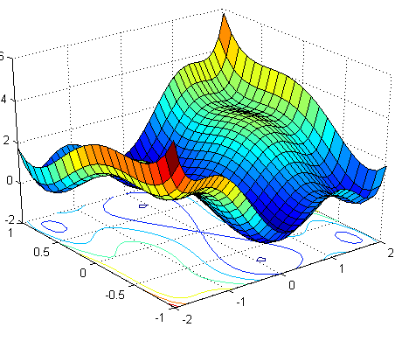





Existence of Sparsity
1
Scientific Computing
Large Language Models
Recommendation Systems
Computer Vision
Speech Processing

Slide 3
Streaming Accelerators
2
Data-driven execution model of streaming accelerators
Maximize the data transfer as well as computational throughput
Schedule the data for a compute engine in the corresponding memory channel
Input
Output
HBM Channel 0
Compute Engine 0
HBM Channel 5
HBM Channel 1
Compute Engine 1
HBM Channel 6
HBM Channel 2
Compute Engine 2
HBM Channel 7
HBM Channel 4
Compute Engine 3
HBM Channel 8

Slide 4
CHALLENGES

Slide 5
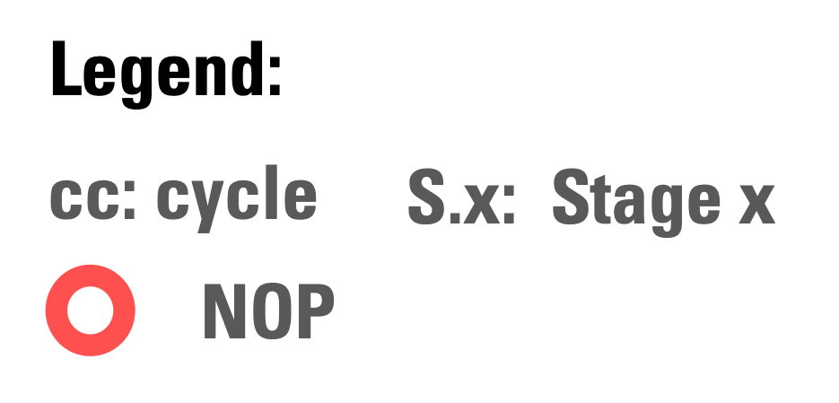
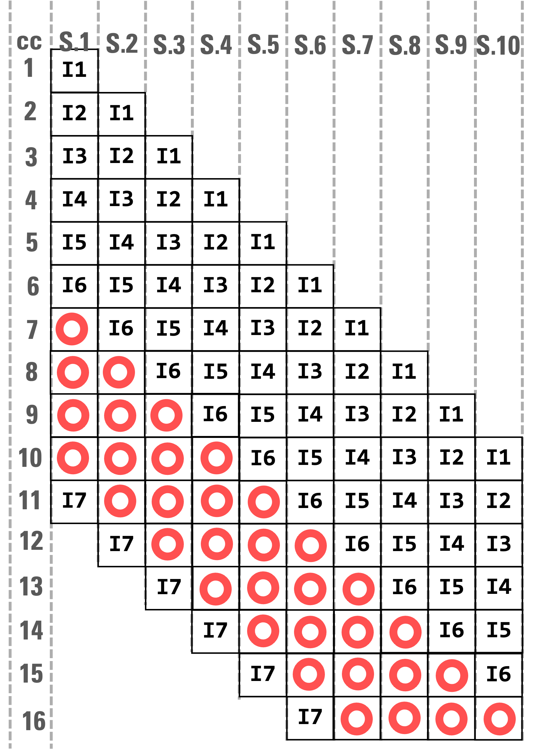
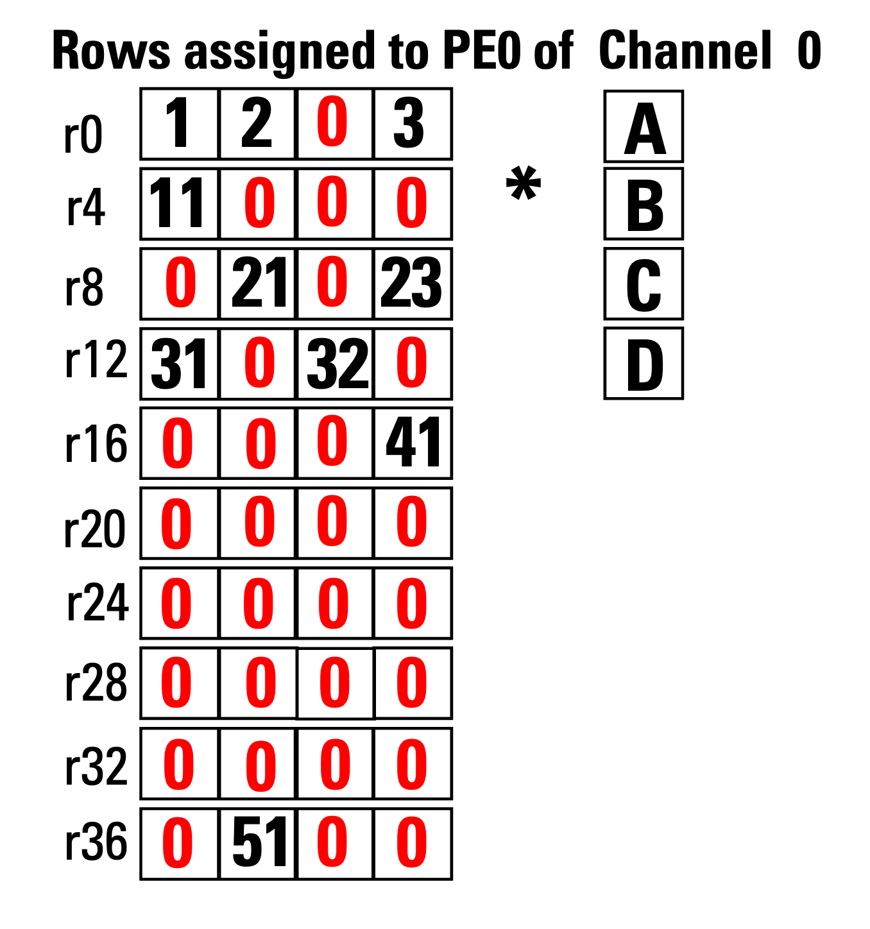

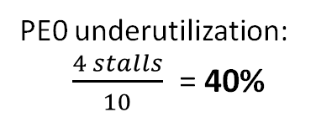
Poor Data Scheduling
3
1. PE-aware Non-zero Scheduling
Throughput:
0.60
PE0 underutilization:
$\frac{4 stalls}{10}$ = 40%
PE0 of Channel 0 Instructions:
I1:
I2:
I3:
I4:
I5:
I6:
r0_op1 = 1A
r4_op1 = 11A
r8_op1 = 21B
r12_op1 = 31A
r16_op1 = 41D
r36_op1 = 51B
RAW
I7:
r0_op2 = 2B +r0_op1
Pipeline of PE-aware Non-zero Scheduling
L. Song et.al Serpens DAC 2022

Slide 6
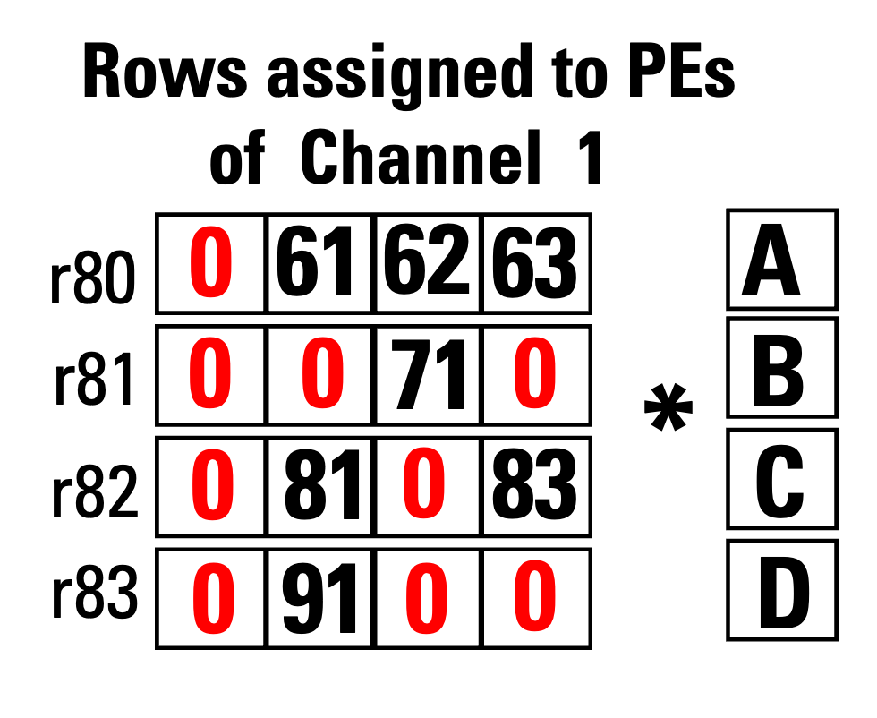
Poor Data Scheduling
4
2. Cross-HBM Channel OoO Scheduling
0
PE0 of Channel 1 instructions:
i8:
i9:
i10:
r80_op1_sh =61A
r81_op1_sh =71C
r82_op1_sh =81B
CrHCS schedule these instructions to the PEs of Channel 0
Pipeline of PE-aware Non-zero Scheduling
U. Bakhtiar et.al Chason MICRO 2025

Slide 7
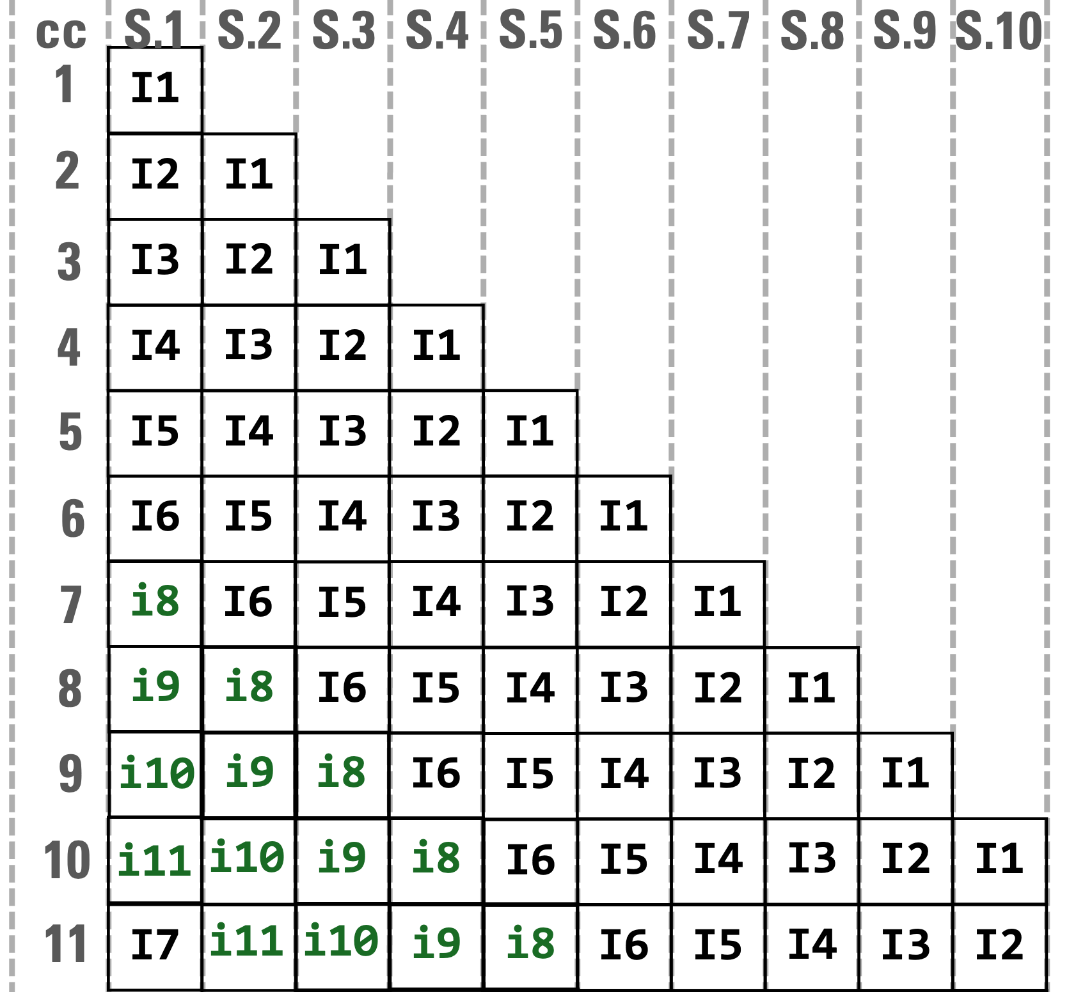

Poor Data Scheduling
5
2. Cross-HBM Channel OoO Scheduling
Throughput:
1 non-zero per cycle
PE0 underutilization: $\frac{1 stalls}{10}$ = 10%
0
PE0 of Channel 1 instructions:
i8:
i9:
i10:
r80_op1_sh =61A
r81_op1_sh =71C
r82_op1_sh =81B
CrHCS schedule these instructions to the PEs of Channel 0
Pipeline of CrHCS
U. Bakhtiar et.al Chason MICRO 2025
Notes:
- animation ?

Slide 8
Poor Data Scheduling
6
Both PE-aware and CrHCS results in considerable number of stalls
This results in high PE underutilization, resulting in sub-optimal performance
PE Underutilization (%)
36 SuiteSparse Workloads

Slide 9
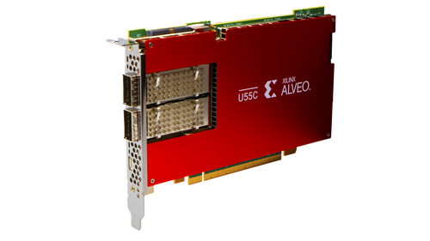









Single Workload Execution Model
7
SOTA sparse streaming accelerators follows a single workload execution model
Multiple workloads on a single accelerator must be executed sequentially
Deploying multiple accelerators for concurrent execution increase the system cost
$$Time T_{A}$$
$${Time T}_{B}$$
Input
Sparse Accelerator
Output
Input
Sparse Accelerator
Output
$$Matrix A$$
$$Vector \vec{x_{A}}$$
$$Matrix B$$
$$Vector \vec{x_{B}}$$
Single-Tenant
$N\%$ Underutilization
$M\%$ Underutilization
$Total Time$ $= (T_{A}+T_{B})$

Slide 10
OUR WORK

Slide 11






Main Goal
8
The main goal of Procyon is to:
Allow multiple workloads to execute on a single sparse streaming accelerator
Improve the PE underutilization inherit in current data scheduling techniques
$Time$ $<(T_{A}+T_{B})$
Input
Sparse Accelerator
Output
$$Matrix A$$
$$Vector \vec{x_{A}}$$
Multi-Tenancy
$$Matrix B$$
$$Vector \vec{x_{B}}$$
Underutilization $<\left(N+M\right)\%$

Slide 12
Key Insight
9
“If we fuse the PE instructions of multiple workloads into a unified set of instructions, it enables multi-tenant execution of a PE while eliminating PE stalls by filling them with instructions from other workloads.”

Slide 13
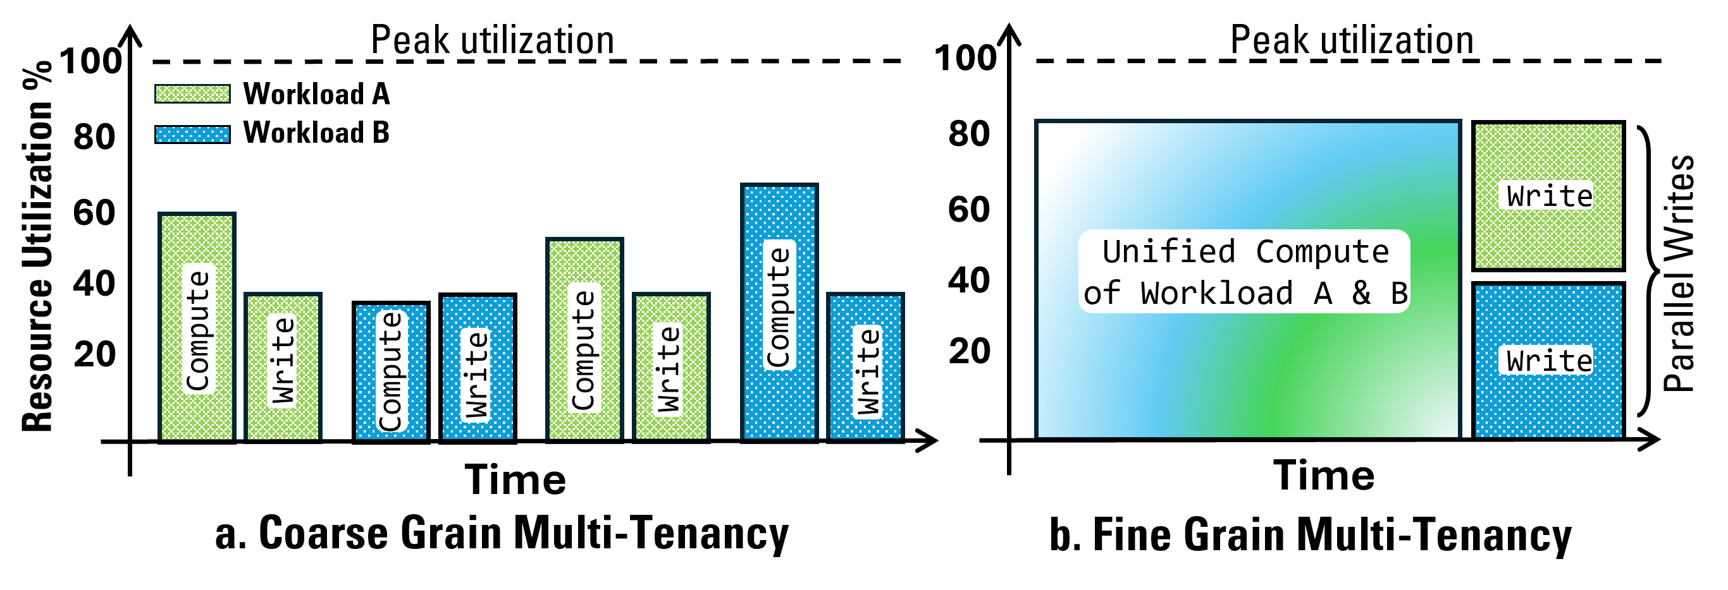
Procyon Scheduler – Level of Granularity
10
Coarse Grain Multi-Tenancy
Fine Grain Multi-Tenancy
Accelerator switches between multiple workloads alternatively
Compute and write stages are sequential
A single accelerator is used
Unified compute for multiple workloads
Parallel write operations
A single accelerator is used but with higher PE utilization

Slide 14
Procyon Scheduler – Level of Granularity
11
Coarse Grain Multi-Tenancy
Fine Grain Multi-Tenancy
Accelerator switches between multiple workloads alternatively
Compute and write stages are sequential
A single accelerator is used
Unified compute for multiple workloads
Parallel write operations
A single accelerator is used but with higher PE utilization

Slide 15
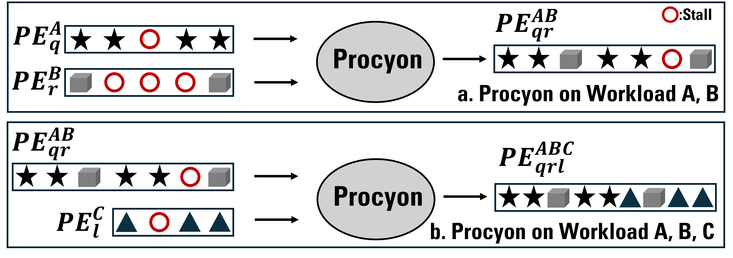
Procyon Scheduler – Mechanism
12
Key Idea: To fuse the instructions of a PE from one workload with those of a PE from another workload, making it a multi-tenant PE.

Slide 16
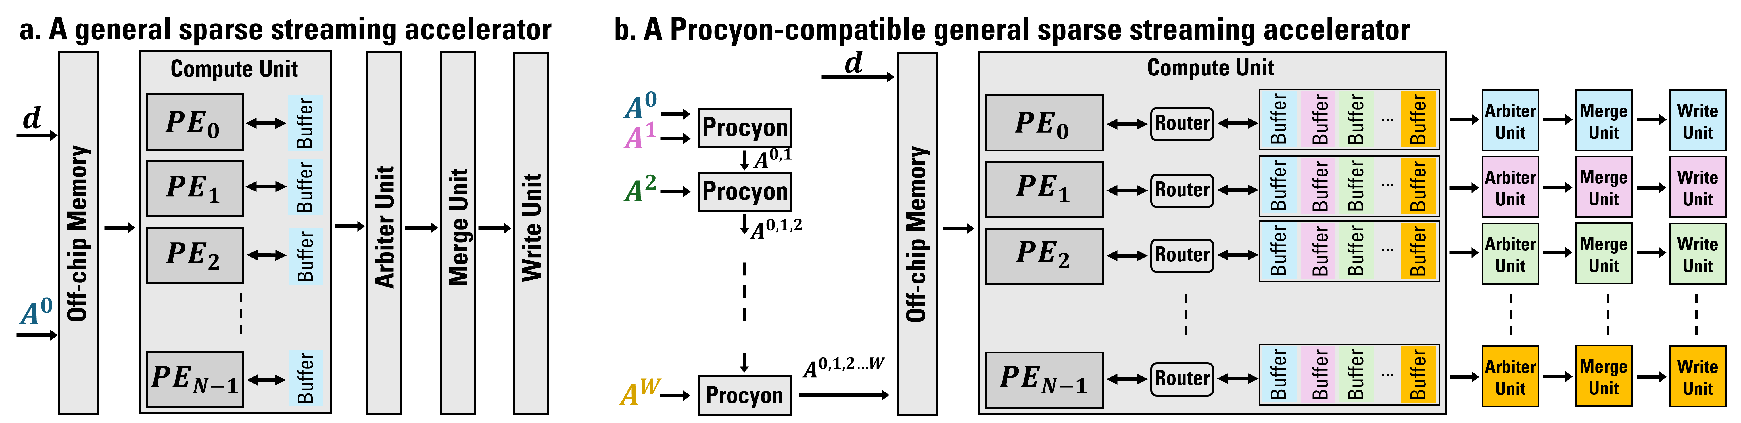
Procyon Architectural Support
13

Slide 17
Procyon Architectural Support
14
A general sparse streaming accelerator
A Procyon-compatible general sparse streaming accelerator

Slide 18
KEY RESULTS

Slide 19
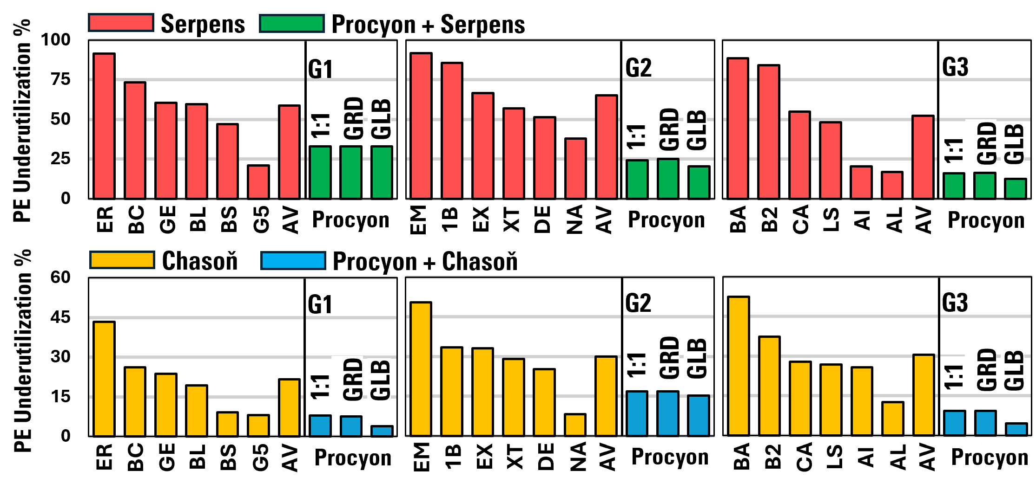
PE Underutilization
15
Procyon compatible baselines achieves lower PE underutilization under all PE pairing schemes as multiple workloads are being executed on each PE.
PE underutilization % of Serpens and Chason with and without Procyon on SuiteSparse Workloads (lower is better)

Slide 20
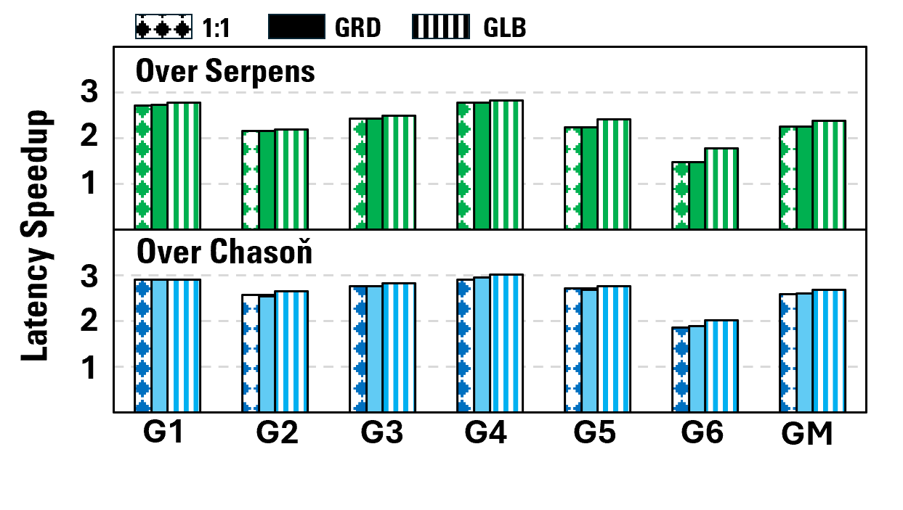
Speedup
16
The lower PE underutilization as well as multi-tenancy results in speedup over sequential execution of the workloads on baselines
Latency speedup of Procyon vs. Serpens and Chason on SuiteSparse workloads groups (higher is better)

Slide 21
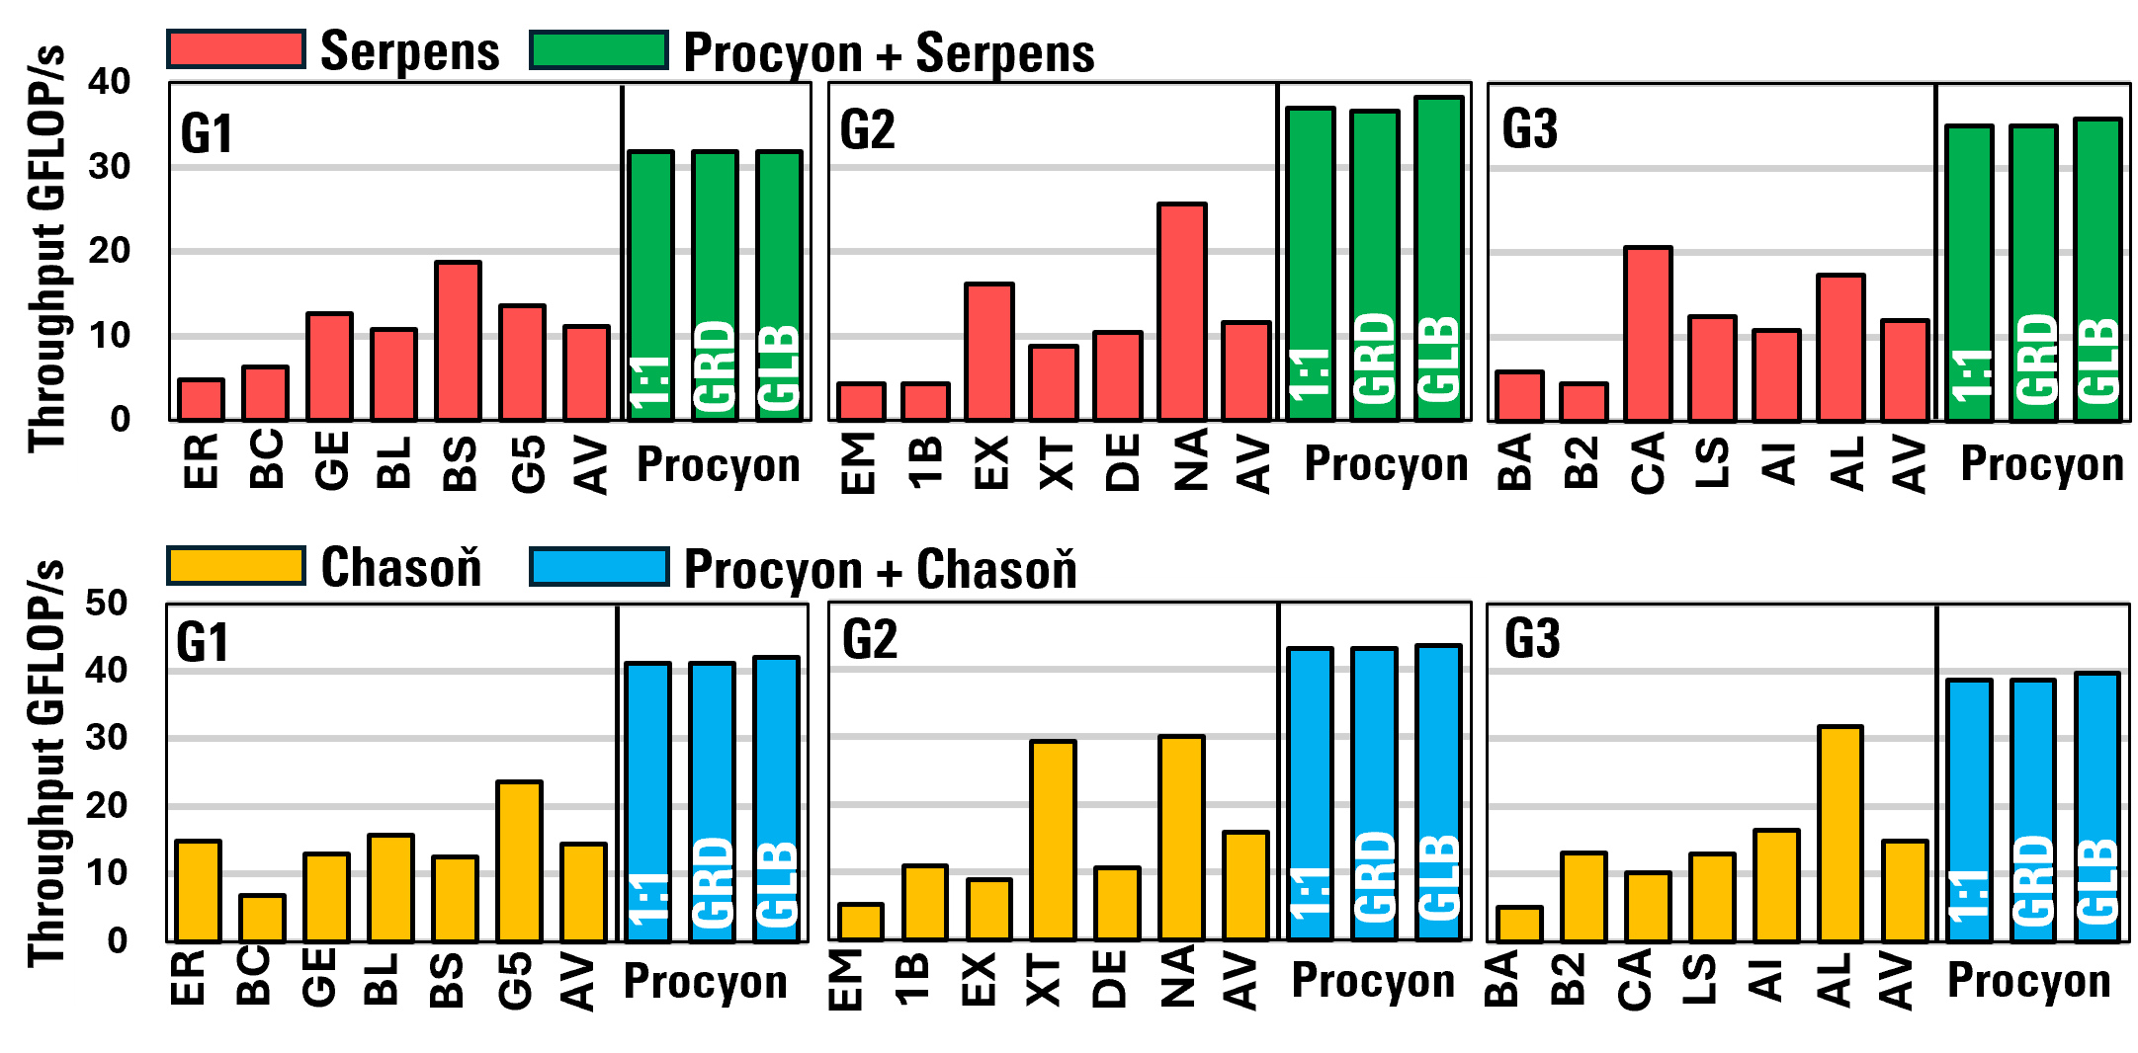
Throughput
Procyon compatible baselines achieves higher throughput due to increased activity of PEs
Throughout of Serpens and Chason with and without Procyon on SuiteSparse Workloads (higher is better)

Slide 22


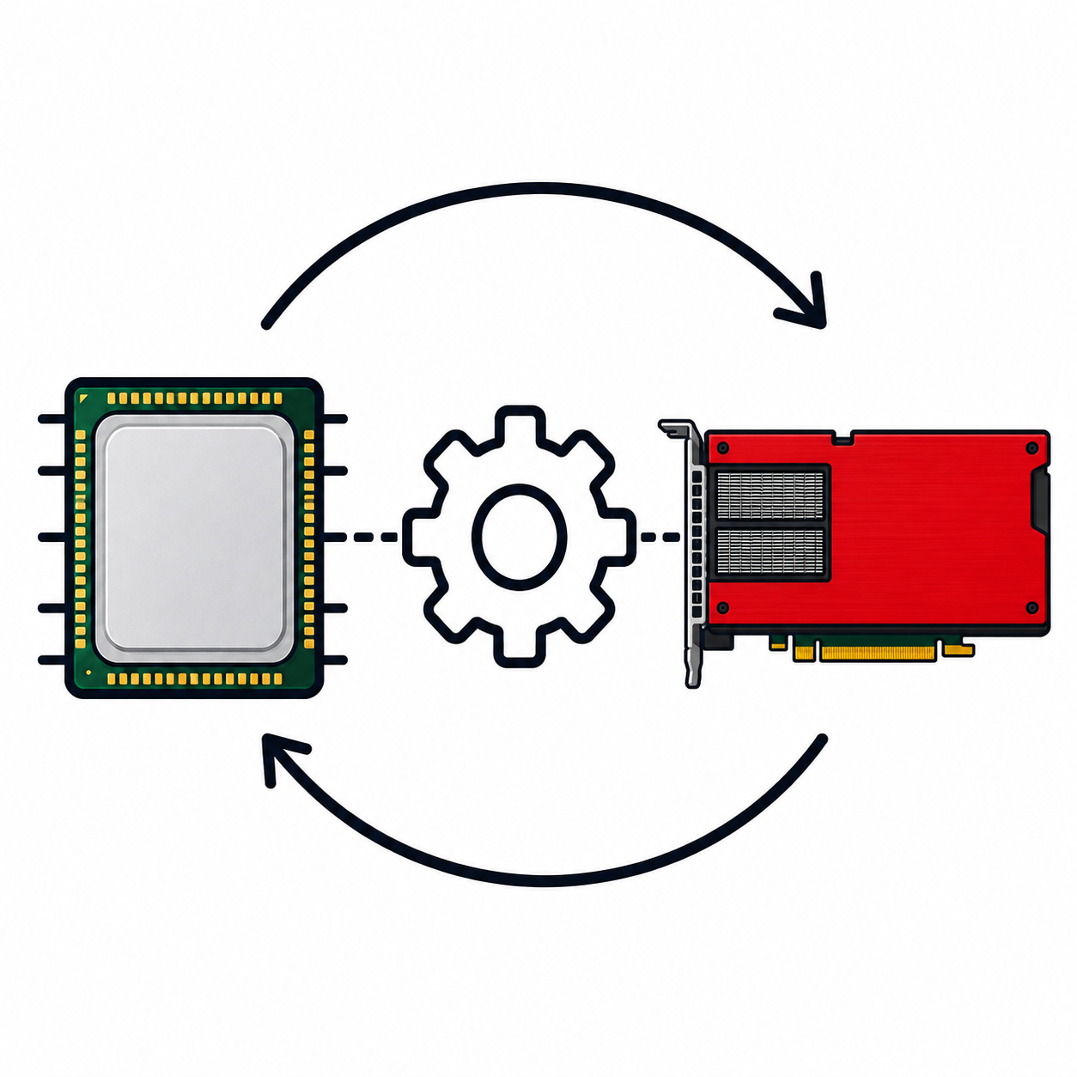

Conclusions
17
Sparsity is a prevalent topic in scientific computing as well as generative AI
Sparse streaming accelerators have shown strong performance gains
Existing sparse streaming accelerators are highly underutilized as well as follow a single workload execution model → sub-optimal performance and increased system cost
We propose Procyon to fuse the instructions of multiple workloads and execute them on a single sparse streaming accelerator concurrently
To support Procyon, we showed the architectural extension for a streaming accelerator
FPGA
Procyon compatible streaming accelerators achieves substantial improvement in PE underutilization, performance and system’s monetary cost

Slide 23



Speaker:
Ubaid Bakhtiar
5th Year ECE Ph.D. Candidate
ubaidb@umd.edu
THANK YOU !!!
Computer Architecture & Systems Lab

