Slide 1


Acamar: A Dynamically Reconfigurable Scientific Computing Accelerator for Robust Convergence and Minimal Resource Underutilization
57th IEEE/ACM International Symposium on Microarchitecture
*
Ubaid Bakhtiar, Helya Hosseini and Bahar Asgari
University of Maryland, College Park
Email: {ubaidb, helia, bahar}@umd.edu
Computer Architecture & Systems Lab
*Acamar / ˈækǝmaːr/ is a binary star system in the constellation of Eridanus.

Slide 2
For best experience, view in Slide Show fashion

Slide 3

Post Moore’s Law Era
End of Moore's Law
Resource Utilization Gap
Need for Efficiency
Diverse Domain-Specific Challenges
Shift in Focus

Slide 4






Outline
What ?
Why ?
How ?
How good ?
Conclusions
Introduction
Challenges
Acamar
Evaluation
Q&A

Slide 5
Introduction
“What is the underlying application?”

Slide 6
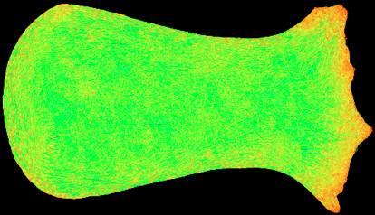
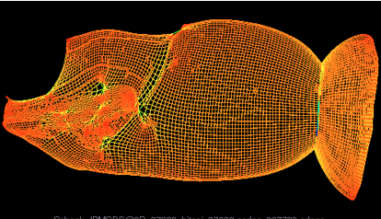
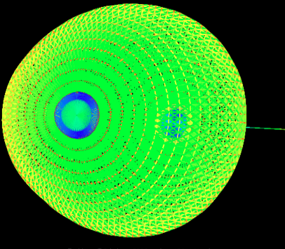
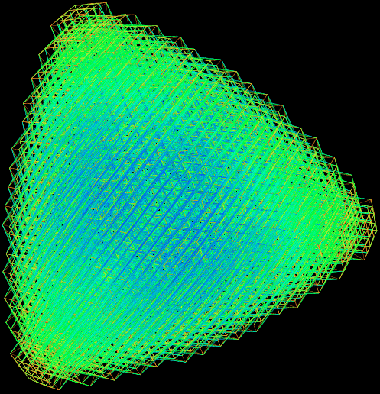
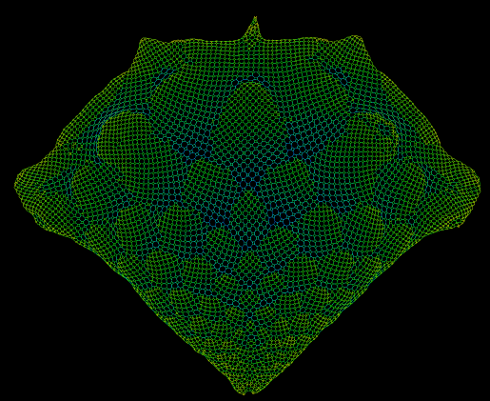
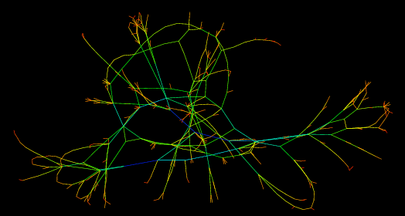
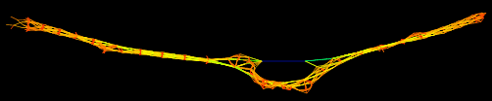
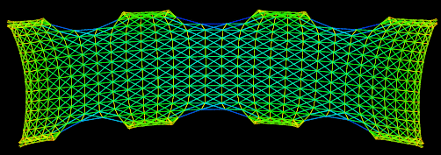
Scientific Problems
Electromagnetics Problem
Semiconductor Device Problem
Fluid Dynamics
Quantum Chemistry
2D/3D Problem
Power Network Problem
Least Square Problem
Structural Problem

Slide 7


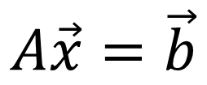
Representing Scientific Problems
$$A\vec{x}=\vec{b}$$
Coefficient Matrix
Constant Vector
Solution Vector

Slide 8
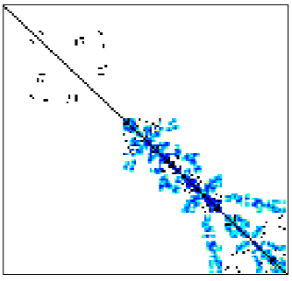
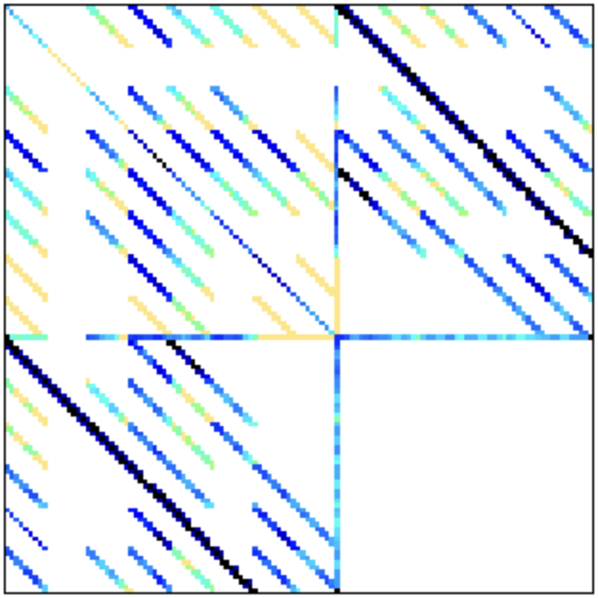
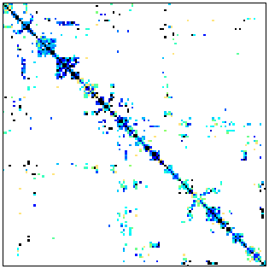
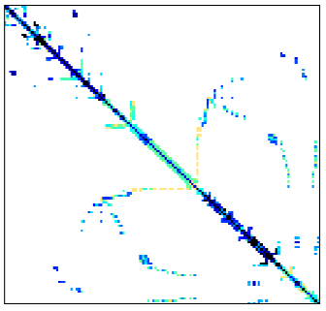
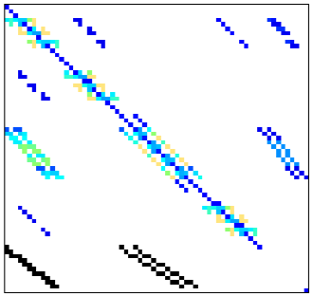
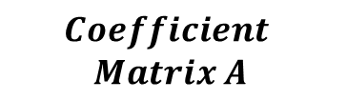
Coefficient Matrix
Temporal
Dependencies
Geometric
Constraints
Stochastic
Uncertainties
encapsulated in
$$Coefficient$$
$$Matrix A$$
results in
Boundary
Conditions
Physical
Properties
Highly Sparse Matrices

Slide 9



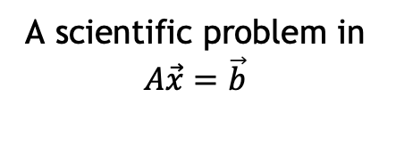
Scientific Computing
Mathematician
Computer Architect
Scientific
Computing
A scientific problem in $A\vec{x}=\vec{b}$
Proposes a mathematical solution
Builds an efficient architecture
Iterative Methods
Direct Methods

Slide 10
Challenges
“Why do the existing architectures not work well?”

Slide 11
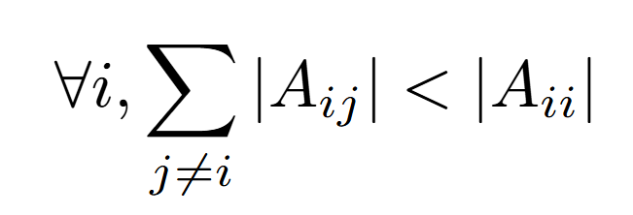
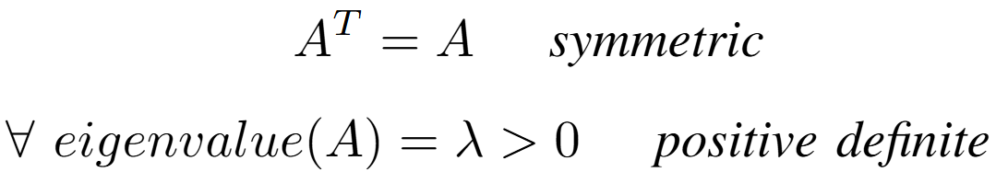
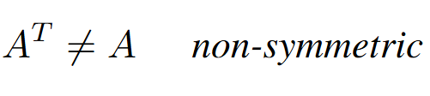
Iterative Solvers
1. Start with an initial guess
2. Iterate over the solution until convergence is achieved
Bi-Conjugate Gradient-Stablized (BiCG-STAB)
Jacobi Iterative
Method (JB)
Conjugate Gradient (CG)
Suitable for: Strictly diagonally dominant coefficient matrix A
Suitable for: Symmetric and positive definite coefficient matrix A
Suitable for: Non-symmetric coefficient matrix A
Key Operation: Sparse Matrix-Vector Multiplication (SpMV)

Slide 12
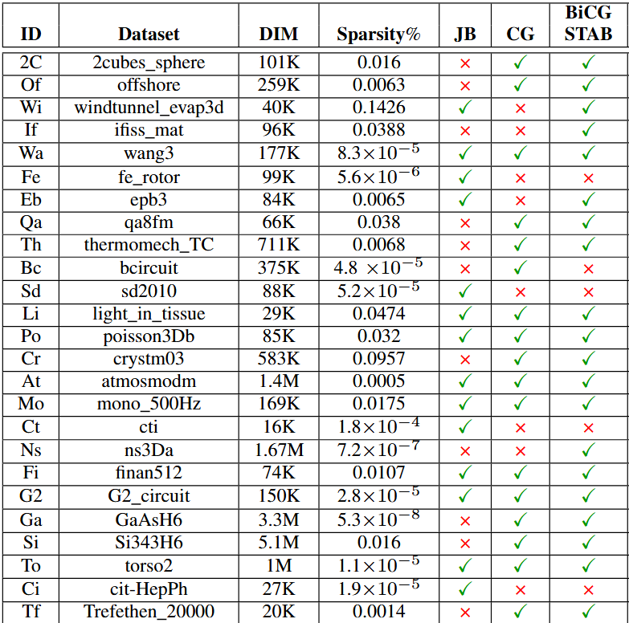

Solution Divergence
Do these solvers always guarantee convergence ?
NO !!
Examples of Solvers diverging and converging for coefficient matrices from SuiteSparse Collection

Slide 13
We need a robust accelerator...
State-of-the-art Accelerators
Only compatible for one specific solver
Static design
Reconfiguration limited to micro-architectural optimizations
Ideally, we want a scientific computing accelerator that offers robust convergence irrespective of the structure of coefficient matrix A

Slide 14
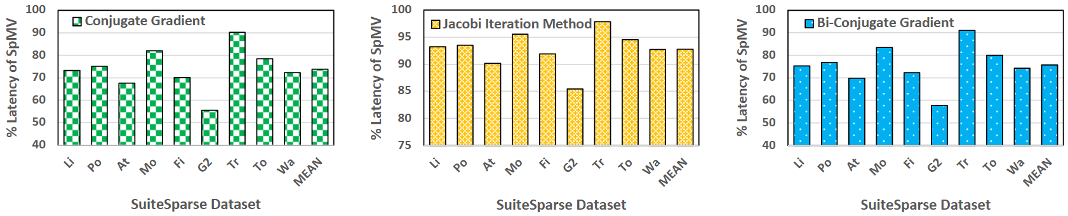
SpMV Kernel
A key kernel in iterative solvers
Majority of total time is spent in doing SpMV
% Latency of SpMV for three iterative solvers for various matrices

Slide 15
SpMV- Resource Underutilization (R.U)
Active
Idle
Idle
Idle
1
1
1
1
1
2 |  |  | 3
4 | 5 | 6
7 | 8 | 9 | 10
Active
Idle
Idle
Active
Row 0: 75% R.U
Active
Active
Active
Idle
PEs
Row 1: 50% R.U
Active
Active
Active
Active
PEs
PEs
Row 2: 25% R.U
PEs
Row 3: 0% R.U
PEs

Slide 16
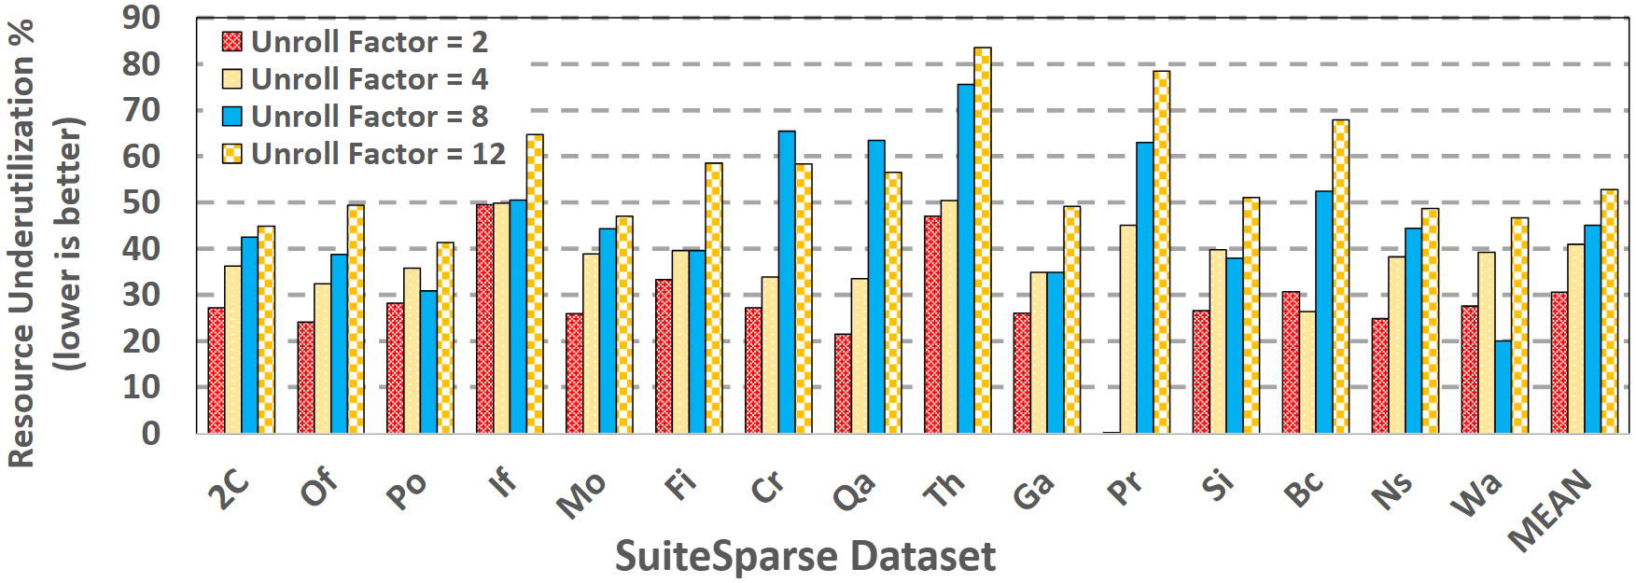
SpMV- Resource Underutilization (R.U)
RU changes with PE allocation/unroll factor. The sparse structure of matrix A does not allow for one fixed unroll factor that will result in most optimal resource utilization in all the datasets.
Resource Underutilization in baseline SpMV for SuiteSparse datasets

Slide 17
Minimal Resource Underutilization
State-of-the-art Accelerators
Rely on fixed number of PEs/resources
Cannot make runtime decisions about resource allocation
Yield sub-optimal performance due to resource underutilization
Ideally, we want a scientific computing accelerator that ensures minimal resource underutilization.

Slide 18
Acamar
“To enable a flexible accelerator that is dynamically reconfigured to match the computations required by the solver suitable for a given coefficient matrix offering a robust and resource efficient solution for diverse datasets”

Slide 19
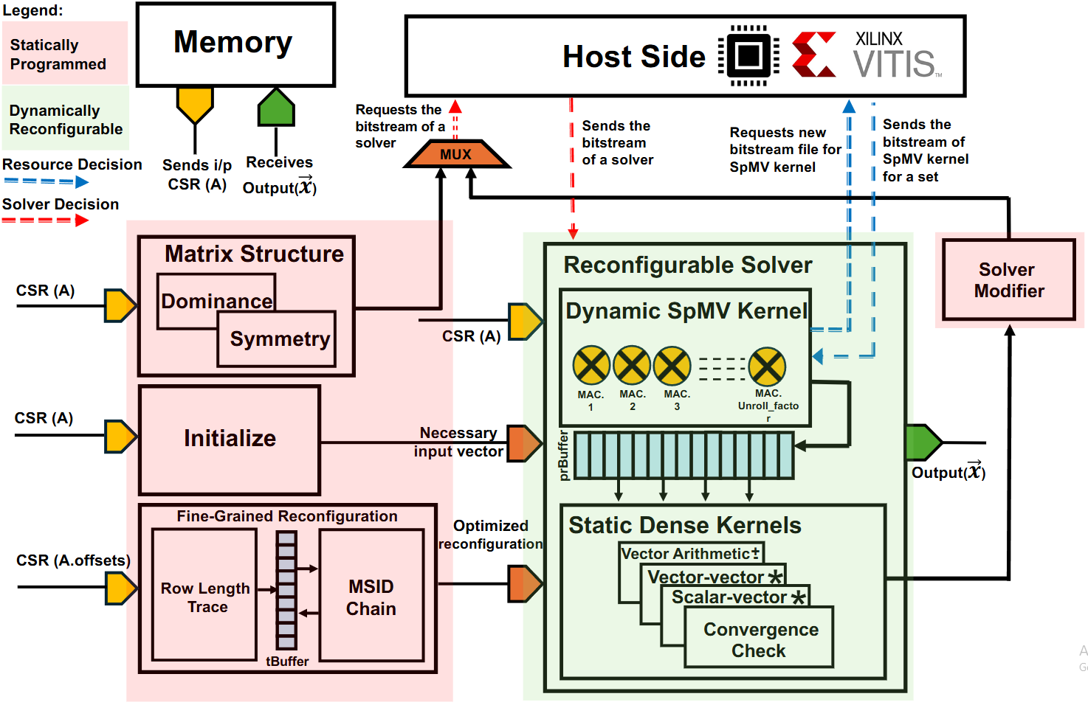
Architecture of Acamar
Acamar is an FPGA-based accelerator
Partial dynamic reconfiguration
Dynamically reconfigurable region
Statically programmed region
Notes:
SOME ANIMATION TO LET THEM KNOW WHAT I AM TALKING ABOUT

Slide 20
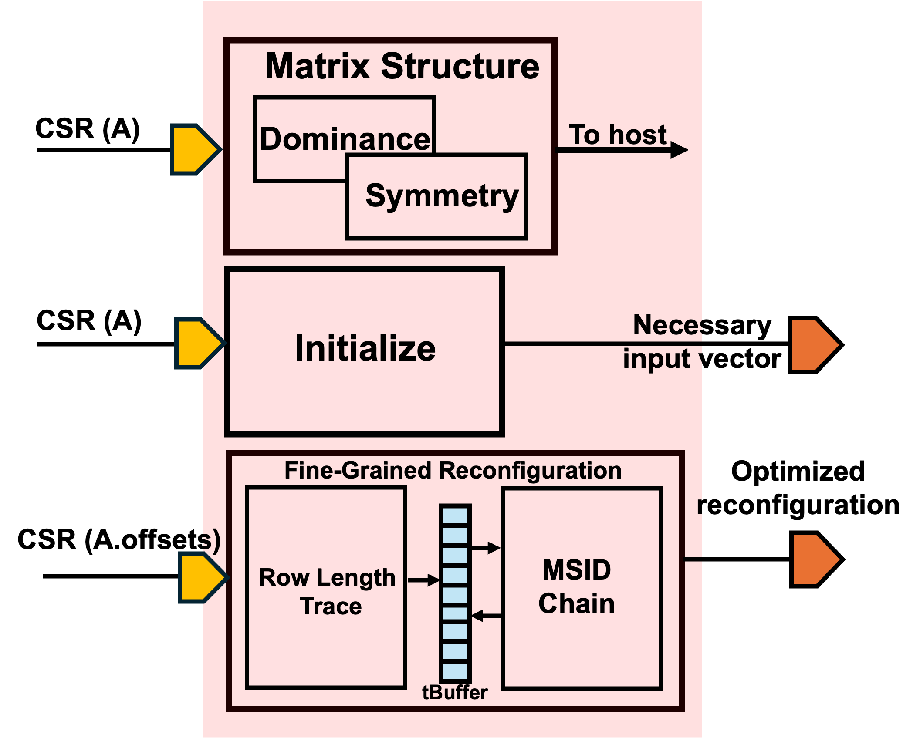
Statically Programmed Region
Matrix Structure Unit
Initialize Unit
To host
Solver Modifier
Fine-Grained Reconfiguration Unit
Solver Modifier Unit
Divergence
Flag

Slide 21


Solver Decision & Robust Convergence
Host Side
Requests the bitstream of a solver
Sends the bitstream of a solver
Matrix Structure
MUX
Solver
Modifier
Dominance
Symmetry
Reconfigurable Region
Records if the coefficient matrix is strictly diagonally dominant and symmetric or not

Slide 22
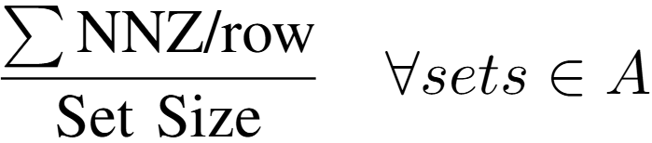
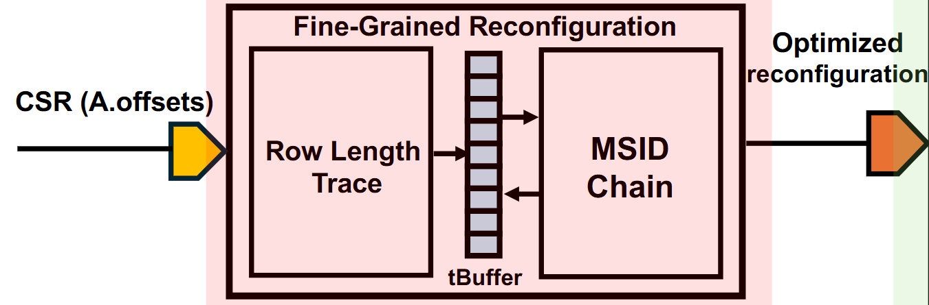

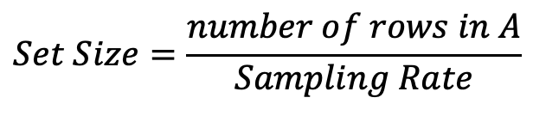

PE/Resource Allocation
In an ideal case, for each row:
Not practical
Massive reconfiguration overhead
Number of PEs = Number of Non-Zeros (NNZ) in that row
Solution: Make sets of rows and find optimal resource allocation for that set
$$Optimal PE allocation=$$
$$Set Size=\frac{number of rows in A}{Sampling Rate}$$
$$Sampling Rate:Number of Sets$$

Slide 23
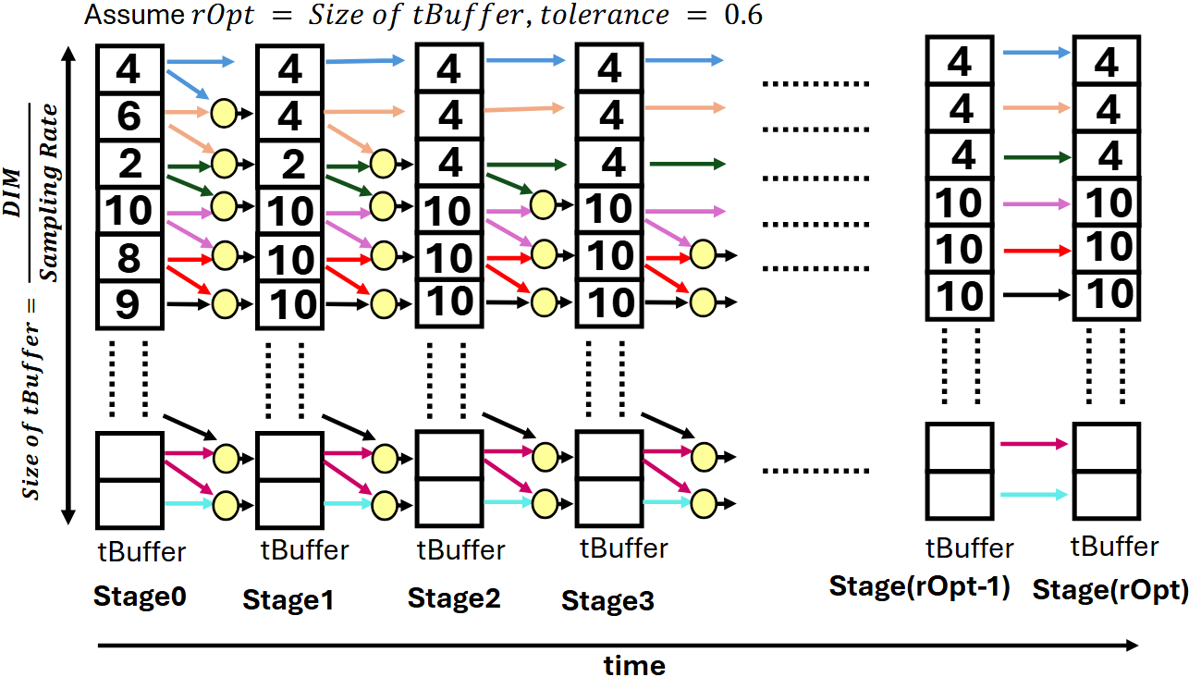
Multi-Stage Iterative Decision (MSID) Chain
Problem: If the optimal number of PEs between sets is not very different, we can end up incurring undesired reconfiguration overhead.
Stage0: Must reconfigure for 6 sets of rows
Stage(rOpt): Reconfiguration instances reduced to only 2
Solution: Iteratively decide if the number of allocated PEs between consecutive sets have a considerable difference

Slide 24
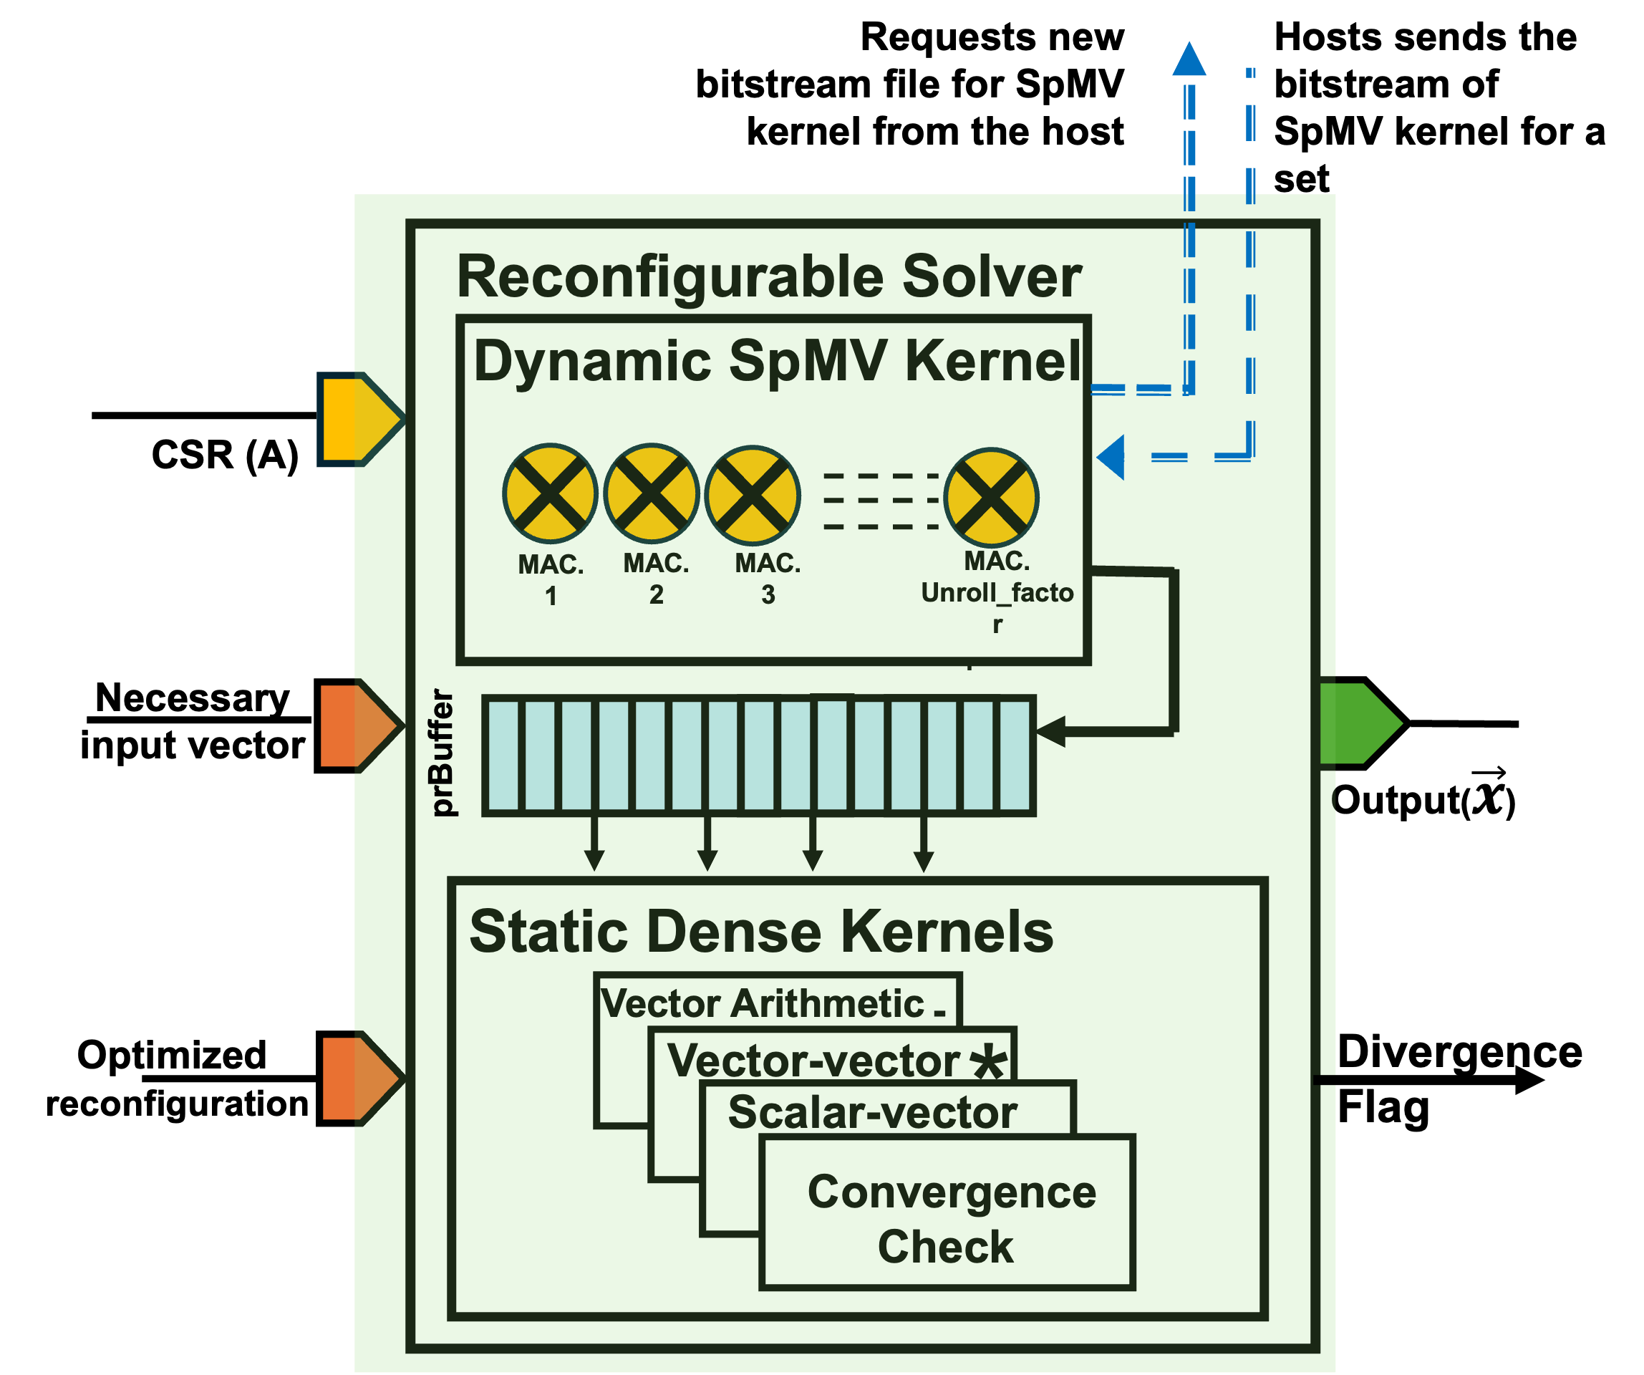
Reconfigurable Solver Unit
Host will dynamically reconfigure
Dynamic SpMV kernel – Nested reconfiguration
Static Dense Kernels

Slide 25
Evaluation
“How good does our solution work?”

Slide 26

Experimental Setup
Simulation : Cycle-accurate simulator based on HLS implementation on AMD Xilinx Alveo U55c
Baselines: Static Design and Nvidia GTX 1650 Super (cuSparse lib.)
Computing Precision: 32 bits
Fine-Grained Reconfiguration Unit Parameters
1. rOpt: Number of MSID-Chain Stages = 8
Convergence Threshold: $10^{−5}$
2. Sampling Rate: Number of sets of rows in coefficient matrix A = 32
Setup Time: 200 Iterations
Datasets: SuiteSparse Collection
3. Tolerence: Tolerence level of MSID-Chain = 0.15

Slide 27
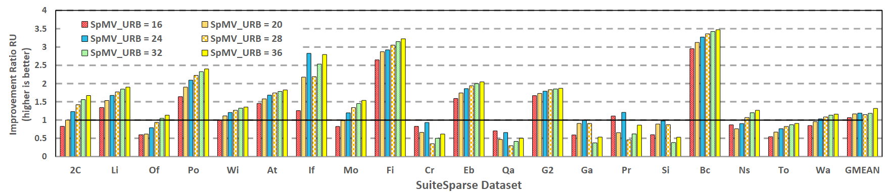
Resource Underutilization (1)
Resource utilization improvements are more prominent over a static baseline that allocates PEs optimistically
Resource underutilization improvement ratio in Acamar over a static baseline (higher is better)

Slide 28
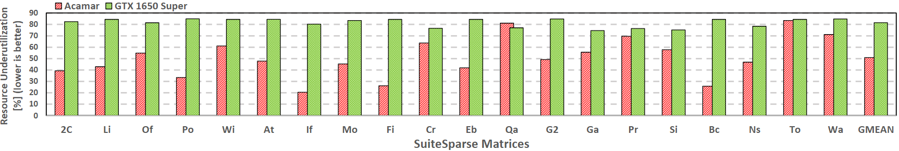
Resource Underutilization (2)
On average Acamar exhibits 1.6x resource utilization improvement and can go up to 3.5x over NVIDIA GTX 1650 Super
Resource underutilization in Acamar and Nvidia GTX 1650 Super (lower is better)

Slide 29
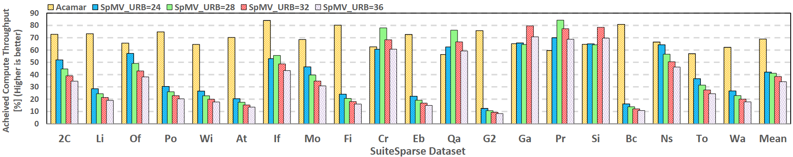
Achieved Compute Throughput (1)
On average Acamar achieves 70% of the peak achievable compute throughput as compared to ~40% in the static baseline, and can go up to ~82%
Achieved compute throughput as a percentage of peak throughput (higher is better)
Acamar v. Static Design

Slide 30
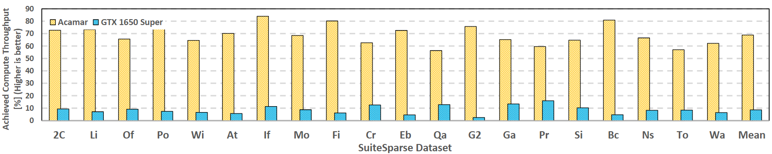
Achieved Compute Throughput (2)
On average Acamar achieves 70% of the peak achievable compute throughput as compared to <10% in Nvidia GTX 1650 Super, and can go up to ~82%
Achieved compute throughput as a percentage of peak throughput (higher is better)
Acamar v. Nvidia GTX 1650 Super

Slide 31
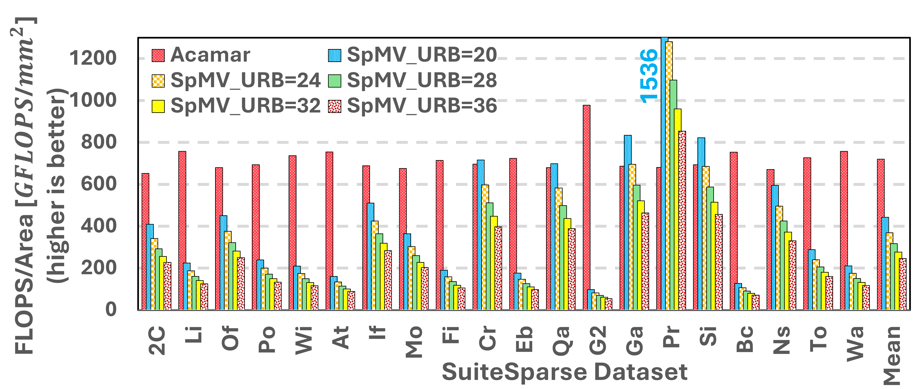
Performance Efficiency
Acamar gives better GFLOPS per unit area, making it more efficient. This leaves more area for another application running on the same FPGA fabric.
Performance Efficiency of Acamar and static baseline design (higher is better)

Slide 32
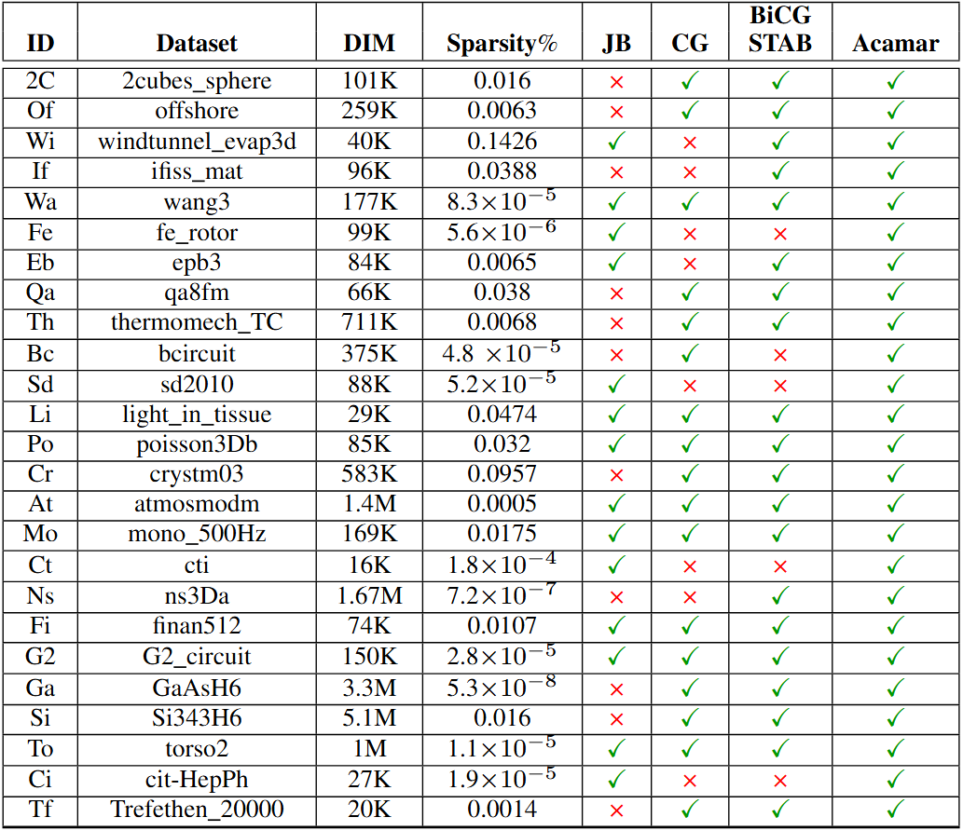
Robustness
Acamar converges for all the datasets owing to its Matrix Structure and Solver Modifier units, making it a robust accelerator for scientific problems.
Examples of solvers diverging and converging for coefficient matrices from SuiteSparse

Slide 33
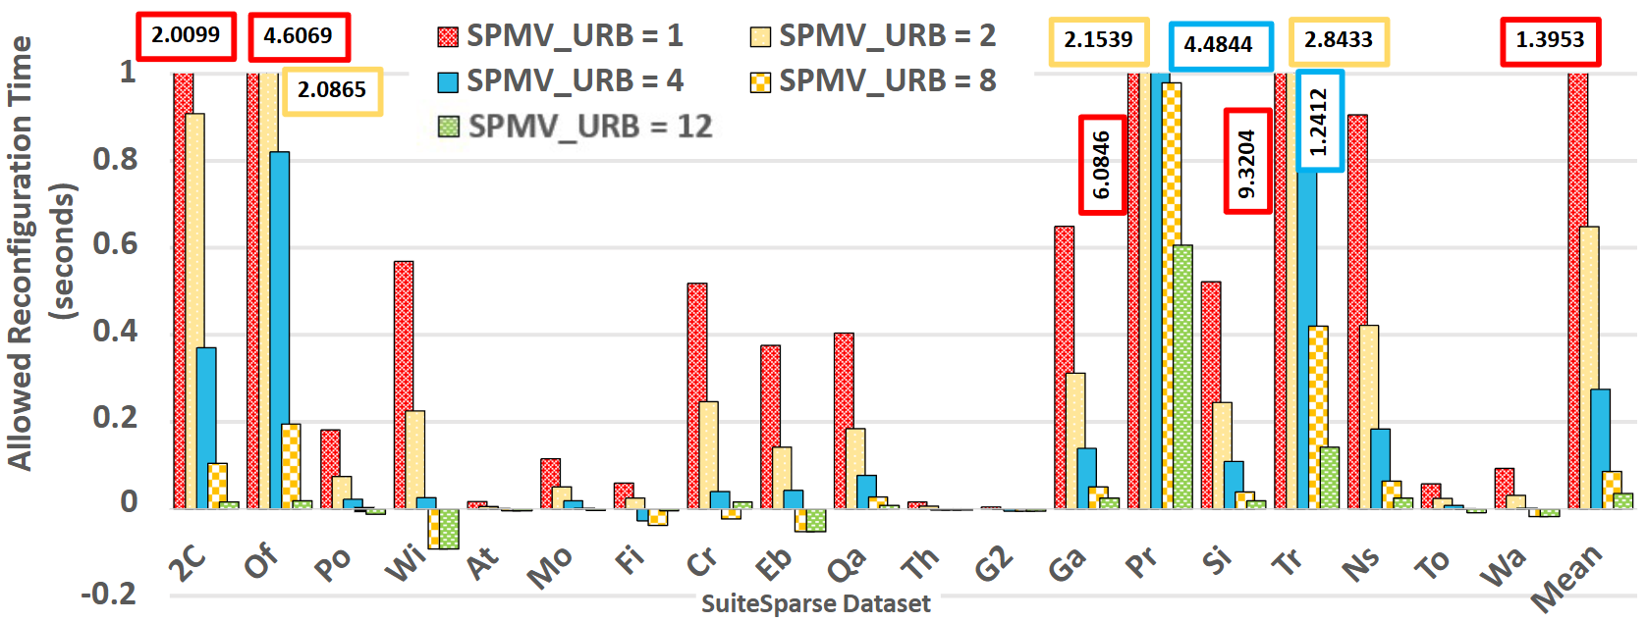
Allowed Reconfiguration Time
To achieve latency equal to or less than the baseline design, the reconfiguration instances must be done within certain time bounds.

Slide 34
Conclusions

Slide 35
Conclusions
Post Moore’s law and increased focus on improved resource utilization
Lack of robust scientific accelerator and dynamic reconfiguration
Inherent resource underutilization in sparse kernels
Acamar – an innovative FPGA-based dynamically reconfigurable accelerator for diverse scientific computing workloads.
Improved resource utilization and performance efficiency

Slide 36

Thank You !!!
Questions and comments are welcomed !!!
We thank the United States Department of Energy (DoE) for supporting this project

Slide 37
Additional Resources

Slide 38








Mathematical Solvers
Solution Vector:$\vec{ x}$
Iterative Methods
Direct Methods
$$x_{0}$$
$$x_{1}$$
$$x_{2}$$
$$A\vec{x}= \vec{b}$$
Solver
$$x_{3}$$
$$x_{4}$$
.
.
$$x_{n}$$

Slide 39
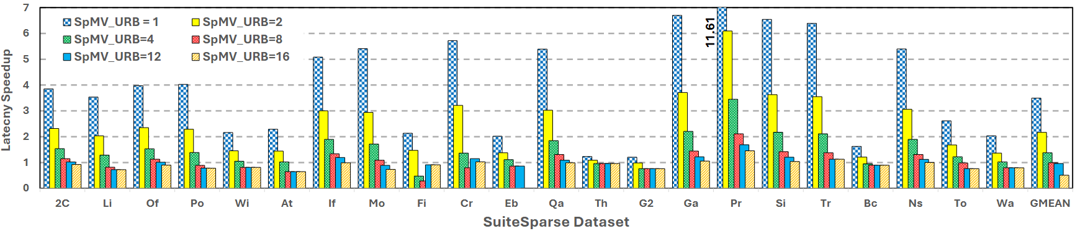
Speedup
Latency speedup of Acamar over static design for different SuiteSparse datasets (GMEAN refers to Geometric Mean).

Slide 40
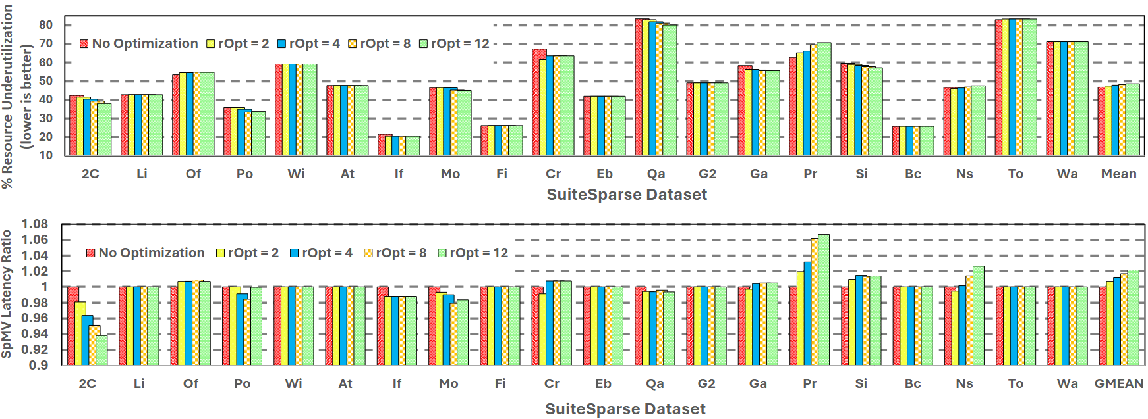
Effect of MSID Chain Stages
Fig 11. Resource underutilization and change in SpMV latency for different MSID Chain stages

Slide 41
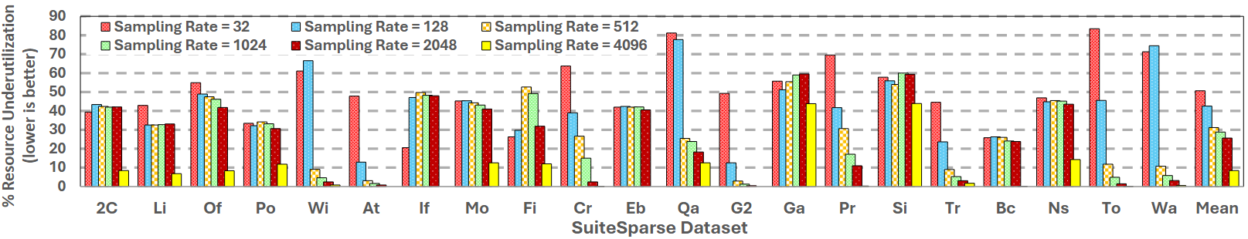

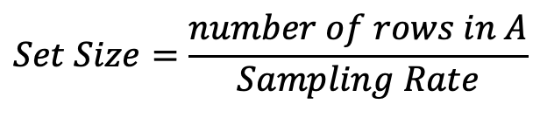
Effect of Sampling Rate
$$Set Size=\frac{number of rows in A}{Sampling Rate}$$
$$Sampling Rate:Number of Sets$$
Fig. 12: Resource underutilization for different sampling rates

