Slide 1

Testing the Programs
中国科学技术大学软件学院
孟宁

Slide 2
Contents
8.1 Software Faults and Failures
8.2 Testing Issues
8.3 Unit Testing
8.4 Integration Testing
8.5 Testing Object Oriented Systems
8.6 Test Planning
8.7 Automated Testing Tools
8.8 When to Stop Testing

Slide 3
Chapter 8 Objectives
Types of faults and how to clasify them
The purpose of testing
Unit testing
Integration testing strategies
Test planning
When to stop testing

Slide 4
8.1 Software Faults and Failures Why Does Software Fail?
Wrong requirement: not what the customer wants
Missing requirement
Requirement impossible to implement
Faulty design
Faulty code
Improperly implemented design

Slide 5
8.1 Software Faults and Failures Objective of Testing
Objective of testing: discover faults
A test is successful only when a fault is discovered
Fault identification is the process of determining what fault caused the failure
Fault correction is the process of making changes to the system so that the faults are removed

Slide 6
8.1 Software Faults and Failures Types of Faults
Algorithmic fault
Computation and precision fault
a formula’s implementation is wrong
Documentation fault
Documentation doesn’t match what program does
Capacity or boundary faults
System’s performance not acceptable when certain limits are reached
Timing or coordination faults
Performance faults
System does not perform at the speed prescribed
Standard and procedure faults

Slide 7
8.1 Software Faults and Failures Typical Algorithmic Faults
An algorithmic fault occurs when a component’s algorithm or logic does not produce proper output
Branching too soon
Branching too late
Testing for the wrong condition
Forgetting to initialize variable or set loop invariants
Forgetting to test for a particular condition
Comparing variables of inappropriate data types
Syntax faults

Slide 8
8.1 Software Faults and Failures Orthogonal Defect Classification 正交缺陷分类
Fault Type | Meaning
Function | Fault that affects capability, end-user interface, product interface with hardware architecture, or global data structure
Interface | Fault in interacting with other component or drivers via calls, macros, control, blocks or parameter lists
Checking | Fault in program logic that fails to validate data and values properly before they are used
Assignment | Fault in data structure or code block initialization
Timing/serialization | Fault in timing of shared and real-time resources
Build/package/merge | Fault that occurs because of problems in repositories management changes, or version control
Documentation | Fault that affects publications and maintenance notes
Algorithm | Fault involving efficiency or correctness of algorithm or data structure but not design

Slide 9
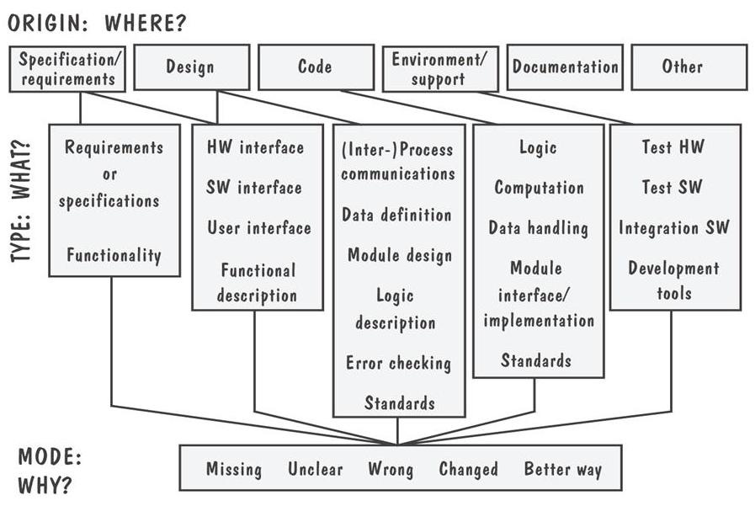
8.1 Software Faults and Failures Sidebar 8.1 Hewlett-Packard’s Fault Classification

Slide 10
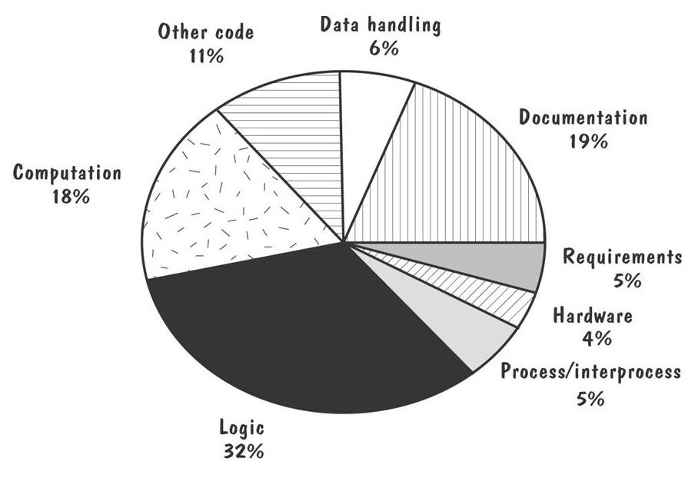
8.1 Software Faults and Failures Sidebar 8.1 Faults for one Hewlett-Packard Division

Slide 11
8.2 Testing Issues Testing Organization
Module testing, component testing, or unit testing
Integration testing
Function testing
Performance testing
Acceptance testing
Installation testing

Slide 12
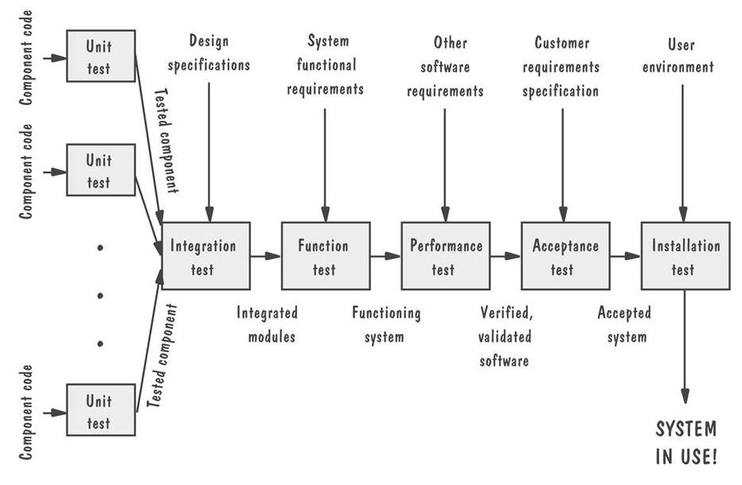
8.2 Testing Issues Testing Organization Illustrated

Slide 13
8.2 Testing Issues Who Performs the Test?
Developer Verify Test
Independent test team
avoid conflict
improve objectivity
allow testing and coding concurrently

Slide 14
8.2 Testing Issues Views of the Test Objects
Closed box or black box: functionality of the test objects
Clear box or white box: structure of the test objects

Slide 15
8.2 Testing Issues White Box
Advantage
free of internal structure’s constraints
Disadvantage
not possible to run a complete test

Slide 16
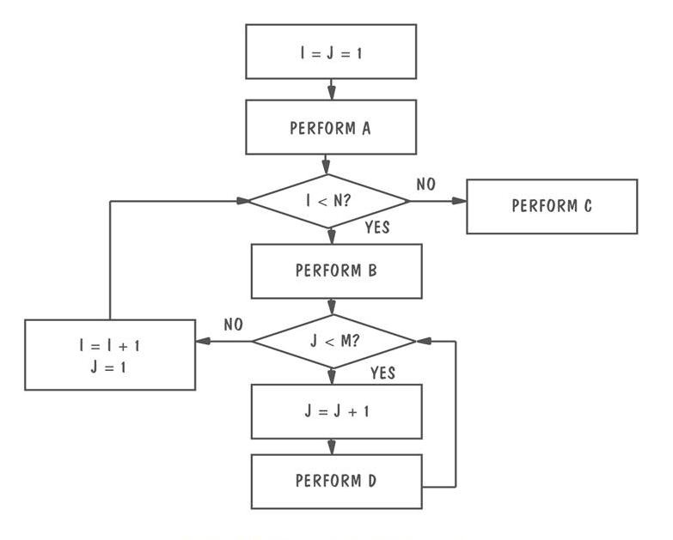
8.2 Testing Issues Clear Box
Example of logic structure

Slide 17
8.2 Testing Issues Factors Affecting the Choice of Test Philosophy
The number of possible logical paths
The nature of the input data
The amount of computation involved
The complexity of algorithms

Slide 18
8.3 Unit Testing Code Review
Code walkthrough
Code inspection

Slide 19
8.3 Unit Testing Typical Inspection Preparation and Meeting Times
Development Artifact | Preparation Time | Meeting Time
Requirement Document | 25 pages per hour | 12 pages per hour
Functional specification | 45 pages per hour | 15 pager per hour
Logic specification | 50 pages per hour | 20 pages per hour
Source code | 150 lines of code per hour | 75 lines of code per hour
User documents | 35 pages per hour | 20 pages per hour

Slide 20
8.3 Unit Testing Fault Discovery Rate
Discovery Activity | Fault Found per Thousand Lines of Code
Requirements review | 2.5
Design Review | 5.0
Code inspection | 10.0
Integration test | 3.0
Acceptance test | 2.0

Slide 21
8.3 Unit Testing Proving Code Correct
Formal proof techniques形式化证明技术
Symbolic execution 符号执行
Automated theorem-proving自动定理证明

Slide 22
8.3 Unit Testing Testing versus Proving
Proving: hypothetical假想的 environment
Testing: actual operating environment

Slide 23
8.3 Unit Testing Steps in Choosing Test Cases
Determining test objectives
Selecting test cases
Defining a test

Slide 24
8.3 Unit Testing Test Thoroughness
Statement testing
Branch testing
Path testing
Definition-use testing
All-uses testing
All-predicate-uses/some-computational-uses testing
All-computational-uses/some-predicate-uses testing

Slide 25
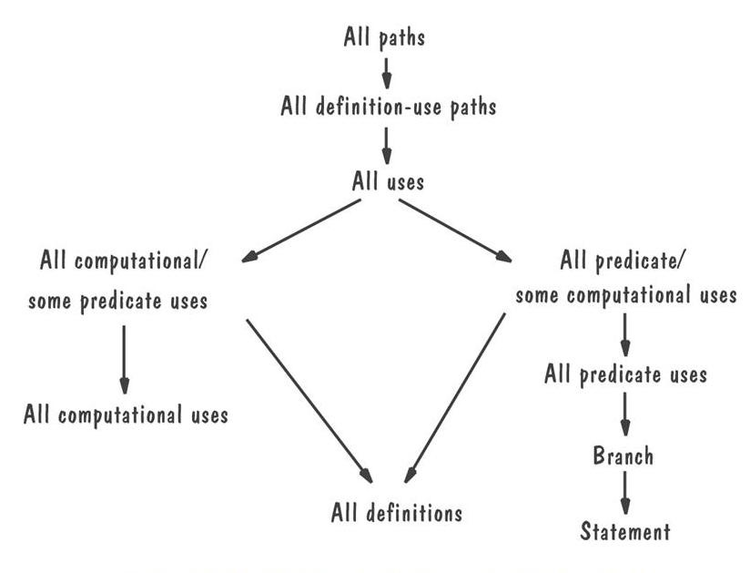
8.3 Unit Testing Relative Strengths of Test Strategies

Slide 26
8.3 Unit Testing Comparing Techniques
Fault discovery Percentages by Fault Origin
Discovery Techniques | Requirements | Design | Coding | Documentation
Prototyping | 40 | 35 | 35 | 15
Requirements review | 40 | 15 | 0 | 5
Design Review | 15 | 55 | 0 | 15
Code inspection | 20 | 40 | 65 | 25
Unit testing | 1 | 5 | 20 | 0

Slide 27
8.3 Unit Testing Comparing Techniques (continued)
Effectiveness of fault-discovery techniques
 | Requirements Faults | Design Faults | Code Faults | Documentation Faults
Reviews | Fair | Excellent | Excellent | Good
Prototypes | Good | Fair | Fair | Not applicable
Testing | Poor | Poor | Good | Fair
Correctness Proofs | Poor | Poor | Fair | Fair

Slide 28
8.4 Integration Testing
Bottom-up
Top-down
Big-bang
Sandwich testing
Modified top-down
Modified sandwich

Slide 29
8.4 Integration Testing Terminology
Component Driver: a routine that calls a particular component and passes a test case to it
Stub: a special-purpose program to simulate the activity of the missing component

Slide 30
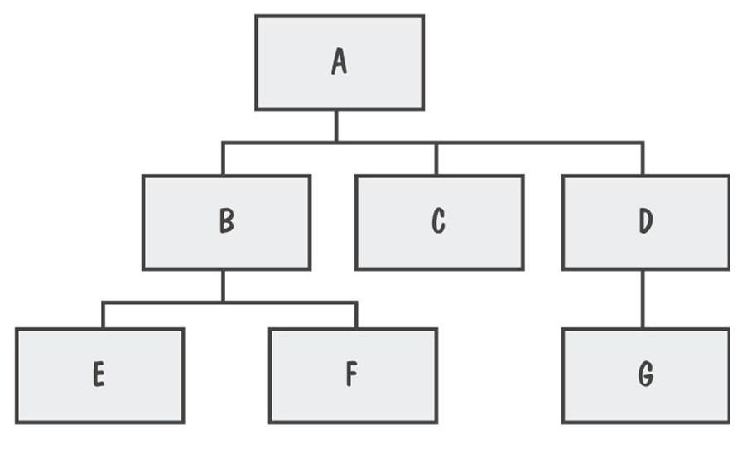
8.4 Integration Testing View of a System
System viewed as a hierarchy of components

Slide 31
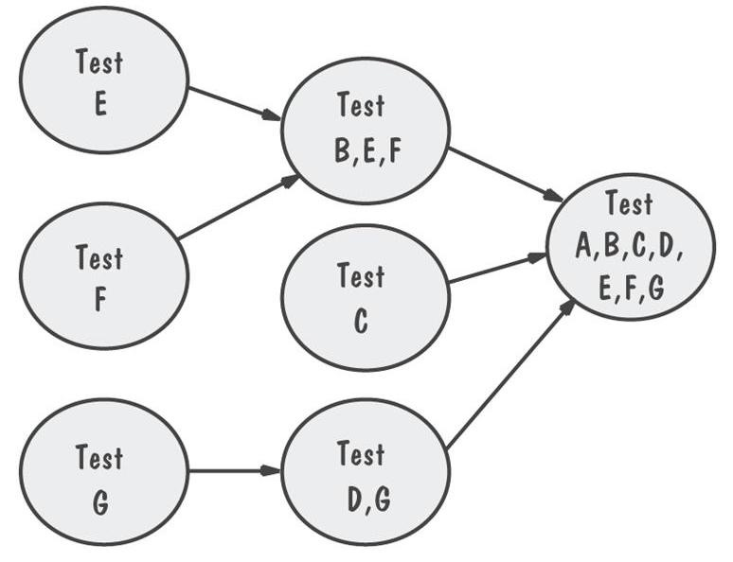
8.4 Integration Testing Bottom-Up Integration Example
The sequence of tests and their dependencies

Slide 32
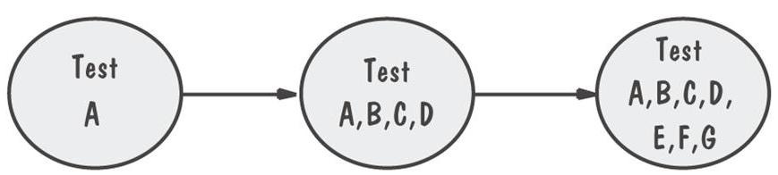
8.4 Integration Testing Top-Down Integration Example
Only A is tested by itself

Slide 33
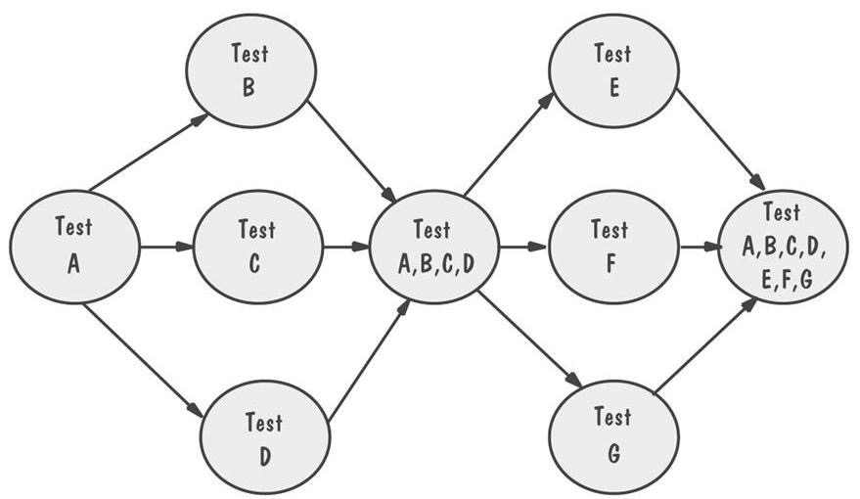
8.4 Integration Testing Modified Top-Down Integration Example
Each level’s components individually tested before the merger takes place

Slide 34
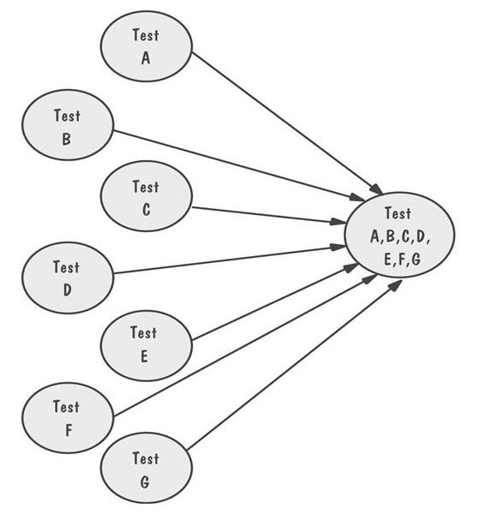
8.4 Integration Testing Bing-Bang Integration Example
Requires both stubs and drivers to test the independent components

Slide 35
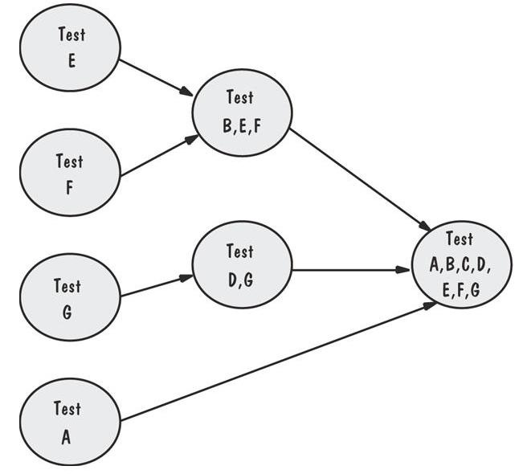
8.4 Integration Testing Sandwich Integration Example
Viewed system as three layers

Slide 36
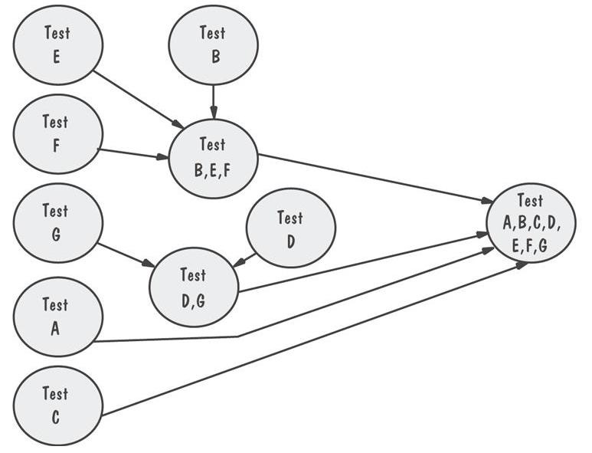
8.4 Integration Testing Modified Sandwich Integration Example
Allows upper-level components to be tested before merging them with others

Slide 37
8.4 Integration Testing Comparison of Integration Strategies
 | Bottom-up | Top-down | Modified top-down | Bing-bang | Sandwich | Modified sandwich
Integration | Early | Early | Early | Late | Early | Early
Time to basic working program | Late | Early | Early | Late | Early | Early
Component drivers needed | Yes | No | Yes | Yes | Yes | Yes
Stubs needed | No | Yes | Yes | Yes | Yes | Yes
Work parallelism at beginning | Medium | Low | Medium | High | Medium | High
Ability to test particular paths | Easy | Hard | Easy | Easy | Medium | Easy
Ability to plan and control sequence | Easy | Hard | Hard | Easy | Hard | hard

Slide 38
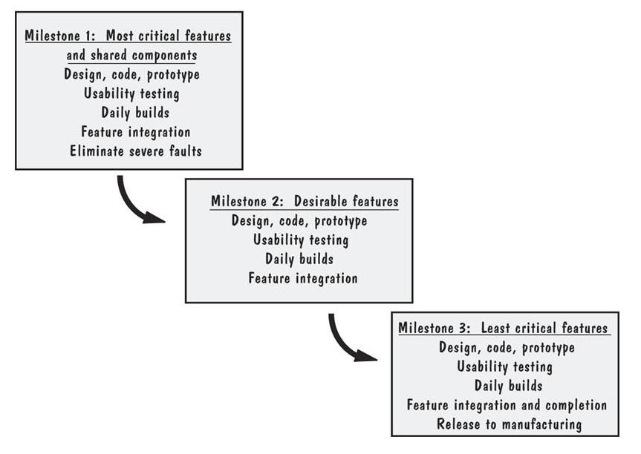
8.4 Integration Testing Sidebar 8.5 Builds at Microsoft
The feature teams synchronize their work by building the product and finding and fixing faults on a daily basis

Slide 39
8.6 Test Planning
Establish test objectives
Design test cases
Write test cases
Test test cases
Execute tests
Evaluate test results

Slide 40
8.6 Test Planning Purpose of the Plan
Test plan explains
who does the testing
why the tests are performed
how tests are conducted
when the tests are scheduled

Slide 41
8.6 Test Planning Contents of the Plan
What the test objectives are
How the test will be run
What criteria will be used to determine when the testing is complete

Slide 42
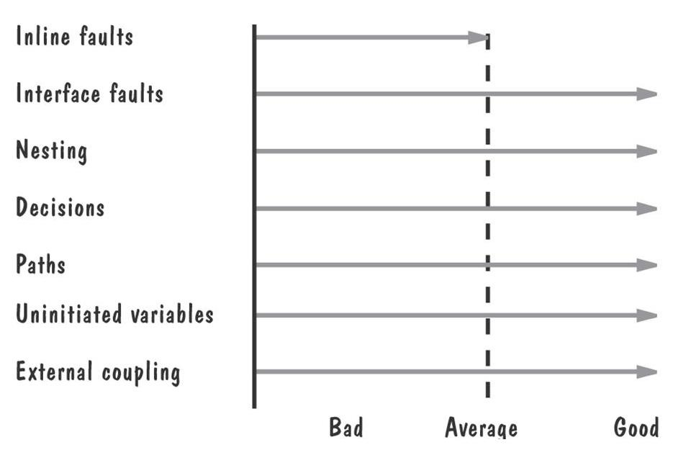
8.7 Automated Testing Tools
Code analysis
Static analysis
code analyzer
structure checker
data analyzer
sequence checker
Output from static analysis

Slide 43
8.7 Automated Testing Tools (continued)
Dynamic analysis
program monitors: watch and report program’s behavior
Test execution
Capture and replay
Stubs and drivers
Automated testing environments
Test case generators

Slide 44
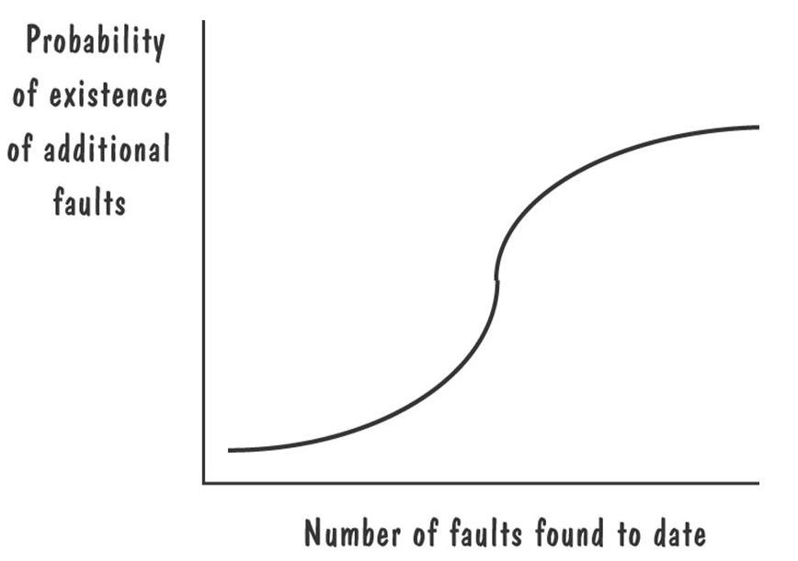
8.8 When to Stop Testing More faulty?
Probability of finding faults during the development

Slide 45
8.8 When to Stop Testing Stopping Approaches
Coverage criteria 覆盖准则
Fault seeding
detected seeded Faults ₌ detected nonseeded faults
total seeded faults total nonseeded faults
Confidence in the software软件可信度
可以用播种的方法计算可信度

Slide 46
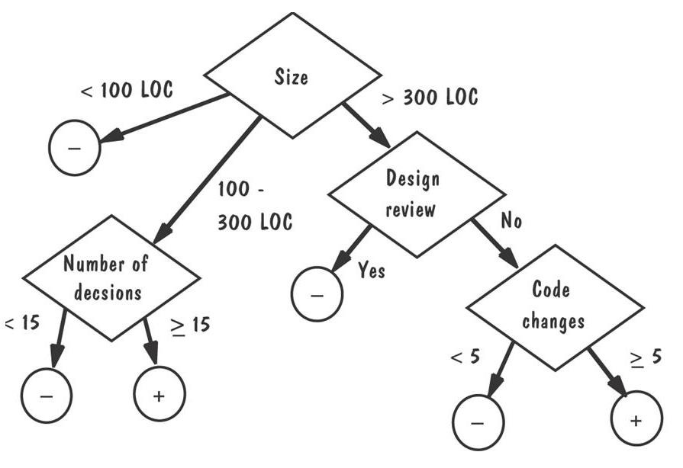
8.8 When to Stop Testing Identifying Fault-Prone(倾向) Code

Slide 47
What this Chapter Means for You
It is important to understand the difference between faults and failures
The goal of testing is to find faults, not to prove correctness

Slide 48
谢谢大家！
References
软件工程 - 理论与实践（第四版 影印版） Software Engineering: Theory and Practice (Fourth Edition),Shari Lawrence Pfleeger,Joanne M. Atlee ,高等教育出版社
软件工程 - 理论与实践（第四版） Software Engineering: Theory and Practice (Fourth Edition),Shari Lawrence Pfleeger,Joanne M. Atlee,杨卫东译,人民邮电出版社
软件工程—实践者的研究方法（Software Engineering-A Practitioner’s Approach）; (美) Roger S. Pressman 著； 机械工业出版社ISBN：7-111-07282-0
http://code.google.com/p/advancedsoftwareengineering/

