Slide 1

Modeling the Process and Life-Cycle
中国科学技术大学软件学院
孟宁

Slide 2
Contents
2.1 The Meaning of Process
2.2 Software Process Models
2.3 Tools and Techniques for Process Modeling
2.4 Practical Process Modeling

Slide 3
Chapter 2 Objectives
What we mean by a “process”
Software development products, processes, and resources
Several models of the software development process
Tools and techniques for process modeling

Slide 4
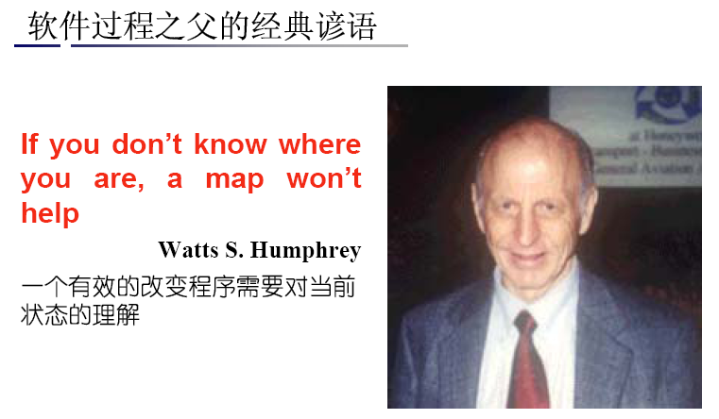
软件过程之父的经典谚语
清醒的头脑比聪明的头脑更重要！

Slide 5
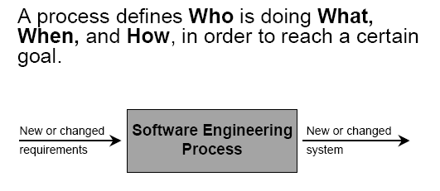
Process with Change

Slide 6
2.1 The Meaning of Process
A process: a series of steps involving activities, constrains, and resources that produce an intended ouput of some kind
A process involves a set of tools and techniques

Slide 7
2.1 The Meaning of Process Process Characteristics
Prescribes all major process activities
Uses resources, subject to set of constraints (such as schedule)
Produces intermediate and final products
May be composed of subprocesses with hierarchy or links
Each process activity has entry and exit criteria
Activities are organized in sequence, so timing is clear
Each process guiding principles, including goals of each activity
Constraints may apply to an activity, resource or product

Slide 8
2.1 The Meaning of Process The Importance of Processes
Impose consistency and structure on a set of activities
Guide us to understand, control, examine, and improve the activities
Enable us to capture our experiences and pass them along

Slide 9
Question 1
描述你早上去上课或者上班的工序过程，并画一个图来表达这个过程。
当回答这个问题时，考虑过程的定义。你的答案应该包括以下：
• the activities involved
涉及到的活动
• the steps required to complete the tasks
完成任务所需要的步骤
• the inputs and outputs to each activity
每个事件的输入和输出
• the constraints involved
涉及到的约束

Slide 10
2.2 Software Process Models Reasons for Modeling a Process
To form a common understanding
To find inconsistencies, redundancies, omissions
To find and evaluate appropriate activities for reaching process goals
To tailor a general process for a particular situation in which it will be used

Slide 11
2.2 Software Process Models Software Life Cycle
When a process involves building a software, the process may be referred to as software life cycle
Requirements analysis and definition
System (architecture) design
Program (detailed/procedural) design
Writing programs (coding/implementation)
Testing: unit, integration, system
System delivery (deployment)
Maintenance

Slide 12
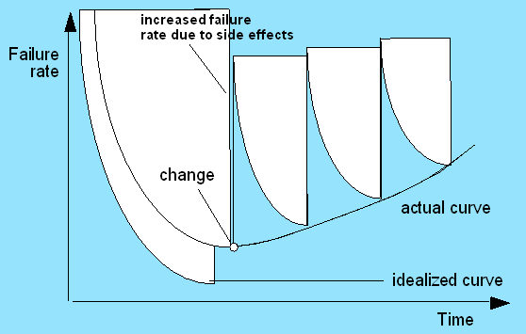
Software life cycle
Software development process
from its conception to its implementation,delivery,use and maintenance.
Die
Death is the beginning.

Slide 13
2.2 Software Process Models Software Development Process Models
Waterfall model
V model
Prototyping model
Operational specification
Transformational model
Phased development: increments and iteration
Spiral model
RUP
Agile methods

Slide 14
2.2 Software Process Models Waterfall Model
One of the first process development models proposed
Works for well understood problems with minimal or no changes in the requirements
Simple and easy to explain to customers
It presents
a very high-level view of the development process
sequence of process activities
Each major phase is marked by milestones and deliverables (artifacts)

Slide 15
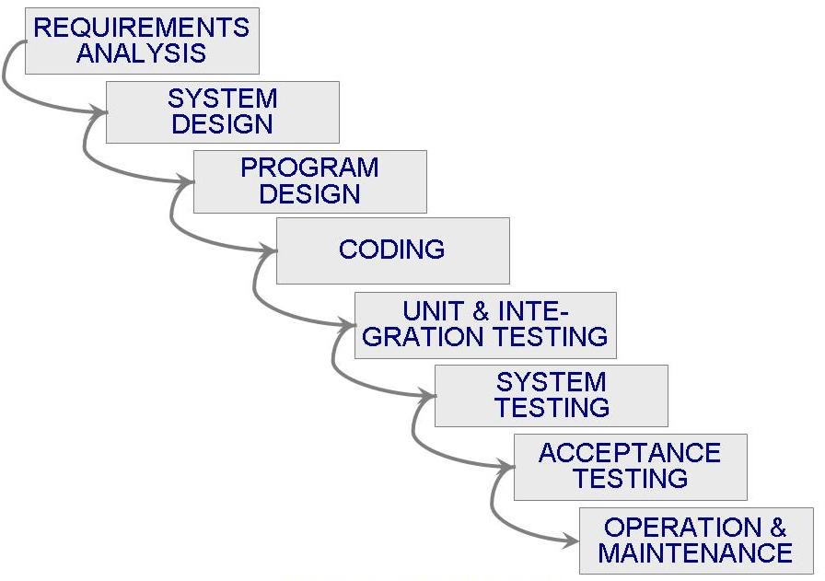
2.2 Software Process Models Waterfall Model (continued)
类比人的生命周期
什么时候算出生呢？

Slide 16
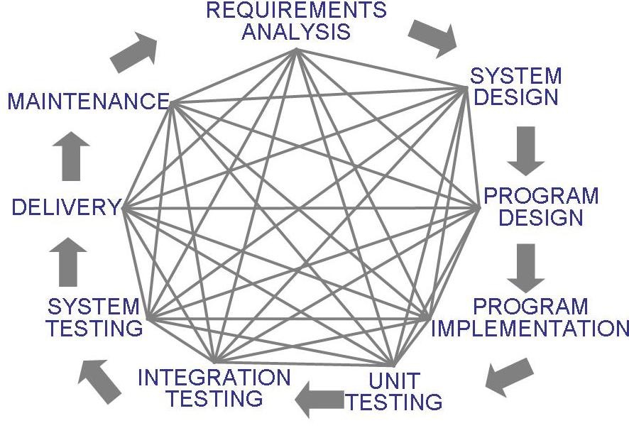
2.2 Software Process Models Waterfall Model (continued)
There is no iteration in waterfall model
Most software developments apply a great many iterations

Slide 17
2.2 Software Process Models Sidebar 2.1 Drawbacks of The Waterfall Model
Provides no guidance how to handle changes to products and activities during development (assumes requirements can be frozen)
Views software development as manufacturing process rather than as creative process
There is no iterative activities that lead to creating a final product
Long wait before a final product

Slide 18
2.2 Software Process Models Waterfall Model with Prototype
A prototype is a partially developed product
Prototyping helps
developers assess alternative design strategies (design prototype)
users understand what the system will be like (user interface prototype)
Protopyping is useful for verification and validation

Slide 19
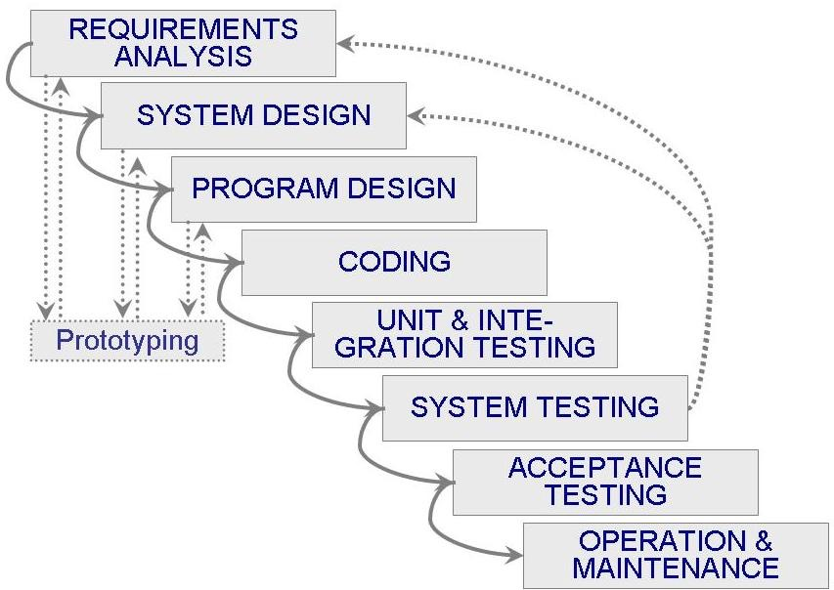
2.2 Software Process Models Waterfall Model with Prototype (continued)
Waterfall model with prototyping
fetus in 3 months

Slide 20
2.2 Software Process Models V Model
A variation of the waterfall model
Uses unit testing to verify procedural design
Uses integration testing to verify architectural (system) design
Uses acceptance testing to validate the requirements
If problems are found during verification and validation, the left side of the V can be re-executed before testing on the right side is re-enacted

Slide 21
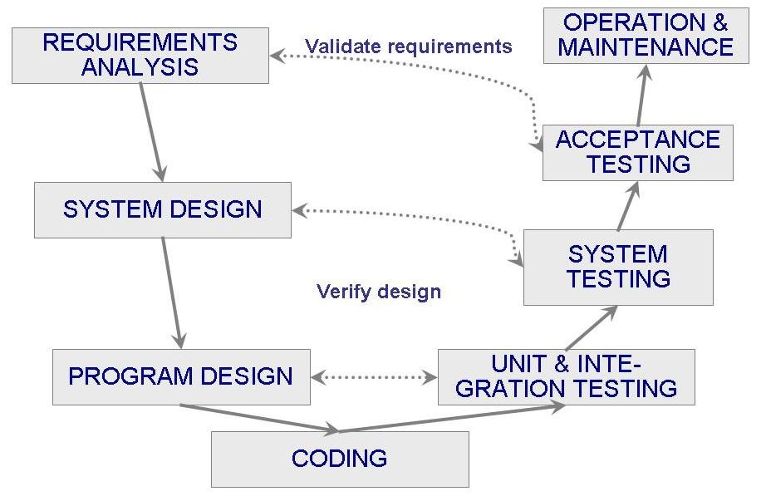
2.2 Software Process Models V Model (continued)

Slide 22
V-模型与结对编程
结对编程
两人一组共同编程，可以减少失误
编码过程中的生死相依原则，同样可以减少失误
哪里开始就在哪里结束
我赤裸裸地来到世间我也将赤裸裸地离开
挥一挥衣袖不带走一片云彩
未定生，先定死
V-模型是生死相依原则在更大的过程中的应用

Slide 23
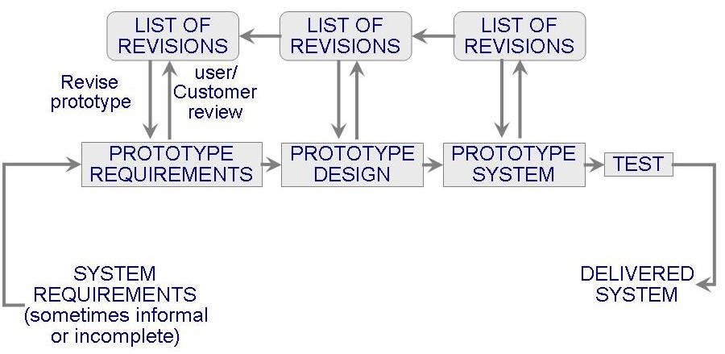
2.2 Software Process Models Prototyping Model
Allows repeated investigation of the requirements or design
Reduces risk and uncertainty in the development

Slide 24
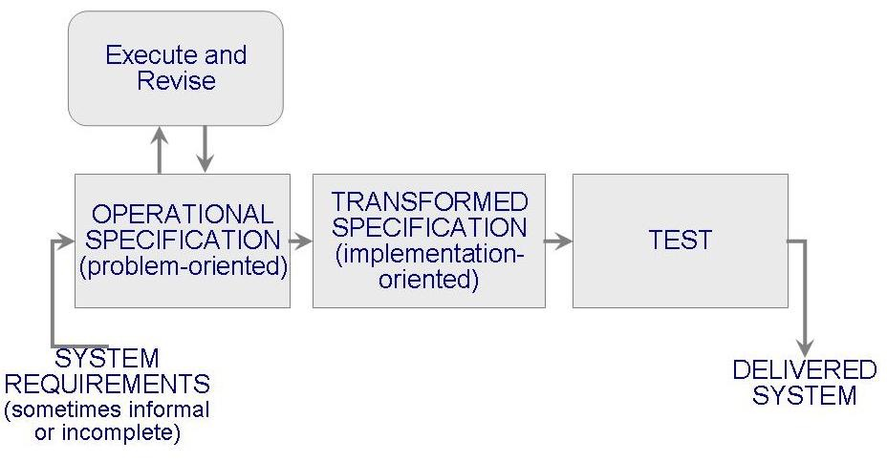
2.2 Software Process Models Operational Specificiation Model
Requirements are executed (examined) and their implication evaluated early in the development process
Functionality and the design are allowed to be merged

Slide 25
2.2 Software Process Models Transformational Model
Fewer major development steps
Applies a series of transformations to change a specification into a deliverable system
Change data representation
Select algorithms
Optimize
Compile
Relies on formalism
Requires formal specification (to allow transformations)

Slide 26
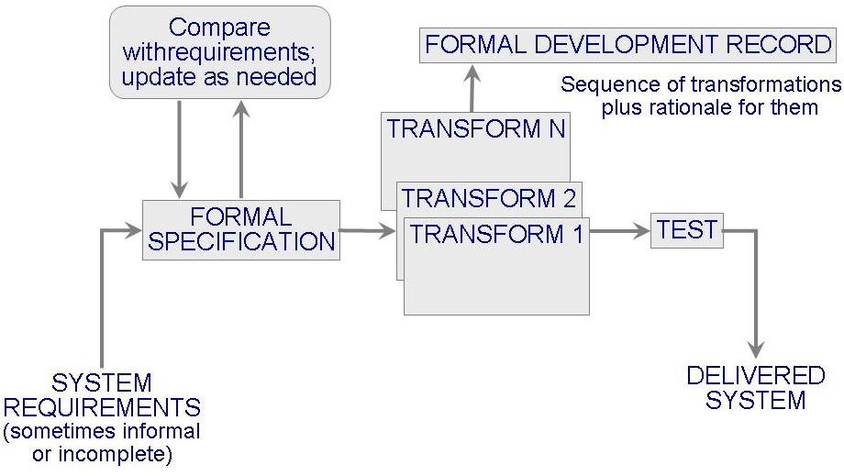
2.2 Software Process Models Transformational Model (continued)

Slide 27
2.2 Software Process Models Phased Development: Increments and Iterations
Shorter cycle time
System delivered in pieces
enables customers to have some functionality while the rest is being developed
Allows two systems functioning in parallel
the production system (release n): currently being used
the development system (release n+1): the next version

Slide 28
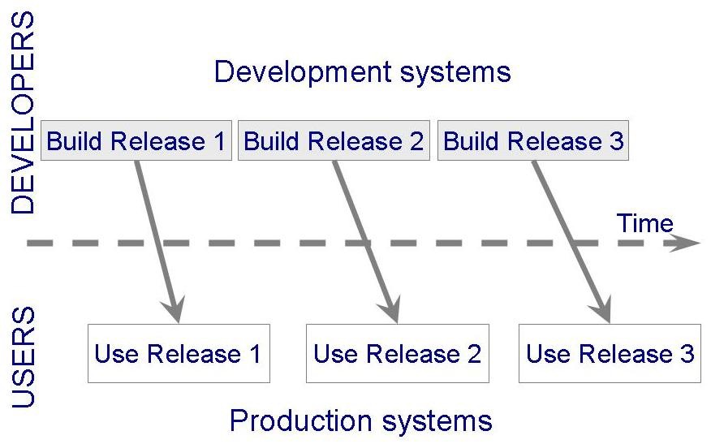
2.2 Software Process Models Phased Development: Increments and Iterations (continued)

Slide 29
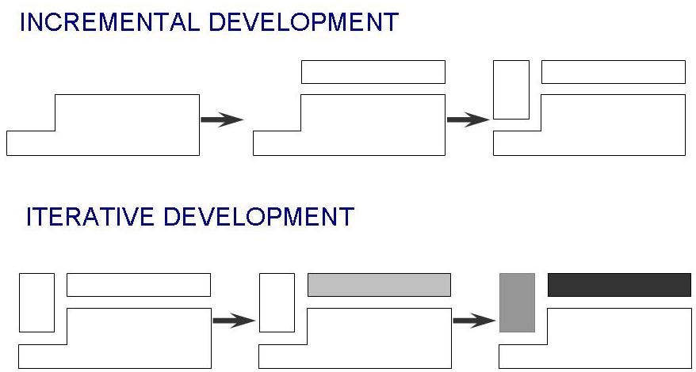
2.2 Software Process Models Phased Development: Increments and Iterations (continued)
Incremental development: starts with small functional subsystem and adds functionality with each new release
Iterative development: starts with full system, then changes functionality of each subsystem with each new release

Slide 30
2.2 Software Process Models Phased Development: Increments and Iterations (continued)
Phased development is desirable for several reasons
Training can begin early, even though some functions are missing
Markets can be created early for functionality that has never before been offered
Frequent releases allow developers to fix unanticipated problems globaly and quickly
The development team can focus on different areas of expertise with different releases

Slide 31
2.2 Software Process Models Spiral Model
Suggested by Boehm (1988)
Combines development activities with risk management to minimize and control risks
The model is presented as a spiral in which each iteration is represented by a circuit around four major activities
Plan
Determine goals, alternatives and constraints
Evaluate alternatives and risks
Develop and test

Slide 32
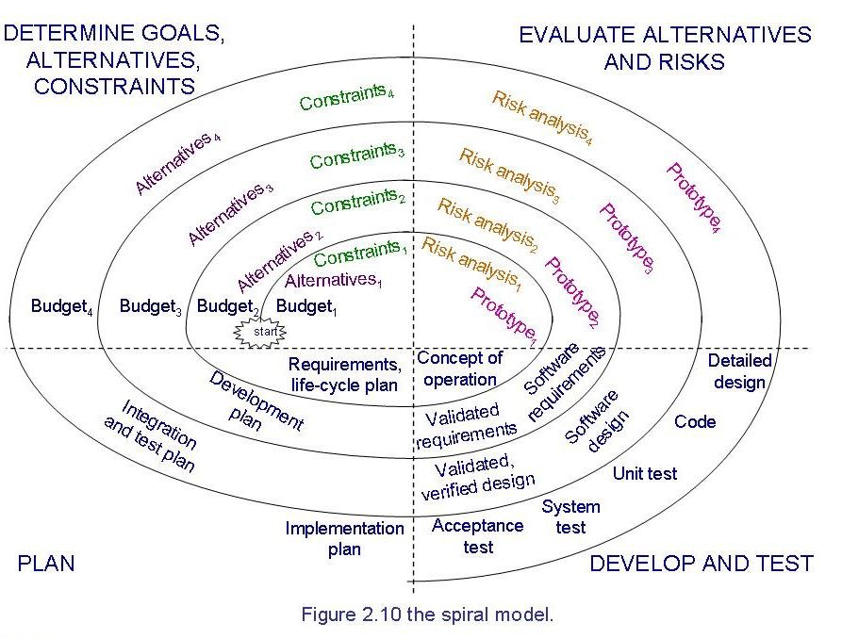
2.2 Software Process Models Spiral Model (continued)

Slide 33
统一过程Unified Process UP
尝试从传统软件过程中挖掘最好的特征和性质，但以敏捷开发中许多最好的原则来实现。
用例驱动，以架构为核心，迭代且增量。
对未来变更的可适应性以及复用。
UML建模技术

Slide 34
Rational Unified Process
Rational 统一过程是由Rational （IBM）软件公司开发和营销的一种软件工程过程，是开发组织用以分配与管理任务和职责的一种规范化方法。这个过程的目的是：
在预定的进度和预算范围内，开发出满足最终用户需要的高质量软件。

Slide 35
最佳软件开发实践 Best Practices
迭代地开发软件 Develop Iteratively
管理需求 Manage Requirements
应用基于构件的架构 Use Component Architectures
为软件建立可视化的模型 Model Visually (UML)
不断地验证软件质量 Continuously Verify Quality
控制软件的变更 Manage Change

Slide 36
RUP的核心
RUP核心是解决可操作性问题，帮助开发人员尽可能少地依赖那些“不可描述的经验”。
它详细给出了
每个阶段参与该过程的各种角色，
该角色在该过程中的产出。

Slide 37
RUP特点
用例驱动
以体系结构为中心（高内聚低耦合）
增量和迭代开发

Slide 38
用例驱动
用Use Case作为划分问题的组织单元，分析和设计活动的局部粒度都遵循这一划分原则。Use Case的定义反映系统外部要素根据特定目标使用拟建系统的状况，能确保问题的局部划分粒度适当，保持了全局与局部的平衡。

Slide 39
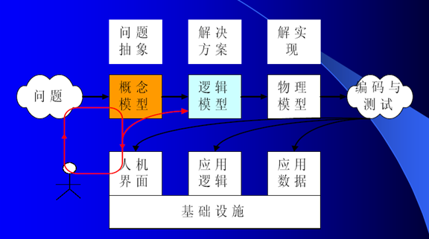
以体系结构为中心
确保方案从一开始就具备高内聚低耦合可持续增长架构

Slide 40
增量和迭代开发
基于风险前驱的原则，渐进地展开分析、设计及其相关活动，每个迭代都会提供一次验证和调整模型机会，推动软件质量的提升。

Slide 41
谁在使用RUP?
电信业
Ericsson、Alcatel、MCI
交通、航空、国防
Lockheed-Martin、British Aerospace
制造业
Xerox、Volvo、Intel
金融业
Visa、Merrill Lynch、Schwab
系统集成业
Ernst & Young、Oracle、Deloitte & Touche

Slide 42
The Manifesto for Agile Software Development
“We are uncovering better ways of developing software by doing it and helping others do it. Through this work we have come to value:
Individuals and interactions over processes and tools
Working software over comprehensive documentation
Customer collaboration over contract negotiation
Responding to change over following a plan
That is, while there is value in the items on the right, we value the items on the left more.”
Kent Beck et al

Slide 43
What is “Agility”?
Effective (rapid and adaptive) response to change
Effective communication among all stakeholders
Drawing the customer onto the team
Organizing a team so that it is in control of the work performed
Yielding …
Rapid, incremental delivery of software

Slide 44
An Agile Process
driven by customer descriptions of what is required
Recognizes that plans are short-lived
Develops software iteratively with a heavy emphasis on construction activities
Delivers multiple ‘software increments’
Adapts as changes occur

Slide 45
Human Factors
key traits must exist among the people on an agile team and the team itself:
Competence.
Common focus.
Collaboration.
Decision-making ability.
Fuzzy problem-solving ability.
Mutual trust and respect.
Self-organization.

Slide 46
2.2 Software Process Models Agile Methods
Emphasis on flexibility in producing software quickly and capably
Agile manifesto
Value individuals and interactions over process and tools
Prefer to invest time in producing working software rather than in producing comprehensive documentation
Focus on customer collaboration rather than contract negotiation
Concentrate on responding to change rather than on creating a plan and then following it

Slide 47
2.2 Software Process Models Agile Methods: Examples of Agile Process
Extreme programming (XP)
Crystal: a collection of approaches based on the notion that every project needs a unique set of policies and conventions
Scrum: 30-day iterations; multiple self-organizing teams; daily “scrum” coordination
Adaptive software development (ASD)

Slide 48
Extreme Programming (XP)
The most widely used agile process, originally proposed by Kent Beck
XP Planning
Begins with the creation of “user stories”
Agile team assesses each story and assigns a cost
Stories are grouped to for a deliverable increment
A commitment is made on delivery date
After the first increment “project velocity” is used to help define subsequent delivery dates for other increments

Slide 49
2.2 Software Process Models Agile Methods: Extreme Programming
Emphasis on four charateristics of agility
Communication: continual interchange between customers and developers
Simplicity: select the simplest design or implementation
Courage: commitment to delivering functionality early and often
Feedback: loops built into the various activitites during the development process

Slide 50
2.2 Software Process Models Agile Methods: Twelve Facets of XP
The planning game (customer defines value)
Small release
Metaphor (common vision, common names)
Simple design
Writing tests first
Refactoring
Pair programming
Collective ownership
Continuous integration (small increments)
Sustainable pace (40 hours/week)
On-site customer
Coding standard

Slide 51
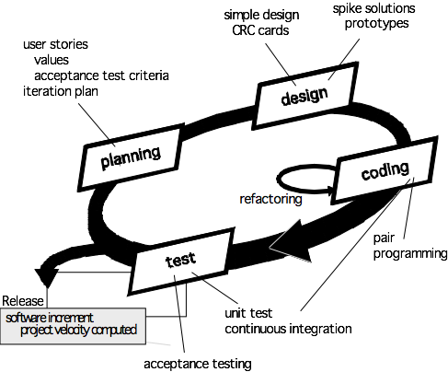
Extreme Programming (XP)

Slide 52
2.2 Software Process Models Sidebar 2.2 When Extreme is Too Extreme?
Extreme programming's practices are interdependent
A vulnerability if one of them is modified
Requirements expressed as a set of test cases must be passed by the software
System passes the tests but is not what the customer is paying for
Refactoring issue
Difficult to rework a system without degrading its architecture

Slide 53
2.2 Software Process Models Sidebar 2.3 Collections of Process Models
Development process is a problem-solving activity
Curtis, Krasner, and Iscoe (1988) performed a field study to determine which problem-solving factors to captured in process model
The results suggest a layered behavioral model as supplement to the traditional model
Process model should not only describe series of tasks, but also should detail factors that contribute to a project's inherent uncertainty and risk

Slide 54
总结开发过程的历史
个人英雄主义的、经验性的软件开发过程
人月神话-没有银弹 No silver bullet
大型软件开发中根本问题和次要问题
规范化的、重视架构设计、过程改进、文档化、周密计划、严格控制的软件开发过程
CMM/CMMI
敏捷软件开发过程
XP
RUP

Slide 55
2.3 Tools and Techniques for Process Modeling
Notation depends on what we want to capture in the model
The two major notation categories
Static model: depicts the process
Dynamic model: enacts the process

Slide 56
2.3 Tools and Techniques for Process Modeling Static Modeling: Lai Notation
Element of a process are viewed in terms of seven types
Activity
Sequence
Process model
Resource
Control
Policy
Organization
Several templates, such as an Artifact Definition Template

Slide 57
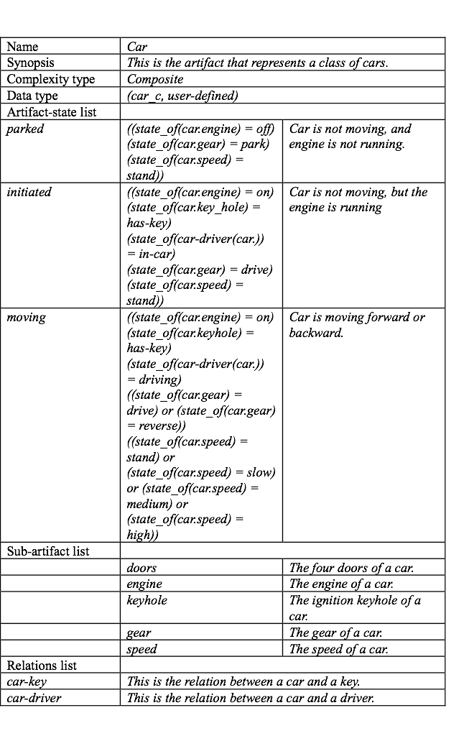

Slide 58
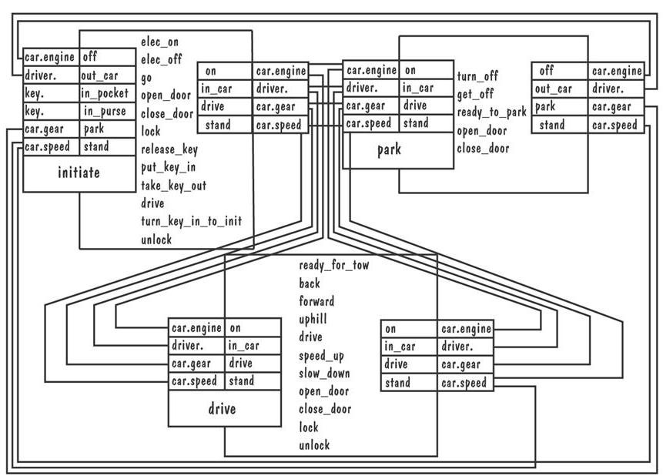
2.3 Tools and Techniques for Process Modeling Static Modeling: Lai Notation (continued)
The process of starting a car

Slide 59
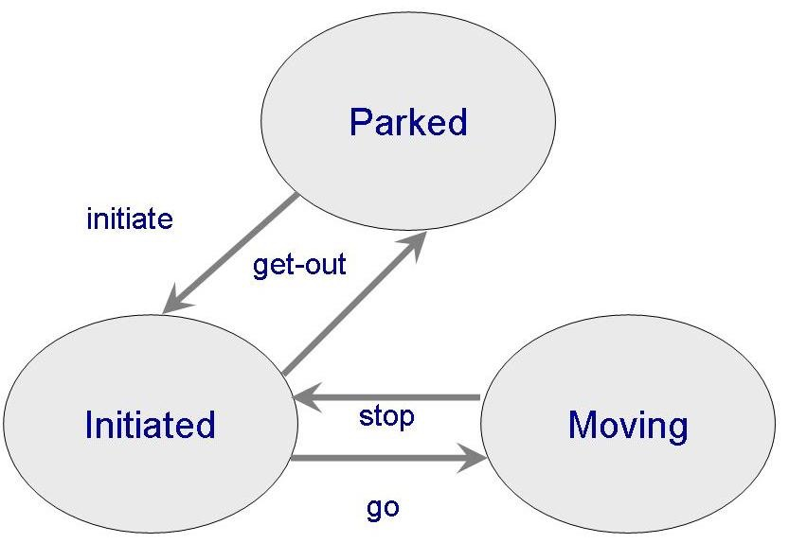
2.3 Tools and Techniques for Process Modeling Static Modeling: Lai Notation (continued)
Transition diagram illustrates the transition for a car

Slide 60
2.3 Tools and Techniques for Process Modeling Dynamic Modeling
Enables enaction of process to see what happens to resources and artifacts as activities occur
Simulate alternatives and make changes to improve the process
Example: systems dynamics model

Slide 61
2.3 Tools and Techniques for Process Modeling Dynamic Modeling: System Dynamics
Introduced by Forrester in the 1950's
Abdel-Hamid and Madnick applied it to software development
One way to understand system dynamics is by exploring how software development process affects productivity

Slide 62
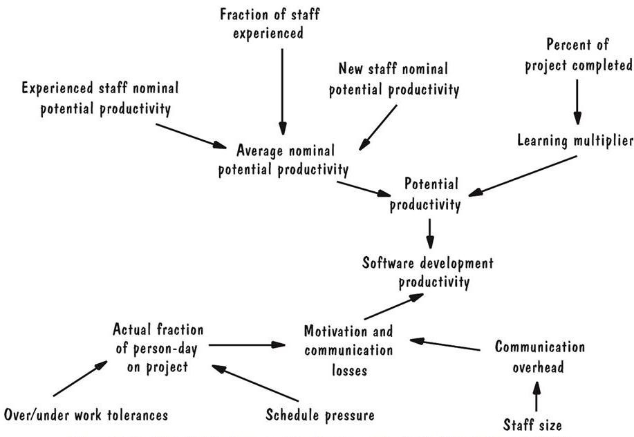
2.3 Tools and Techniques for Process Modeling Dynamic Modeling: System Dynamics (continued)
Pictorial presentation of factors affecting productivity
Arrows indicate how changes in one factor change another

Slide 63
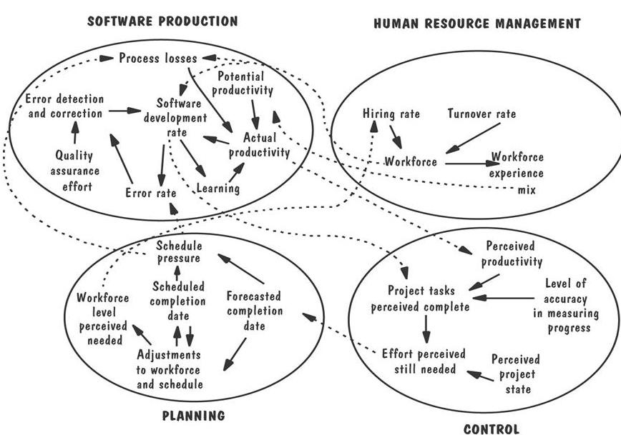
2.3 Tools and Techniques for Process Modeling Dynamic Modeling: System Dynamics (continued)
A system dynamic model containing four major areas affecting productivity

Slide 64
Question
静态模型和动态模型的区别是什么？并说明每种模型的作用和用途。
一个静态过程模型描述一个过程的基本元素。还描写输入从哪里转换为输出。
一个动态过程模型扮演一个过程，允许用户看到产品随着时间的推移而如何改变。
对于确定过程的基本元素，一个静态模型是有用的。
对于过程的变化是如何随着时间的推移而影响过程的结果，一个动态模型可能会对这种模仿有用。

Slide 65
2.4 Practical Process Modeling Desirable Properties of Process Modeling Tools and Techniques
Facilitates human understanding and communication
Supports process improvement
Supports process management
Provides automated guidance in performing the process
Supports automated process execution

Slide 66
Question
Explain the difference between prescriptive and descriptive process models.
说明性过程模型和描述性过程模型之间的差异。每种模型的目的是什么？每种模型的使用场合是什么？

Slide 67
Answer
描述性模型企图描写在过程中实际发生什么。what is
说明性过程模型企图描述在过程中会发生什么。what should be
common understanding
与实际情况比较找项目过程中的问题
模型应该反映出项目目标，比如建高质量软件、早发现缺陷、满足预算和日程约束等。
不同的模型试用于不同的情形。

Slide 68
What this Chapter Means for You
Process development involves activities, resources, and product
Process model includes organizational, functional, behavioral and other prespectives
A process model is useful for guiding team behavior, coordination and collaboration

Slide 69
谢谢大家！
References
软件工程 - 理论与实践（第四版 影印版） Software Engineering: Theory and Practice (Fourth Edition),Shari Lawrence Pfleeger,Joanne M. Atlee ,高等教育出版社
软件工程 - 理论与实践（第四版） Software Engineering: Theory and Practice (Fourth Edition),Shari Lawrence Pfleeger,Joanne M. Atlee,杨卫东译,人民邮电出版社
软件工程—实践者的研究方法（Software Engineering-A Practitioner’s Approach）; (美) Roger S. Pressman 著； 机械工业出版社ISBN：7-111-07282-0
http://code.google.com/p/advancedsoftwareengineering/

