Slide 1

Sentiment Analysis of Tweets
Ubaydullo Asatullaev
- Machine Learning Project

Slide 2

Introduction
Opinion and sentimental mining is an important research areas because due to the huge number of daily posts on social networks, extracting people’s opinion is a challenging task. About 90 percent of today’s data has been provided during the last two years and getting insight into this large-scale data is not trivial.
Sentiment analysis is a relatively recent area in the field of data mining. There are different techniques for extracting, processing, and seeking objective data in texts.
Sentiment-Analysis-of-Tweets

Slide 3
01f
03
Sentiment Classification
The dataset contains sentiments and opinions of selected Twitter id user “@elonmusk”. I have taken permission from Twitter company to do this research project. Each review is either labelled as positive or negative. The dataset contains the ‘text’ and ‘sentiment’ fields. These fields are separated by the ‘tab’ character. See below for details:
1. text:- Sentence that describes the review.
2. sentiment:- 1 or 0. 1 represents positive review and 0 represents negative review and subjectivity and polarity has been provided based on the sentiments.
Sentiment-Analysis-of-Tweets

Slide 4
01f
03
Sentiment Classification
Now discuss the complete process of ‘sentiment classification’. Below will be the flow of the project.
Loading The dataset
Exploring Dataset
Text Pre-Processing
Build a model for sentiment classification
Make the prediction on test case
Result of Sentiment Analysis
Sentiment-Analysis-of-Tweets

Slide 5
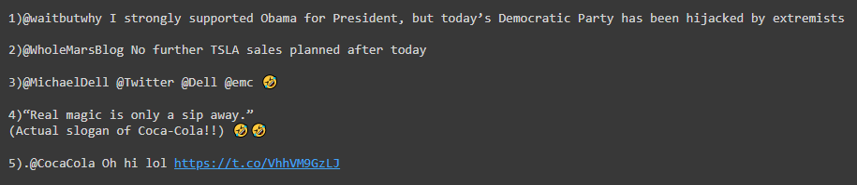
01f
03
Loading the Dataset
Loading the data using tweepy.API() method is done as follows:
The first five records of loaded data are shown in the table below.
Sentiment-Analysis-of-Tweets

Slide 6
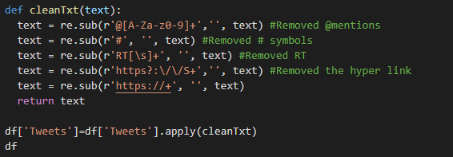
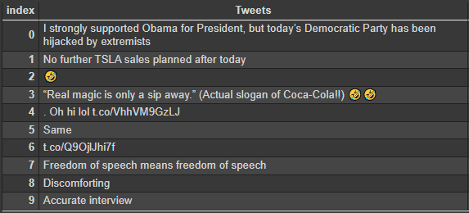
Exploration of the Dataset
Cleaning the text by this function as follows:
Sentiment-Analysis-of-Tweets

Slide 7

01f
03
Text Pre-Processing
This section will focus on how to do preprocessing on text data. Which function have to be used to get better format of the dataset which can apply the model on that text dataset. we have a few techniques to do this process.
All vectorizer classes take a list of stop words as a parameter and remove the stop words while building the dictionary or feature set. And these words will not appear in the count vector representing the documents. we will create new count vectors bypassing the stop words list.
Sentiment-Analysis-of-Tweets

Slide 8
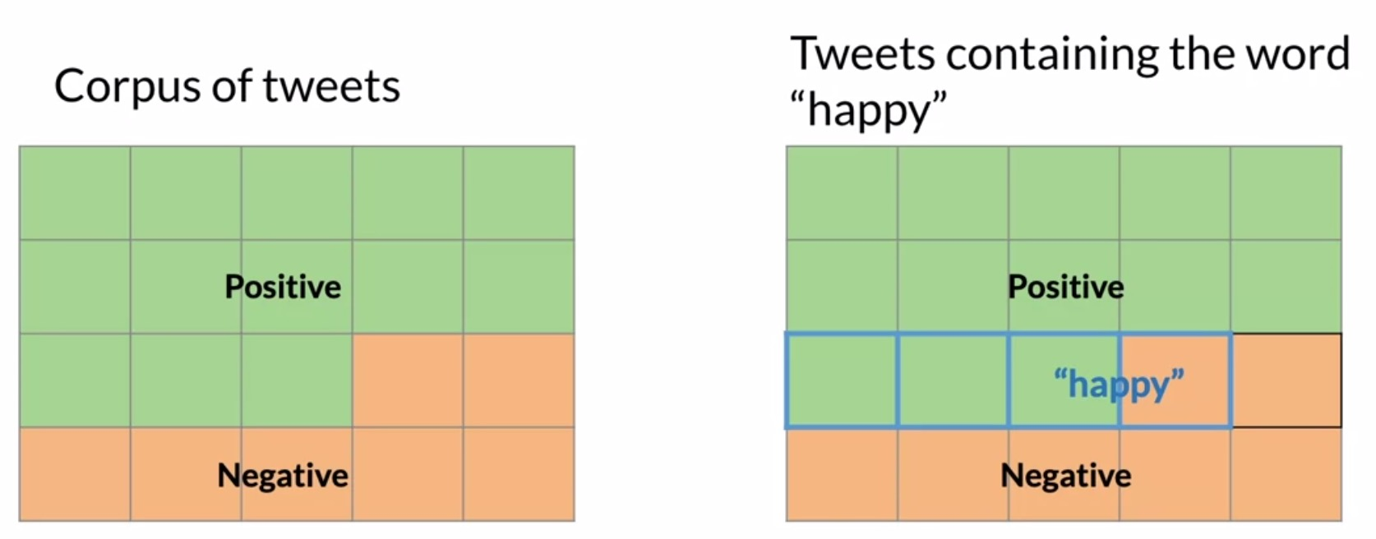
Building a Model for Sentiment Classification
Naive-Bayes Model For Sentiment Classification- Naive-Bayes classifier is widely used in Natural language processing and proved to give better results. It works on the concept of Bayes theorem.
Shown graph is a graphical representation of this “overlap”. Let’s explore how we may handle this case using probability, with a Venn diagram-based graphical interpretation.
Sentiment-Analysis-of-Tweets

Slide 9

Building a Model for Sentiment Classification
One way to think about probabilities is by counting how frequently events occur. Let’s define event A as a tweet being labeled positive. The probability of event A, denoted by P(A), is calculated as:
In the example shown in the figure below, P(A)=1320=0.65, or 65%. It’s worth noting the complementary probability here, which is:
Sentiment-Analysis-of-Tweets

Slide 10
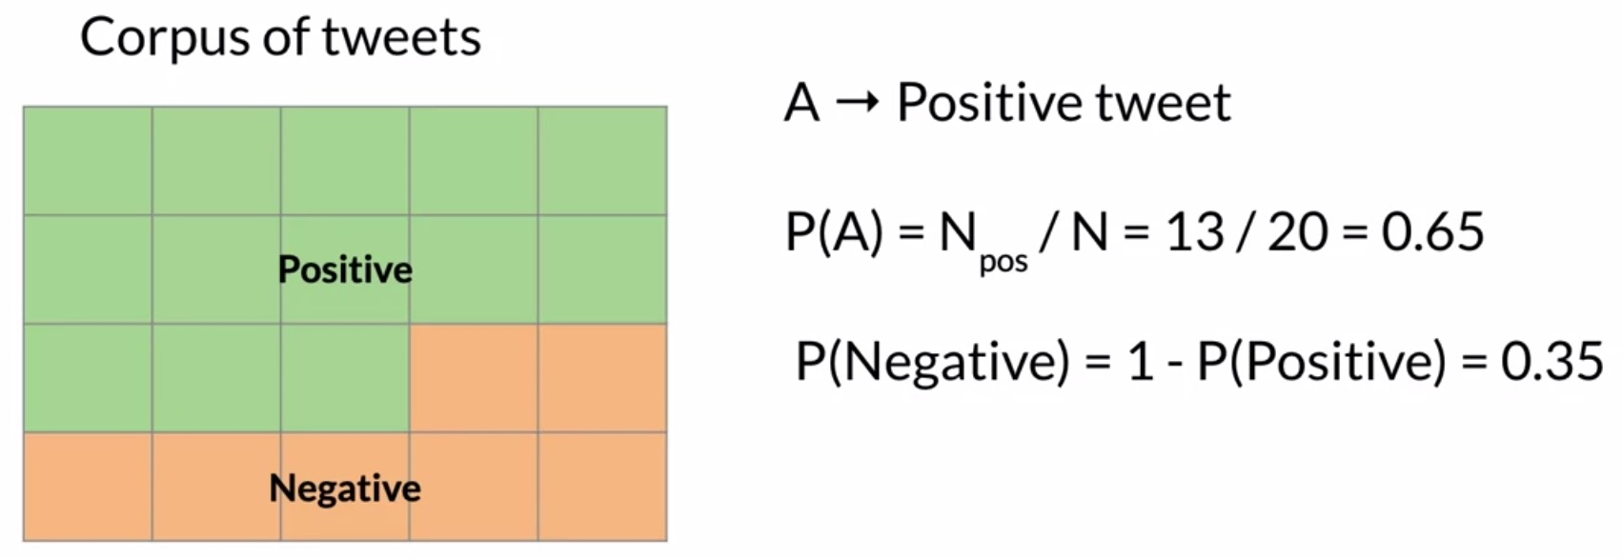
Building a Model for Sentiment Classification
P(Negative) is the leftover of 1 – P(Positive), which is 0.35.
Sentiment-Analysis-of-Tweets

Slide 11
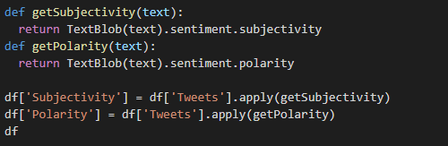
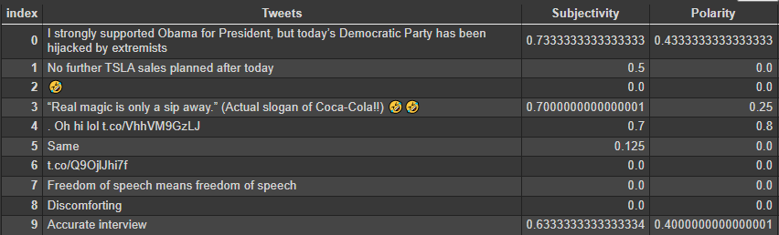
01f
03
Make Prediction on Test Case
Creating a function to get subjectivity and polarity
Sentiment-Analysis-of-Tweets

Slide 12
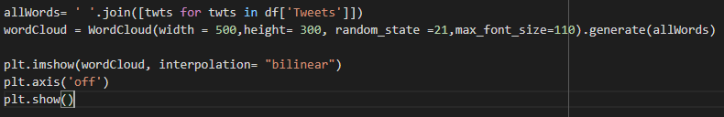
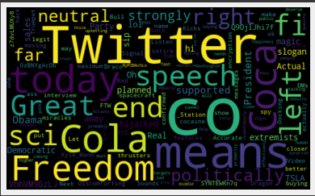
01f
03
Make Prediction on Test Case
How well sentiments are distributed using a library named “wordCloud” to generate Plot Word Cloud figure as follows:
Sentiment-Analysis-of-Tweets

Slide 13
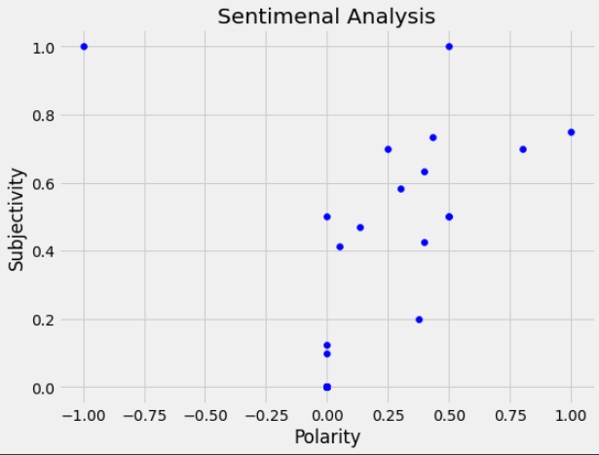
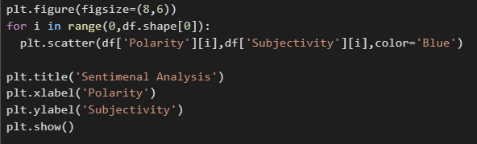
01f
03
Result of Sentiment Analysis
Plotting the polarity and subjectivity on the figure below:
Here on the figure, the polarity scores are more on the right side of 0 which positivity level is high and only 1 negative polarity on the far left. And the combined subjectivity is also higher expressed.
Sentiment-Analysis-of-Tweets
Sentiment-Analysis-of-Tweets

Slide 14
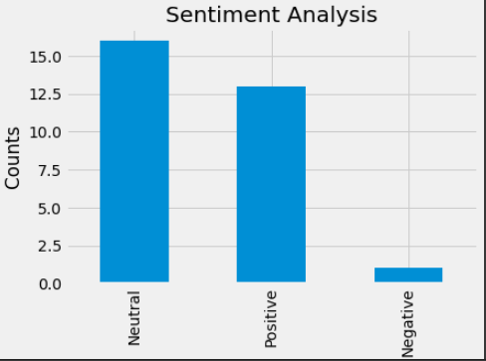
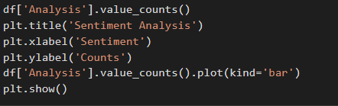
03
Result of Sentiment Analysis
Plotting the counts and sentiments on the figure on the right by the code below:
On the figure Sentiment Analysis, we can @elonmusk comments are more neutral and positive rather negative based around 30 data provided randomly.
Sentiment-Analysis-of-Tweets
Sentiment-Analysis-of-Tweets

Slide 15
Conclusion
In this research Sentiment Analysis, the API credentials have been taken from Twitter co. the dataset is obtained from twitter id user @elonmusk. Text data was unstructured data and needed preprocessing before applying models. Then, Naive-Bayes classification Models are used as an algorithm for classifying texts.
Sentiment-Analysis-of-Tweets

Slide 16
RESOURCES
Source Code in my Colab Account:
https://colab.research.google.com/drive/1oeotxLZ5c1bAGr2_ElVovkGe-zNBlYdp?usp=sharing

Slide 17
THANKS
Do you have any questions?
ubaydullohazard@gmail.com

