Slide 1
SvelteJS

Slide 2
What is it?
It is the same as any frontend framework like React, Vue, Angular
You can write it with Javascript or Typescript
One of the most simplest markups so far in any frameworks
It is imperative language, not declarative like React and others

Slide 3
Programming paradigms
Declarative programming: you tell what you want, not how to get it.
Example: collection.Where(num => num % 2 != 0);
Description: I want odd numbers, I dont care how you do it for me.
Imperative programming: you tell do you want to happen, step by step.
Example:
List<int> collection = new List<int> {1, 2, 3, 4, 5};
List<int> results = new List<int>();
Foreach(var num in collection)
{
if(num % 2 != 0) results.Add(num);
}
Description:
Here is a list of numbers, create empty list, loop list of numbers,
check if its odd,
add to new list that number

Slide 4
How it differents from other frameworks?
It is NOT declarative state-driven code like React
When writing with React browser do extra work to convert code into
DOM operations. To make those operations efficient, React uses virtual DOM diffing.
Very simple markup
It is 25x times faster than React, 50x times faster than Vue
Not thinking accessibility throws an warning: <img src=”images/hey.png” />
if missing alt-attribute
If writing styles inside *.svelte files and not using them, it warns you
Svelte runs at build time, converting your components into highly efficient imperative code.
You can write very ambitious applications with excellent performance.

Slide 5
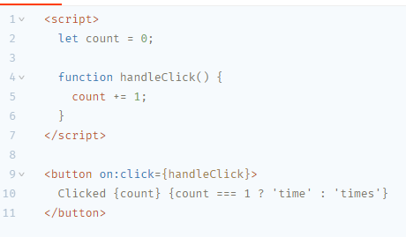
Example markup of SvelteJS

Slide 6
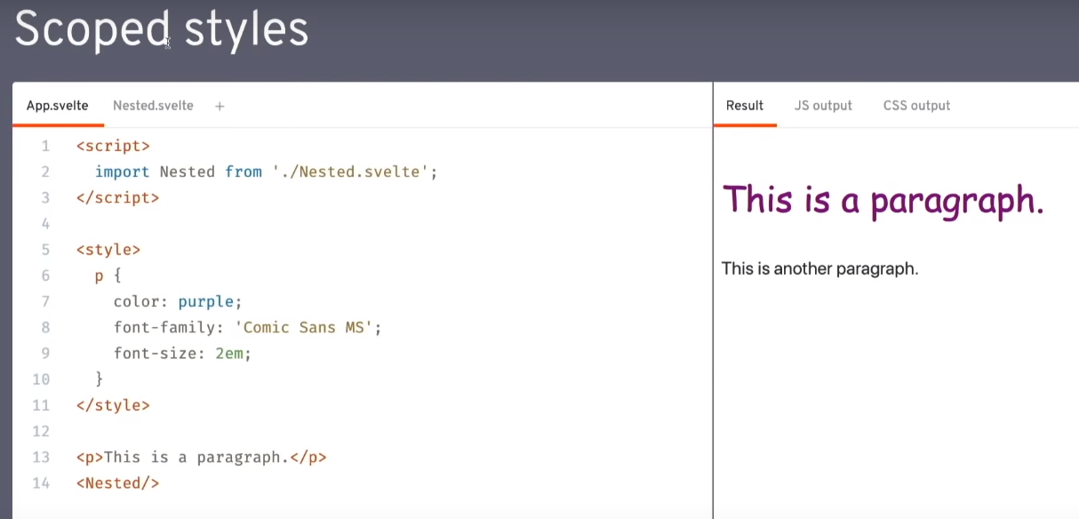
Styles not affecting others

Slide 7
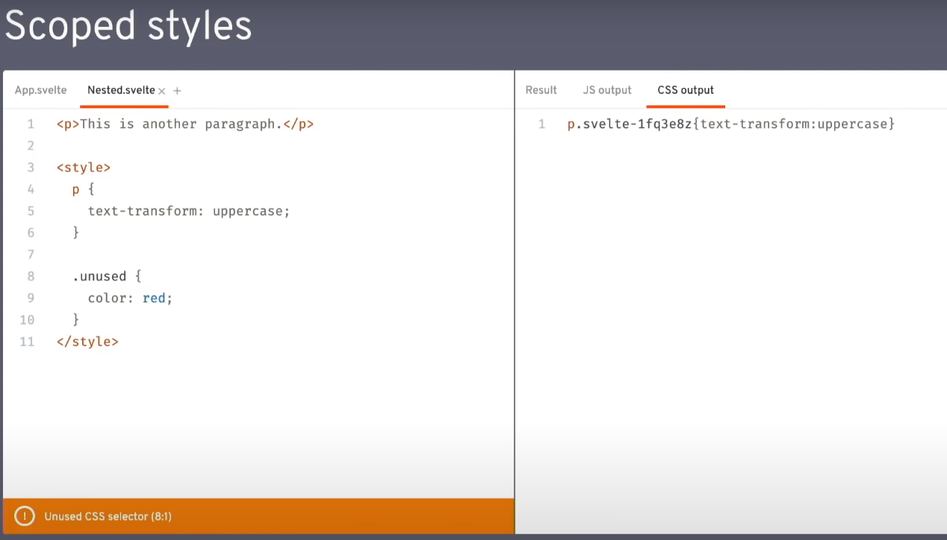
Style warnings

Slide 8
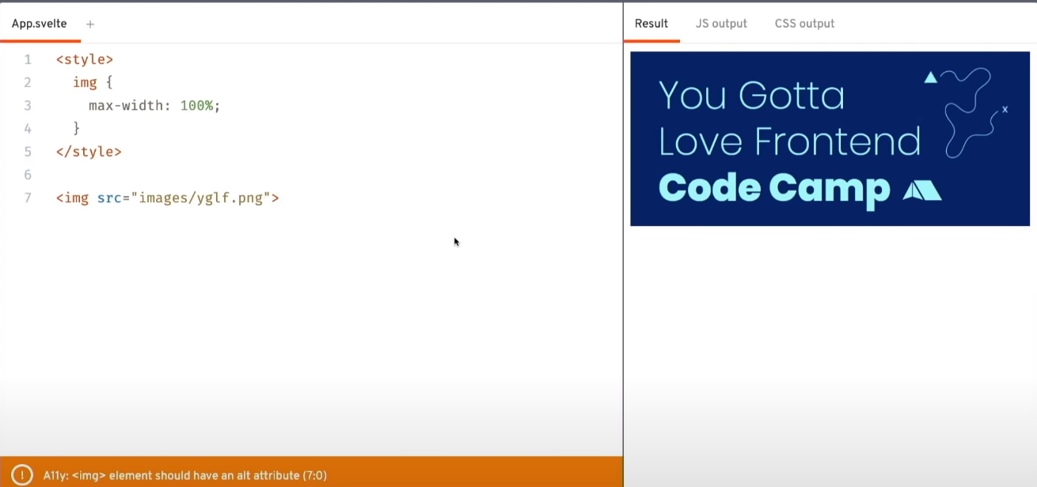
Style warnings

Slide 9
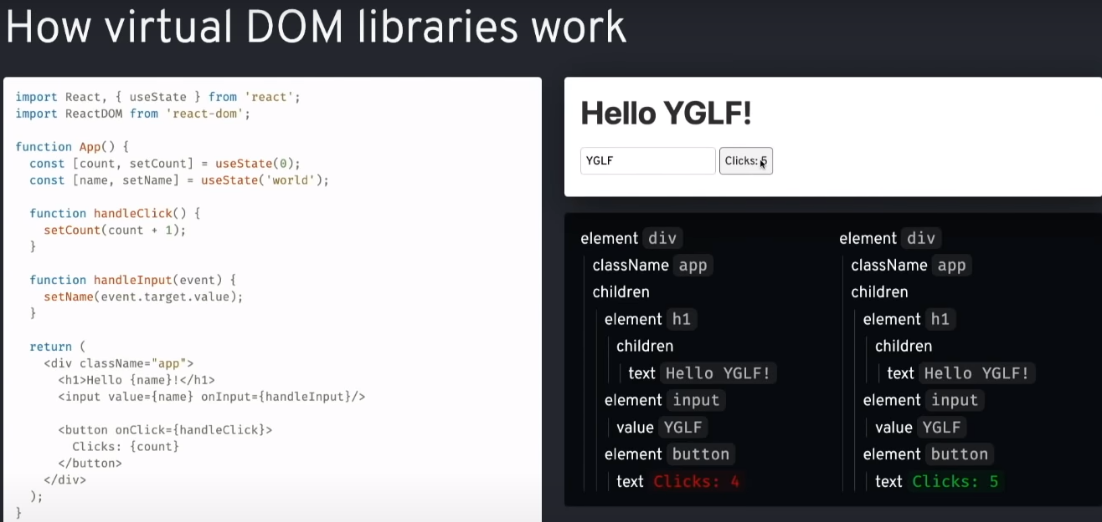

Slide 10
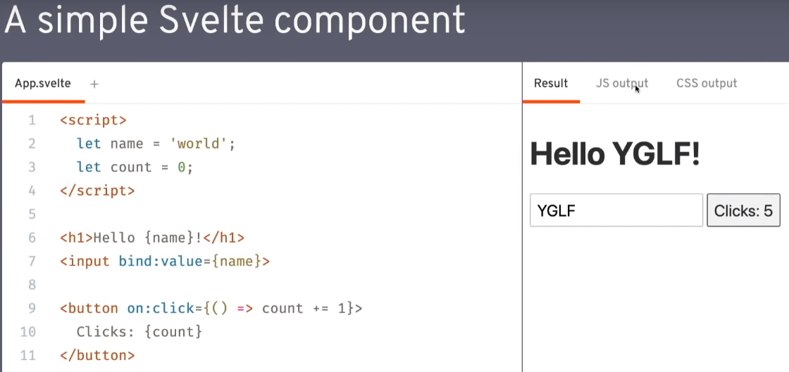

Slide 11
Links
What is Svelte: https://svelte.dev/blog/svelte-3-rethinking-reactivity
Video introduction: https://www.youtube.com/watch?v=AdNJ3fydeao

Slide 12
Download repo
https://github.com/Ubernt/SvelteWorkshop

