Slide 1


Heart Rate Monitor with the Arduino
Jens Gansloser
Fabian Meyer
SS14 – Ubiquitos Computing Mini-Project

Slide 2
Project
Create a Heart Rate Monitor with the Arduino.
Advantages against commercial devices:
Full source code available
Full insight into the used technology
Can be compared to commercial ones in precision and performance
Higher performance/precision?

Slide 3
Measurement Principle
LED (Red/IR)
Skin
Blood
Photodiode
Blood
Light through skin
Light reflected

Slide 4
Heart Rate and Oxygen Saturation
Red LED (660nm)
IR LED (940nm)
Rate: time between two maxima / minima
Saturation: difference between red and infrared light intensity
Detect maxima / minima and calculate time difference.

Slide 5
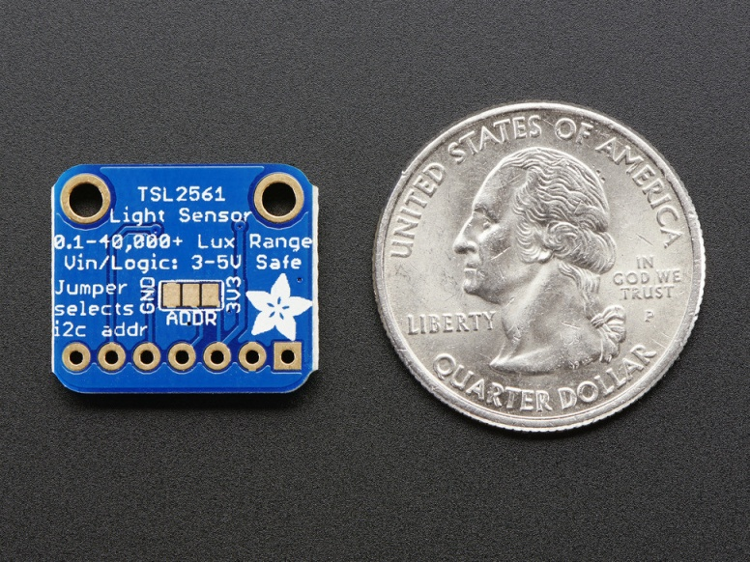
Hardware
Adafruit TSL Light Sensor
Broadband and IR Photodiode
Different integration times
Different sensitivity
I2C interface
Red and IR LED
Bluetooth Module (not used)
Arduino
Needs I2C and USART support
Notes:
16bit resolution.

Slide 6
Data Flow
Heart rate (bpm)
Bluetooth module
PC / Smartphone
UART
Heart rate
Oxygen saturation
Heart rate calculation
Arduino
I2C
Light sensor
Notes:
Bluetooth not support, because we got a wrong module (not compatible to pc).
However, adding bluetooth support is easy (serial connection).

Slide 7
Data Flow
Implementation not trivial: Prototype implemented on PC
Light Sensor Data
Arduino
UART
PC
Heart rate calculation
I2C
Heart rate
Light sensor
Notes:
We implemented the prototype on the PC, for easier debugging and optimization. Our first aim was to get the heart rate.

Slide 8
Software
Libraries
Heart Rate Monitor
QSerialPort
Serial port control
FFTW
Calculation of the Fourier Transform
Qt
Graphical User Interface
Qwt
Graphs
GUI
Debugging and information display
Serial Interface
Get sensor data
Get sensor settings
Set sample rate
FFT Module
Signal processing
Arduino Software
Read sensor light value (extended driver)

Slide 9
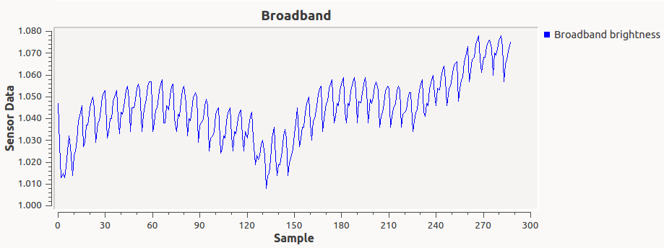
Signal Processing
Output signal from the light sensor (array of discrete light values):
Pulse (with noise)
How to get the Heart Rate ( = Minima time difference)?
Notes:
Output signal from light sensor (broadband photodiode)
Visualized on PC
Now how to get the pulse from this data?
Minima need to be determined.
Noise: Not clear curves, Y-axis shift.

Slide 10
First Approach
Determine the grade
Is it declining or rising?
Determine minima
Notes:
Wie kann man die minima bestimmen?

Slide 11
First Approach
Determine the grade
Is it declining or rising?
Determine minima
Does not work!
Input light signal contains a lot of noise, a lot of shifting in the Y-Offset, different environment light, …

Slide 12
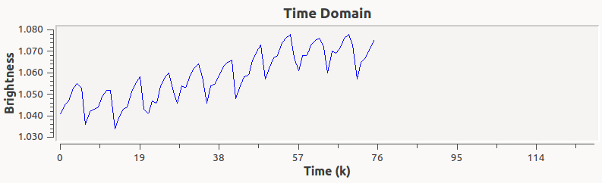
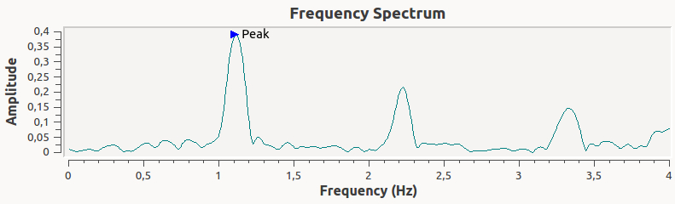
Fourier Transform
Elegant way to determine the heart rate
Transform
Discrete Signal
Frequencies
Peak Frequency = Heart Rate
Notes:
Beter and more elegant. After reading tons of books.
We want to find the frequency of the pulse.
→ The frequency with the highes amplitude is the pulse (sinus frequency)

Slide 13
Fourier Transform
Unfortunately not that easy …
Transform
. . . . . . . .
Filtering, Window Function, Zero Padding, …
Discrete Signal
Frequencies

Slide 14
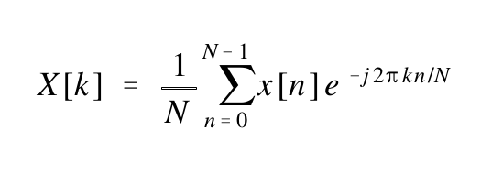
Which Fourier Transformation?
Complex, Real?
Discrete, Continues?
Periodic, Aperiodic?
→ Complex Discrete Fourier Transform (DFT) - Forward transform synthesis (polar form)
Different application fields
N samples
x[n] discrete input values
X[k] discrete output values
Calculation with complex numbers

Slide 15
Complex DFT
Input values
Array of complex data (discrete input data)
Real part = Sensor values
Complex part = 0
Output values
Array of complex data (discrete output data)
Rectangular coordinate system (complex and real values – cos and sin functions)
Transformation to polar coordinate system with magnitude and phase (human readable)
Notes:
FFT = Fast Fourier Transform = Fast DFT Implementation
So lets see, what we have to give as input and get as output.

Slide 16
Signal Processing
Filter
Window Function
Zero Padding
FFT
Converting/
Scaling
Notes:
As already mention, we can not use only the FFT. We need to prepare the data at first
Here are the steps that need to be done to get a nice frequency spectrum at the end..

Slide 17
Signal Processing
Filter
Window Function
Zero Padding
FFT
Converting/
Scaling
Butterworth Bandpass Filter
(Convolution)
→ Remove unwanted frequencies
Hamming-Window
→ Reduces Leakage Effect
Pad additional samples with zero →
Interpolation (for higher frequency resolution)
Time Domain →
Frequency Domain
Interpret Output Array,
Prepare data,
Remove DC offset,
Find peak frequency, convert to bpm
Notes:
I will not explain these steps in detail. I only show the principle and why they need to be done.
Leakage effect is DFT related. Its when the sampled values don’t fit to the sinusoid basis frequency.
It makes the plot worse and harder to find the correct optimum.

Slide 18
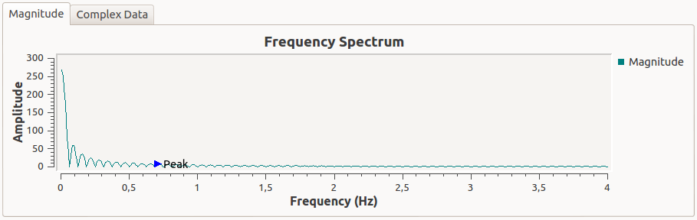
Signal Processing
Frequency Spectrum
No Filter and no Window Function
Notes:
Lets see how these steps affect the resulting frequency spectrum.
Here are a lot of low frequencies which are not interesting end pollute the resulting spectrum.

Slide 19
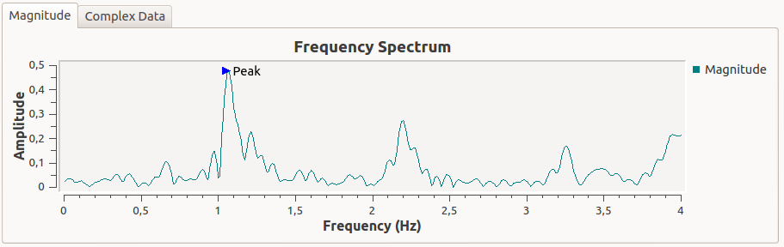
Signal Processing
Frequency Spectrum
No Window Function
Notes:
Looks better but the peaks do not look very nice.

Slide 20
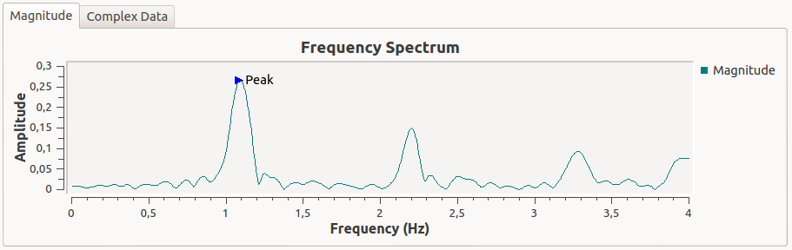
Signal Processing
Frequency Spectrum
With everything
Notes:
Nice smooth curve and peaks are easy to determine.

Slide 21
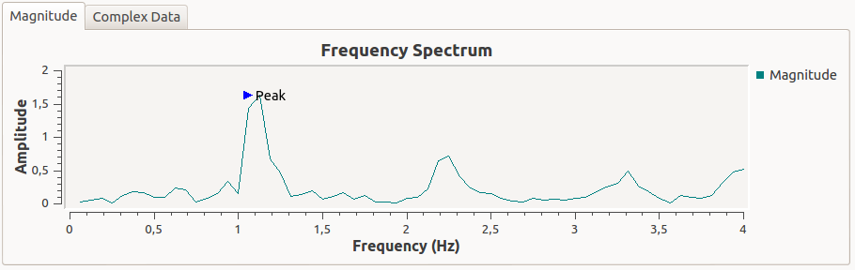
Signal Processing
Frequency Spectrum
No Zero Padding
Notes:
Results in lesser output points with lower frequency resolution. The peaks are not at their real x position.
Can be between two points.
However, the data is the same.

Slide 22
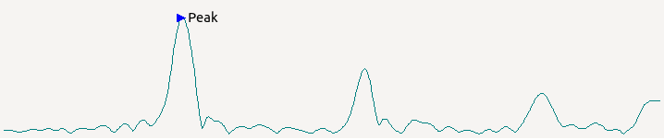
Signal Processing
Output array of complex DFT (N samples)
(after converting to polar form)
Peak detection only with this data
Peak
Peak
[0]
[1]
[N/2]
[N-1]
First data element
DC Offset (not displayed)
Nyquist frequency
(1/2 of sample rate)
Notes:
It is important, to correctly interpret the output data.

Slide 23
Signal Processing
A lot of things to consider:
Sample Frequency (Nyquist-Shannon theorem)
Segment Duration
Which Filter?
Filter Parameters
Target Frequency
Filter stabilization time
Correct data scaling
Zero Padding (interpolation) – numer of samples
Find correct frequencies
Improving frequency resolution
Number of samples
Timeinterval for doing FFT
…
Notes:
Sehr viele Parameter zum Einstellen, sehr viele Schritte um Daten vorzubereiten.
Zu viel um alles zu erklären, deswegen ein paar hier aufgezählt.

Slide 24
Further Steps / Improvement
Port to Arduino
FFT library is available - http://wiki.openmusiclabs.com/wiki/ArduinoFFT
Research needed, if performance is enough
Else do signal processing on smartphone
Use smaller uC (ATtiny, …)
Add bluetooth module (trivial)
Add oxygen saturation measurement (easy to implement - the technology is the same as the heart rate measurement)
Create wrist band (smaller LED)
Brighter LED (to get greater frequecy peaks)
Notes:
Vergleichstest durchgeführt – Messwerte sehr genau.

Slide 25


Slide 26
Sources
http://www.dspguide.com/
Mastering the Discrete Fourier Transform in One, Two or Several Dimensions - Pitfalls and Artifacts, Isaac Amidror, Springer
DFT – Diskrete Fourier-Transformation, André Neubauer, Springer
Signaltheorie, Alfred Mertins, Springer
http://www.thefouriertransform.com/series/fourier.php
https://ccrma.stanford.edu/~jos/mdft/
http://paulbourke.net/miscellaneous/dft/
http://www.ignaciomellado.es/blog/Measuring-heart-rate-with-a-smartphone-camera
http://www-users.cs.york.ac.uk/~fisher/mkfilter/trad.html

Slide 28
Time
Domain
Forward FT
Frequency Domain
Inverse FT

Slide 29
data vector (queue)
real data
ptr = add(value)
effectiveSize
copyToDataOut()
fftw_complex array
complex data
zeroPadding . . .
effectiveSize + zeroPadSize

Slide 30



Add data
$$t_{1}$$
$$t_{2}$$
$$t_{3}$$
Calculate FFT
Sliding Window

Slide 31
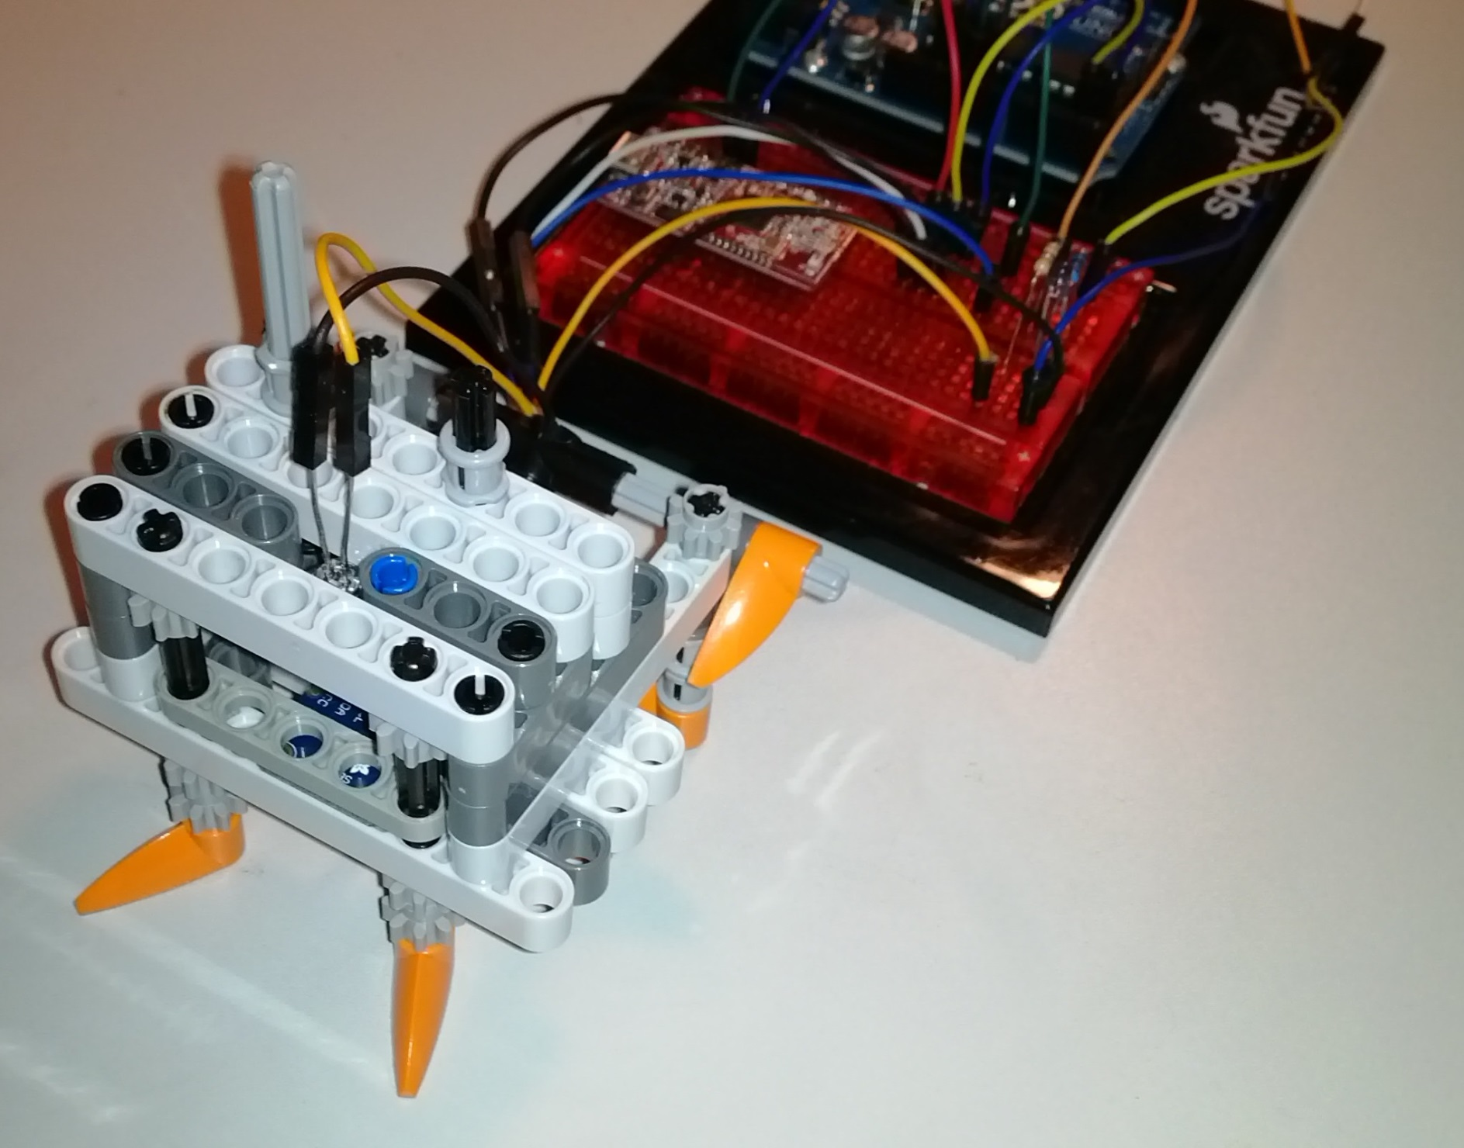
Red LED
Finger is placed
between LED and
sensor
Luminosity Sensor

Slide 33
Window Function
Zero Padding
FFT
Ideal Filter
Converting/
Scaling

Slide 34
LED (Red/IR)
Skin
Blood
Photodiode
Blood
Light through skin
Light reflected

