Slide 1
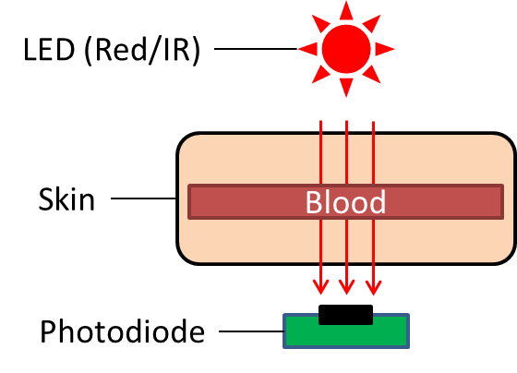
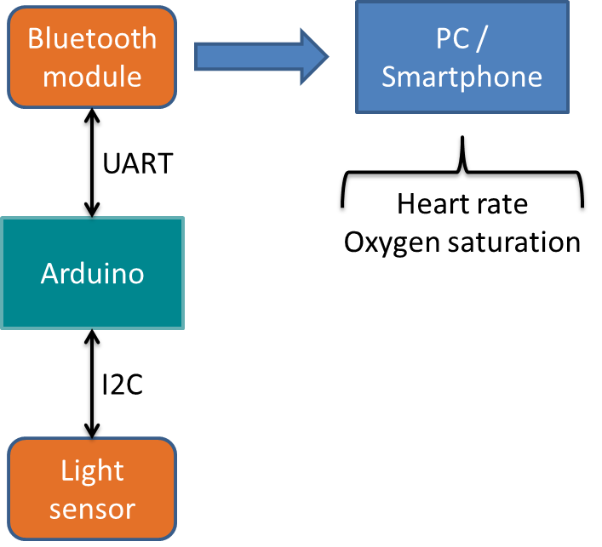
Heart Rate Monitor
Ubiquitous Computing Project
Fabian Meyer
Ubiquitous Computing Laboratory
HTWG Konstanz
Konstanz, Germany
fameyer@htwg-konstanz.de
Jens Gansloser
Ubiquitous Computing Laboratory
HTWG Konstanz
Konstanz, Germany
jeganslo@htwg-konstanz.de
Ralf Seepold
Ubiquitous Computing Laboratory
HTWG Konstanz
Konstanz, Germany
ralf.seepold@htwg-konstanz.de
Abstract
The aim of this project is to build a heart rate monitor device. There are already a lot of devices commercially available which measure the
heart rate. However, the internal functionality of these devices is not exposed to the user, so there cannot be made any statements about their precision and the quality of the results. The purpose of this project is to create a fully functional heart rate monitor device from scratch, so all internal functionality is known. Further projects can use these implementation and apply changes according to their application field.
Measurement principle
The heart rate is measured by using the photoplethysmogram technique. This method measures the change of blood volume through the absorption or reflection of light. A LED emits red light, which shines through a body part (e.g. finger). On the other side a photodiode measures the intensity of light that traversed the tissue. Since blood changes its volume depending if blood flows from or to the heart, more or less light of the LED gets absorbed by it. As a result the registered intensity of light by the light sensor changes continuously with the pulse.
The light intensity and its changes over time are used to clalculate the heart rate of a person.
Prototype features
Detects heart rate with high quality and precision
Only less and cheap hardware is required (microcontroller, light sensor)
Heart rate calculation using a desktop pc
Signal processing with the discrete Fourier Transform (filtering, transforming, window function, …)
Only free software is used
Visually appealing cross platform GUI with Qt
Window Function
Zero Padding
FFT
Ideal Filter
Converting/
Scaling

