Slide 1
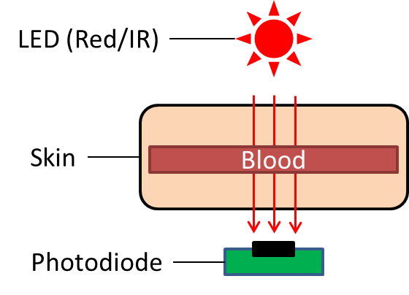
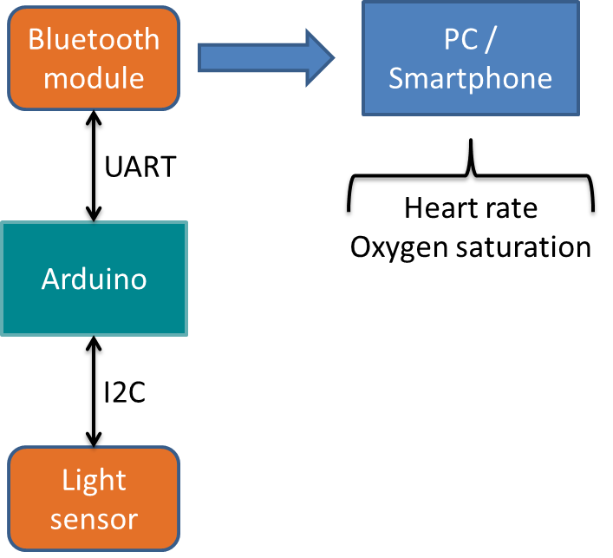
Heart Rate Monitor
Ubiquitous Computing Mini Project
Fabian Meyer
Ubiquitous Computing Laboratory
HTWG Konstanz
Konstanz, Germany
fameyer@htwg-konstanz.de
Jens Gansloser
Ubiquitous Computing Laboratory
HTWG Konstanz
Konstanz, Germany
jeganslo@htwg-konstanz.de
Ralf Seepold
Ubiquitous Computing Laboratory
HTWG Konstanz
Konstanz, Germany
ralf.seepold@htwg-konstanz.de
Abstract
There are many heart rate monitor devices available, which can even be connected to a smartphone or computer via bluetooth. However, the internal functionality of these devices is not exposed to the user, so there cannot be made any statements about their precision and quality. The purpose of this project is to create a fully functional heart rate monitor device from scratch, so all internal functionality is known. Further projects can use these implementation and apply changes according to their application field.
Measure the heart rate
The heart rate is measured by using the photoplethysmogram technique. This method measures the change of blood volume through the absorption of light. A LED emits red light, which shines through a body part (e.g. finger). On the other side a photodiode measures the intensity of light, that traversed the tissue. If the heart pushes blood through the vessels, more oxygenated blood flows between LED and photodiode. Since blood changes its color according to its grade of oxygenation, more or less light gets absorbed by it.
The values of light intensity and its changes over time are used to clalculate the heart rate of a person.
Prototype Features
ATMega for measuring light intensity
Highspeed calculation using a desktop pc (leads to high resolution)
Signal processing with the Fourier Transformation (filtering, transforming, window function, …)
High quality and high precision heart rates
Visually appealing cross platform GUI with Qt
Filter
Window Function
Zero Padding
FFT
Converting/
Scaling

