Slide 1
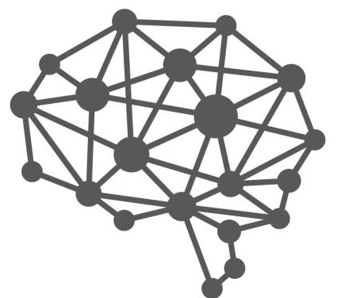

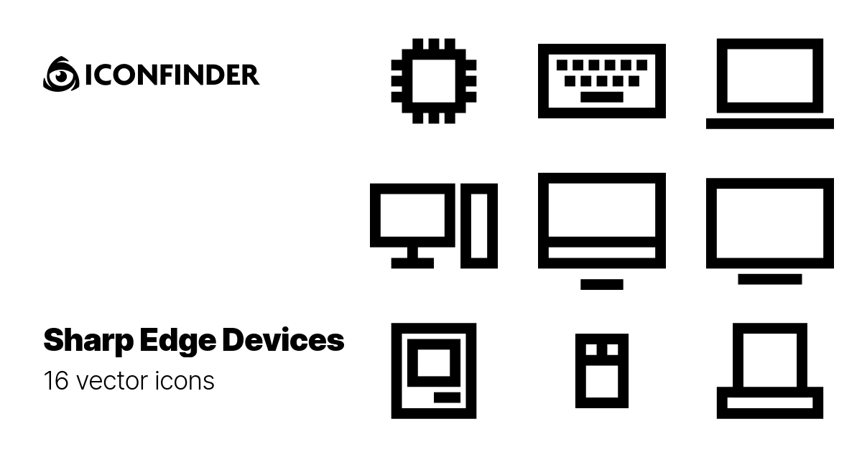
FedNLP: focus of this work
Text Clssification.
Fine-tuning
BERT, DistilBERT, BART, GPT, etc
Seq. Tagging
Fine-tuning
Deployment
Pre-training
…
…
Fine-tuning
Text Generation.
…
Private, geo-distributed
Public, centralized
Cloud
Cloud&Clients
Clients

Slide 2
Text Cls.
Fine-tuning
Compression
BERT, DistilBERT, BART, GPT, etc
Seq. Tagging
Fine-tuning
…
Pre-training
…
…
Fine-tuning
Text Gen.
Deployment
Private, geo-distributed
Public, centralized

