Slide 1

Mobile Game Development Coursework 2 MHI622947
By Stephen Cartner

Slide 2

Javascript
A Fully fledged dynamic programming language with versatile, compact and flexible code.
Has all the components expected of a traditional programming language.
Prototype-based object systems.
HTML DOM, OOJ, BROWSER BOM etc

Slide 3


Technology in the mobile Games Industry
API familiarity.
Multicore threading.
Mobile features.

Slide 4
Mobile Games Development Techniques – Native Apps
Native Apps Pros
Easier Monetisation
Easier to support
Fewer restrictions on functionality
Developed for set hardware so can be optimised for set device.
Installed directly on device from app store
Safety Insurance
Native Apps Cons
Development can be expensive
Maintenance cost is higher if app supports multiple platforms.
Must be developed and optimised separately on device to device basis.
Long approval times

Slide 5
Mobile Games Development Techniques – Web apps
Web Apps Pros
Compatible across multiple devices and platforms.
Can easily be made compatible with older devices.
No need for app store approval.
Doesn’t need to be approved by and downloaded from an app store.
Web Apps Cons
Limited access to device features.
Hard to make a web app well known since it’s not listed in app stores.
No regulated quality control so users aren’t guaranteed safety and security.
Building for multiple different browsers can be expensive to maintain but is necessary due to users using many different web browser services.

Slide 6
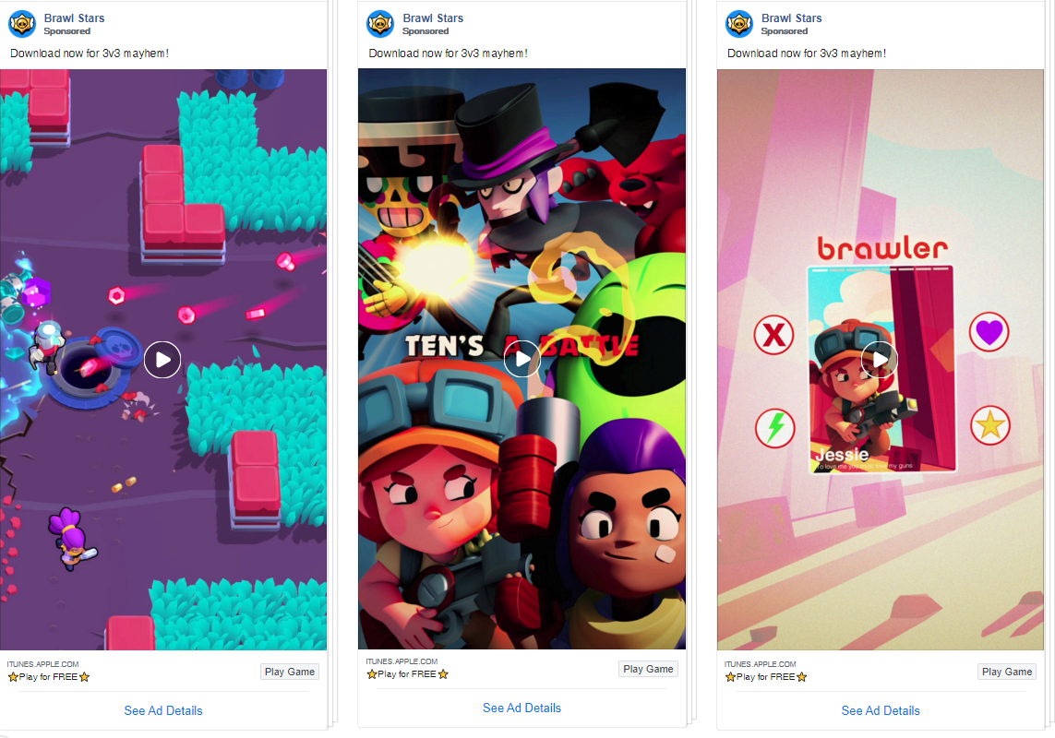
Inherent flaws in mobile game production
Controls
Discoverability
Immersion
Low entry barrier
Low quality development is easy
Innovation is risky

Slide 7
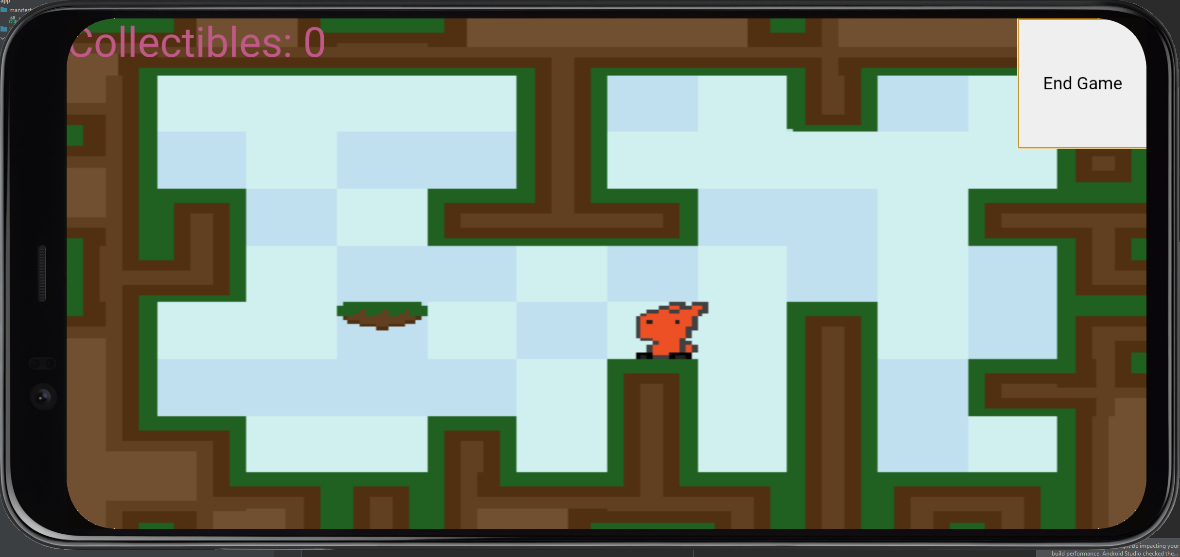
Self Critique
Shortcomings:
Collectables
Score system
UI
Inputs
Processing load

Slide 8

Further Expansions
Native app development.
Phone feature integration.
Monetisation.
Different Javascript approaches.

