Slide 1


bp.com/statisticalreview #bpstats
© BP p.I.c.2021

Slide 2
Key minerals for the changing energy system

Slide 3
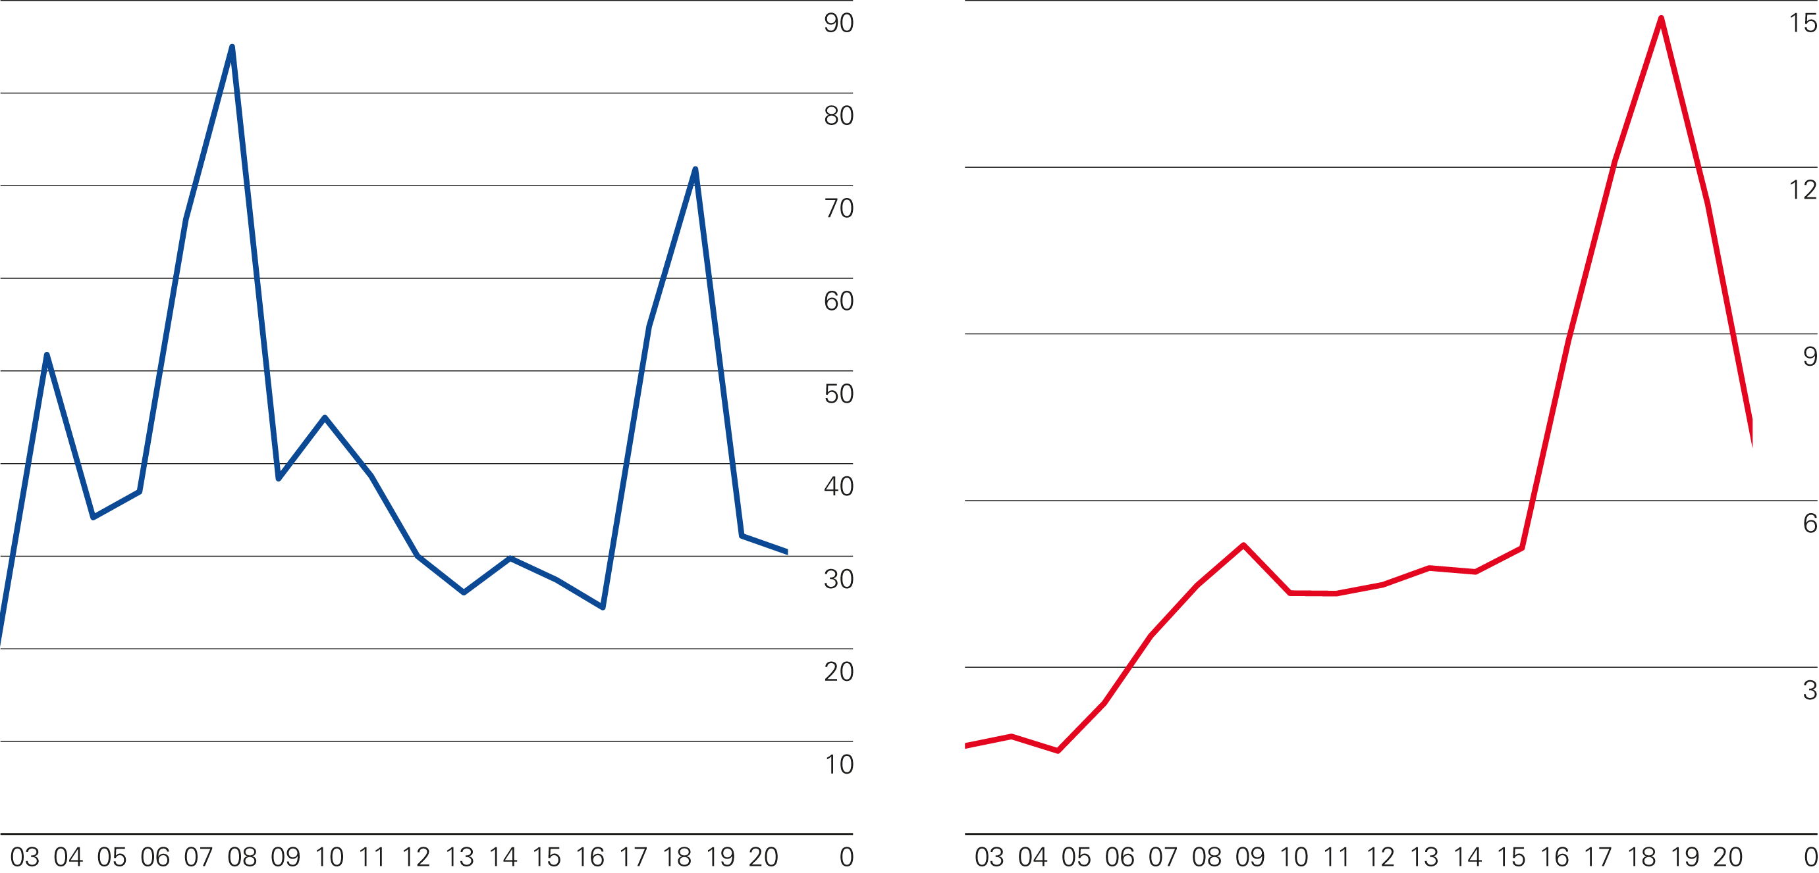
Key minerals prices
Cobalt prices
Thousands of US dollars per tonne
Lithium carbonate prices
Thousands of US dollars per tonne

