Slide 1
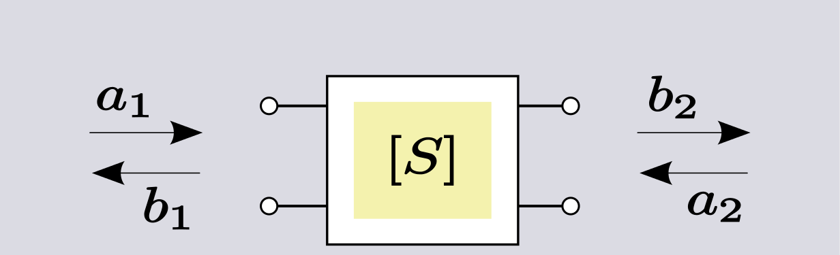
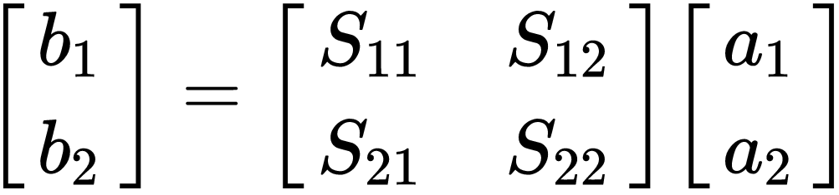
Comparison of 10 amplifiers
RF (radio freq.) amplifiers: kHz - GHz
Characterized by VNA (vector network analyzer)
    Amplitude & phase properties
Characteristics captured in ‘Scattering parameters’:
Reflected waves
Incident waves
Port 1
Port 2
S-parameters in a two-port network
Credit: User:Spinningspark, Filelink: Two-port_S-parameters.svg
Transmission
forward (21) / backward (12)
Reflection
at Port 1 (11) / Port 2 (22)

Slide 2
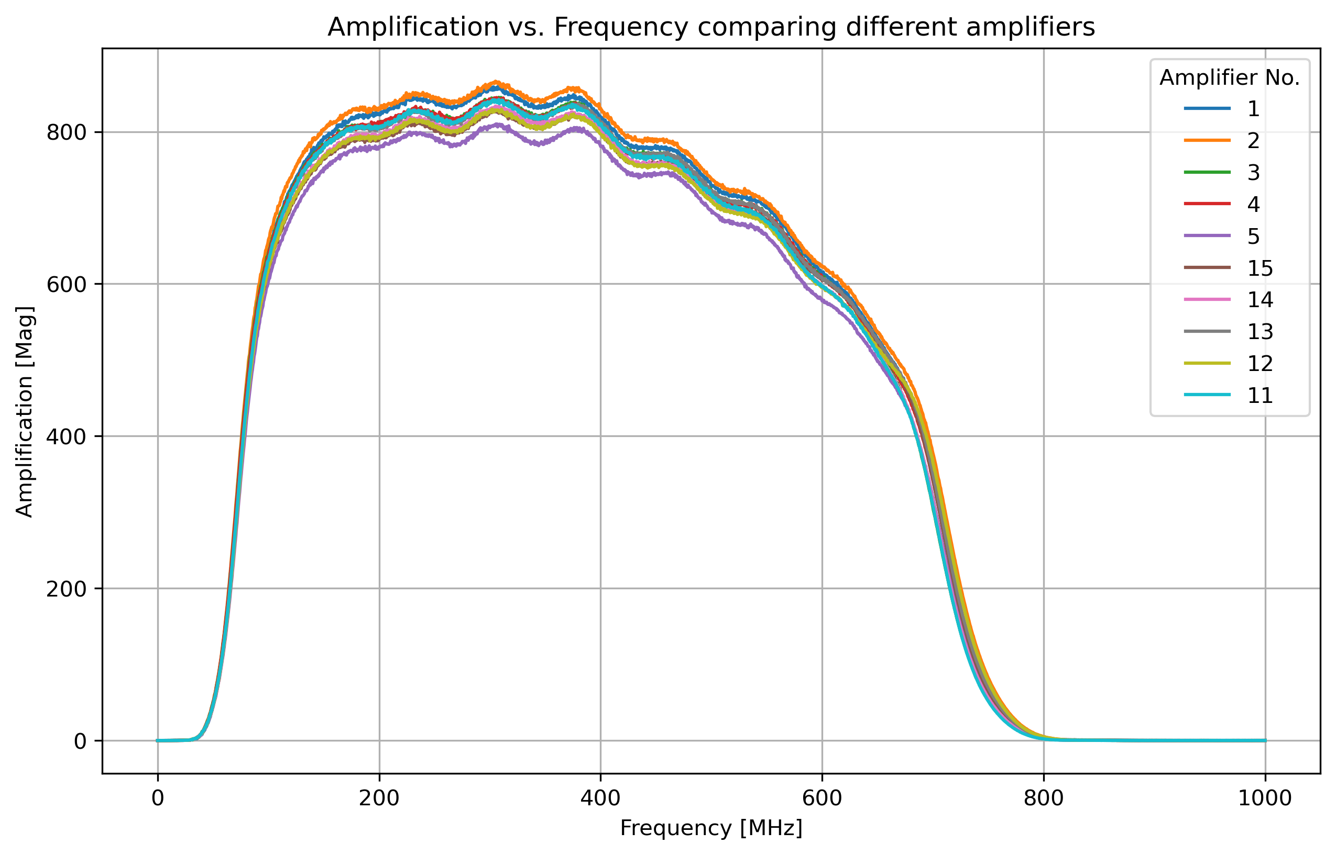
S21 amplitude

Slide 3
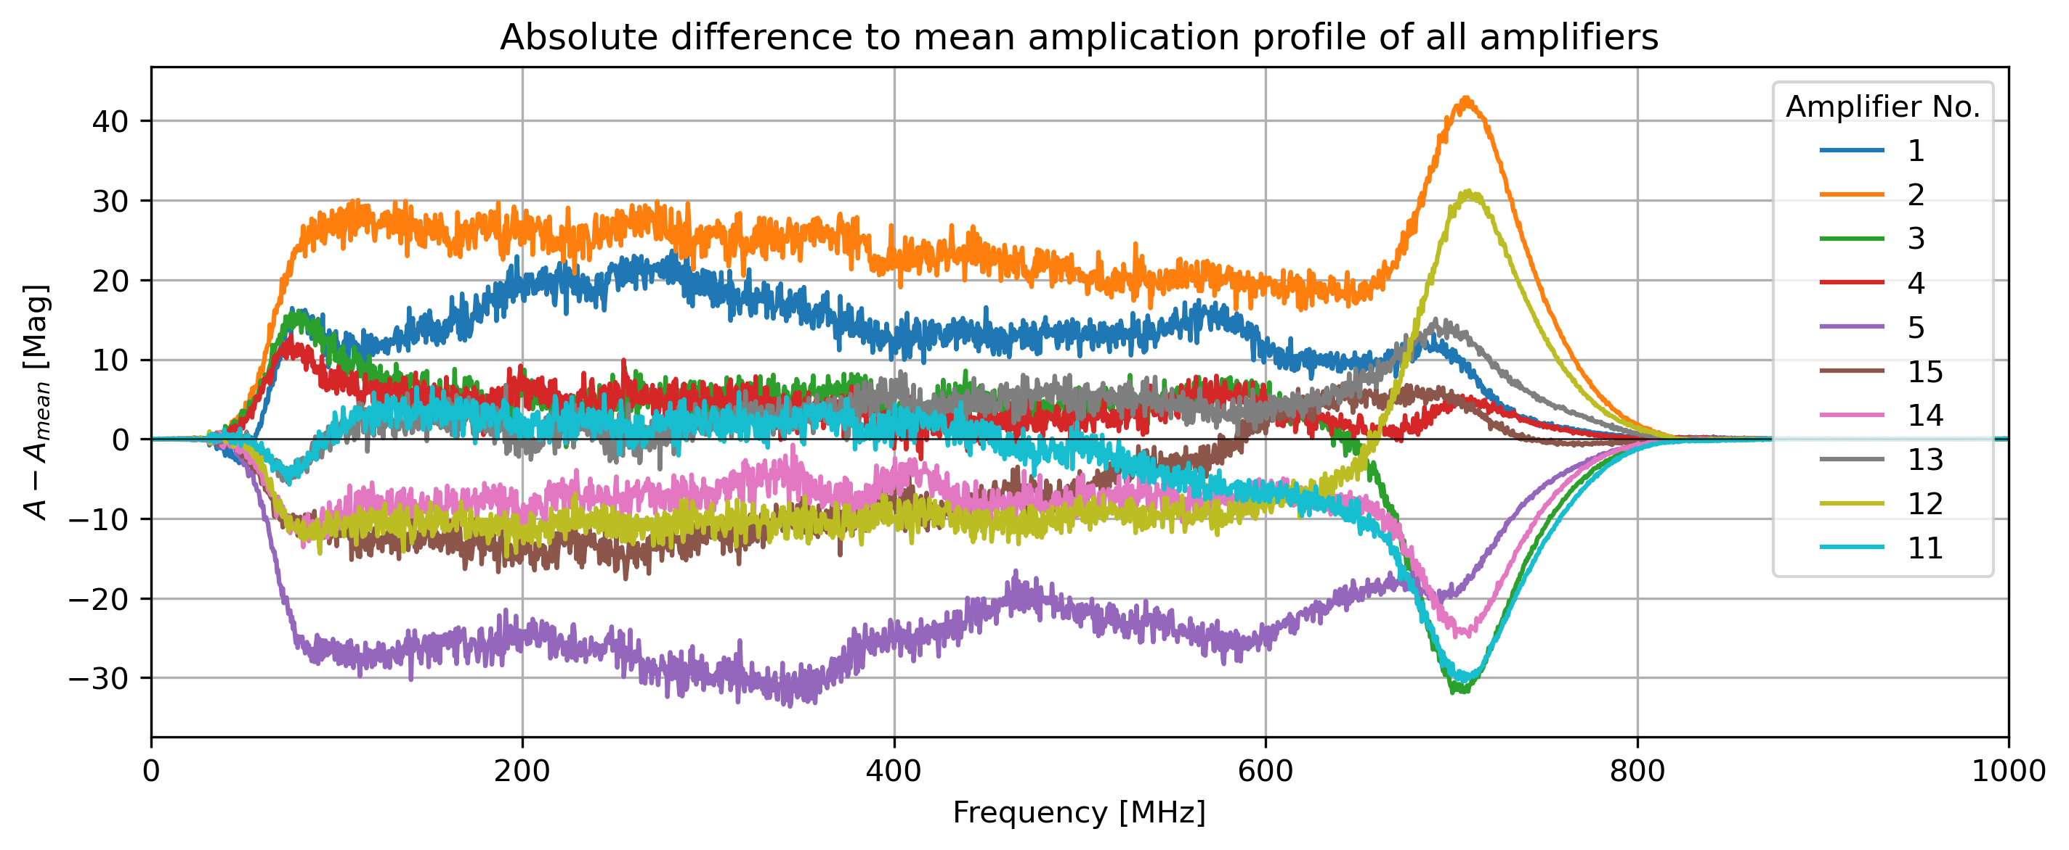
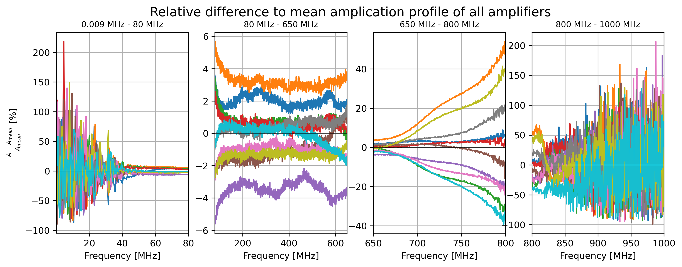
S21 amplitude
Highest gain
Lowest gain

Slide 4
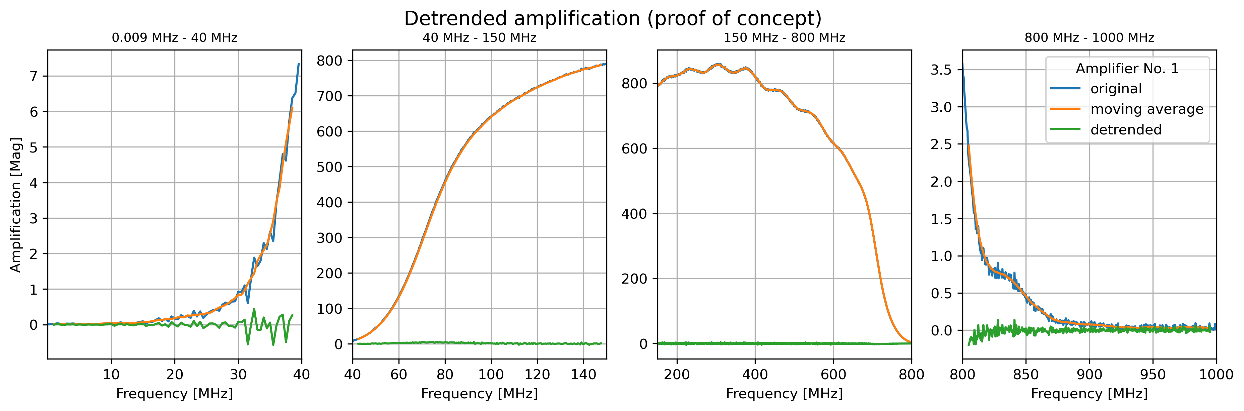
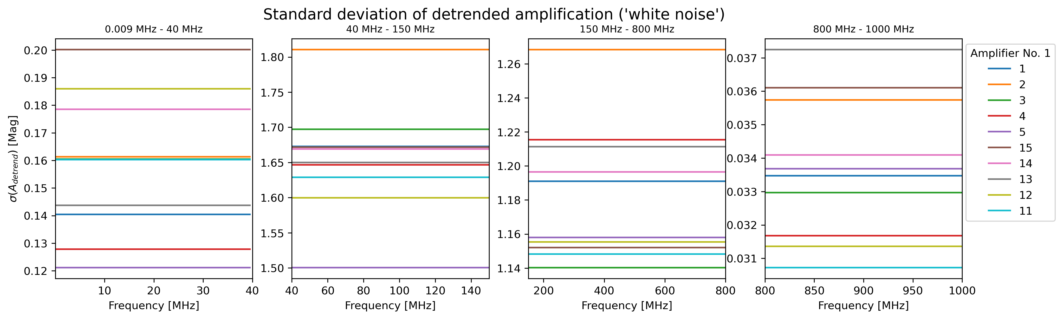
S21 amplitude
High noise
Low noise

