Slide 1
ATAC-seq Technology and Data Analysis
Asli Uyar

Slide 2
ATAC-seq protocol
From Buenrostro et al., 2013
Captures open chromatin sites
Using a simple two-step protocol
Requires 500–50,000 cells
Notes:
transposase-accessible chromatin using sequencing

Slide 3
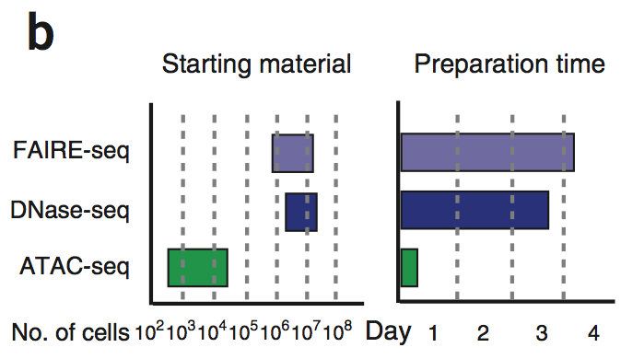
ATAC-seq technology
Intact islets
Lyse cells
Collect nuclei by centrifugation
Add Tn5 (Nextera)
Incubate 30 min at 37 C
Buenrostro et al, 2013
Clean transposed DNA
Amplify/qPCR Sequence
3

Slide 4
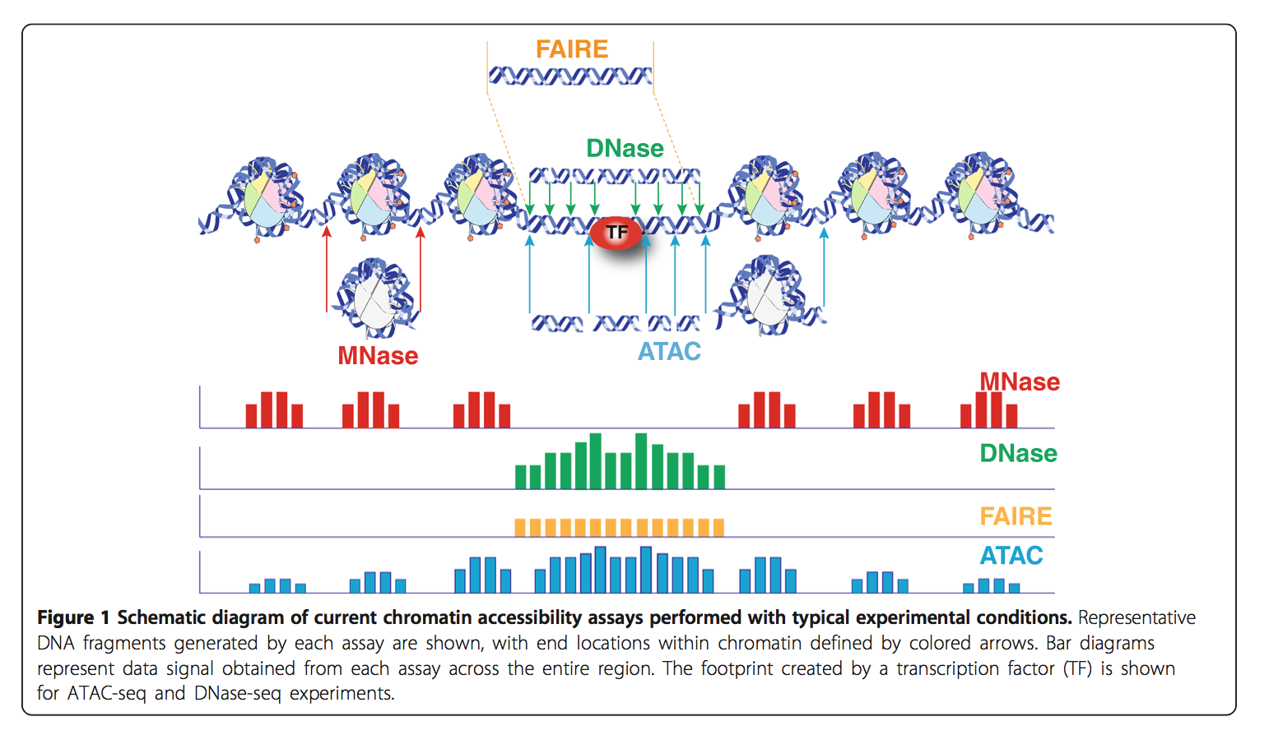
Chromatin accessibility assays
Chromatin accessibility: a window into the genome, Tsompana and Buck Epigenetics & Chromatin 2014

Slide 5
ATAC-seq data analysis pipeline
Raw fastq data
Quality Check
fastq
Quality Filtering
fastq
Quality Trimming
fastq
Adapter Trimming
fastq
Alignment
bam/sam
Shifting, Removing Duplicates, Sorting
bed
Peak Calling
bed, bedGraph
Annotations
Integrated data analysis
Differential analysis

Slide 6
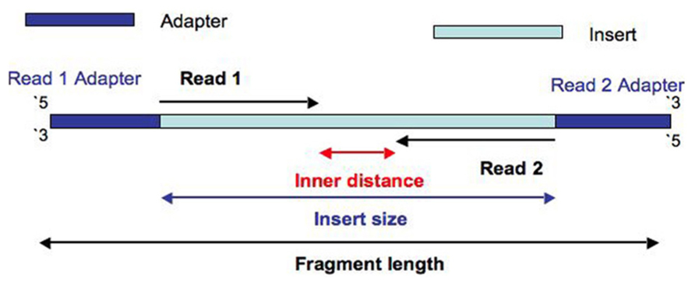
Sequencing - paired end reads and insert size

Slide 7
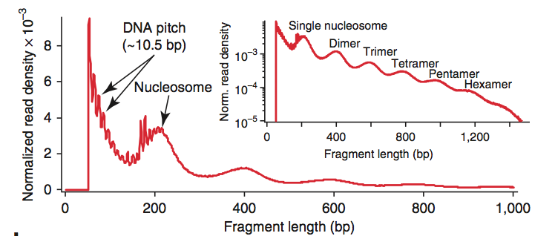
Insert size distribution of a typical ATAC-seq library
Buenrostro, 2013
nReads
32658550
nAlignedReads
22089723
duplication rate
20%
nReads
32692590
nAlignedReads
9267501
duplication rate
60%
Notes:
32658550 22089723 20%
32692590 9267501 60%

Slide 8
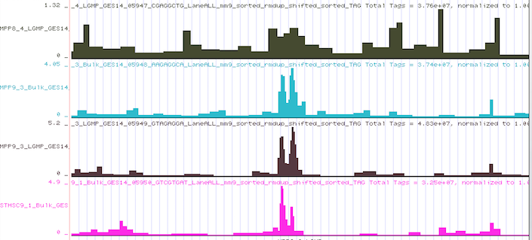
Aligned read distribution

Slide 9
Peak calling
A computational method used to identify genomic loci that have been enriched with aligned reads
commonly in chromatin assays, i.e. ChIP-seq, DNase-seq. ATAC-seq etc…
Estimating the background signal
No control input sample available
Local/global
Peak width
Algorithms available
Macs, peakDeck, Homer

Slide 10
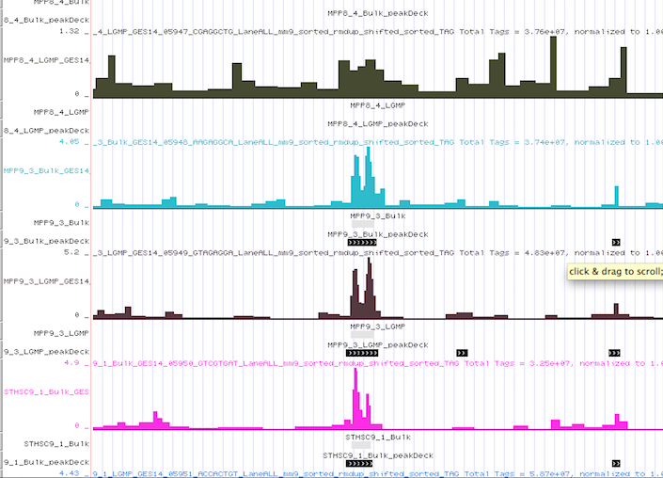
ATAC-seq peaks

Slide 11
Pipeline demo

