Slide 1
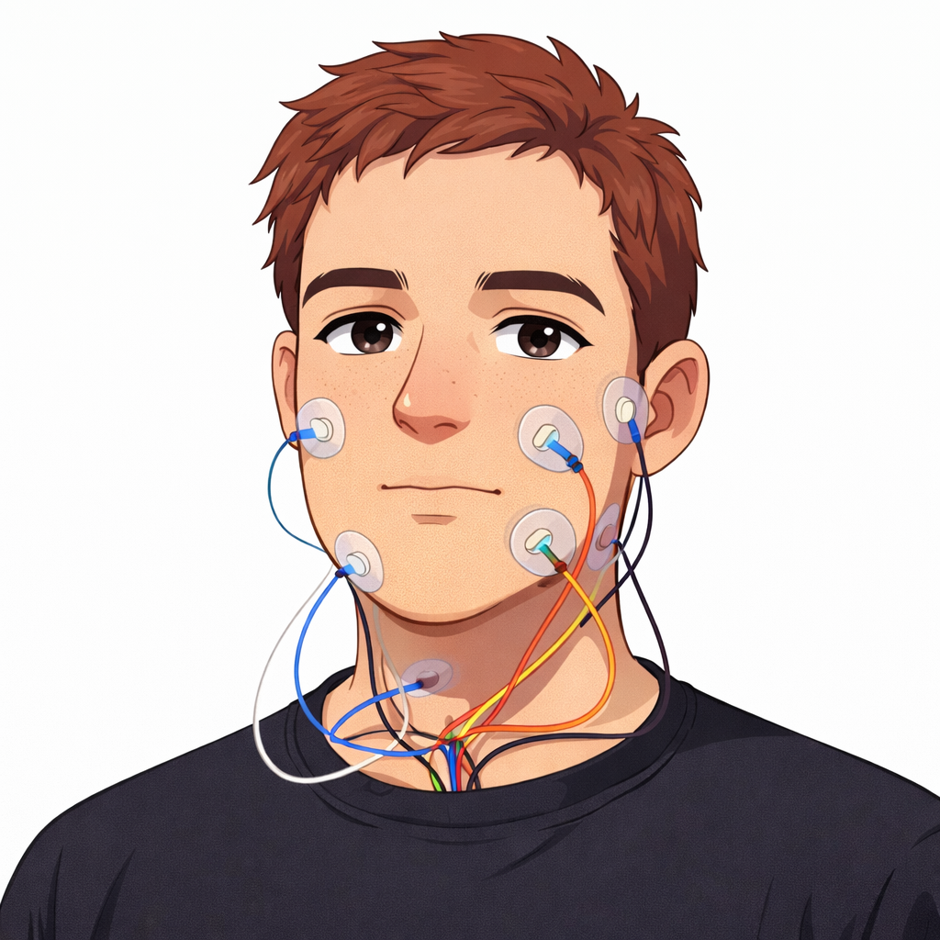
EMG Adapter
(Trainable)
Converts EMG features→EMG embeddings for conditioning the LLM
EMG Input
8-channel facial EMG
Feature Extraction
Linear projection (features → 512)
Conv subsampling ×2 (stride-2) → ~4× downsample
Temporal conv stack (multi-scale dilations) + SE gating
Positional encoding
Transformer encoder (4 layers, 8 heads)
Projection to LLM hidden size

