Slide 1
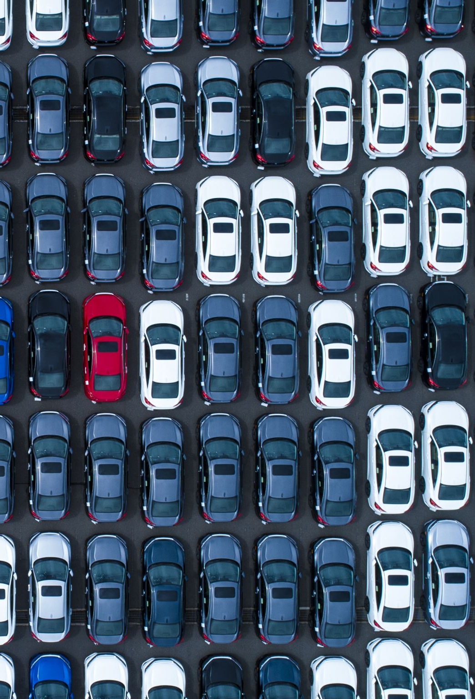
Car Damage Classification For insurance verification
Course: ML 2
Lecturers: Lasha Chochua, Shota Natenadze
Student: Durmishkhan(Ucha) Gigineishvili
July, 2025

Slide 2

Introduction & Motivation
Why is it economics related?
insurance fraud detection
automation/reducing losses/costs
reducing corruption

Slide 3
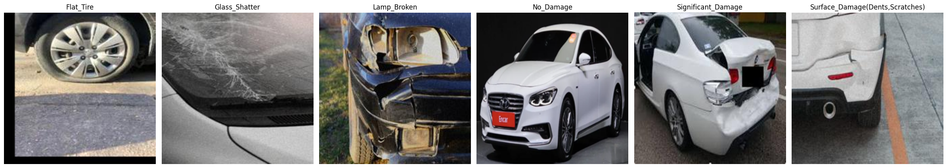
Datasets OvervieW & Preprocessing:
Data sources: 3 different Kaggle datasets used to collect the 6 classes
Classes: 1) Flat_Tire
2)Glass shatter
3)Lamp broken
4)No damage 5)Significant damage
6) Surface damage (dents , scratches)

Slide 4
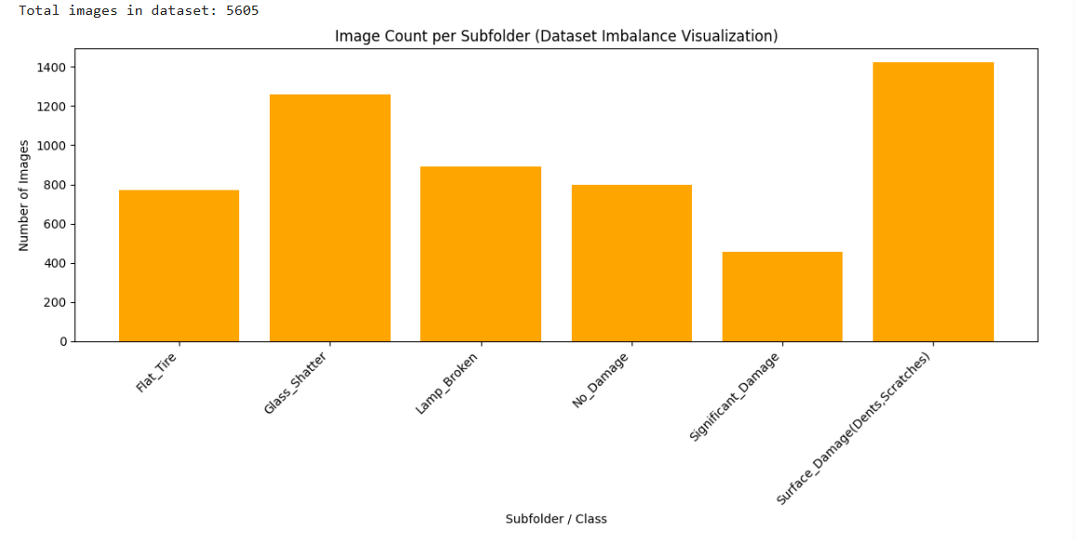
Initial raw dataset imbalance visualization:

Slide 5
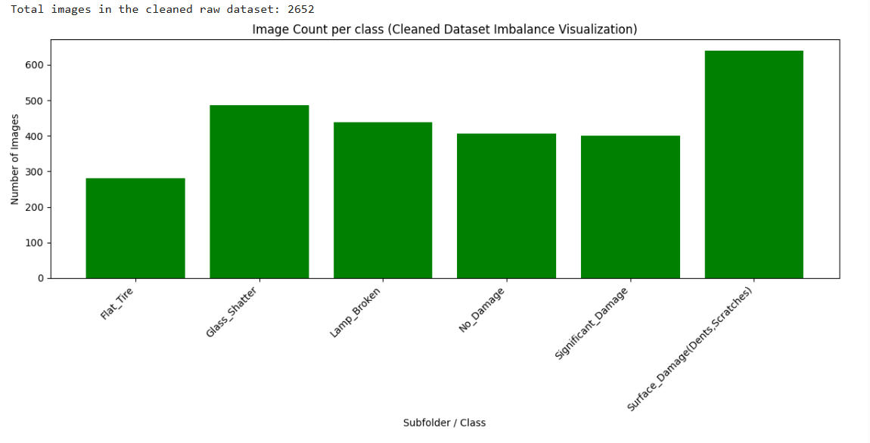
Initial dataset distribution after cleaning from duplicates and similar redundant pictures:

Slide 6




Then I separated dataset manually into Train, Validation and test parts.
120-120 per class for validation-test. In total 720-720 validation-test unique pictures, remaining were dedicated to train set.

Slide 7
Augmentations used on train set to upscale remaining pictures to 700 per class:
Random horizontal flip (mirroring)
Collor jitter (modifying colors)
Random rotation (rotating)
Random affine (moving up, down etc)
Random perspective (changing perspective)
Gaussian blur (adding some blur)

Slide 8
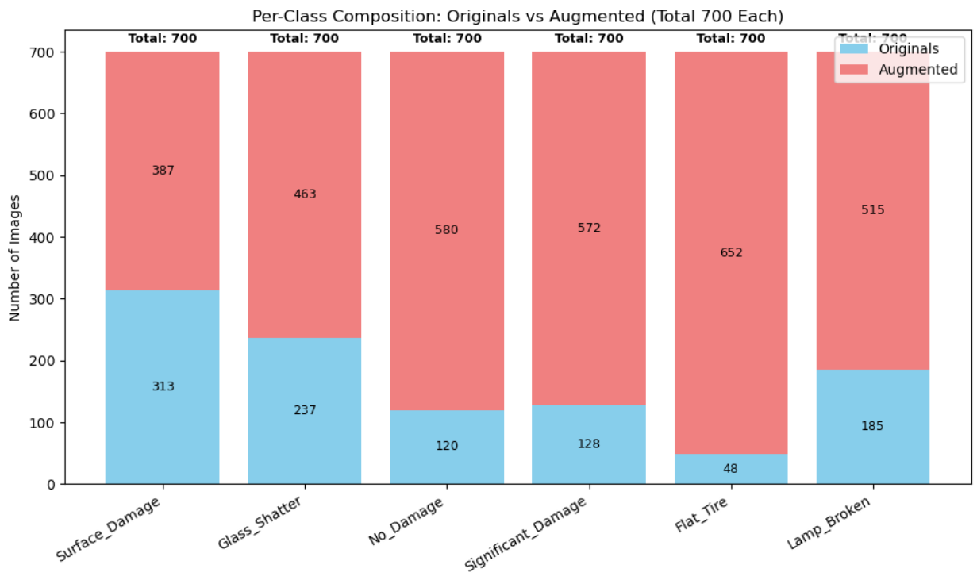
Data augmentation results:

Slide 9
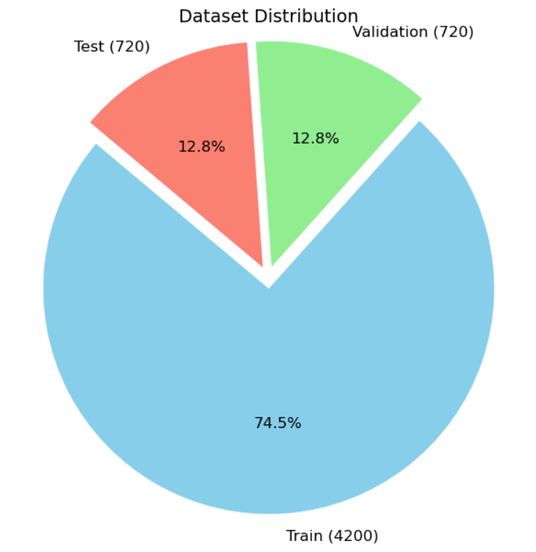
The final dataset structure used:
Train: 4200 pictures
Test: 720 pictures
Validation: 720 pictures

Slide 10
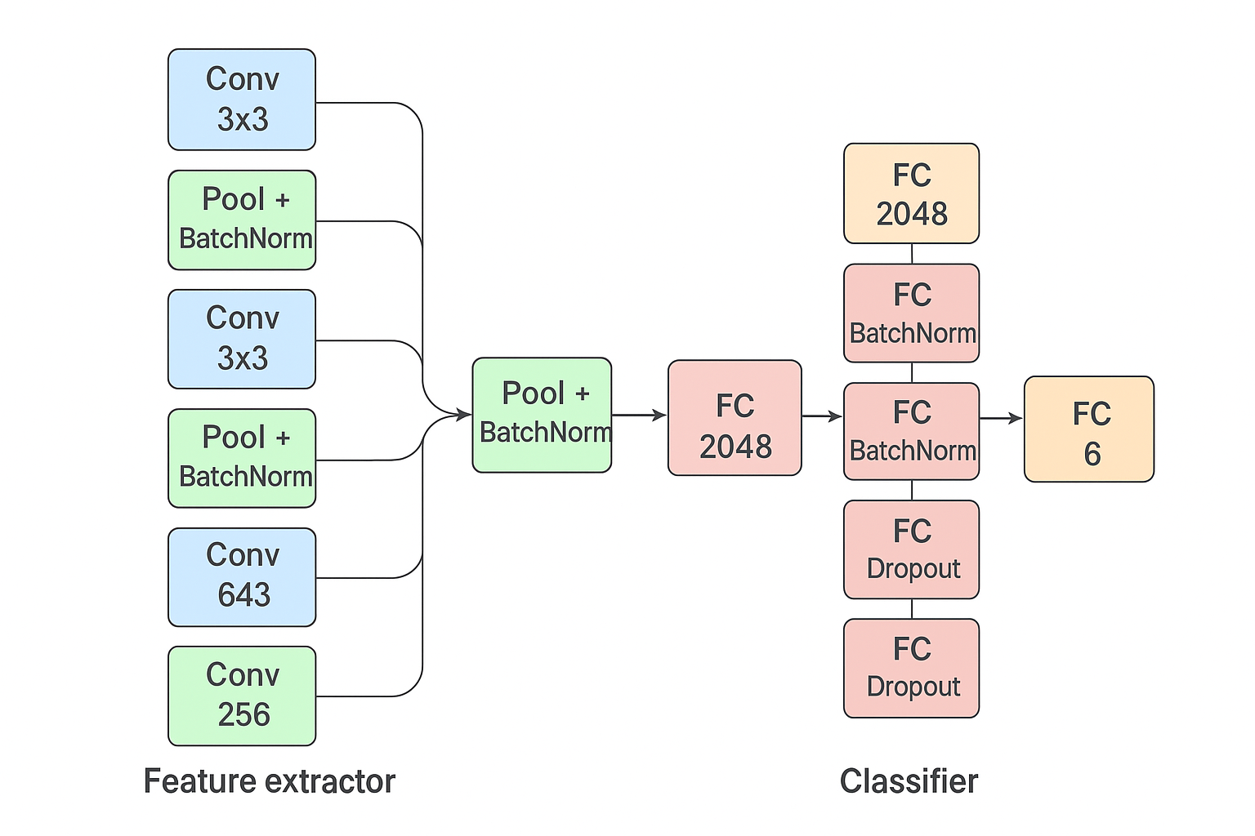
The scratch model characteristics
6 convolutional layers
Pooling+Batchnorm2d at the end of each layer
Fcnn with 4 main layers with batchnorm1d+dropout

Slide 11
The training loop characteristics:
Model parameters with best validation gets saved automatically
ADAM optimizer used
Early stopping: Patience of 5 epochs
Flexible learning rate schedule: ReduceLRonPlateau function with patience 2 , coefficient 0.5

Slide 12


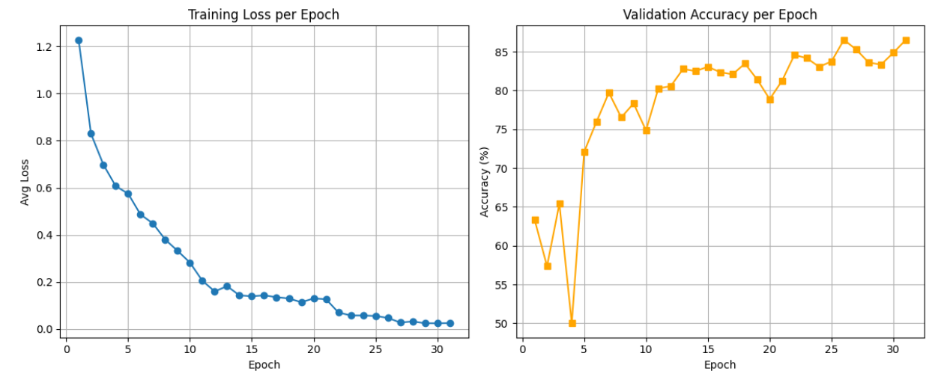



Training Results

Slide 13
Results in terms of peak validation percentage and the test set result:
Validation peak: 86.5%
Result on test set: 84.72% accuracy
Inference about overfitting: slightly overfitted to the validation set

Slide 14
Results analysis:
1) Per class accuracy
2) Confusion matrix
3) Confidence interval for the average model accuracy
4) Confidence intervals for per class accuracies

Slide 15
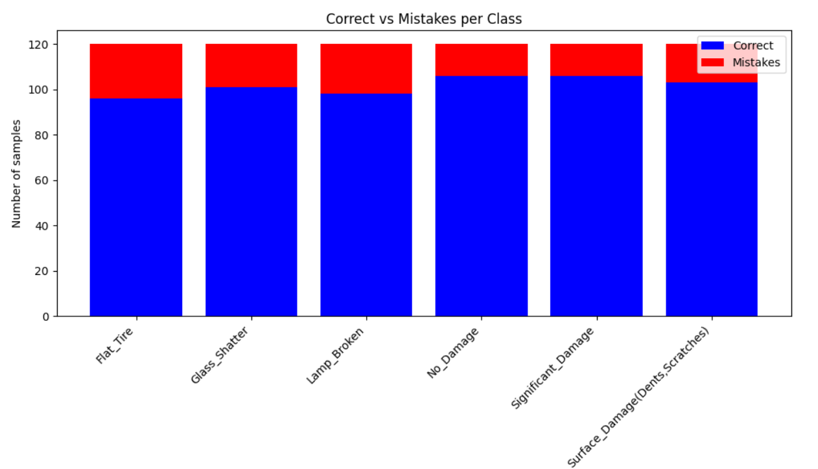
Per class accuracy:
Per-Class Accuracy:
Flat_Tire : 96/120 -> 80.00%
Glass Shatter : 101/120 -> 84.17% Lamp Broken : 98/120 -> 81.67%
No Damage : 106/120 -> 88.33% Significant Damage: 106/120 -> 88.33%
Surface Damage(Dents , Scratches): 103/120 -> 85.83%

Slide 16
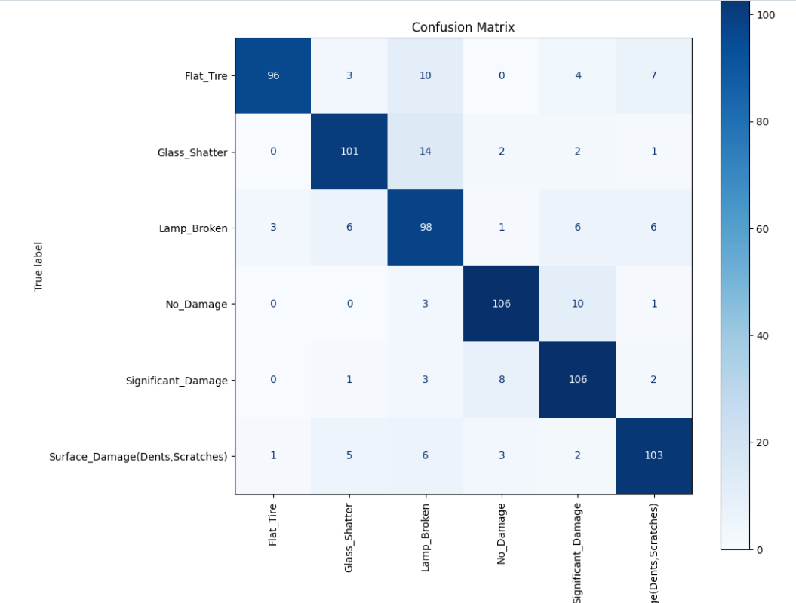
Confusion matrix showing what class the model confused with incorrect another one:

Slide 17
I also tried training on residuals and combining the results, but model was not able to get any useful additional information
Result of the training:
Scratch Model Accuracy: 84.72% Combined Model Accuracy after Residual Training: 84.58% ⚠️ No improvement after residual training. Using original model predictions

Slide 18
In the next slides I’ll be discussing using bootstrap sampling and binomial distribution for approximating 95% confidence intervals
Bootstrap sampling: used for aggregated model accuracy
Binomial distribution: used for per class accuracies
Discussion of when those approaches are valid

Slide 19
Validity of Bootstrap Sampling for Confidence Interval
🔹 When Used:
To estimate confidence intervals for overall model accuracy
🔹 Why It's Valid:
Does not assume identical probability of success across examples
Captures variability through resampling with replacement
Approximates the empirical sampling distribution of accuracy
Works well even when class accuracies differ significantly
🔹 Why Binomial Doesn’t Work Here:
Accuracy varies by class → trials are not identically distributed
Violates binomial assumptions → bootstrap is a better choice

Slide 20
Validity of Binomial Approximation (Per-Class Accuracy)
🔹 When Used:
To estimate confidence intervals for per-class accuracies
🔹 Why It's Valid:
Each class forms a set of i.i.d. Bernoulli trials
Constant probability of success within the same class
Allows modeling with binomial distribution
🔹 Normal Approximation Condition:
Valid if:
n⋅p≥5 & n⋅(1−p)≥5
For n=120, this fails when there are fewer than 5 misclassifications

Slide 21
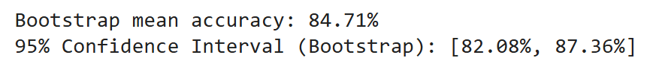
Developing approximated 95% confidence interval for aggregated model accuracy using bootstrap sampling
100k bootstrap samples used
Results:

Slide 22
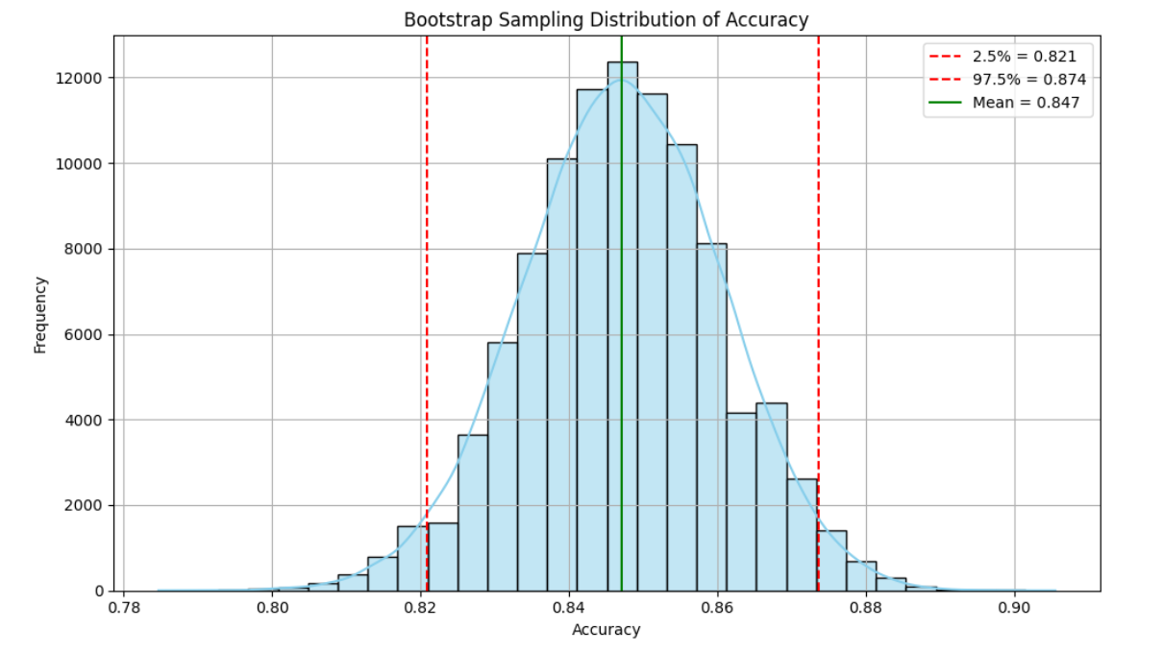
How my bootstrap sampling distribution of model accuracy looks like

Slide 23
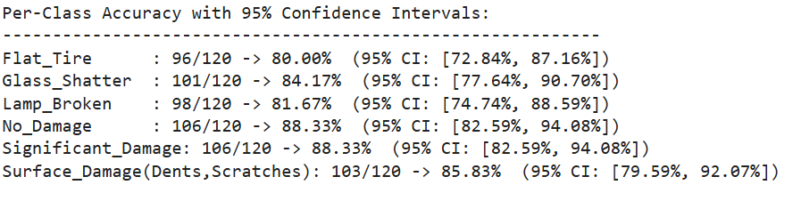
95% confidence intervals for per class accuracies using binomial distribution.

Slide 24
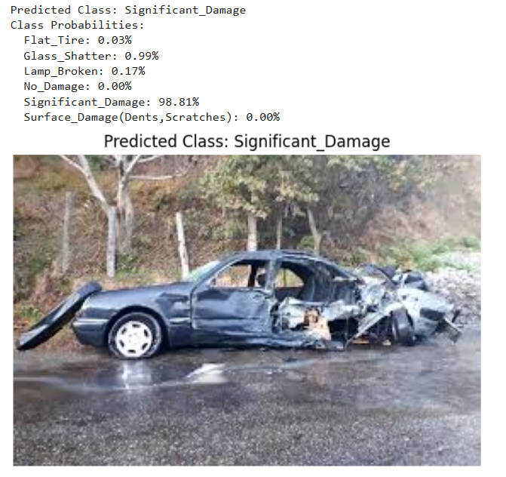
Testing my model on some external unseen picture:

Slide 25
Now the final upgrade, using pretrained model Resnet50
Trained FCNN part for 5 epochs
Another 5 epochs unfreezed last convolutional block of the Resnet 50
Finally with patience 5, ReduceLRonPlateatu LR scheduler, and validation tracking unfreezed and trained using whole Resnet50 model

Slide 26
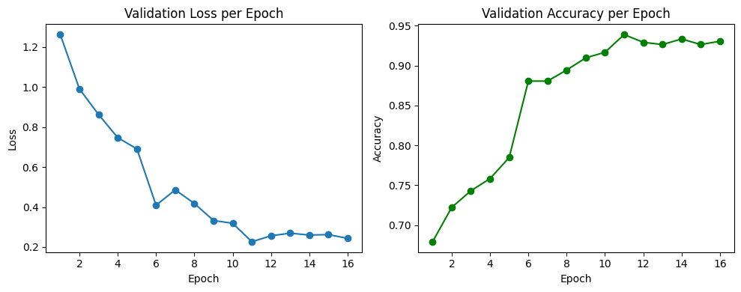
Pretrained model training results:

Slide 27
Pretrained model Validation vs Test accuracy:
Validation peak: 93.9%
Accuracy on the test set: 94.1

Slide 28
Per class accuracies: Flat Tire : 112/120 -> 93.33% Glass Shatter : 113/120 -> 94.17% Lamp Broken : 113/120 -> 94.17% No Damage : 116/120 -> 96.67% Note that it has more than 115/120 accuracy violating normality assumption in binomial conf. interval Significant Damage: 114/120 -> 95.00% Surface Damage(Dents , Scratches): 109/120 -> 90.83%

Slide 29
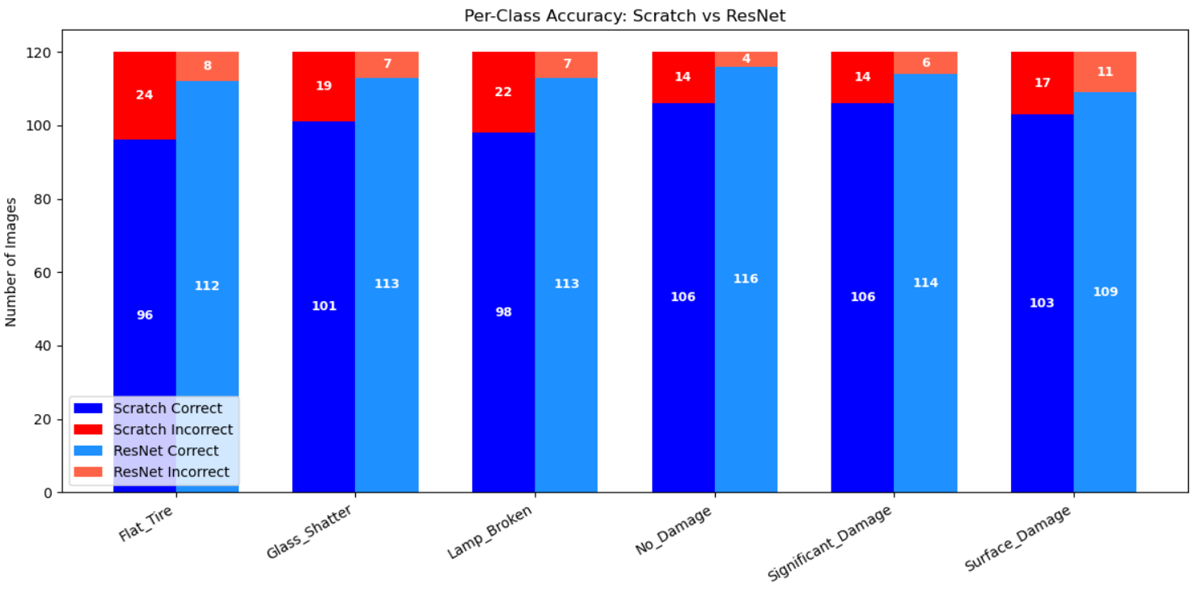
Comparison of scratch model per class accuracy vs pretrained model

Slide 30
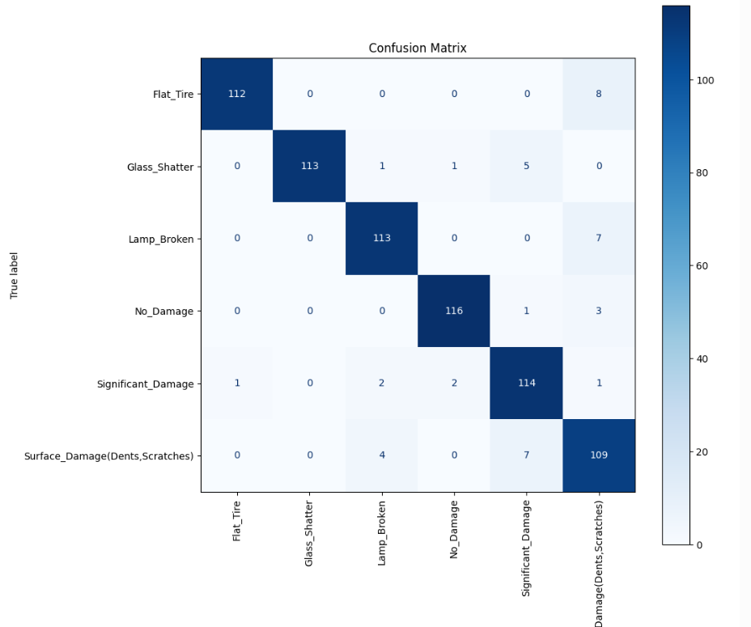
Let’s check the confusion matrix to see whether or not pretrained model still suffers from notable confusion.

Slide 31

Using bootstrapped sampling to develop roughly approximated 95% confidence interval for the Resnet50 model:
100k bootstrapped samples used
Result:

Slide 32
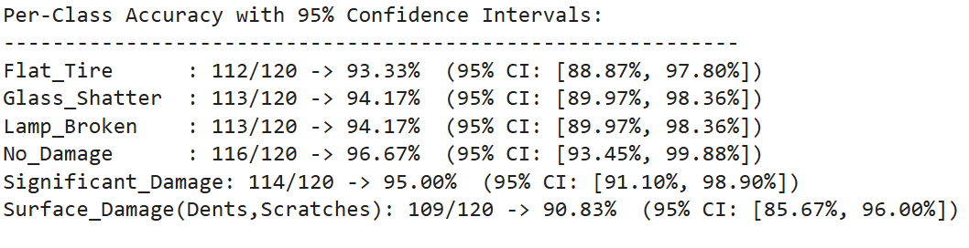




Using binomial distribution for approximating 95% confidence interval for per class accuracies. Note that conf. interval for No damage is not valid as it violated normality assumption for binomial distribution.
Not valid!

Slide 33
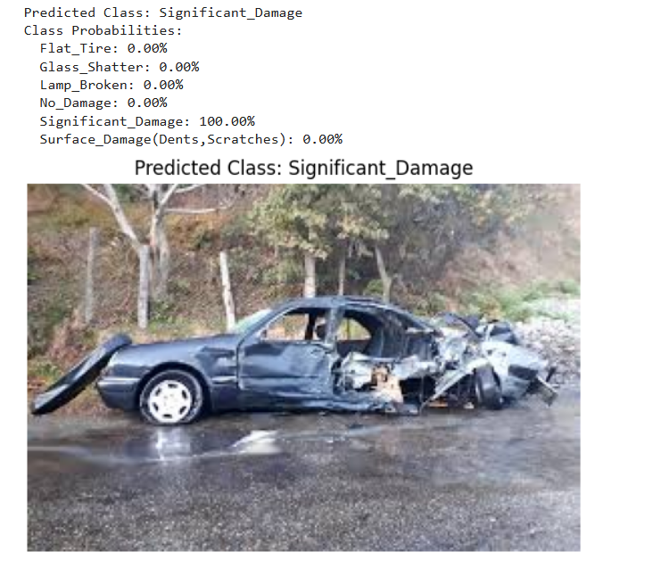
Testing the pretrained model on the same picture as scratch was tested

Slide 34
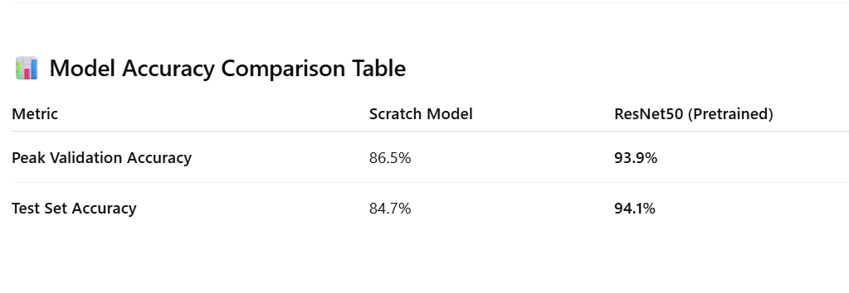
Comparison of scratch vs pretrained model results.

Slide 35
Potential improvements if data was available :
I would add missing parts classes
I would also add interior damage assessment related classes
I would increase number of pictures in the train set to boost the accuracy of both scratch and pretrained models
I would increase number of pictures in the train and validation sets too to make inferences that are statistically stronger, while maintaining balance of the Validation and Test in each class.

Slide 36
Thank you for your attention!
Any questions?

