Slide 1
CHECK POINT 1 Capstone project 3: HR Analytics Capstone no:3 Batch :D Group no:3
Group members:
Pavan Kumar Reddy,Uchala
Sourav,Das
Vasanthi,Burada
Vani,Unnam
Naveen Veera Durgesh,Telu

Slide 2
Group Members Responsibilities:
Data Manipulation using python:
Sourav,Das
Vani,Unnam
Naveen Veera Durgesh Telu
Analysis using SQL:
Vasanthi,Burada
Pavan Kumar Reddy,Uchala
Statiscal Analysis using Python:
Naveen Veera Durgesh Telu
Sourav,Das

Slide 3
Task 1.1 Data manipulation using python
Analysis of percentage joined of offer released.
Approach: Using subsetting, we extracted the columns where the candidates joined and who didn’t join. Next, we calculated the percentage of candidates who joined of offer released. Similarly, we have calculated the percentage of candidates who joined the company based on joining bonus and for candidates who did not.
Insights: After the analysis, we can say that joining bonus influences the candidates to accept or reject the offer.

Slide 4
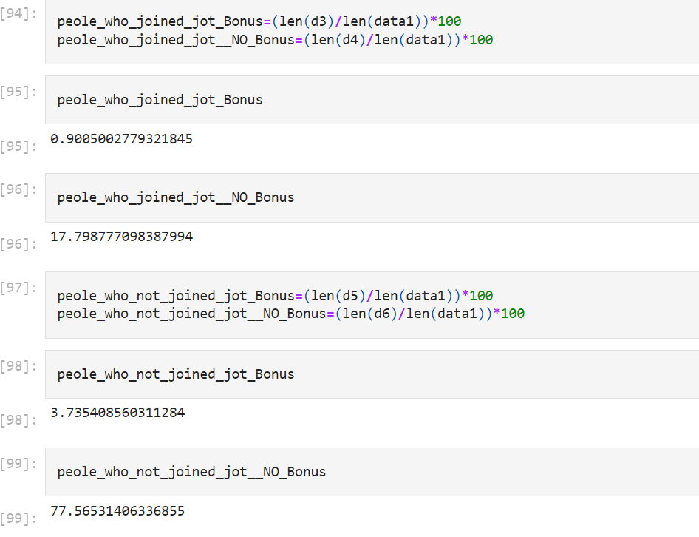
Output:
Percentage of people who joined and did not join, when joining bonus was given and not given:

Slide 5
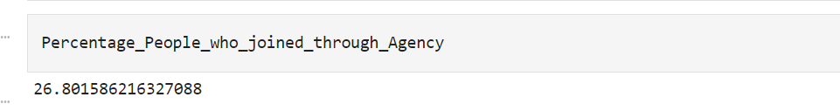
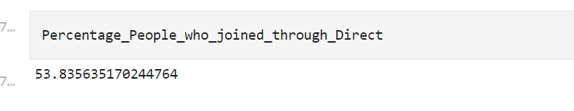
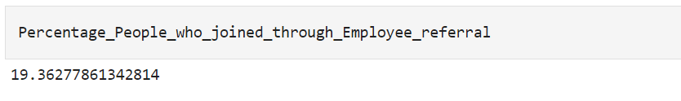
B. What are the key drivers that influence candidates joining/ not joining the company?
Approach: We merged the tables based on the common column. Next, we calculated the percentage of the candidates who joined the company, from different candidate sources (Direct, Agency, Employee_Referral)
Inferences: Candidate are joining through direct(candidate source)are more in number.
Output:

Slide 6
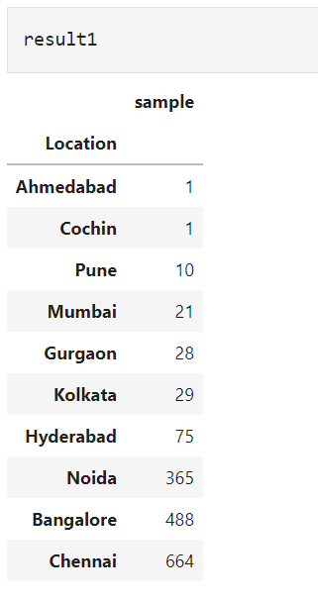
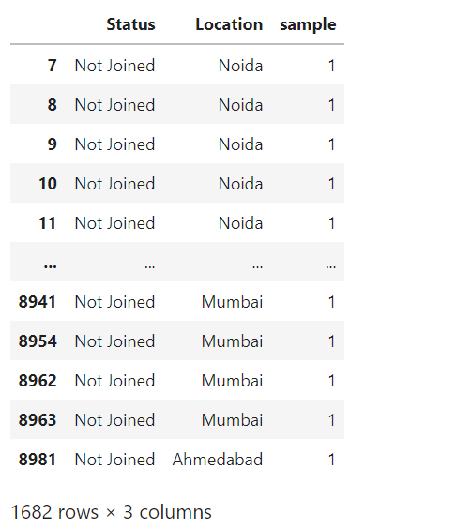
c. Are there any specific locations where candidates are not joining?
Approach: To solve this question, we merged three tables and extracted required columns and used group by function on location.
Inferences: Candidates in Chennai are more likely to not join the company.
Ouput:

Slide 7
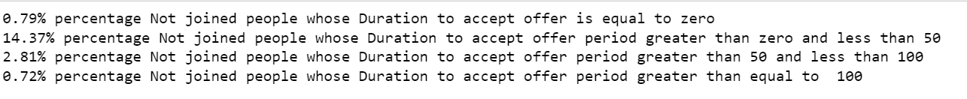
D. Does joining status depends on duration to accept offer?
Approach: To solve this question,we gave conditions to the column(Duration_accept_offer) and group by on column(Status).We included column(sample) to perform aggregation and sorted the column sample in ascending order. We also calculated percentage for each condition for the candidates who joined and didn’t join.
Inferences: Yes, joining status of a candidate depends on offer,based on operations performed, we can say that most of the candidates are atmost taking 100 days to accept offer.

Slide 8
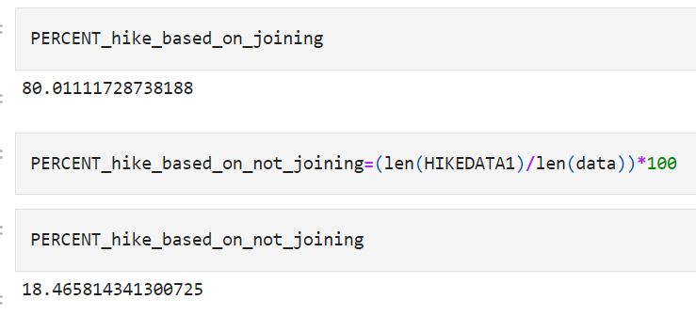
E. Hike offered has an impact on joining status or not?
Approach: We extracted the columns(status and hike offered in ctc) and calculated percentage for candidates where candidates joined and did not join the company when hike_offered_in_ctc based on the condition (==0,>0 & <=10,>10 & <=50,>50 & <=100).
Inferences: Hike offered has a definite impact on joining status.Candidates who were offered more than 100% hike are more willing to join.

Slide 9
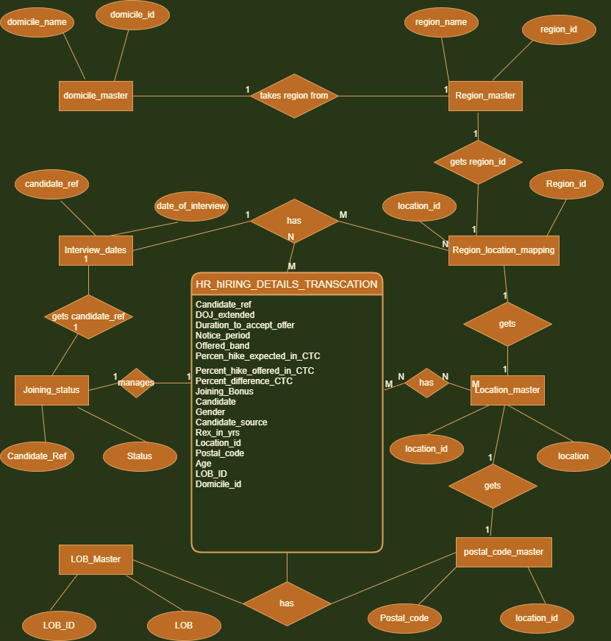
Task 1.2 Stage:1 Analysis using sql: 1.Construct an ER-diagram for the above mentioned requirement.

Slide 10
2.Construct tables and inserting data as per ER diagram.
Approach: In a multi instance system,we used “no order” unless, we want the sequence numbers to also indicate the order in which the records had a sequence number assigned to them (in general, the order in which they were inserted.
Inserting data as per the given dataset.

Slide 11
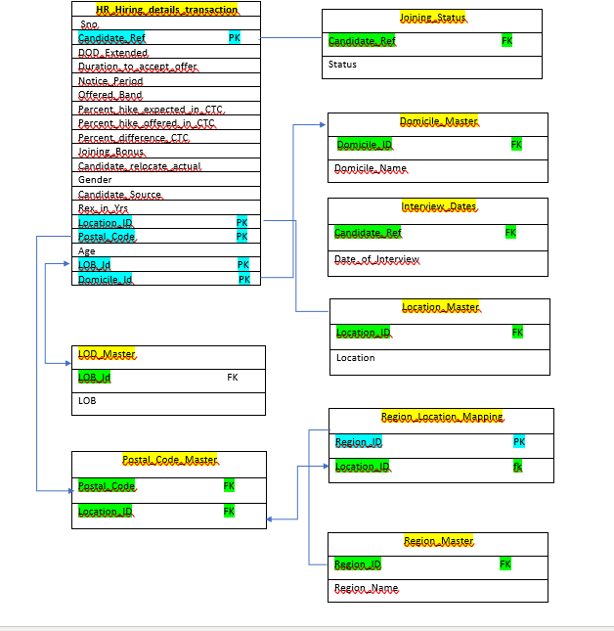
3. Identify the relationships between tables and use appropriate standards for the same where applicable

Slide 12
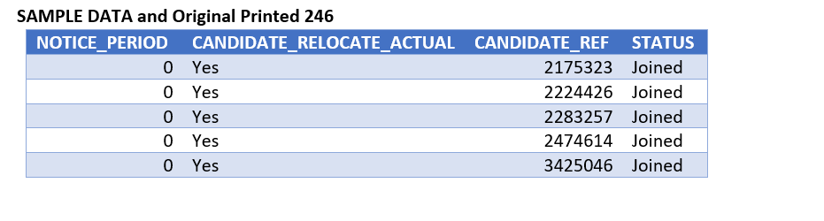
Stage:2 1.Generate those candidates info who have accepted offer and joining time is less than 30 and candidates who are ready to relocate.
Explanation: We extracted the required columns by joining two tables based of a common column and provided the necessary conditions.
Inferences: Based on the results of above operation, we can say that a fair amount of people are willing to relocate to join the company.
Output:

Slide 13
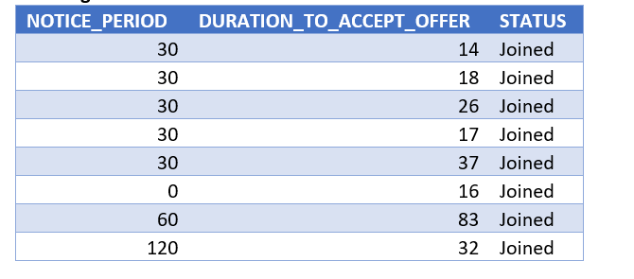
2. Generate Info of those candidates who have accepted offer and also display list the candidates who have been offered and yet to accept the offer within 10 days.
Approach: To answer this question,we haved used join and given the required conditions using where clause.
Output:

Slide 14
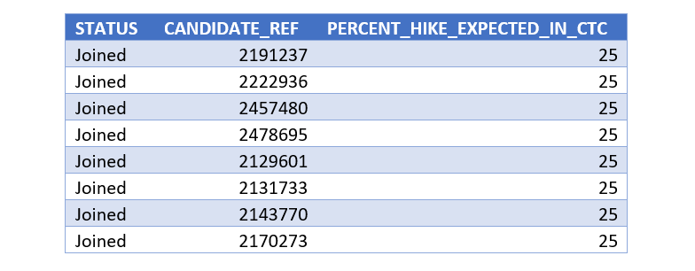
3. Generate Info those candidates who are willing to join and the ECTC is 25% hike from their CTC.
Approach: We have extracted the required columns by joining the tables and provided the conditions using where clause.
Output:

Slide 15
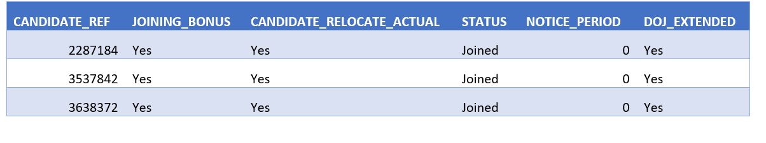
4. Generate Info of those candidates who are willing to join and the ECTC is 25% hike from their CTC joining time is less then 30 days and candidates who are ready to re-locate and joining bonus is offered.
Approach: Extraction of required columns and joining the tables based of a common column and providing required conditions.
Inferences: Candidates joining the company or not joining the company is partially influenced by percent of hike offered.
Output:

Slide 16
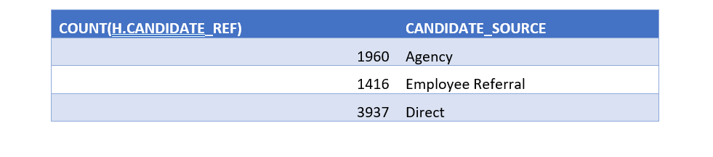
5. Generate the count of the candidates who are hired through what source and also who have joined and declined the offer.
Approach: We extracted the required columns and performed count function and applied group by function on candidate source column.
Inferences: Candidates joining are through direct(candidate_source) are more in number.

Slide 17
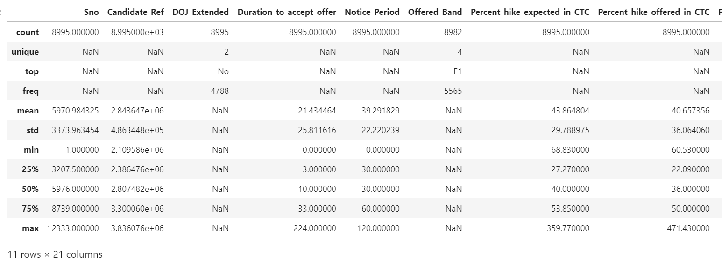
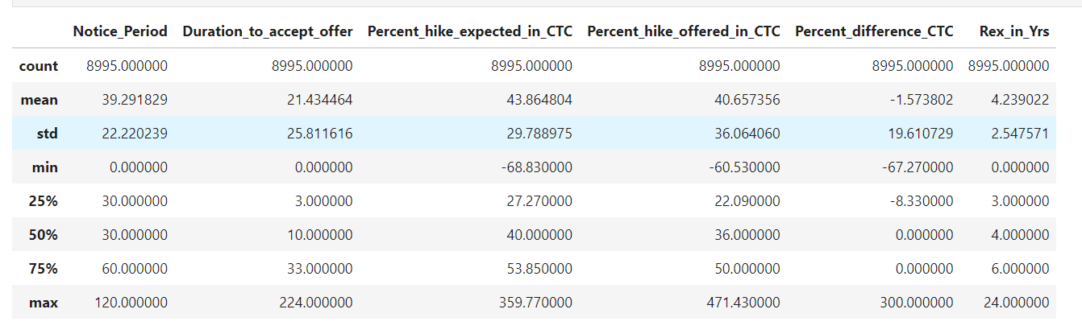
Task 1.3 Statistical Analysis using python 1. Descriptive statistics for both numerical and categorical and draw few insights from them.
Approach: We have done analysis on data using describe(),which performed mean,min,max,standard deviation,count. By using categorical, we use the parameter include = ALL, then we get the ‘NAN’.
Insights: In the given dataset, we have only numerical columns,but no categoricals columns.

Slide 18
2.Perform relevant hypothesis testing(T test,Chi square,ANOVA testing)
Approach:
T test: We didn’t perform t test here, due to lack of numerical (continuous colmuns). To perform a t test, the columns must of continuous in nature, and there must be a significant mean difference.
Chi square test: Chi square statistical hypothesis is a test, for finding independence between categorical columns.
ANOVA test: In this test, we need 3 columns, 2 numerical and 1 categorical. Since, there are no 2 continuous numerical columns, we didn’t perform this test.

Slide 19
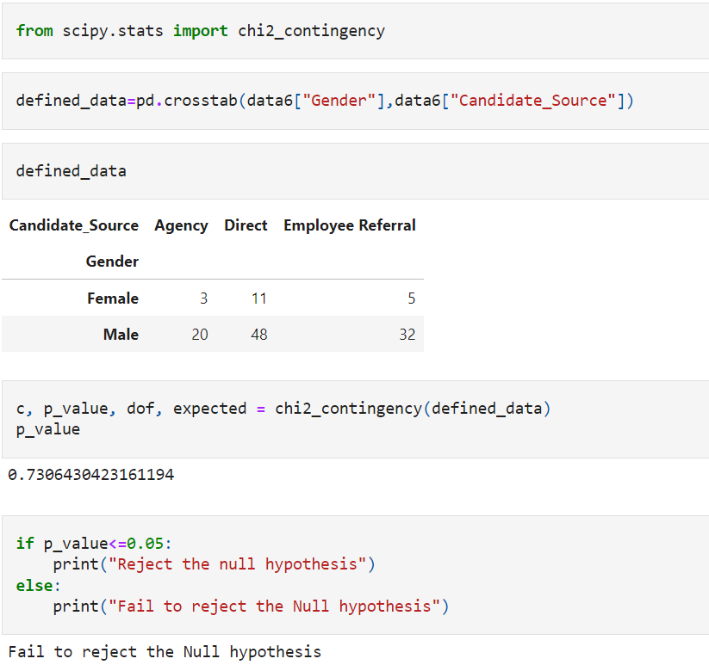
Output:

Slide 20
Thank you

