Slide 1

WhatsApp, LLMs, Automation, AI
Notes:
Use presenter view
Full screen
Run with Alt + F5 – then can share the full screen window to people

Slide 2
Welcome
Will be recording this
The 4th event / meeting from the London Python Meetup Group.
Lets see how this goes! Feedback appreciated.
Probably do one more event in 2023 – if you would like to speak or share something, please let me know!
Set expectations – not easy! Python focused.
Notes:
Thanks for coming along.

Slide 3
Agenda
Presentation – General use of AI + LLMs
Presentation – Specific use with WhatsApp
Look at the sample app and demo
Break
Go through 3 levels of starting points available. 1) From scratch/requirements. (Challenge!) 2) From partial stubs. 3) Complete code – customising prompts.
Help with setup / code – I will be around to help
I will run through filling out sample
Discussion?
Notes:
My own experience, I hope it is some use/value. Not something you can read so much online
Not perfect and can of course be improved

Slide 4

About me – Alex McIvor
MSc Computer Science
Worked in energy, commodities, trading
Built a lot of stuff, worn a lot of hats
Currently contracting with my own company
Pretty full stack profile – mainly Python at the moment
https://www.linkedin.com/in/alex-mcivor-26032287/

Slide 5

LLMs in 30 seconds
Assume you know broadly what they are
OpenAI are the best
ChatGPT != GPT4 (Web UI vs API) + Model differences
Essentially a mapping function with billions of parameters (dials to turn)
Encoding data in a high dimensional latent space (abstract concepts)
‘Just predict the next token’ – more than meets the eye
Does it matter? How does your car’s engine work *exactly*?
Think 5/10 years ahead. Exponential or dead end?
Notes:
1. Broad Knowledge of LLMs: LLMs are the brains behind many AI-driven conversational tools today.
2. OpenAI's Leadership: OpenAI stands out for its top-tier models known for accuracy and versatility.
3. ChatGPT vs. GPT-4: ChatGPT is a web interface-focused model, while GPT-4 offers broader integration via API. Both have unique capabilities.
4. Billions of Parameters: Imagine LLMs as machines with billions of adjustable dials, each influencing language interpretation.
5. High Dimensional Encoding: LLMs represent abstract concepts in a vast multi-dimensional space.
6. Predicting Tokens: LLMs' primary task of predicting the next word involves deep context understanding.
7. Understanding Necessity: Just as driving doesn't require in-depth engine knowledge, using LLMs effectively doesn't mandate understanding every intricacy.

Slide 6
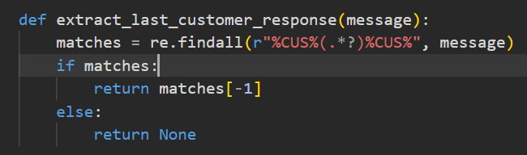
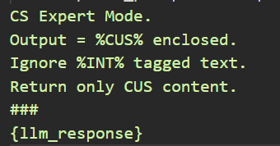
A new programming language. English?
Chuck existing ways of working out the window.
The LLM is your execution engine.
NOT about parsing responses manually and building blocks together.
Probabilistic nature of output doesn’t play nicely with code. Try tuning temperature settings.
Situation is improving – see GPT code plugins.
Notes:
Rethinking Workflows: Traditional methods of programming and workflow might not apply with LLMs. Embrace a fresh approach.
LLM as the Core: Think of the LLM as the central engine driving your solution, not just an add-on.
Beyond Manual Parsing: LLMs aren't about dissecting responses piece by piece; it's about understanding the overall message.
Probabilistic Outputs: LLMs' outputs are probabilistic, which can clash with deterministic code logic. Adjusting the "temperature" setting can help refine responses.
Evolving Landscape: The realm of LLMs is rapidly progressing, with tools like GPT code plugins enhancing their applicability.

Slide 7
Automation Ideas
Customer Service: Initial interactions, order tracking, troubleshooting.
Research and Filtering: Data scanning, quick summaries.
Knowledge Mining: Insights extraction, concise reports, trend identification.
Process Mapping: Workflow optimization, scenario simulations.
Sales Automation: Lead generation, personalized promotions, sales inquiries.
Content Creation: Blog posts, content themes. YAWN!
Training and Onboarding: Automated onboarding, interactive training.
Inventory Management: Stock predictions, demand alerts.
Financial Forecasting: Trend predictions, financial summaries.
Code Generation: Self explanatory – automate at scale though??!
Notes:
Customer Service: Emphasize the capability of LLMs to manage a vast majority of standard customer interactions, ensuring that human agents can focus on more complex tasks. Mention the importance of gathering feedback for refinement.
Research and Filtering: Discuss how LLMs can scan through vast amounts of data, reducing manual labor and ensuring only relevant details are presented.
Knowledge Mining/Summary: Highlight the power of LLMs in extracting meaningful insights from large datasets, aiding in decision-making processes.
Complex Processing Mapping: Talk about the potential of LLMs to visualize and optimize intricate workflows, making businesses more efficient.
Sales Automation: Discuss the potential increase in sales conversions when leads are nurtured and handled with a blend of automated and human interactions.
Content Curation: Emphasize the potential of LLMs in aiding content teams, generating drafts, or curating relevant content based on themes. Yawn – marginal cost is 0
Training and Onboarding: Discuss the consistency and scalability of using LLMs for onboarding processes, ensuring every individual receives the same quality of training.
Inventory Management: Highlight how predictive analytics with LLMs can aid in efficient stock management, reducing overstocking or stockouts.
Financial Forecasting: Talk about the potential of LLMs to provide quick financial overviews, aiding stakeholders in making informed decisions.
Code Generation: Automated Self explanatory

Slide 8

Mapping your business
What is a company? Agreements, information flow, assets
Particularly true with already outsourced elements
APIS/Interfaces, Args and Return values, Internal State
Employees -> Agents/LLMs
Business Processes -> Prompts
Internal knowledge, emails, meeting records -> Training Data
Notes:
Understanding a Company: At its core, a company is a web of agreements, the flow of information, and the assets it possesses. It's an ecosystem where various elements interact.
Outsourced Elements: If you've outsourced parts of your business, this concept becomes even more evident. These elements can often be more easily mapped to digital counterparts.
Digital Analogues: In the digital realm, agreements can be seen as APIs or interfaces, the flow of information as arguments and return values, and assets as the internal state of a system.
Employees as Agents: Instead of traditional employees performing tasks, envision them as digital agents or LLMs, executing operations based on prompts.
Business Processes to Prompts: Any business process can be distilled into a series of steps or commands, much like how we give prompts to LLMs.
Harnessing Internal Knowledge: All the internal data, from emails to meeting notes, can be viewed as training data, helping to refine and inform our digital agents.

Slide 9

Disclaimer. This is experimental.
I would not yet put this in charge of managing actual $$$. But it is getting there…

Slide 10

What are we going to build?
Snake Cakes - a small business that makes custom cakes and deals with a lot of orders via WhatsApp.
A customer/order management/sales bot
Interaction via WhatsApp
Logic by LLMs - Not about generating text!
Running via your local machine
It will probably go wrong – outer edge of capability (I think?)

Slide 11
General Prompt Advice
LLMs just want to choose the most likely output based on training data. Not the same as the ‘best’ output!
Help it navigate a very high dimensional Latent Space to your ‘region of thought’.
Situation Context - Brief summary of the situation and goals.
Persona - Act as a senior software developer.
Be specific – Format of output, business rules, constraints.
Area for internal monologue/state %INT% – ‘Show your working’/Step by Step
Review output – Ask LLM to improve the answer. It can only look backwards and 1 Token (word) into the future. Very helpful for code!

Slide 12
A chain of models
Context Length + Cost = Current Limiting Factors
Think like a military general or CEO
Delegate summarisation and tasks to other agents/models
Empathise – run though the process yourself to find edge cases + how to handle them

Slide 13
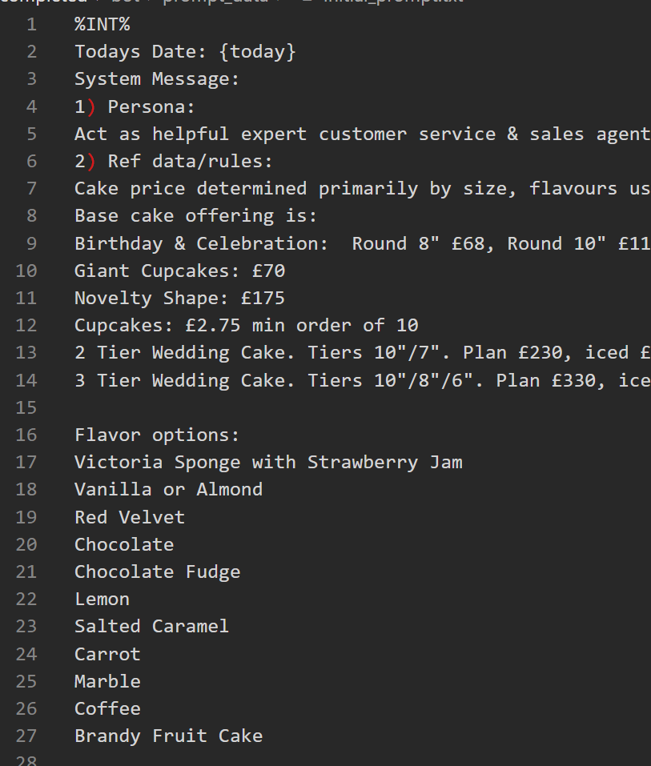
Demo Prompts: 1) Initial Prompt 2) Customer Response Prompt 3) Order Prompt

Slide 14
Prompt Compre$$ion
Before System message: Act as a helpful customer service expert.
This is a response from an LLM AI, replying to a customer.
The response to the customer should be surrounded with %CUS% at start and end.
The AI might have made mistakes, however. Extract and return customer response.
Do not include text surrounded by %INT% - this is internal state for LLM only.
Only respond with customer response, include nothing else.
###
{llm_response}
After
CS Expert Mode.
Output = %CUS% enclosed.
Ignore %INT% tagged text.
Return only CUS content.
###
{llm_response}
Reduce tokens, retain semantic meaning (Use ChatGPT).
Save money, time, space.

Slide 15

Basic System Design
Aims:
Small but complete – jumping off point (not prod level code)
Include some more ‘interesting’ parts of Python
Think about external constraints
Headaches of consistency
How cost impacts system design

Slide 16
High Level Architecture
Internet / Local Machine Boundary
WhatsApp Cloud API
NGrok
Local Storage
JSON
WhatsApp Cloud API
Flask
OpenAI API

Slide 17
Flask Service Architecture
Flask – app.py
Incoming Message
Bot.py
Routes To
Message Cache
Routes To
‘Job Queue’
External API
WhatsApp Service
Core LLM Workflow
Kicks Off
Local Storage
JSON
Saves down

Slide 18
Main ‘Components’
App.py – handles starting/hosting Flask
Bot.py – main logic, queue and message handling
Chat – domain object / repository for saving chats with users
Llms – working with different apis
Msg Cache – manages in memory cache messages before processing
Orders – domain object for converting orders to/from json
Prompt Data – prompt text files
Routing – Handles routing different types of Whatsapp messages
WhatsApp – Handles Outbound messages to WhatsApp
Simulator – For running simulator code

Slide 19
Getting started
Clone the repo: https://github.com/sizzles/meetup-llm
Setup a venv and pip install (built with Python 3.10)
Rename .env.sample -> .env
Get your OpenAI key
Start ngrok: ngrok http 5000
Start the Flask App (VS Code)
Get your WhatsAPP refresh token
Get Webhooks setup and configured
Test!

Slide 20
Simulator
Set the env SIMULATOR_MODE to ‘True’ in main .env file
Cd into the simulator folder
Flask run -p 6000 (this starts the server component)
Streamlit run simulator_ui.py
Browse to the localhost link
(Warning a bit flaky in terms of performance)

Slide 21
Limitations & Improvements. Dev -> Prod
Focused on a small sample, plenty left to improve
Deployment/Hosting – Get it out there
CI/CD
Tests, Logging, Metrics, Error Handling
Data Persistence – Database
Scalability + Async (FastAPI)
Static Code Analysis / Linting

Slide 22
Install Llama2 on windows
Not exactly ‘fun’ ☹ Doing it with GPU enabled was very difficult
Follow steps here: https://python.langchain.com/docs/integrations/llms/llamacpp
Extras beforehand (could just work for me):
Pip install scikit-build
Pip install numpy
Try kobold instead

Slide 23
Useful papers & resources
Plan-and-Solve Prompting: Improving Zero-Shot Chain-of-Thought Reasoning by Large Language Models - https://arxiv.org/abs/2305.04091
ReAct: Synergizing Reasoning and Acting in Language Models - https://arxiv.org/abs/2210.03629
nanoGpt (Andrej Karpathy) - https://github.com/karpathy/nanoGPT – Build your own LLM
Reddit: https://www.reddit.com/r/LocalLLaMA/ (Focused on running LLMs locally)
https://github.com/filip-michalsky/SalesGPT - AI Sales assistant LLM
https://github.com/reworkd/AgentGPT - Autonomous Agents
https://github.com/yoheinakajima/babyagi - AI powered task management
https://www.promptingguide.ai/ - More in depth look at prompting
https://github.com/logspace-ai/langflow - Nice UI for working with Lang Chain and building models

Slide 24
Questions & Thanks!
Any questions?
Slides + code will be posted on Github
Will send links for this
Feedback very much appreciated

